Slide 1

SKNSITS Department Of Computer Engineering
“Blockchain Based CrowdFunding Platform”
Class: B.E. Academic Year:2022-23
Sub: Blockchain Technology Sub Code: 410248
Presented by Guide
1) Abhijit Raut Prof. Ravirai Chaudhary
2) Prathamesh Sawant
3) Prafulla Dhobale
4) Aniket Sinare

Slide 2
Contents
Problem statement
Scope
literature review
SRS
Model
Conlusion
References

Slide 3
Problem Statement
Crowdfunding is one of the most popular ways to raise funds for any project, cause or for helping any individual in need. With the onset of Covid we have seen a rise in Crowdfunding activities across the globe which includes small campaigns to help people get oxygen and medical help to large funds such as PM Cares.
To create platform which is secure, has transparency, is Anti-Fraud, will help in global contribution

Slide 4
Scope
It is to be a ReactJS based application, which will be supported by any web browser. Internet connectivity will be required. Users will require ‘Metamask’ browser extension to sign transactions.
Crowdfunding over the years has helped people but has also seen heavy frauds in the name of Crowdfunding. With this platform we want to bring transparency to the process of crowdfunding and build trust among people to contribute to all the causes.
Given the Ethereum Blockchain provides us with most of the security features, the development does not require much cost. The only cost would be the server cost of the deployed application.

Slide 5
Literature Review
Sr No. | Paper Name | Author | Year | Advantages | Disadvantages
1. | Blockchain Technology Overview | Sharnitha Katragadda, Varshitha Ravi, Prasanna Kumar, G. Jaya Lakshmi | 2020 | High response rate | Time Consuming to summarise.
2 | Blockchain Technology Beyond Bitcoin | Raghad Alshabandar, Abir Hussain , Robert Keight, Wasiq Khan | 2020 | Accessible to Everyone | Difficult to Understand

Slide 6
Sr No. | Paper Name | Author | Year | Advantages | Disadvantages
3 | Blockchain Based Smart Contracts | Gomathy Suganya Ramaswami , Teo Susnjak, Anuradha Mathrani | 2020 | It creates Valid Contracts. | Unauthauriozed access may not allowed.

Slide 7
Software Requirement Specification
Software Requirement
RAM : 8 GB
Hard Disk : 40 GB
Processor : Intel i5 Processor
IDE : Remix
Coding Language : JavaScript, Solidity
Operating System : Windows 10, Linux

Slide 8
Hardware Requirement
Processor : Pentium-IV
Speed : 1.1 GHz
RAM :512 MB(min)
Hard Disk : 40 GB
Key Board : Standard Windows Keyboard
Mouse : Two or Three Button Mouse
Monitor : LCD/LED

Slide 9
Model
The stakeholders can be divided into two parts:
Campaign Creators : These are the users who have created a Campaign.
Contributors & Approvers : Contributors are the users who contribute and fund the campaigns. Approvers are Contributors who have contributed more than the Minimum Contribution, and they can approve the withdrawal requests.

Slide 10
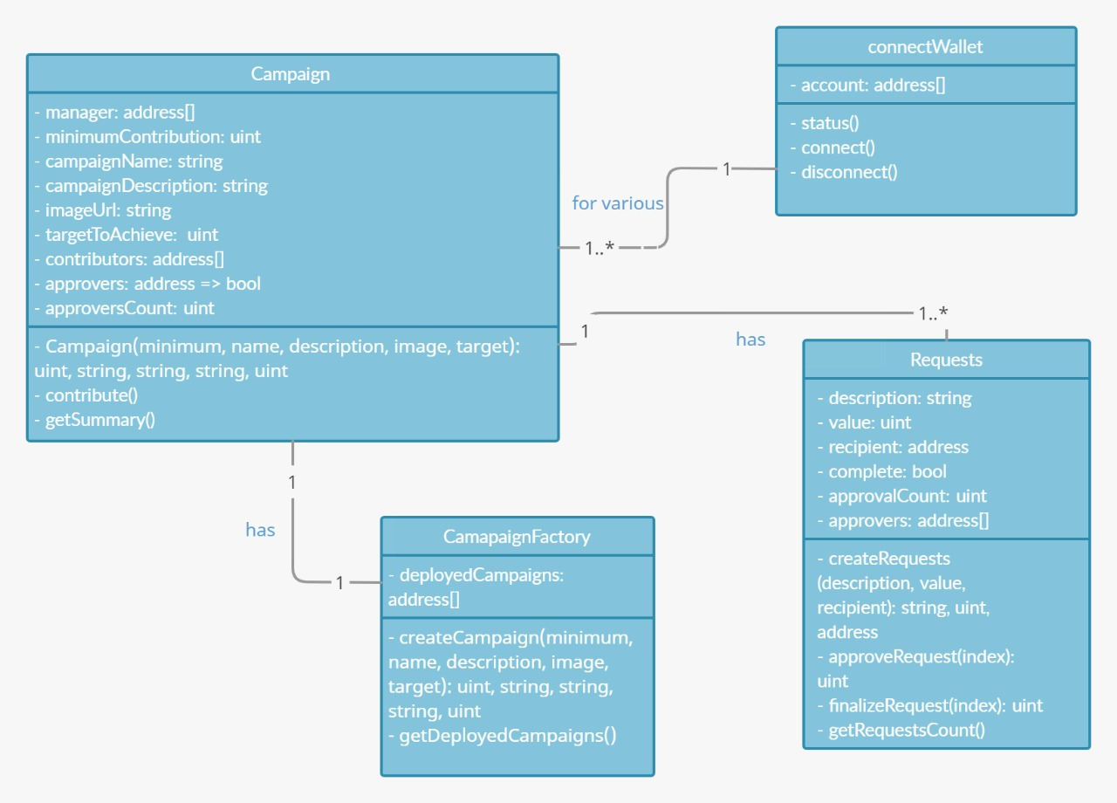
System Architecture

Slide 11
The Technologies that we will use are:
Web3
Solidity
Ethereum Smart Contract
React.js

Slide 12
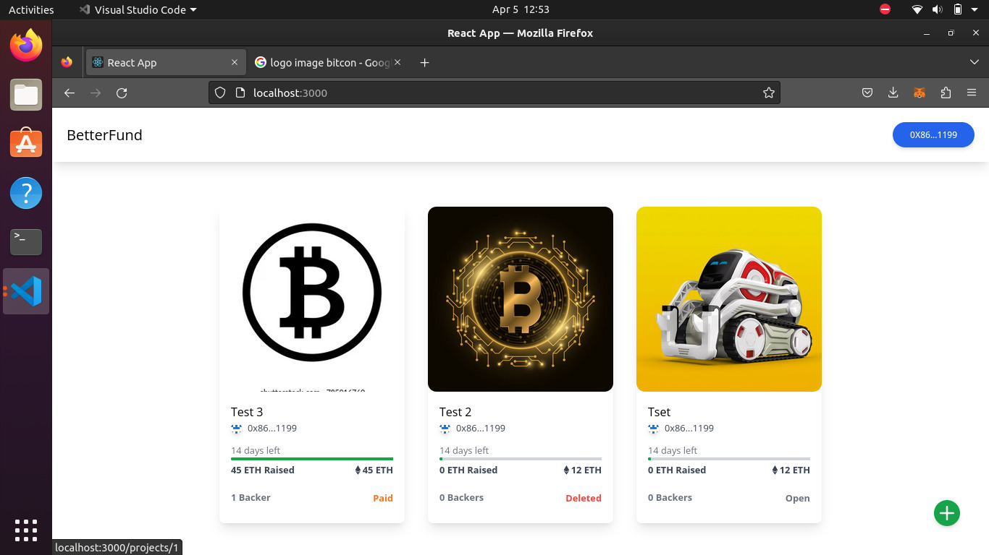
Following are the proposed features
Just like Crowdfunding in the real world as well as on other crowdfunding platforms, anyone can create a campaign in a few minutes. The campaign information will be managed by the Ethereum-based smart contract and thus cannot be tampered with.

Slide 13
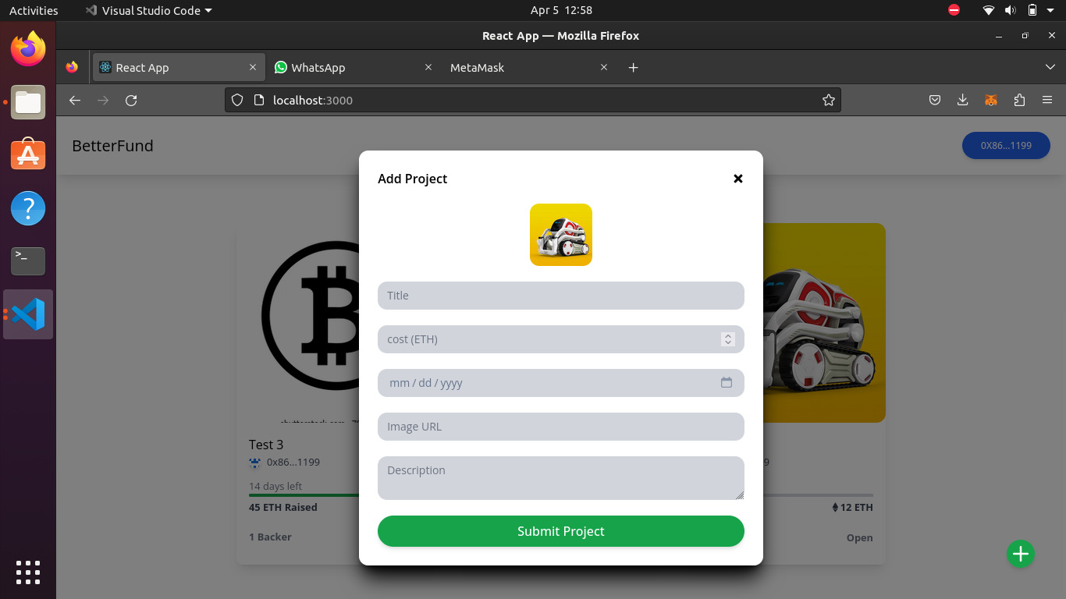
Contributing to a Campaign
Once a campaign has been created, users can share the campaign and anybody can contribute to the campaign. The funds will go to the address of the campaign and not to the creator of the campaign, thus making the process more efficient and anti-fraudulent.

Slide 14
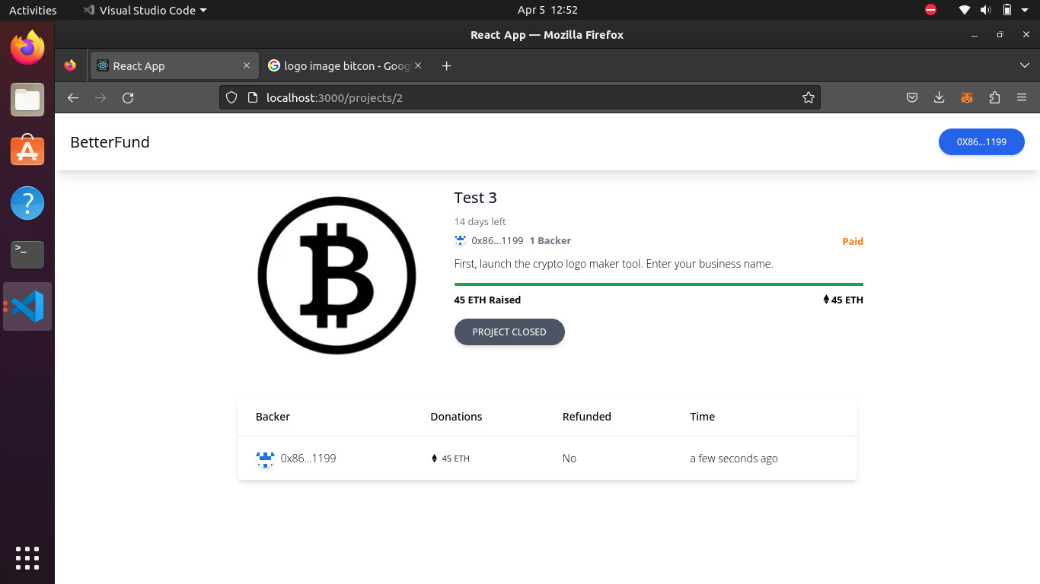
Donate of Funds
The Creator of a Campaign can propose how to use the funds in the form of a Withdrawal Request. Anybody who contributes more than a particular amount is called an approver, and will be able to approve or deny the request.
Funds can’t be withdrawn without the approval of 50% approvers.

Slide 15
Conclusion
Conventional crowdfunding methods have long suffered from lack of transparency and fraud. It is an avoidable problem, and we believe that we have implemented a solid solution that can do away with these long-standing problems.
The aim to have a transparent, anti-fraudulent, decentralized platform has been achieved to a great extent. This project has covered the weak points of general crowdfunding platforms to provide transparency to the process of crowdfunding and build trust among people, so that they may contribute their wealth to good causes without fear of fraud.

Slide 16
References
[1]. https://ieeexplore.ieee.org/document/9640888.
[2]. CryptoRelief platform: https://cryptorelief.in
[3]. Next JS Documentation: https://nextjs.org/
[4]. Learning Solidity Language: https://cryptozombies.io/.
[5]. web3.js - Ethereum JavaScript API: https://web3js.readthedocs.io/en/v1.3.4/
[6]. How data is stored in Ethereum Blockchain: https://laurentsenta.com/articles/storage-and-dapps-on-ethereum-blockchain/

