Slide 1
DaTA QUALITY MONITORING
~ By
ANIKET BIYANI
SIDDHANT MUNDHE

Slide 2
Outline
Project Statement
Introduction
Project Overview
Project Requirements
Architecture
Tools Used
Execution overview
Azure Databricks
Data Ingestion
Data profiling
Data Quality
Continuous Monitoring
Alerting Mechanism
Results
Future Scope
Conclusion

Slide 3
Project Statement
Develop a data quality monitoring system using PySparkSQL for data profiling and quality assessments & explain a developed process for Azure Databricks for continuous monitoring of data quality & generate alerts for anamolies

Slide 4
Introduction
Objective: The primary objective of this project is to develop a comprehensive data quality monitoring system using PySparkSQL for efficient data profiling and quality assessments, which will be implemented on Azure Databricks for continuous monitoring.
Importance: In today's data-driven world, ensuring the quality of data is paramount for making informed decisions and maintaining business integrity. Data quality issues can lead to incorrect analysis, flawed insights, and ultimately, poor business outcomes. Therefore, it is crucial to have robust data quality monitoring systems in place to detect anomalies, inconsistencies, and errors in data.

Slide 5
Project Overview
Utilize PySparkSQL for efficient data processing and analysis.
Leverage Azure Databricks for scalability, reliability, and integration capabilities.
Implement robust monitoring and alerting mechanisms to respond promptly to data anomalies.
Ensures data integrity and reliability.
Facilitates proactive identification and resolution of data quality issues.
Enables data-driven decision-making with confidence.

Slide 6
Project Requirements
Functional Requirements
Data Ingestion
Data Profiling
Quality Assesment
Continuous Monitoring
Alerting
Non Functional Requirements
Scalability
Reliability
Performance
Security
Maintainability
Usability

Slide 7
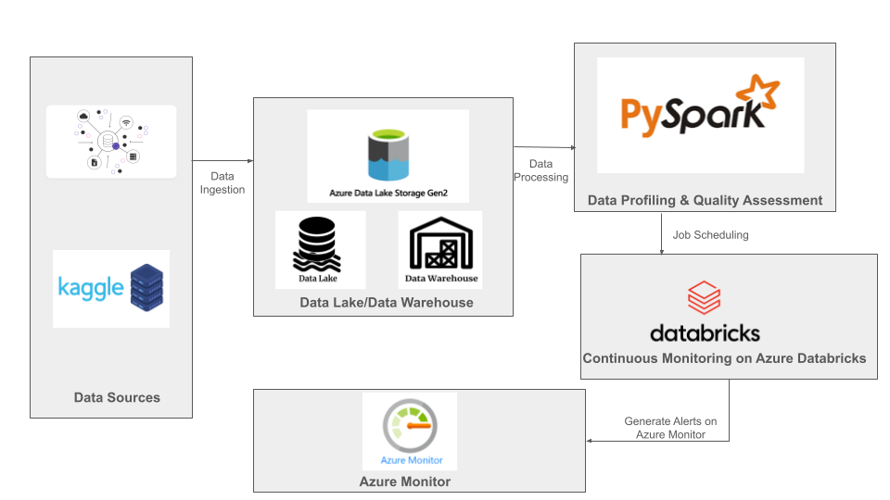
Architecture

Slide 8
Tools Used
PYSPARK SQL
AZURE DATABRICKS
AZURE DATALAKE STORAGE(GEN2)
AZURE MONITOR

Slide 9
Execution Overview
Setting up Azure Databricks
Integration with ADLS GEN2
Data Profiling
Data Quality
Job Scheduling
Continuous Monitoring
Alerting Mechanism

Slide 10
Azure Databricks
Platform Overview: Azure Databricks provides a scalable and managed Spark environment, making it an ideal choice for deploying our data quality monitoring system.
Advantages: The platform offers seamless integration with other Azure services, high scalability, and built-in security features.
Deployment: We will deploy the developed system on Azure Databricks, leveraging its capabilities to ensure efficient and reliable monitoring of data quality.

Slide 11
Data Ingestion
Source Integration: Datasource is taken from kaggle .
Data Storage: Data will be stored in the storage account by creating containers through account or Azure Storage Explorer Relevant data will be extracted from these sources using appropriate extraction techniques, ensuring that only necessary data is ingested for quality monitoring.
Example Tools: We utilize tools such as Azure Data Lake Storage Gen2.

Slide 12
Data Profiling
Purpose: The primary purpose of data profiling is to gain insights into the structure and content of the data.
Techniques: We will employ various techniques such as summary statistics, data histograms, outilers,missing values and data columns metric to profile the data.
Implementation: PySparkSQL will be utilized to efficiently perform data profiling tasks, enabling us to understand data characteristics and distributions effectively.

Slide 13
Quality Assessment
Metrics: We defined a set of quality metrics based on business requirements, which may include completeness, accuracy, consistency, etc.
Calculation: These metrics will be calculated and evaluated against predefined thresholds to determine data quality.
Example Metrics: Metrics such as null value percentage, unique value count, and data range scores ,reliabilty to assess data quality.

Slide 14
Continuous Monitoring
Automated Pipelines: We scheduled PySparkSQL notebooks to run at regular intervals, ensuring that data quality monitoring tasks are automated.
Alerting Integration: Our system integrated with custom alerting systems to provide real-time alerts whenever anomalies,start ,success are detected.

Slide 15
Alerting Mechanism
Real-time Monitoring: Our system will continuously monitor data quality metrics in real-time with azure monitor
Alert Generation: Whenever an anomaly or quality issue is detected, alerts will be generated automatically.
Integration: These alerts will be integrated with communication channels such as email, Slack, or Microsoft Teams, ensuring that stakeholders are notified promptly.

Slide 16
Results &Outputs
Data Profiling Insights
Quality Assessment Metrics
Alerts and Anomalies
Outputs of project:
We have uploaded our project end to end steps in this link with profiling and quality assesment files and screenshots
https://github.com/aniket4632/DataQualityMonitoring

Slide 17
Future Scope
Advanced Analytics Integration
Real-Time Data Monitoring.
Customizable Alerting Mechanisms
Data Governance Framework.
Integration with Data Catalogs.

Slide 18
Conclusion
In conclusion, we have developed a robust data quality monitoring system leveraging PySparkSQL for data profiling and quality assessments, and Azure Databricks for continuous monitoring.
The integration of alerting mechanisms allows stakeholders to be notified of anomalies in real-time, enabling timely corrective actions.
Key Takeaways:Overall, this system enhances data reliability, integrity, and trustworthiness, thereby improving decision-making and business outcomes

Slide 19
Q&A:
We open floor for any questions

