Slide 1
iAvenue Labs
Sprint 1 under POC
January 2021
By
Swagota Bera
Team Member

Slide 2
Contents
Problem Statement Understanding
Data Understanding
Data Visualisation - Deriving Insights
Data Cleaning - Missing values, Outliers etc.
Feature Engineering
Model Building - Trying out regression models
Model Evaluation - Best Model
Recommendation
Conclusion

Slide 3
Problem Statement
Understanding
Problem Statement
A US-based housing company named Surprise Housing want to invest in the Australian market to earn profit.
Company already located the property in Australia for investing purpose. But before investing, wants to know the actual price of the property and analytical results from the Data Scientist to decide whether to proceed or not.
Data scientist will have to build the regression model with the help of the provided database providing the database information regarding the building and modifying year and month, construction details, location and quality. Database information are termed as independent variables here.
Following outcomes are expected from Data Scientist :
* Prediction of the actual price of the concerned property.
* Identifying those information which is significant in the price prediction so
that company will focus only on that information only.
* Efficiency calculation of the identified information .
Business Goal
The build model will be further implement for the house price prediction purpose with the help the available independent variables.
Accordingly, the management will manipulate the strategy of the firm and concentrate on areas that will yield high returns.
Same model will be helpful for the company for further new market also.

Slide 4
Data Preprocessing -Data Cleaning in Excel
Step 1--- Check if there is any spacing mismatch in categorical data.
Step 2--- Check blank cell. If there is any fill with NAN value.
Step 3--- Check the format consistency for both numerical and
categorical data.
Step 4--- Check if there is any value errors.
Step 5--- Hall spelling of the variables are according to the data
description dictionary.
Step 6--- Identify Columns that contain a single values and delete that
columns .
Step 7--- Consider columns have very few values and remove columns
having unique values < 1%.
Step 8--- Identify redundant rows and columns and delete that rows
and columns.

Slide 5
Data Understanding
Data Visualisation
Loading of Datasets
Inspection of Variables Types and Visualization
Variable Characteristics
Cont..

Slide 6
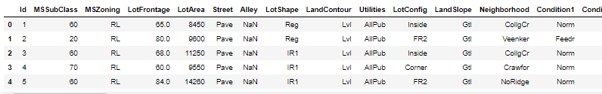
Data Understanding
Data Visualisation
Loading of Datasets
The database is in .csv format which is loaded in Jupyter notebook for Python Programming.
The dimension of database is 1460 x 81 i.e. Having 80 feature variables and one target variable . The sample size is 1460.
Inspection of Variables Types and Visualization
Visualization of Categorical Variables
Visualization of Temporal Variables
Visualization of Discrete Variables

Slide 7
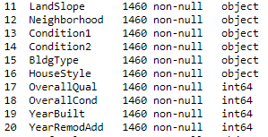
Data Understanding
Data Visualisation
Variables Types
The database variables are mixture of categorical and numerical variables. Numerical are those of type int and float and categorical those of type object.
Id is a unique identifier for each of the houses. Thus this is not a variable that we can use.
Cont..

Slide 8
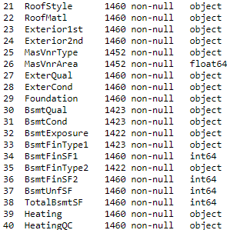
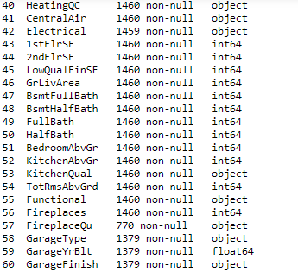
Data Understanding
Data Visualisation
Cont..

Slide 9
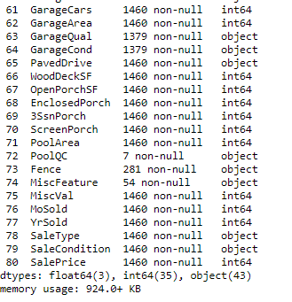
Data Understanding
Data Visualisation
Cont..

Slide 10
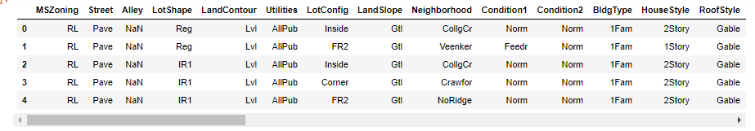
Data Understanding
Data Visualisation
Visualization of Categorical Variables
Categorical Variables cannot be feed directly for the modelling
purpose. So these variables are encoded into dummy numerical
data which in the feature engineering part in categorical encoding.
Cont..

Slide 11
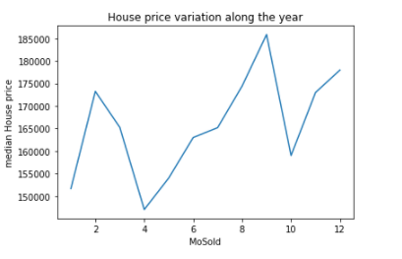
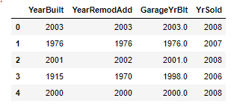
Data Understanding
Data Visualisation
Visualization of Temporal Variables
The temporal variables indicate the year in which the houses were built or remodelled or a garage was built, or the house was indeed sold.
Instead of using this variable directly for model building, it should be transformed to capture the time elapsed between the time the house was built and the time the house was sold for example. Which will be done in the feature engineering part.
MoSold, is another time data which indicates the month in which the house was sold.
The price seems to vary depending on the month in which the house is sold.
Cont..

Slide 12
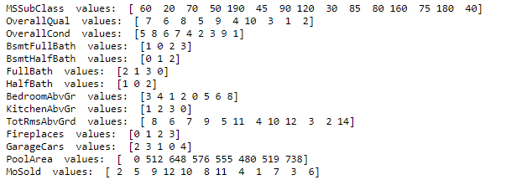
Data Understanding
Data Visualisation
Visualization of Discrete Variables
Top 20 Values are represented here for visualization.
Discrete variables can be pre-processed or engineered as if they
were categorical. So, these variables will go for categorical
encoding in the feature engineering part.
we need to re-cast them as object
Cont..

Slide 13
Data Understanding
Data Visualisation
Variable Characteristics
Missing Data
Categorical Variables Encoding
Linear Model Assumptions
Distributions
Outliers
Feature Magnitude
Cont..

Slide 14
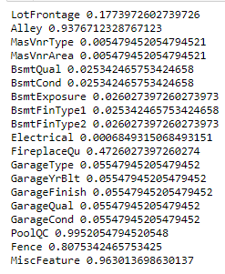
Data Understanding
Data Visualisation
Missing Data
List of variables containing NA( Not Applicable) along with their
percentage of NA.

Slide 15
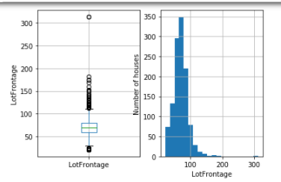
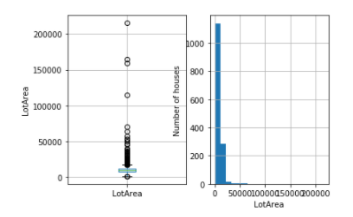
Data Understanding
Data Visualisation
visualise outliers and distributions of continuous variables Outliers
The majority of the continuous variables seem to contain outliers.
The majority of the variables are not normally distributed.
As we are planning to build linear regression, we need to tackle these to improve the model performance.
Discretisation will tackle both problem.

Slide 16
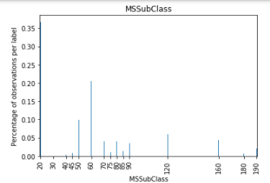
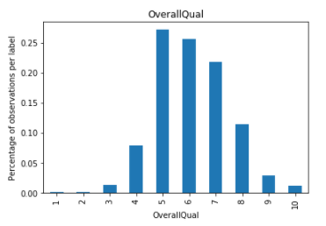
Data Understanding
Data Visualisation
Outlies in Discrete Variables
We will call outliers those values that are present in less than 5 % of the houses. This is exactly the same as finding rare labels in categorical variables.

Slide 17
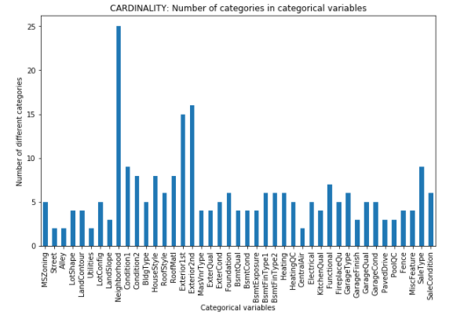
Data Understanding
Data Visualisation
Number of labels: cardinality
Most of the variables, contain only a few labels. Then, we do not have to deal with high cardinality.

Slide 18
Feature Engineering
Feature Engineering
Extracting Features from Dates
Missing Data Imputation
Categorical Variable Encoding
Discretisation
Outlier Handing
Feature Scaling

Slide 19
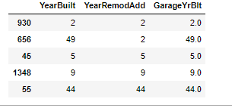
Feature Engineering
Extracting Features from Dates
Instead of the "year", now we have the amount of years that passed since the house was built or remodelled and the house was sold.
New temporal variables are going to treat them as numerical and continuous.
Remove YrSold from the variable list because it is no longer in our dataset

Slide 20
Feature Engineering
Missing data imputation
Continuous variables
Categorical Variables
For numerical data the missing values are replaced with median value as the distribution is skewed.
For categorical data the missing values are the maximum frequency data.

Slide 21
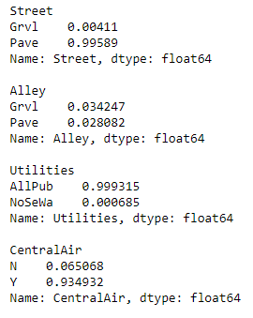
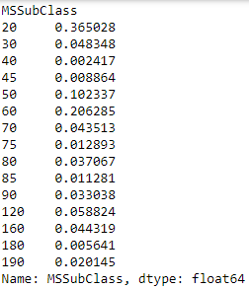
Feature Engineering
Rare Labal Encoding
Continuous variables
Categorical Variables
Integer Label Encoding is implemented for rare label treatment

Slide 22
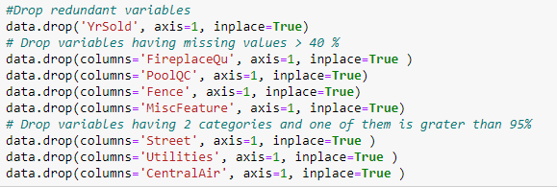
Feature Engineering
Dropping variables which are having missing values greater than 40 %
Dropping those variables which are having only two categories and one category is more than 95 % and other is very less.

Slide 23
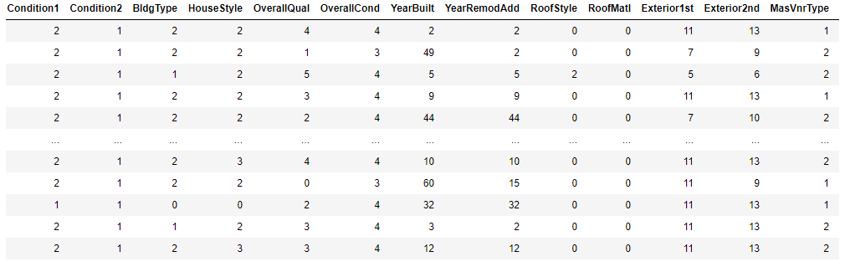
Feature Engineering
Categorical Encoding
Integer Encoding categorical encoding is implemented for categorical encoding
Dropping of those variables having at least 4 NAN values.

Slide 24
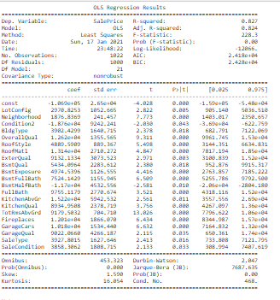
Model Building - Trying out regression models
Those variables having P value grater than 5% are dropped as the significance level is fixed at 5%. Only 21 variables are finally left.

Slide 25
Reccomendation
Selected Features
( In descending order of their importance)
OverallQual
RoofStyle
RoofStyle
Neighborhood
BsmtExposure
BsmtFullBath
BsmtHalfBath
FullBath
KitchenQual
TotRmsAbvGrd
Fireplaces
GarageCars
ExterQual
LotConfig
KitchenAbvGr
SaleType
BldgType
BsmtQual
SaleCondition
GarageQual

Slide 26
Model Evaluation –
Best Model
LASSO Regression
Train R2 = 82.5%, Test R2 = 78.1%
Random Forest
Train R2 = 97.5%, Test R2 = 85.2%
Decision Tree
Train R2 = 83.0 %, Test R2 = 75.5 %
SVR
Train R2 = 78.8 %, Test R2 = 75.2 %

Slide 27
Recommendation
Finally, selected 20 features are the significant features for the
prediction of the house price.
Random Forest Regressor come up with better performance
i.e. 85.2 % on test datasets for the price prediction purpose.

Slide 28
Thank You

