Slide 1


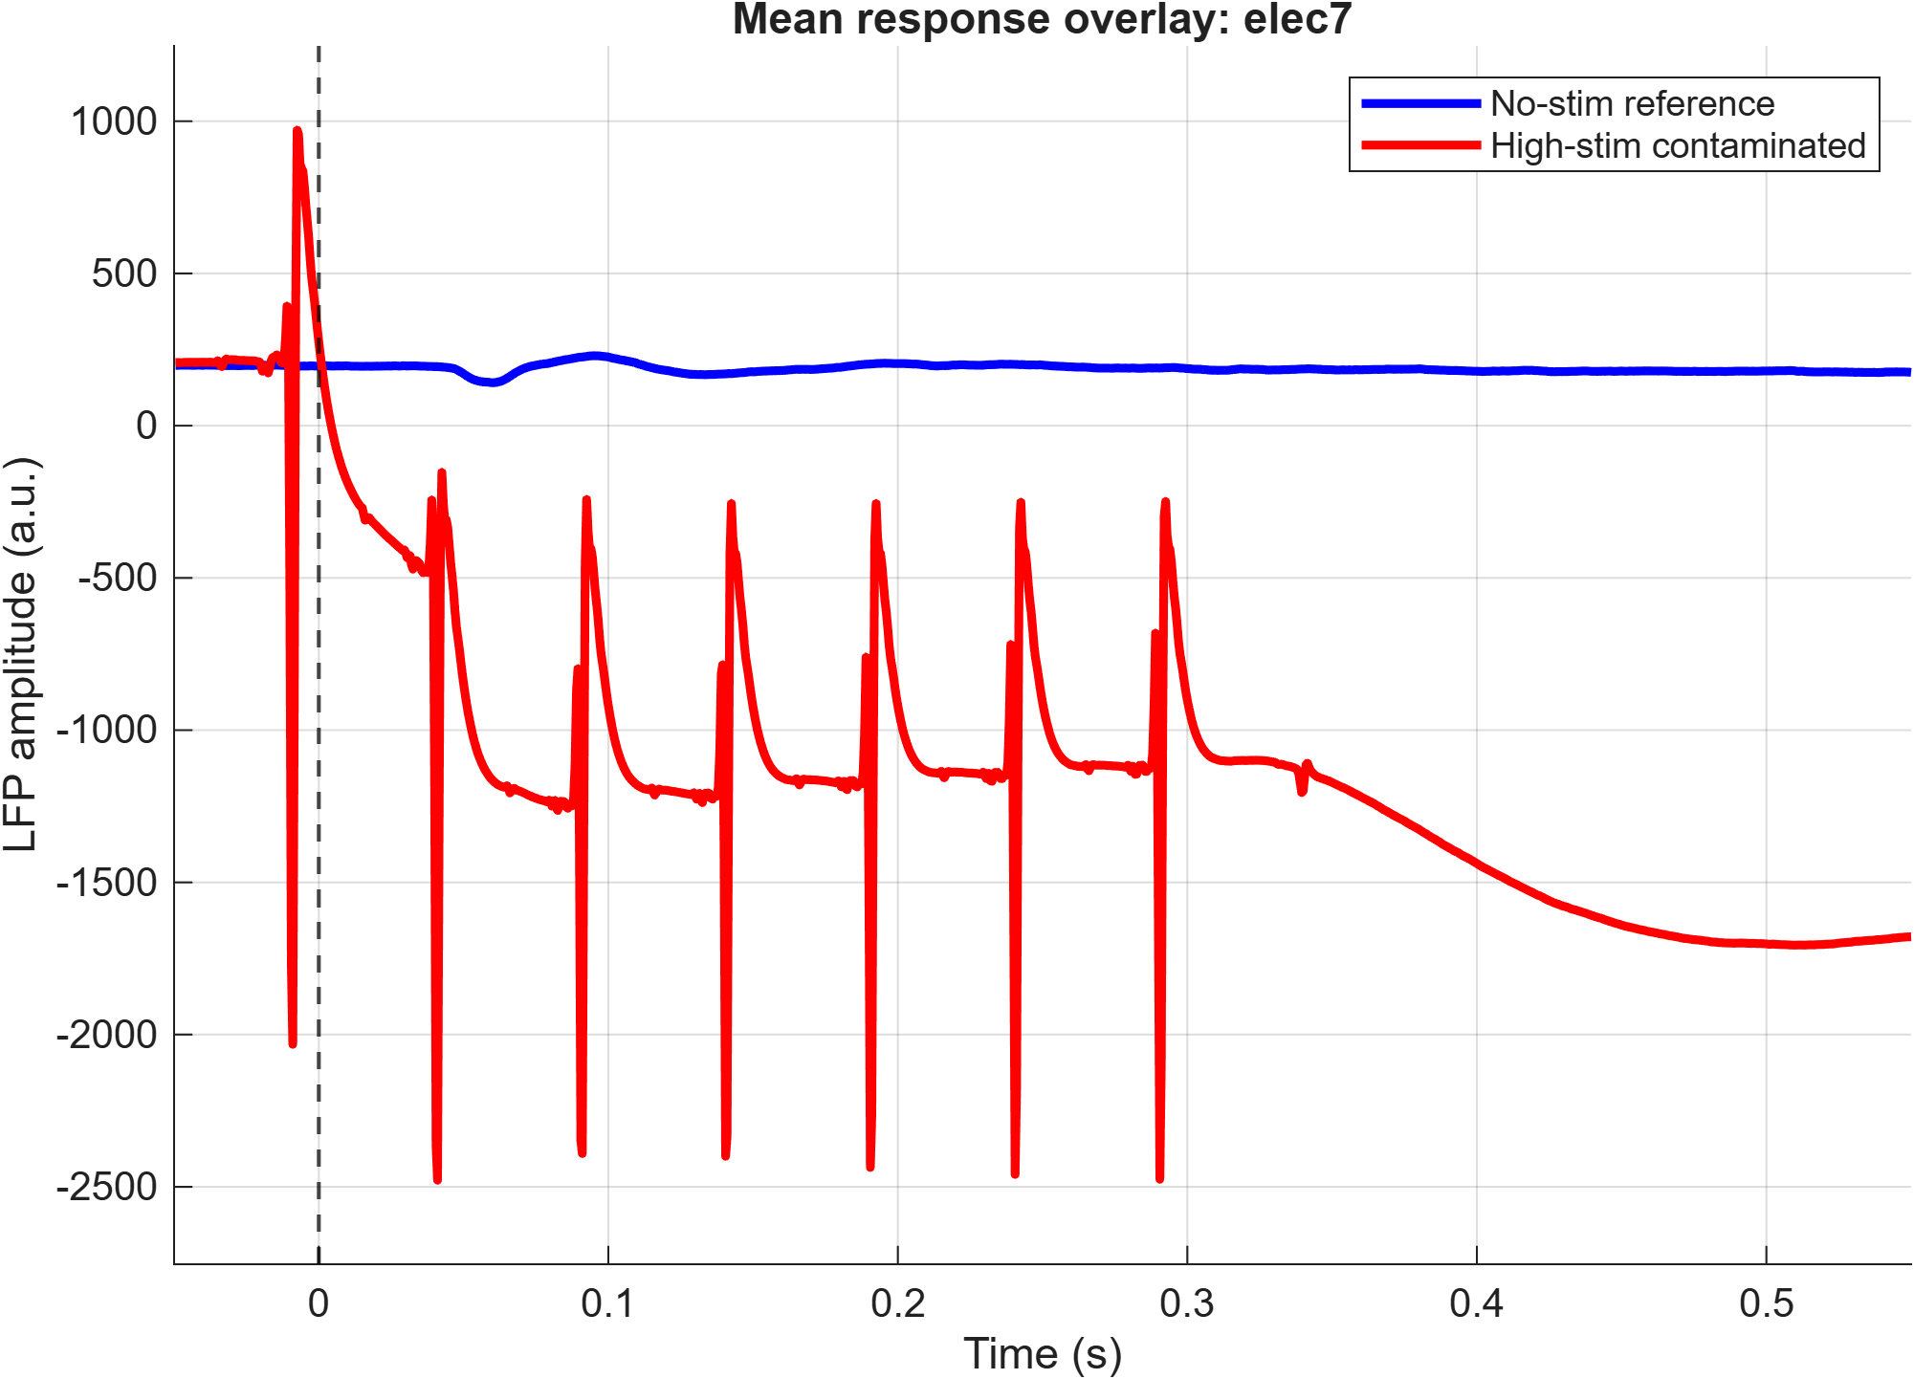
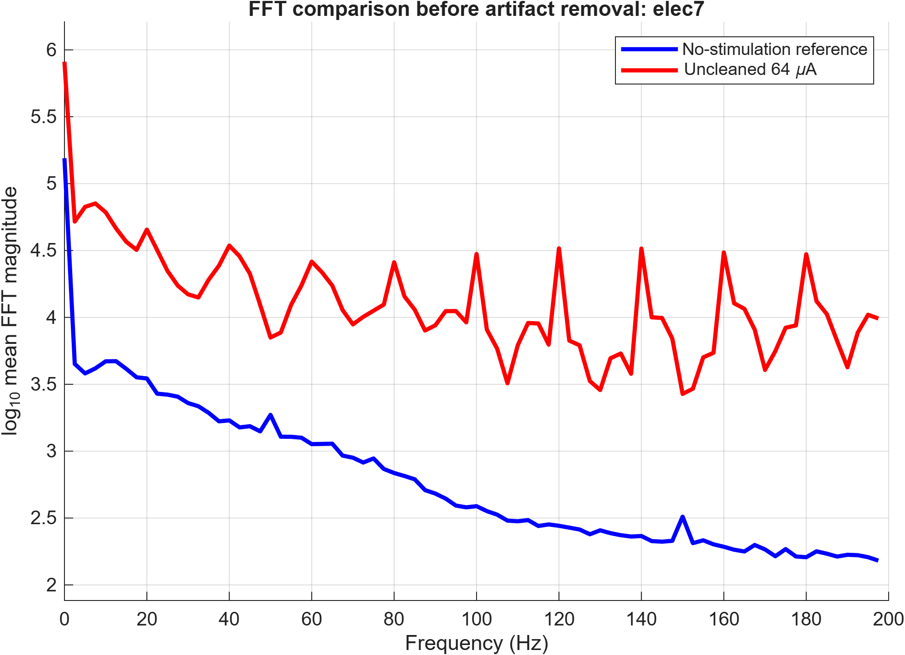
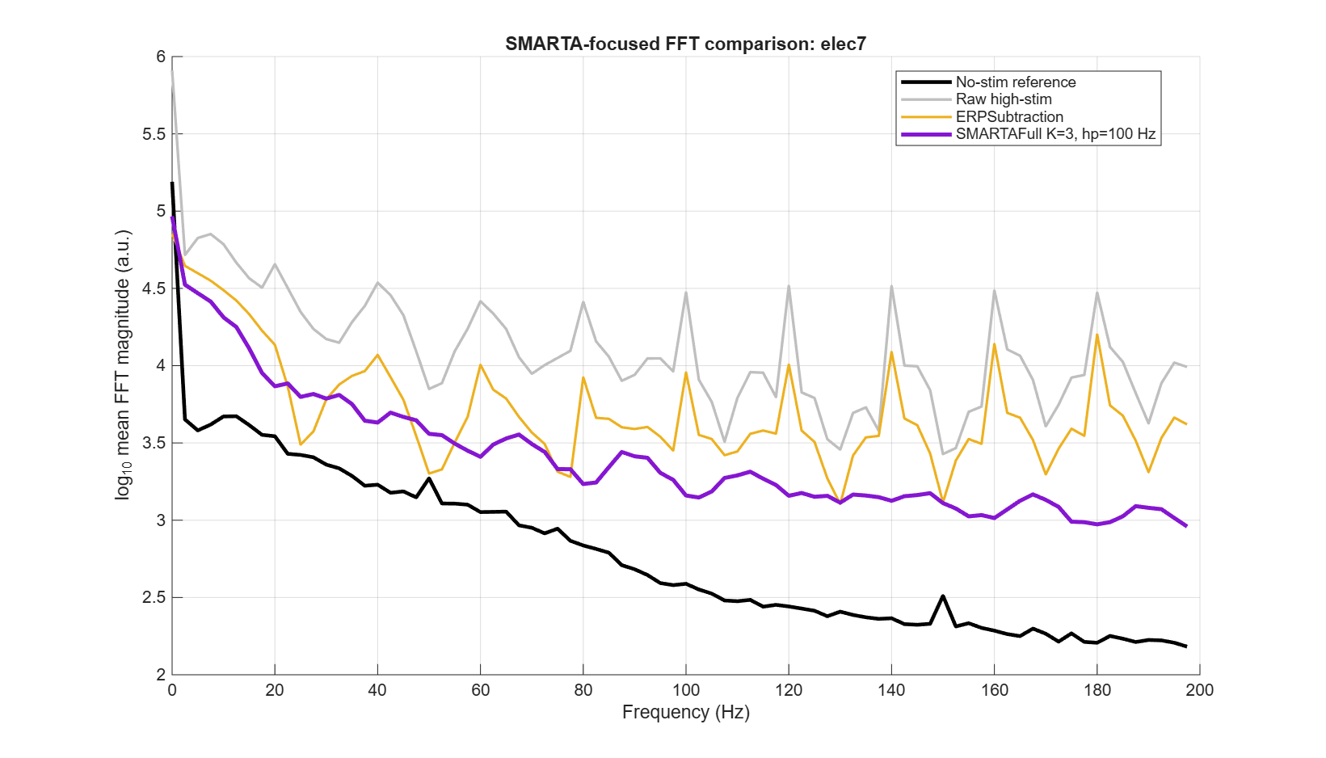
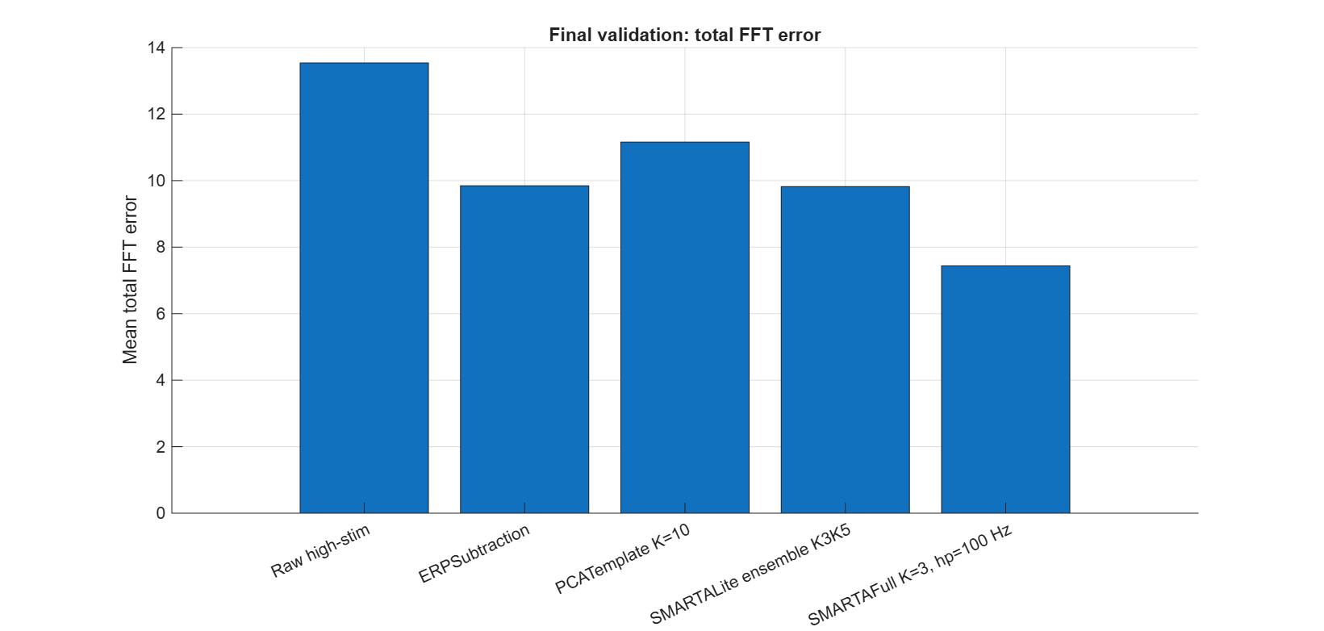
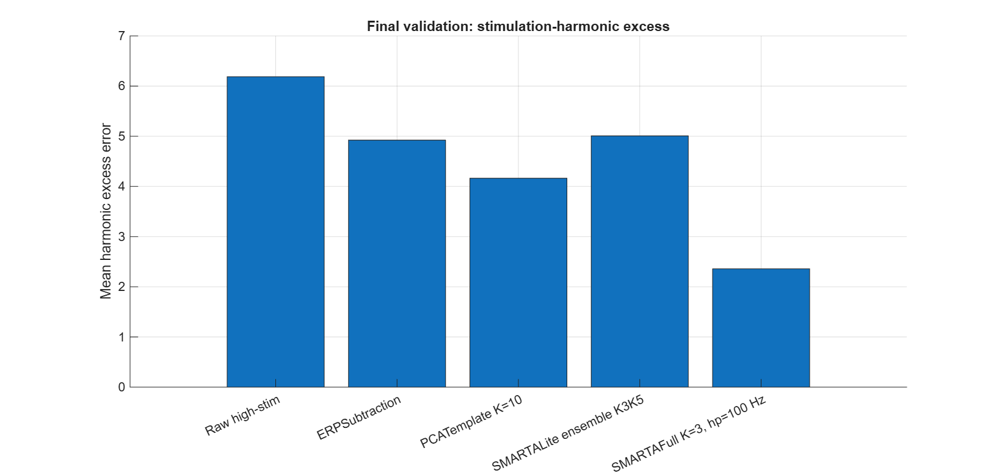
Indian Institute of Science, Bangalore
Artifact Removal for
ICMS-Evoked LFP Recordings
Ramya Sree Galanki • M. Tech Signal Processing, Department of ECE, IISc
Advisors: Prof. Chandra R. Murthy • Prof. Supratim Ray
Motivation & Problem
Key Findings
Intracortical microstimulation introduces large pulse-locked artifacts into simultaneously recorded LFP signals.
These artifacts can be much larger than the neural response of interest.
Artifact shape varies across trials, pulses, and electrodes, so a single fixed template may not be sufficient.
Goal: suppress stimulation artifact while preserving the underlying LFP structure.
Fixed ERP templates reduce the dominant artifact but can leave structured residuals.
PCA suppresses stimulation harmonics strongly, but may risk over-cleaning time-locked neural activity.
SMARTAFull adapts the artifact estimate using local similarity and optimal shrinkage.
In final real-data validation, SMARTAFull gave the best overall artifact reduction across 31 selected V1 electrodes.
Representative Result: SMARTAFull Cleaning
Data & Setup
Dataset: GRF_001 ICMS-LFP recordings from NHP Dona.
Conditions compared: no-stimulation and high-stimulation trials.
LFP recordings were analyzed electrode-wise from segmented trial data.
Final real-data validation used 31 selected V1 electrodes.
Main artifact-analysis window: 0–0.4 s after stimulation onset.
Evaluation used FFT error, harmonic artifact error, pulse-triggered residuals, and balanced score.
Methods Compared
Electrode 7: SMARTAFull reduces stimulation-related harmonic structure and moves the high-stimulation spectrum closer to the no-stimulation reference.
ERP Subtraction: fixed average artifact template baseline.
PCA Template K=10: PCA subspace removal for stimulation artifacts.
SMARTALite: local nearest-neighbor pulse-template subtraction.
SMARTAFull K=3, hp=100 Hz: similarity-based artifact estimation with optimal shrinkage; final selected method.
SMARTAFull workflow: Pulse segments → high-pass similarity features → nearest neighbors → optimal shrinkage → local template subtraction → cleaned LFP
Final Across-electrode Validation
Why SMARTA?
Fixed templates cannot capture trial-to-trial and pulse-to-pulse artifact variability.
PCA is powerful but may remove time-locked neural activity.
SMARTAFull selects locally similar artifact segments and forms adaptive templates.
OptShrink/optimal shrinkage suppresses noise in the artifact-segment matrix by shrinking unreliable singular values instead of hard-truncating components.
Final validation showed the best overall artifact reduction across selected electrodes.
Evaluation Metrics
Across 31 selected V1 electrodes, SMARTAFull achieved the lowest mean total FFT error and lowest stimulation-harmonic excess error among the tested methods.
Total FFT error: spectral distance from no-stimulation reference.
Harmonic excess error: residual stimulation-related harmonic power.
Pulse-triggered residual: remaining pulse-locked artifact after cleaning.
Balanced score: combines artifact suppression and signal-preservation criteria.
Takeaways
Trial-to-trial and pulse-to-pulse artifact variability limits fixed-template subtraction.
PCA is effective for harmonic suppression but can be aggressive.
SMARTAFull K=3, hp=100 Hz provides the best real-data trade-off between artifact suppression and signal preservation.

