Slide 1
Storage - eMMC, UFS
Current Topics Presentation
Aniket Kumar Lata
ECEN 5613
11/04/2014
November 04, 2014

Slide 2
eMMC – Embedded MultiMediaCard
eMMC is an embedded non-volatile memory system, comprised of both flash memory and a flash memory controller integrated on the same silicon die.
It is a managed memory, which defines a mechanism for indirect memory accesses to the memory array.
This indirect access is often enabled by a separate controller.
The advantage of indirect memory access is that the memory device can perform several background memory management tasks without the involvement of the host software.
The eMMC solution consists of three components - the MMC (multimedia card) interface, the flash memory, and the flash memory controller - and is offered in a standard BGA (ball grid array) package.
eMMC eliminates the need to develop interface software for all types of NAND memory by integrating the embedded controller into the memory chip
November 04, 2014

Slide 3
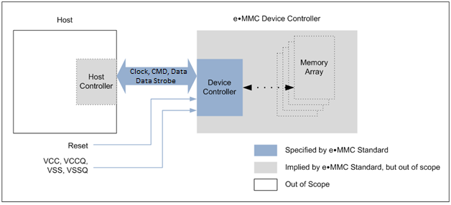
eMMC System Overview
November 04, 2014
Source: JESD-84B50-1 URL: http://www.jedec.org/standards-documents/docs/jesd84-b501

Slide 4
eMMC Functional description
Boot mode: The device will be in boot mode after power cycle, reception of CMD0 with argument of 0xF0F0F0F0 or the assertion of hardware reset signal.
Device identification mode : The device will be in device identification mode after boot operation mode is finished or if host and /or device does not support boot operation mode. The device will be in this mode, until the SET_RCA command (CMD3) is received.
Interrupt mode : Host and device enter and exit interrupt mode simultaneously. In interrupt mode there is no data transfer. The only message allowed is an interrupt service request from the device or the host.
Data transfer mode: The device will enter data transfer mode once an RCA is assigned to it. The host will enter data transfer mode after identifying the device on the bus.
Inactive mode : The device will enter inactive mode if either the device operating voltage range or access mode is not valid. The device can also enter inactive mode with GO_INACTIVE_STATE command (CMD15). The device will reset to Pre-idle state with power cycle.
November 04, 2014

Slide 5
eMMC Device Overview
CLK : Each cycle of this signal directs a one bit transfer on the command and either a one bit (1x) or a two bits transfer (2x) on all the data lines. The
Data Strobe: This signal is generated by the device and used for data output and CRC status response output
CMD: This signal is a bidirectional command channel used for device initialization and transfer of commands. The CMD signal has two operation modes: open-drain for initialization mode, and push-pull for fast command transfer.
DAT0-DAT7 : These are bidirectional data channels. The DAT signals operate in push-pull mode. Only the device or the host is driving these signals at a time. By default, after power up or reset, only DAT0 is used for data transfer.
November 04, 2014

Slide 6
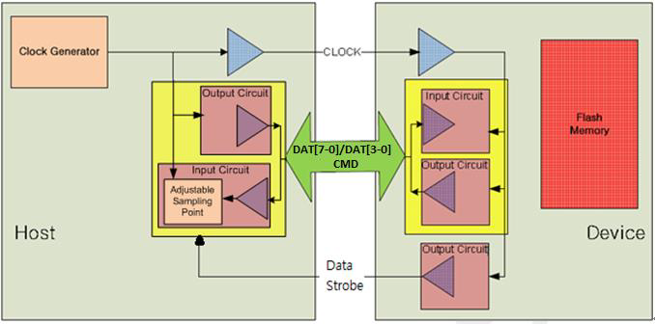
eMMC – Host (Microcontroller) Interface
November 04, 2014
Source: JESD-84B50-1 URL: http://www.jedec.org/standards-documents/docs/jesd84-b501

Slide 7
eMMC – Host (Microcontroller) Interface
The CLK input for the eMMC package needs to be generated by the host
The Data Strobe signal generated by the eMMC controller can be monitored to check data output and responses.
The CMD bidirectional signal used for device initialisation and generation of commands can be monitored/controlled via one of the GPIO pins of the host controller
DAT7-0 of the eMMC controller can be connected to GPIO pins of the host. These pins would be used for data transfer
An driver needs to be written in software for initialisation, data read and data write of the eMMC package.
November 04, 2014

Slide 8
UFS – Universal Flash Storage
Universal Flash Storage (UFS) is a simple, high performance, mass storage device with a serial interface.
It is primarily for use in mobile systems, between host processing and mass storage memory devices.
This could bring higher data transfer speed and increased reliability in flash memory storage, thus reducing market confusion and the varying number of adapters for different number of cards
Target host applications : Mobile phone, UMPC, DSC, PMP, MP3 and any other applications that require mass storage, 168 bootable mass storage, and external card
The electrical interface for UFS uses the M-PHY, developed by the MIPI Alliance organization.
November 04, 2014

Slide 9
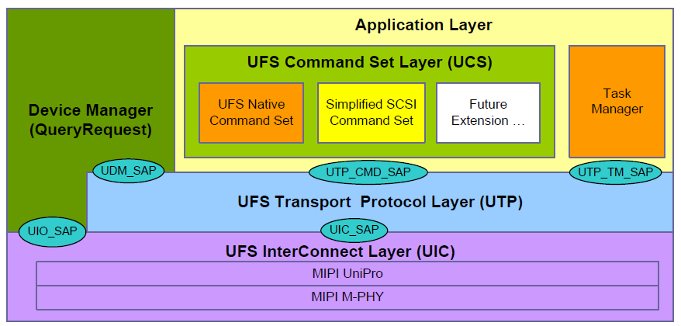
UFS Architecture overview
November 04, 2014
Source: JESD220B URL: https://www.jedec.org/standards-documents/results/jesd223b

Slide 10
UFS Architecture
Application Layer : The application layer consists of the UFS command set layer (UCS), the device manager and the Task 232 Manager
UFS Interconnect (UIC) Layer : UFS interconnect layer is composed by MIPI UniPro, which provides basic transfer capabilities to the upper layer (UTP), and MIPI M-PHY, adopted as UFS physical layer.
UFS Transport Protocol (UTP) Layer: A design feature of UTP is to provide a flexible packet architecture that will assist the UFS controller in 373 directing the encapsulated command, data and status packets into and out of system memory.
A second feature of the UTP design is that once a device receives a command request notification from the host, the device will control the pacing and state transitions needed to satisfy the data transfers and status completion of the request.
January 30, 2010

Slide 11
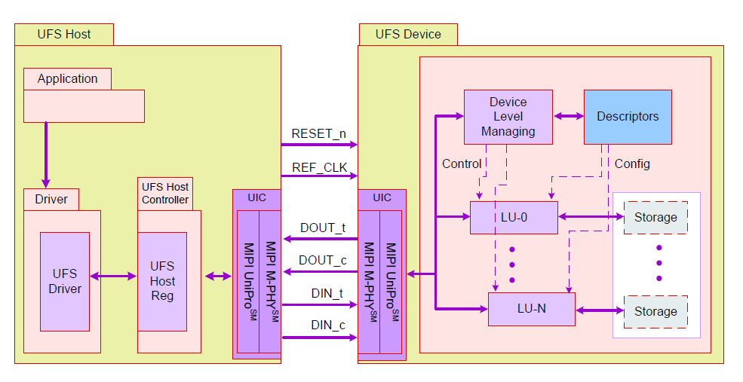
UFS System Model
November 04, 2014
Source: JESD220B URL: https://www.jedec.org/standards-documents/results/jesd223b

Slide 12
UFS System Model
The UFS host consists of the application which wishes to communicate with the UFS device. It communicates with the device using the UFS driver.
The UFS driver is meant for managing the UFS host controller through the UFS-HCI (UFS Host Controller Interface). The UFS-HCI is basically a set of registers exposed by the host controller.
The UFS Interconnect (UIC) Layer consists of MIPI UniPro and MIPI M-PHY. The physical layer M‐PHY is differential, dual simplex PHY that includes TX and RX pairs.
Potential UFS devices can be memory card (full size and micro size), embedded bootable mass storage devices, IO devices etc.
The device manager performs device level functions like power management while the logical unit performs functions like read, write etc
November 04, 2014

Slide 13
UFS – host (microcontroller) interface
The UFS host controller must have an MIPI M-PHY interface to communicate with the UFS controller
The REF_CLK and RESET signals need to be provided to the UFS controller by the host.
The Data In and Data Out signals which enable data transfer should be provided to the UFS controller via M-PHY interface.
The host controller can use GPIO to configure and M-PHY interface at its end
The driver software for UFS will include initialisation of UFS controller via M-PHY interface, read and write operations
November 04, 2014

Slide 14
References
http://www.jedec.org/standards-documents/docs/jesd84-b501 (eMMC JEDEC standards)
https://www.jedec.org/standards-documents/results/jesd223b/ (UFS JEDEC standards)
http://en.wikipedia.org/wiki/Universal_Flash_Storage (UFS Wikipedia page)
http://www.datalight.com/solutions/technologies/emmc/what-is-emmc (eMMC information link)
November 04, 2014

