Slide 1
Memory (SD/MMC) Card Reader
SD/ MMC Card Read/Write
File Read
Block Fill
Data Copy
Graphic LCD display

Slide 2
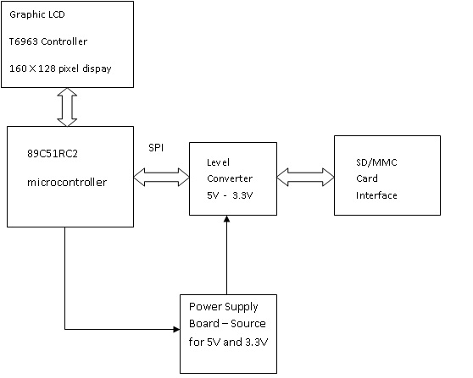
Block Diagram

Slide 3
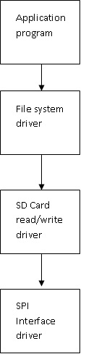
Code Structure
Application program with user interface
File Read operation driver
SD Card Read/Write driver
SPI driver at the lowest level
Serial interface
Graphic LCD driver

