Slide 1
UART 16550A
Aniket Bhojane
BATCH 85

Slide 2
UART PROTOCOL
UART is a computer hardware device for asynchronous serial communication which allows communication with external devices.
UART allows us to have configurable data format and transmission speeds.
Includes 16 Byte FIFO Buffer.
WISHBONE Interface in 32-bit and 8-bit data bus mode (configurable)
UARTs provide serial asynchronous receiver data synchronization, parallel-to-serial and serial-to-parallel data conversion for both the transmitter and receiver sections.
Synchronization for the serial data stream is accomplished by adding start and stop bits to the transmit data to form a data character.
Data integrity is ensured by attaching a parity bit to the data character. The parity bit is checked by the receiver for any transmission bit errors.

Slide 3
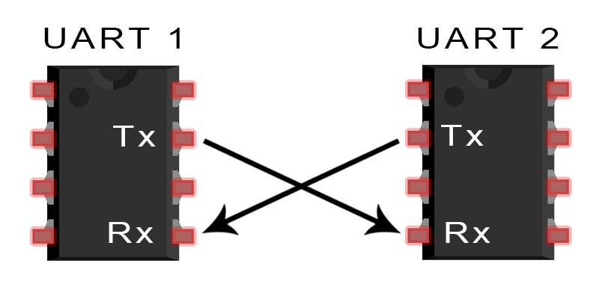
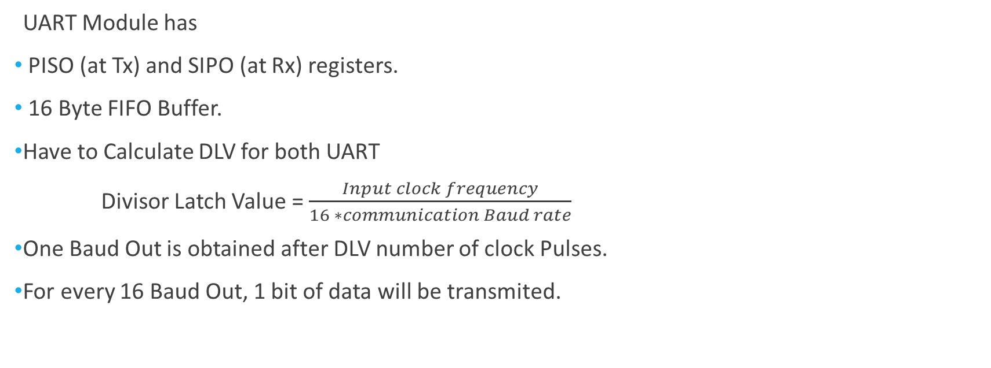
UART Module has
PISO (at Tx) and SIPO (at Rx) registers.
16 Byte FIFO Buffer.
Have to Calculate DLV for both UART
Divisor Latch Value = $\frac{Input clock frequency}{16 ∗communication Baud rate}$
One Baud Out is obtained after DLV number of clock Pulses.
For every 16 Baud Out, 1 bit of data will be transmited.

Slide 4
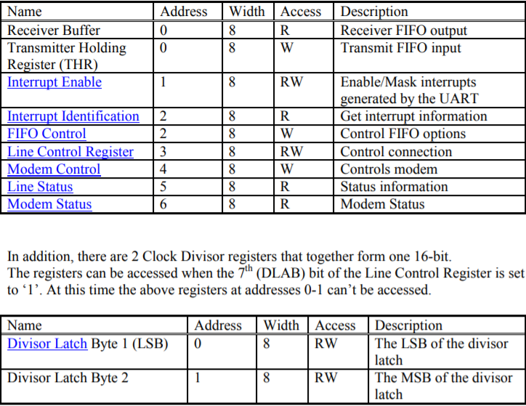
Registers List

Slide 5
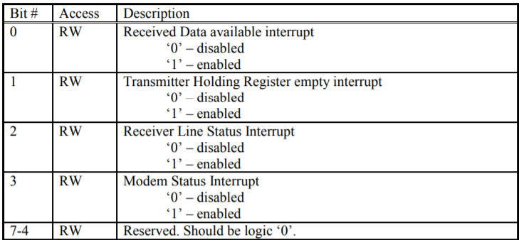
Interrupt Enable Register

Slide 6
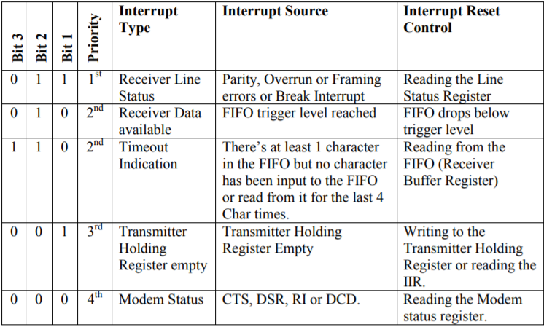
Interrupt Identification Register (IIR)

Slide 7
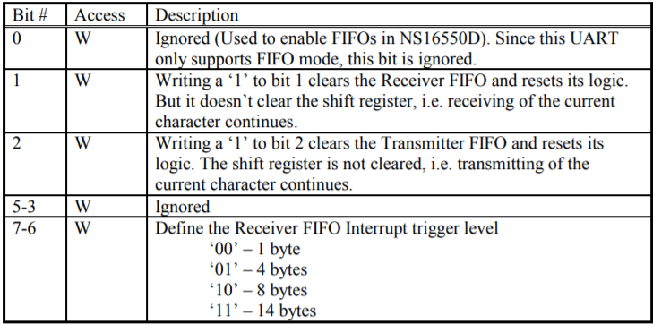
FIFO Control Register (FCR)

Slide 8
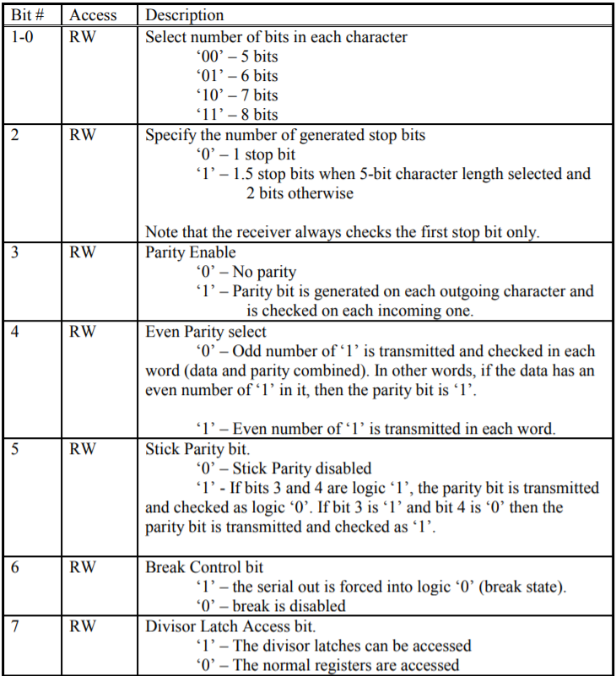
Line Control Register

Slide 9
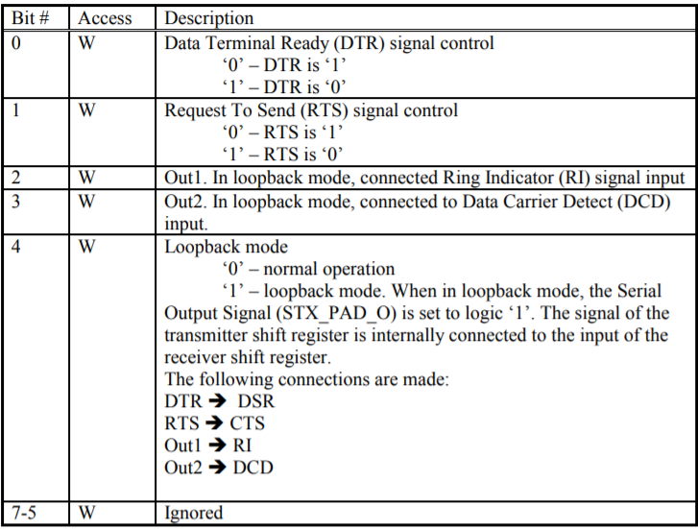
Modem Control Register (MCR)

Slide 10
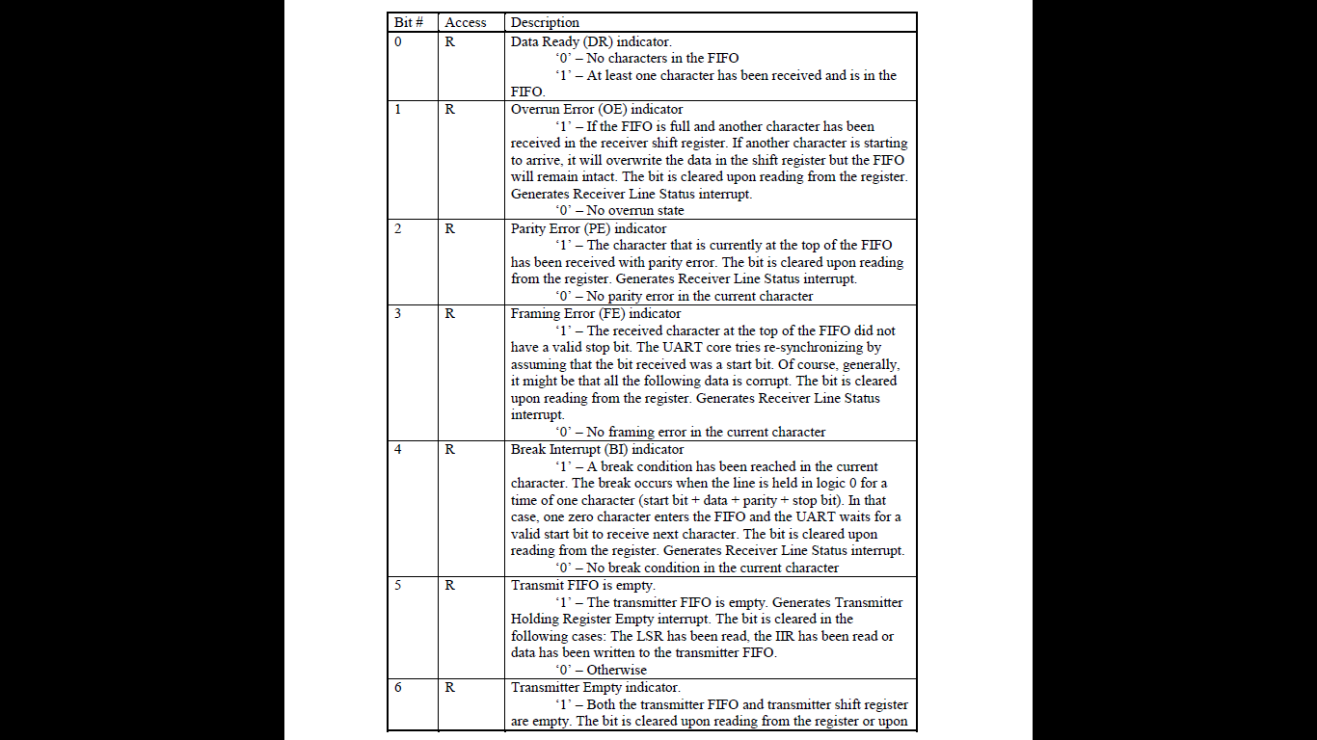
Line Status Register

Slide 11
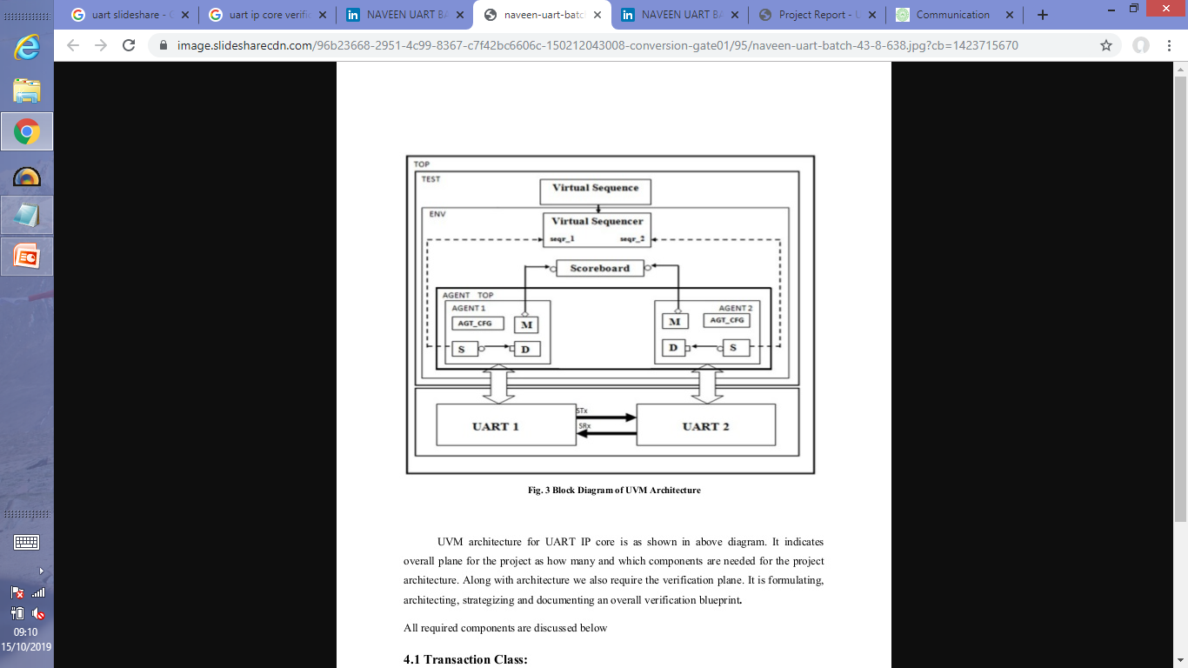
Testbench Architecture

Slide 12
Testcase Scenarios
Operations
Half duplex
Full duplex
Loop back
Error
Parity Error
Frame error
Time out error
Overrun error
Break Interrupt error
THR empty

Slide 13
Transaction Details
We will randomize address, data and write enable.
While writing sequence, we need to use constraints to access different registers using their addresses and load required data into it.
Sequence Order.
LCR[7] = 1
DL MSB
DL LSB
LCR[7] = 0
IER
FCR
THR
IIR

Slide 14
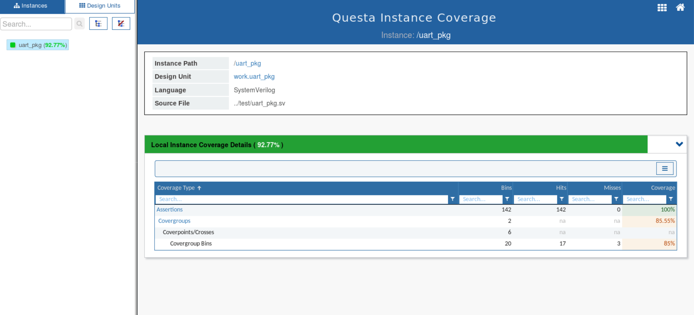
Coverage Model

Slide 15
Application
Used by Modem to communicate with network.
GPS units.
Wireless Communication.

Slide 16
Advantages and Disadvantages
Advantages
Includes 16 byte FIFO buffer.
Makes High Speed Communication more reliable.
Disadvantages
As UART uses serial communication, speed is less.
Baud rate of UART must be within 10% of each other
Requires Two wires.
At a time only two systems can communicate with each other.
Does not support multiple master/Slave System.

Slide 17
THANK YOU

