Slide 1





SMART INDIA HACKATHON 2026
“NWIS — AI-Powered Nearby Well Intelligence for Safer Drilling”
  Problem Statement ID – 26121
  Problem Statement -eRTMAC-NWIS(Nearby Wells Intelligence System):
An AI-Powered Offset Well Knowledge and Decision Support Platform For Drilling Operations
  Theme- Smart Automation
  PS Category- Software
  Team ID- U13UM7H3
  Team Name - SpaceX

Slide 2
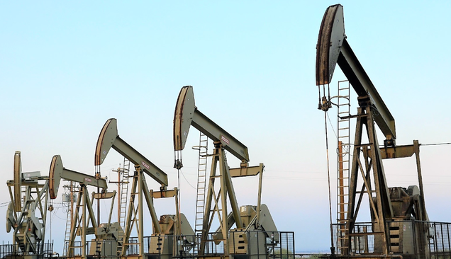
From Historical Experience → Proactive Drilling Decisions
SpaceX
  PROBLEM
  Scattered Knowledge
Historical drilling experiences are difficult to access alongside the active well.
  No Unified Offset View
Nearby wells, formations and historical incidents are not connected in one decision interface.
  Reactive Risk Awareness
Similar drilling problems may only become apparent after they occur.
  SOLUTION
  eRTMAC-NWIS connects:
Location + Depth + Formation + Historical Events + Drilling Parameters
To identify similar historical situations and generate proactive alerts.
2
Notes:
2

Slide 3
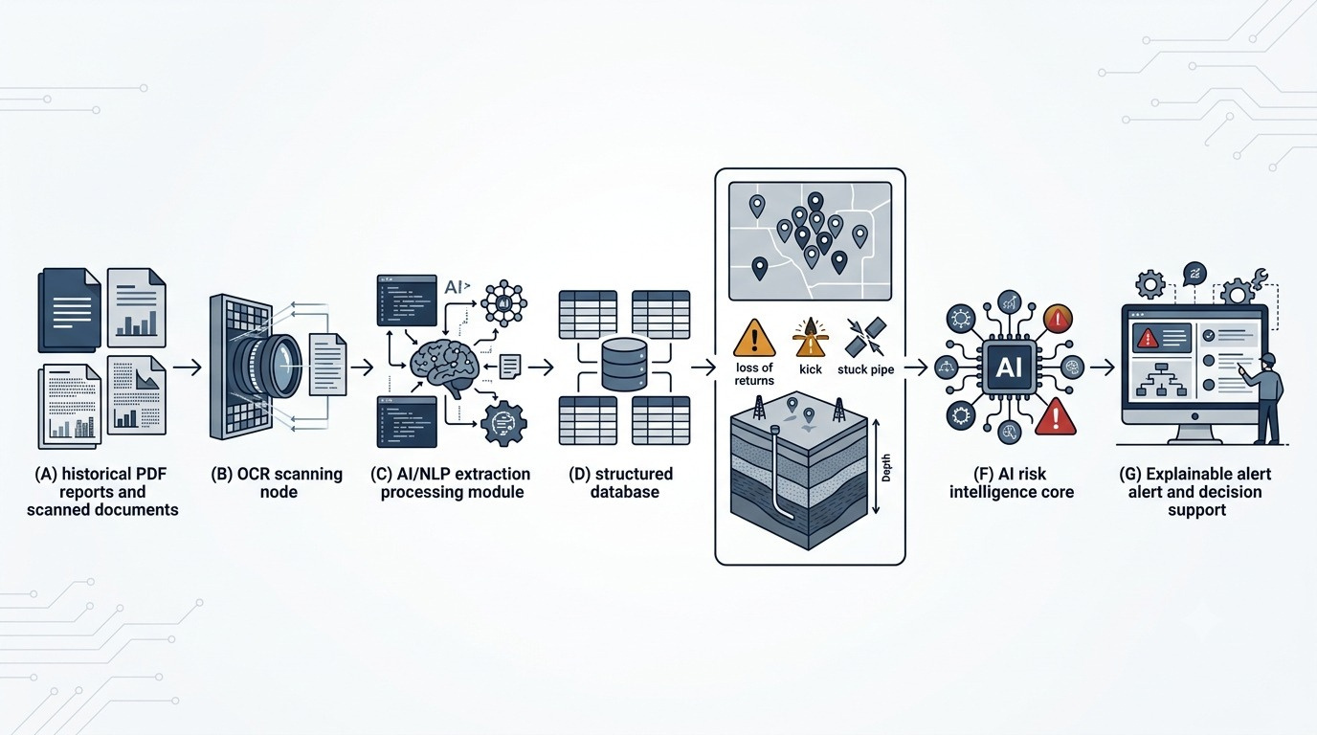
SpaceX
TECHNICAL APPROACH
  Python & Pandas for Data Processing, Streamlit ,Folium & Branca for the Map/UI, Scikit-Learn for the similarity scoring.
  Methodology: Nearby Well distance search - Formation context match--historical event retreival-risk scoring
Python
Pandas
Streamlit
Folium
Plotly
Scikit-learn
3
Notes:
3

Slide 4
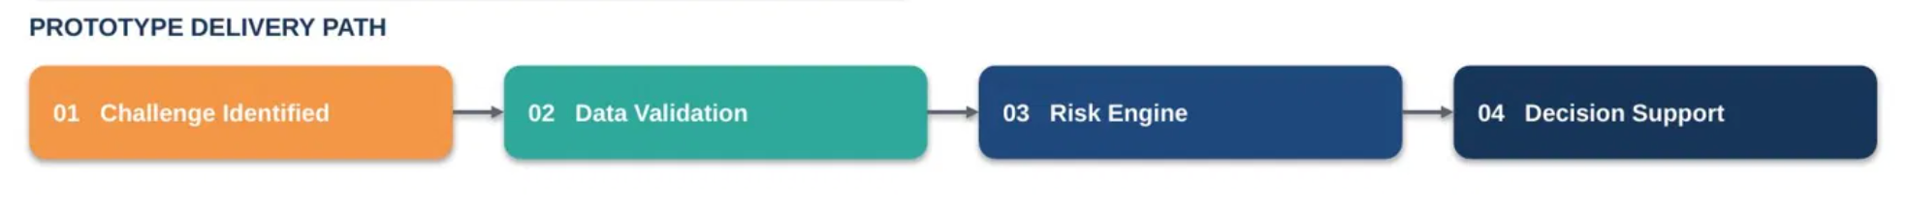
SpaceX
FEASIBILITY AND VIABILITY
prototype-ready on synthetic + real-world data
  Built on existing, proven technologies with a modular Map + Data + Risk Engine + UI architecture
FEASIBILITY
CHALLENGES
OUR APPROACH
  Complete OIL Operational data not publicly available in required format
  Real-World Drilling data May contain missing/Inconsistent records
  Prototype risk Scores require real world validation
  Synthetic Prototype Dataset Modeled Around PS requirements but wells dataset scraping from DrillerDB
  Data validation for IDs, depths, formations and events
  Human in the loop decision support,not autonomous drilling instructions
  Existing Technologies:
Python, Pandas, Streamlit,
Mapping Liberies
  Modular Architecture:
Map + Data + Risk Engine + UI
  Prototype Ready Using some of the data sets are synthetic
4
Notes:
4

Slide 5
SpaceX
IMPACT AND BENEFITS
  Turns historical drilling knowledge into actionable, evidence-based intelligence for the drilling team, operations and environmental safety
HOW NWIS CREATES IMPACT??
WHY IT MATTERS??
EXPECTED IMPACT
HISTORICAL WELL DATA
NEARBY WELL MATCHING
DEPTH & FORMATION
1
2
3
• Decision Speed — time to manually locate relevant history vs. using NWIS
KNOWLEDGE
PRESERVATION
  WELLS
  EVENTS
  FORMATION
  PARAMETERS
  LOCATION SEARCH
  WITHIN 5-20KM RADIUS
  MATCH DEPTH
  SAME GEOLOGICAL LAYER
AWARENESS
• Risk Awareness — % of historical risk events surfaced before matching depth/formation
4
HISTROICAL
EVENTS
5
RISK PATTERN
DETECTED
6
EXPLAINABLE
ALERT
• Downtime/NPT — estimated reduction from historical mitigation practices
FAST
DECISIONS
OPERATIONAL
EFFICIENCY
  SIMILAR INCIDENTS FOUND
  MUD LOSS,KICKS,STUCK PIPE
  SIMILAR INCIDENTS FOUND
  MUD LOSS,KICKS,STUCK PIPE
  RISK ALERT + EVIDENCE
  DECISION SUPPORT
• Knowledge Reuse — % of historical events made searchable via NWIS
5
Notes:
5

Slide 6
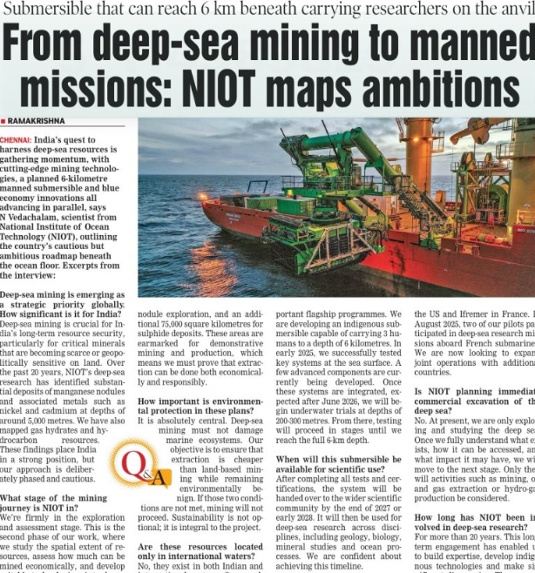
RESEARCH AND REFERENCES
SpaceX
  Smart India Hackathon 2026 — PS 26121: eRTMAC-NWIS — Official problem statement. SIH 2026
  Oil India Limited — Organizational & upstream oil/gas domain context. Oil India Limited
  3W Dataset — Petrobras — Public oil-well operational/event dataset. 3W Dataset
  DataDrill — SPE — Public drilling dataset for formation-pressure/kick analysis. DataDrill
  National Data Repository — DGH, India — Reference for Indian E&P/well data. National Data Repository
  Prototype Dataset — Synthetic data created for demonstration due to limited public access to required Oil India offset-well records.
6
Notes:
6

