Slide 1
Grep
globally search for a regular expression and print matching lines
Name : Aniket Bhagwan Warhade
Mis: 111903017
Div: 1 Batch s1
Dsa2 mini project

Slide 2
Grep command
The grep command stands for “global regular expression print”, and it is one of the most powerful and commonly used commands in Linux.
grep searches for pattern/string in each file and print each line that matches with pattern.

Slide 3
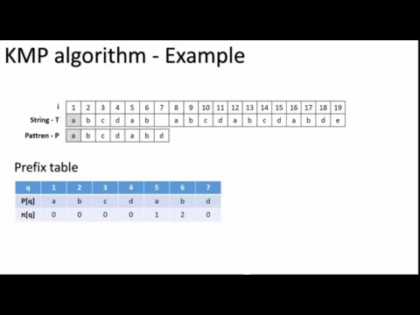
Use Knuth Morris Pratt (Kmp) Algorithm for pattern Searching
Which reduce the time complexicity of pattern searching to O(m+n)
Generally it is O(mn) for naive algorithm.

Slide 4
Use of singly linked list adt to store multiple file in command line argument and files in directory during recursive search of string.
Use of system functions like getopt , open ,close , read ,lseek ,readdir,opendir .
Use of ansi escape code sequence color to highlight the searched pattern.
Syntax: ESC[attr1 ; attr2;…… e.g. “\033[0;42m” -green background

Slide 5
Flow chart of grep
List Adt
Node
Getting Pattern flag and filenames through CLA
Highlight given pattern and print the line
fIleName
Next
Copy pattern into word and store all files in linked list and using getopt function get all flags
If pattern is found in line switched for different flag
list
While list not empty Pop one by one file .
Using Kmp Algorithm search pattern in each line of file
front
end
Open the file in read mode using function open in fcntl.h
get each line of file using ReadLine function

Slide 6
Functionalities:
-r : recursively search pattern in all file present in directory.
-o : Print only the matched parts of a matching line
-v : It prints all the lines that do not match pattern
-e exp : It specifies expression and can be used multiple times.
-f file : It takes patterns from file, one per line.
-c : It prints no. of lines that will match given pattern
-h : It displays the matched lines, but do not display filenames
-H : It displays the matched lines alongwith filenames

Slide 7
-n : It displays the matched lines alongwith line no.
-i : It ignores the case while matching
-l : It displays list of filenames only
-w : It matches the whole word from the file
-m : it will search for only specified number of matches .(stop reading files after specified matched line).
-b : it will print byte offset within input file before matched line.(number of character present before matched line).
-A : Prints searched line and n lines after the result.
-B : Prints searched line and n line before the result.
-C : Prints searched line and n lines after before the result.
By default search for string in file

Slide 8

References:
https://linuxcommand.org/lc3_man_pages/grep1.html
https://www.geeksforgeeks.org/kmp-algorithm-for-pattern-searching/
https://codeforwin.org/2018/03/c-program-to-list-all-files-in-a-directory-recursively.html
https://www.theurbanpenguin.com/4184-2/

