Slide 1
Air Traffic Control: Coordinate Mission
Grade 9 Mathematics · The coordinate plane
Notes:
Hook: ask how air traffic controllers say exactly where an aircraft is.
Today learners guide aircraft using ordered pairs.

Slide 2
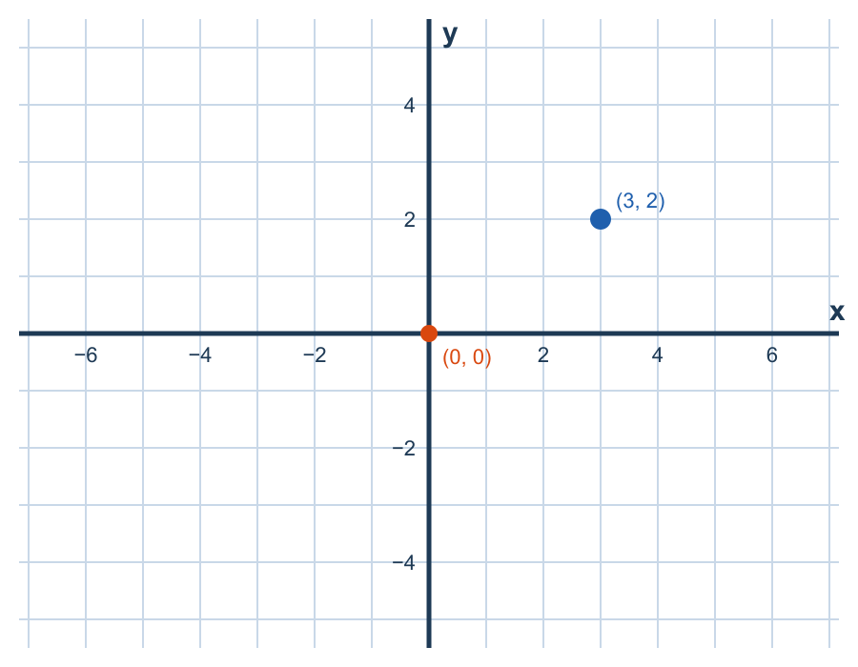
The airfield is a coordinate plane
The x-axis runs left to right.
The y-axis runs bottom to top.
The axes cross at the origin, (0, 0).
Grid lines are equally spaced on both axes.
Notes:
Draw both axes on the board. Stress equal spacing on both axes.

Slide 3
Reading an ordered pair (x, y)
x: move right (+) or left (−) from the origin.
y: move up (+) or down (−).
Always move along x first, then y.
  Example: (3, 2) means 3 right, then 2 up.
Notes:
Common mistake: swapping x and y.
Ask learners to say each move aloud before they move.

Slide 4
The four quadrants
The axes split the plane into four quadrants.
Points on an axis are not in any quadrant.
Quadrant | x | y
I | + | +
II | − | +
III | − | −
IV | + | −
Notes:
Quadrants are numbered counter-clockwise, starting at the top right.

Slide 5
Negative coordinates
(−4, −3) means 4 left, then 3 down.
The sign gives the direction; the number gives the distance.
(−4, −3) is in Quadrant III.
Notes:
Contrast (−4, −3) with (4, 3) on the grid.

Slide 6
Teacher answer key
Runway Alpha: (3, 2)
Hangar: (−4, −3)
Practice target: (3, −2)
Notes:
Hidden slide — not shown to learners.

Slide 7

Tower to runway: plotting steps
1. Start at the origin.
2. Move along the x-axis.
3. Move parallel to the y-axis.
4. Confirm the position with the tower.
TOWER
RUNWAY
Notes:
Model each step with flight NX7 before learners try.

Slide 8
Extension: distance between two aircraft
Optional for fast finishers.
$$d=\sqrt{{\left(x_{2}−x_{1}\right)}^{2}+{\left(y_{2}−y_{1}\right)}^{2}}$$
Notes:
Extension only; not required for the mission.

Slide 9
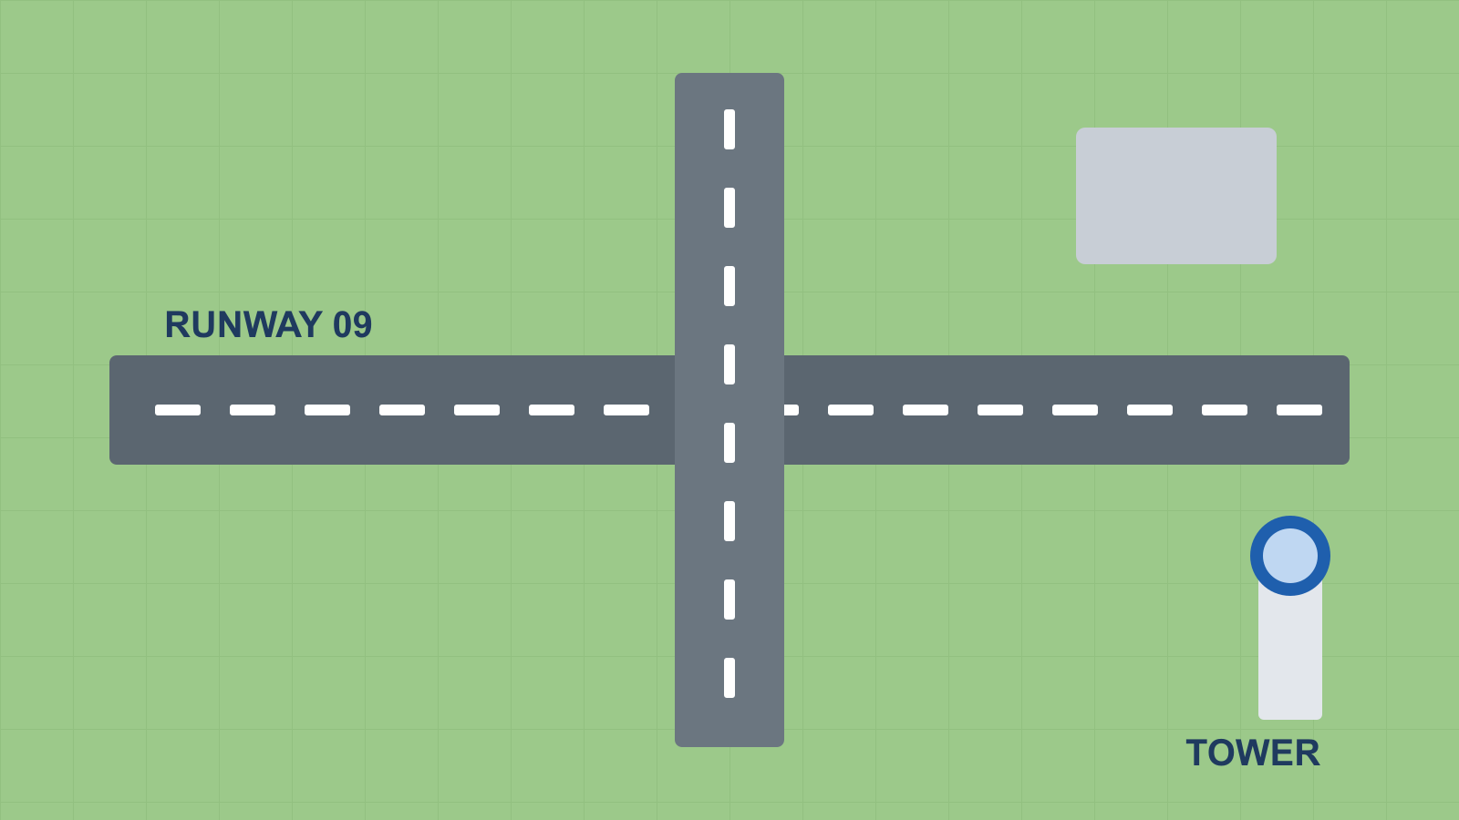
Mission practice
Guide flight NX7 to runway (3, −2).
Park a plane anywhere in Quadrant II.
Line up aircraft by x-coordinate, left to right.
Notes:
Use the game to practise; discuss errors as a class.

