Slide 1
Trapezium Quest
Grade 8 Mathematics · Quadrilaterals (sample lesson)
Notes:
Sample lesson bundled with NEXUS Play Studio.
Hook: Swiftee the arctic bird needs help sorting ice floes by shape.

Slide 2
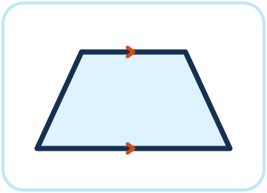
What is a trapezium?
A trapezium is a quadrilateral with at least one pair of parallel sides.
The parallel sides are called the bases.
The other two sides are called the legs.
With this definition, every parallelogram is also a trapezium.
Notes:
We use the inclusive definition (at least one pair), as in our textbook.
Some books use “exactly one pair” — mention it, but keep our definition.

Slide 3
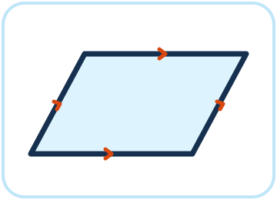
Spot the parallel sides
Parallel sides never meet, however far they are extended.
Arrow marks on a diagram show which sides are parallel.
Check each shape: does it have at least one pair of parallel sides?
Notes:
Guided identification: model one shape, then let learners try.
Common mistake: thinking a kite has parallel sides.

Slide 4
Trapezium or not?
Count the pairs of parallel sides.
Shape | Pairs of parallel sides | Trapezium?
Trapezium | 1 | Yes
Right trapezium | 1 | Yes
Parallelogram | 2 | Yes
Kite | 0 | No
Notes:
Answer rule: a shape is a trapezium if it has at least one pair of parallel sides.

Slide 5
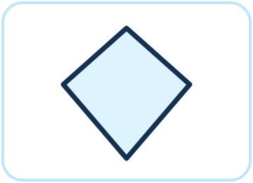
Match the shapes
Match each shape to its name: trapezium, parallelogram, kite.
Use the parallel sides to decide.
Notes:
Matching practice for the game.

Slide 6
Teacher answer key
Trapezium → trapezium
Parallelogram → parallelogram (also a trapezium)
Kite → kite (not a trapezium)
Notes:
Hidden slide — not shown to learners.

Slide 7
Expedition complete
A trapezium has at least one pair of parallel sides.
You can spot parallel sides and name trapeziums, parallelograms and kites.
Notes:
Exit ticket: draw a trapezium that is not a parallelogram.

