Slide 1


Introduction
Smart Device Usage Analysis for Bellabeat

Slide 2


How can a wellness company play it smart?
Welcome to the analysis of smart device usage data for Bellabeat! In this presentation, we'll explore insights from FitBit Fitness Tracker Data to understand how consumers use non-Bellabeat smart devices and how these insights can shape Bellabeat's marketing strategy.

Slide 3
Business Task and Data Sources:
Business Task
Data Sources
Analyze smart device usage data to gain insights into consumer behavior and inform Bellabeat's marketing strategy.
FitBit Fitness Tracker Data (CC0: Public Domain) and potentially additional data sources.

Slide 4
Data Preparation
Data Organization
Data Cleaning
The FitBit Fitness Tracker Data contains minute-level output for physical activity, heart rate, and sleep monitoring.
Ensured data integrity and addressed any issues with bias, credibility, privacy, security, and accessibility.

Slide 5
Data Analysis
Analysis Process:
Aggregated and organized the data for effective analysis.
Key Insights:
Trends in smart device, including activity levels, sleep patterns, and heart rate.
Relationships between different metrics, such as activity and sleep duration.

Slide 6
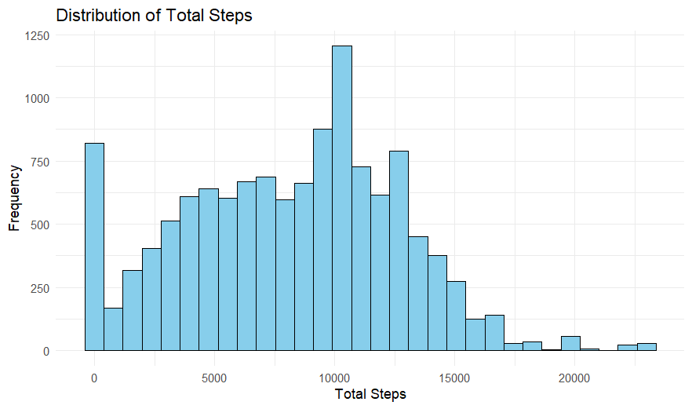

Slide 7
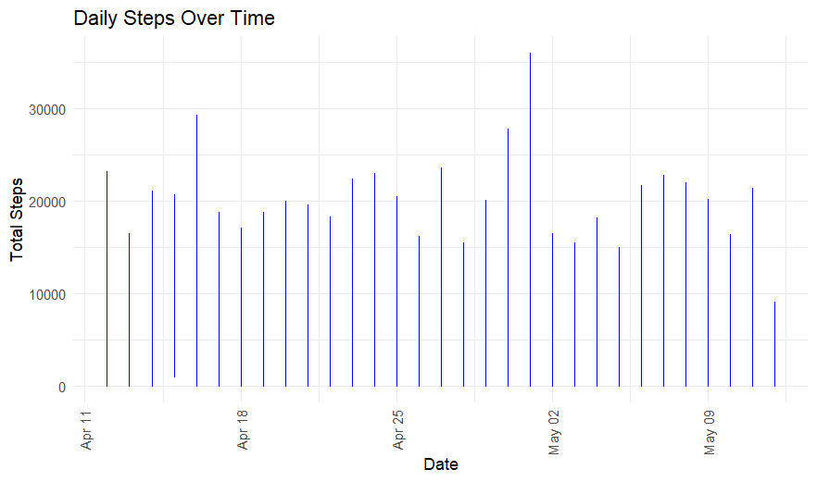

Slide 8
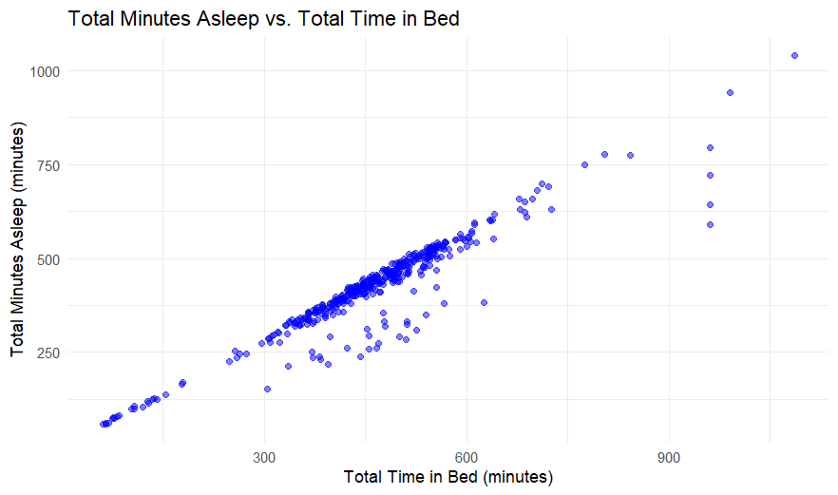

Slide 9
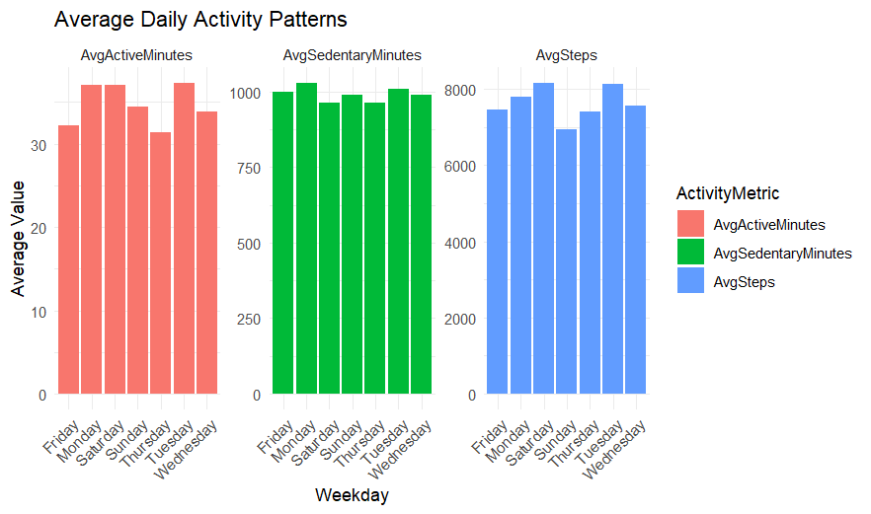

Slide 10
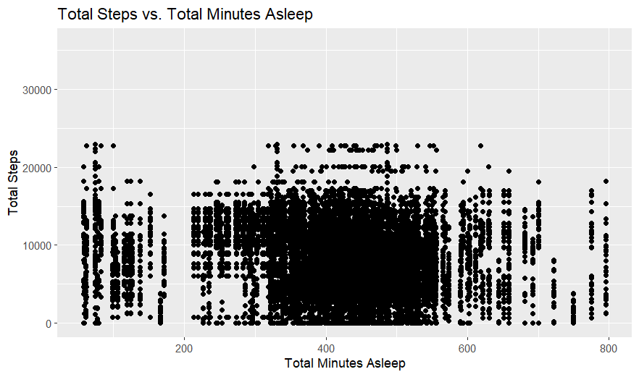

Slide 11
High-Level Recommendations
Tailored Marketing Strategies
Product Development
Targeted Advertising
Personalize marketing efforts based on identified trends in smart device usage.
Incorporate features that align with consumer preferences and behavior.
Optimize digital marketing campaigns to reach potential customers effectively.

Slide 12
Conclusion
Next Steps:
Implement recommended strategies based on analysis findings.
Continuously monitor smart device usage data to refine marketing strategies and drive business growth.
By analyzing smart device usage data, we've gained valuable insights into consumer behavior that can inform Bellabeat's marketing strategy. Leveraging these insights, Bellabeat can better understand its target audience and tailor its products and marketing efforts accordingly.

Slide 13
Thank you for your attention. Q&A: Feel free to ask any questions.
Email: ca26072000@gmail.com
LinkedIn: https://www.linkedin.com/in/aniketchhaikuria/
Website: https://github.com/aniketchhaikuria

