Slide 1


YO’I’O
You only Invest Once
Recommend stocks by analyzing Reddit’s content and topic modelling (BERT)
Unstructured Data Analytics Project | Fall 2022
McCombs School of Business, UT Austin
Kavya Angara
Prathmesh Savale
Pratik Gawli
Rajshree Mishra
Aniket Patil

Slide 2
Why content analysis matters while recommending stocks ?
Financial analyst working at a YO’I’O investment company
Importance of understanding people’s sentiments about the market along with company performance necessary
Recently becoming an important factor in deciding upon which stocks should the investment company track
Ultimately decide whether one should buy a particular stock/stocks from a particular industry to maximize the profits.
Wallstreetbets on Reddit is one of the many public forums where people discuss such recent market trends and express their sentiments about them
Notes:
With more and more discussions happening online and people discussing more and more stocks,

Slide 3
Road Map
Scraping data from Reddit
Topic Modelling
Sentiment Analysis
S
Recommend Stocks
Notes:
With more and more discussions happening online and people discussing more and more stocks,

Slide 4
Data Source
For Topic Modelling
Scraped ~500k comments & posts from the subreddit r/Wallstreetbets
Date range: Sept 1, 2022 to Sept 30, 2022
For Sentiment Analysis
Scrape data to get top stock tickers from Sept 1, 2022 to Sept 30, 2022
Scrape data for only those top tickers to perform sentiment analysis
Stock Simulator - Retrospect
Scraped Yahoo finance for actual monthly closing prices

Slide 5
Pre-processing Steps
For Topic Modelling
Remove comments with less than 10 words to ensure only opinions are well-explained
Only keep content with more than 5 upvotes to weed out irrelevant content
Remove outlier topics (taken care by BERT)
For Sentiment Analysis
Assign sentiment score on lexicons we got from topic modelling
+2 for positive sentiment & -10 for negative sentiment
Stock Simulator - Retrospect
Perform sentiment analysis on top 10 tickers in windows of 90, 60 and 30 days and
Get actual data from yahoo finance for the same top 10 tickers to compare our recommendations

Slide 6
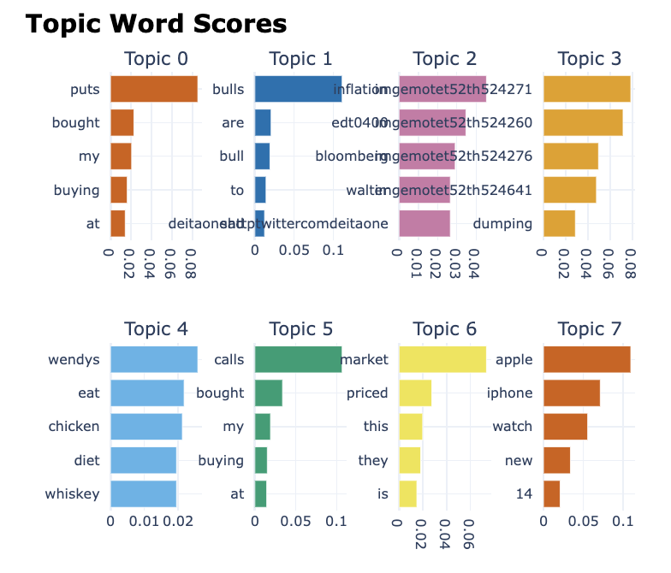
Topic Modelling | Analysis & Results
We have used BERTtopic for topic modelling
to understand the context of the market.
The top 5 topics based on the forum data are:
Buying puts
SPY down
Bulls are sad
Inflation
Money Trading
This is as expected because from 1st September to 30th September the market (S&P 500 index) has gone down from 3966.85 to 3585.62.
Notes:
buying puts -> betting against the market
spy down -> S&P down

Slide 7
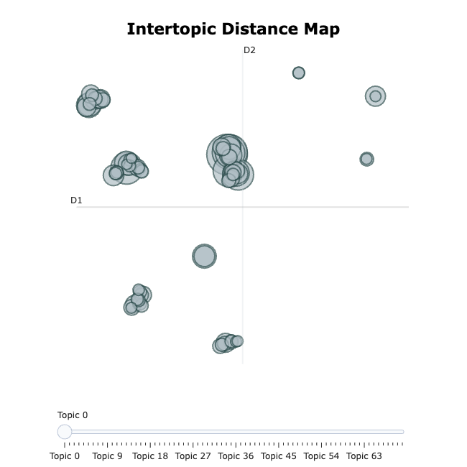
Topic Modelling | Analysis & Results
Could topics like Wendy’s to earn money, queen’s demise, divorces & girlfriend be related to the main topic of discussion about stocks?
Central cluster (largest cluster) includes most of the major topics relating to discussions about the market going down
The second largest cluster (to the left of the central cluster) includes topics about union strikes, which could be triggered by inflation, a main cause of the market falling

Slide 8
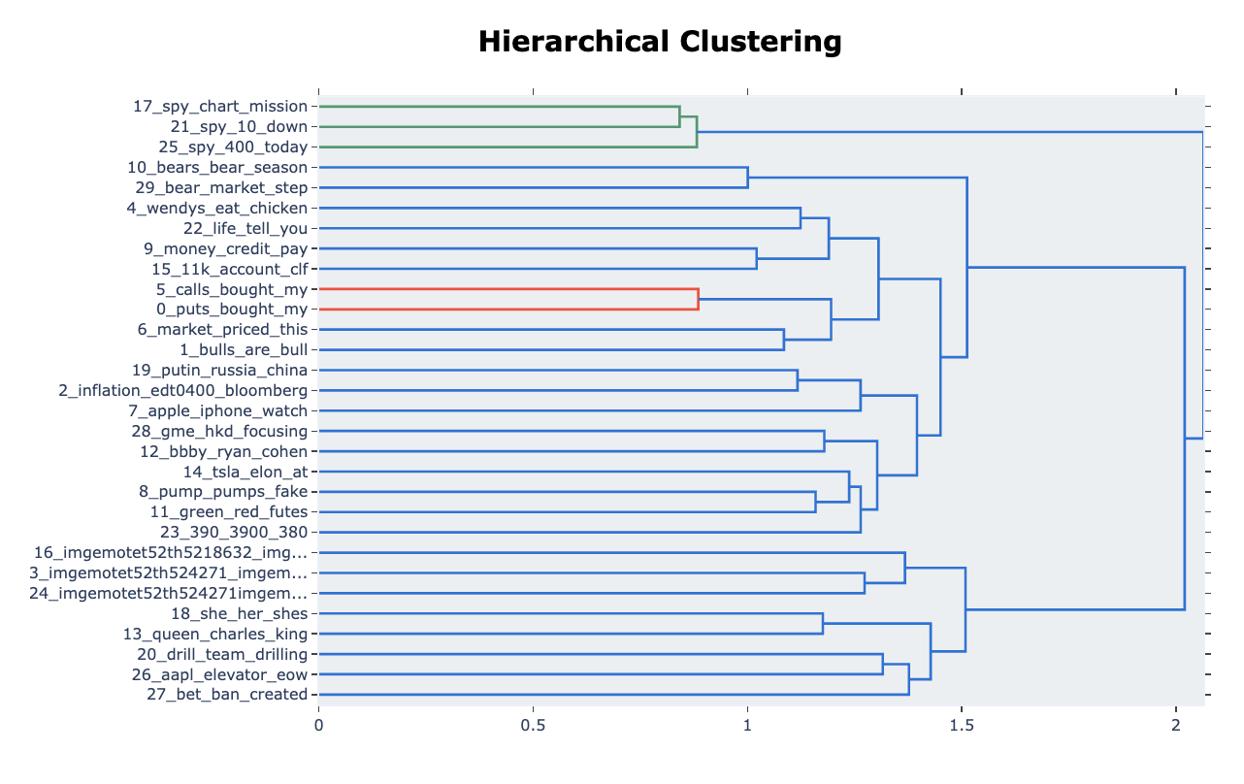
–
Topic Modelling | Analysis & Results

Slide 9
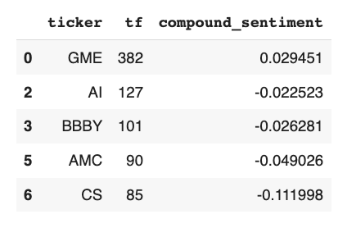
Sentiment Analysis | Analysis & Results
modified rules for VADER:
Topic modelling tells us that there is a strong negative sentiment in the market, people talk about buying puts, inflation, working at Wendys, filing for divorces and leaving their girlfriends
We capture this sentiment by adding lexicons for the WSB specific slang terms in vader, weighting negative words more than positive
Sentiment analysis is run for the most frequently discussed stocks
Word | Assigned Score
tendies | 2
bull | 2
calls | 2
moon | 2
btfd | 2
bear | -10
short | -10
sell | -10
puts | -10
going t*** up | -10
Results/Scores for the 5 most discussed tickers:

Slide 10
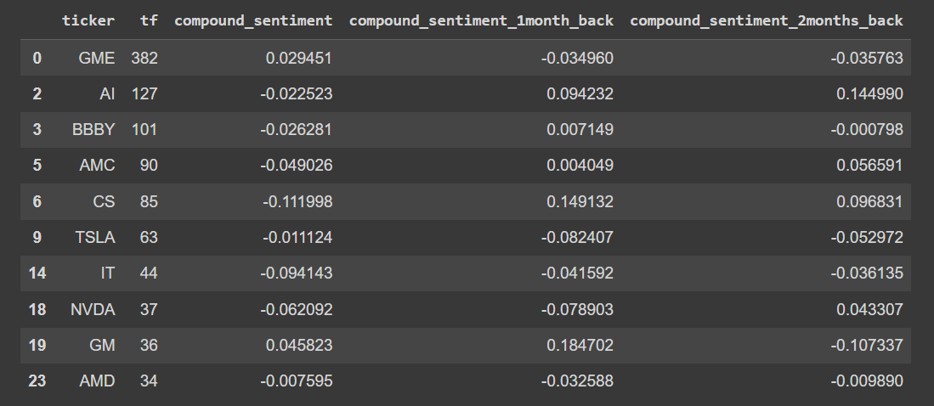
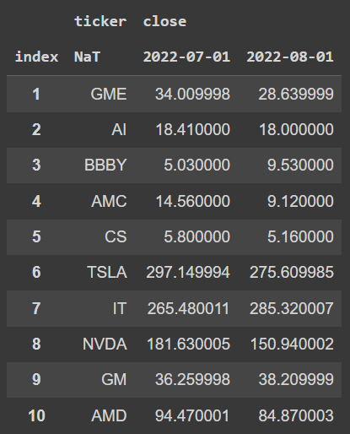
Recommendations and Stock Simulator – Retrospective
Compound Sentiment Score from VADER
Monthly closing prices (Yahoo Finance)

Slide 11
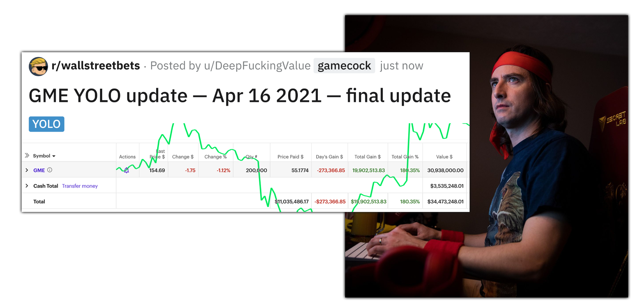
Thank You -
Diamond Hands Forever

