Slide 1
PreLearningApp
TEAM MEMBERS:
KIRAN BS (M1064186),
TAPAN BEHERA (M1064210),
ANIKET DHANAWADE (M1064349),
PAVAN KUMAR (M1064299),
SAI HARSHA VARDHAN BOKAM(M1064236),
SURAJKUMAR LOCHAR(M1064384),
RAMYA (M1064228)

Slide 2
Requirements
User Authentication
Access Study Materials and Resources
Practice and assess programming concepts
Post doubts
Resolve doubts
User Profile
Share and Care page for motivation

Slide 3
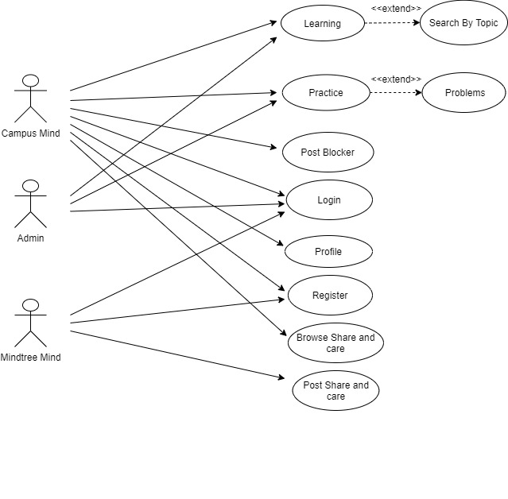
Use case diagram

Slide 4
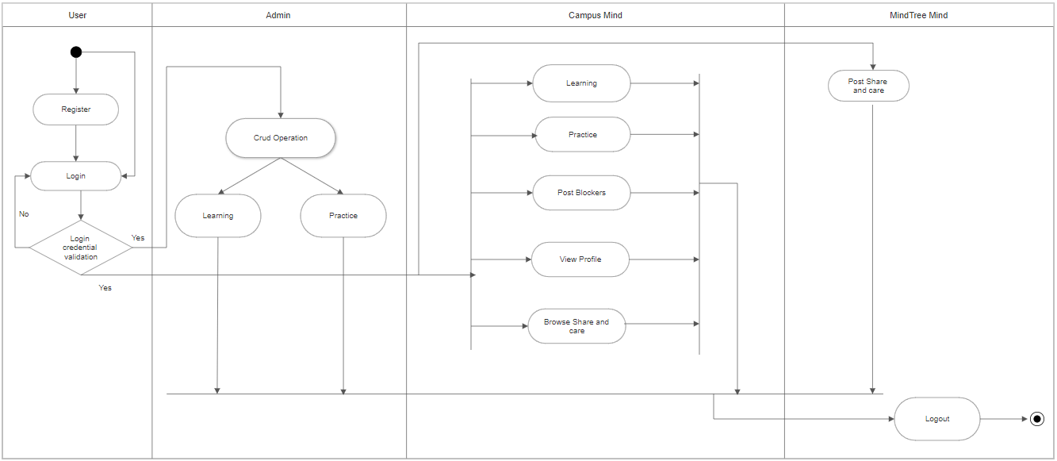
Activity Diagram

Slide 5
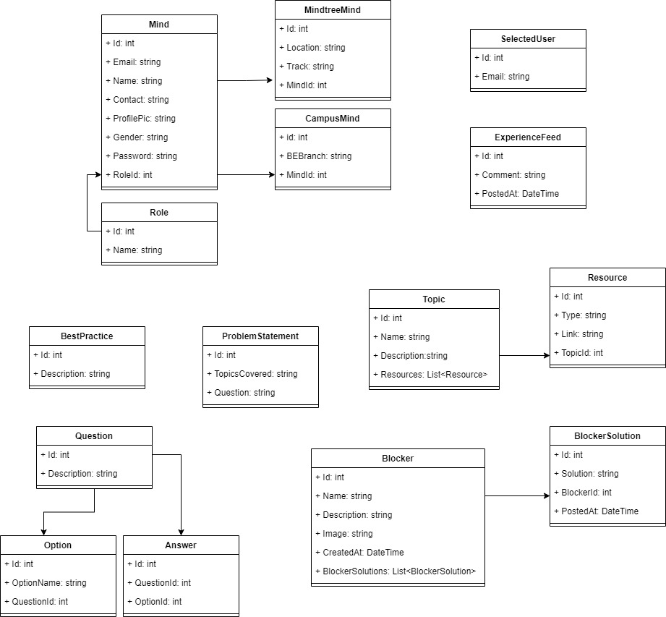
Class Diagram

Slide 6
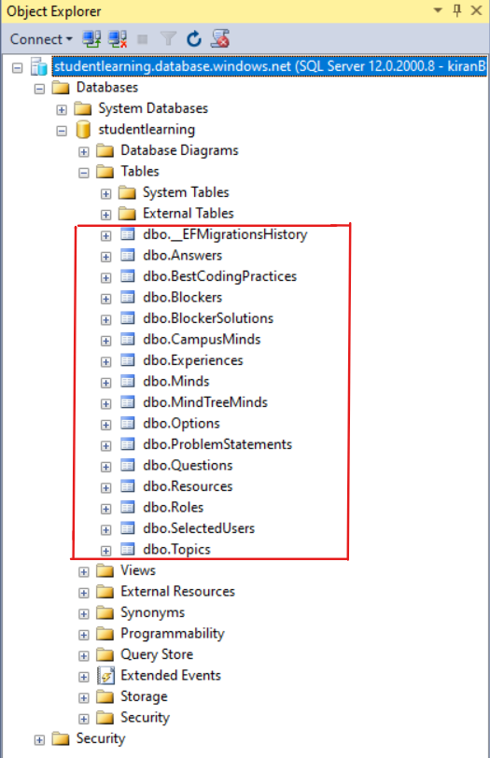
Database

Slide 7
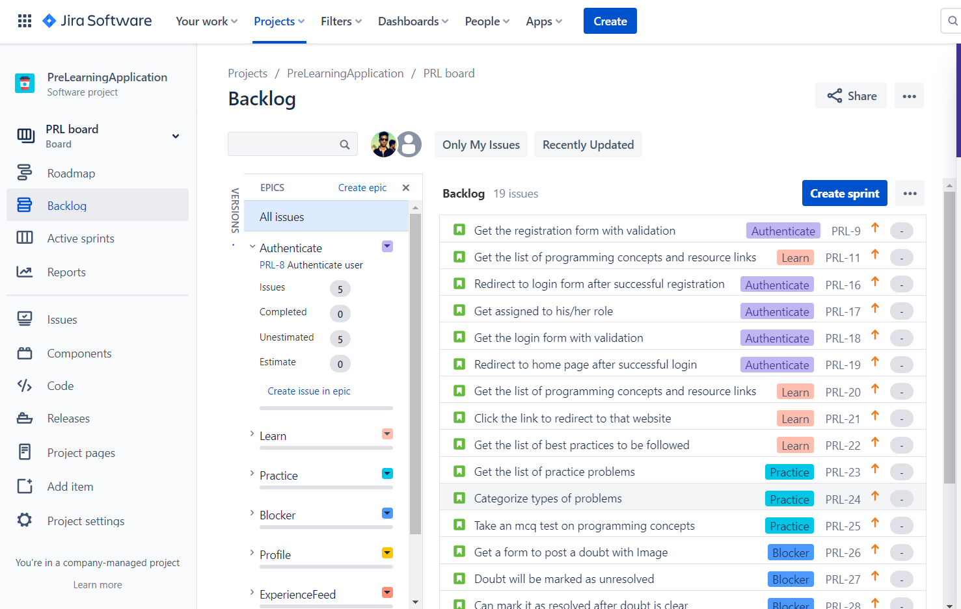
Backlog

Slide 8
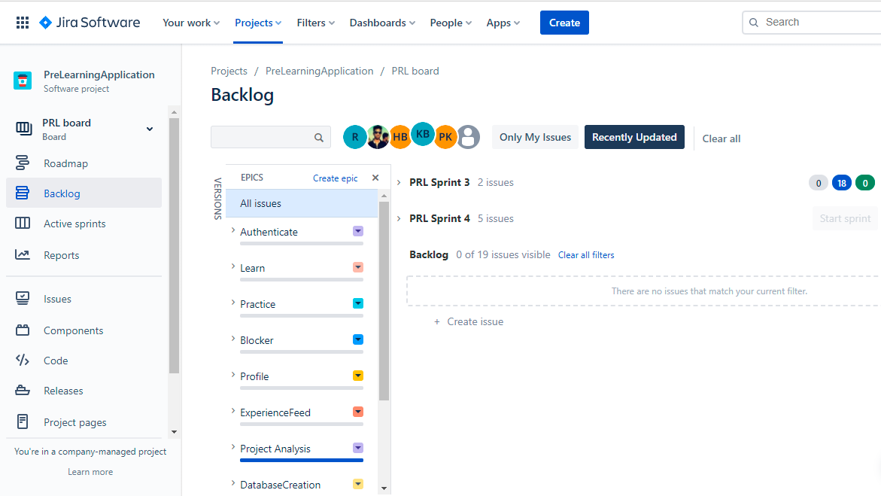
Epics

Slide 9
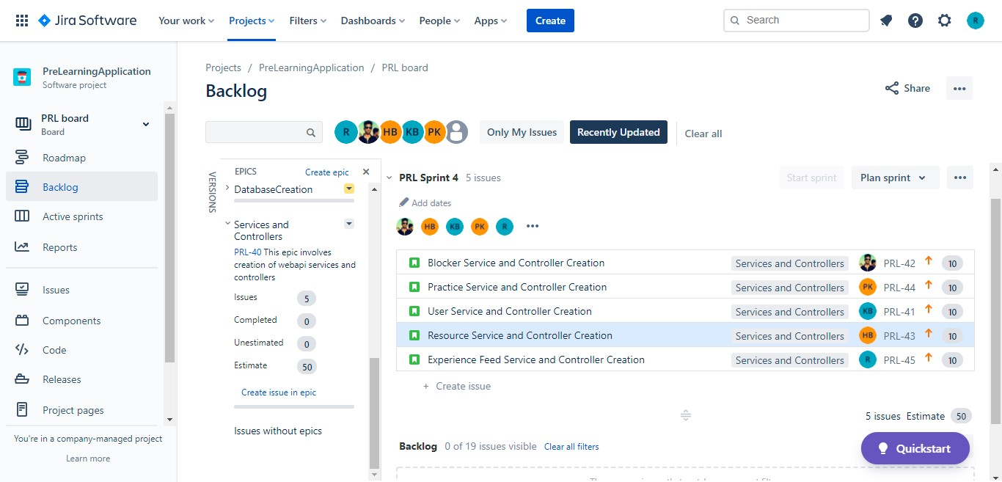
Sprint

Slide 10
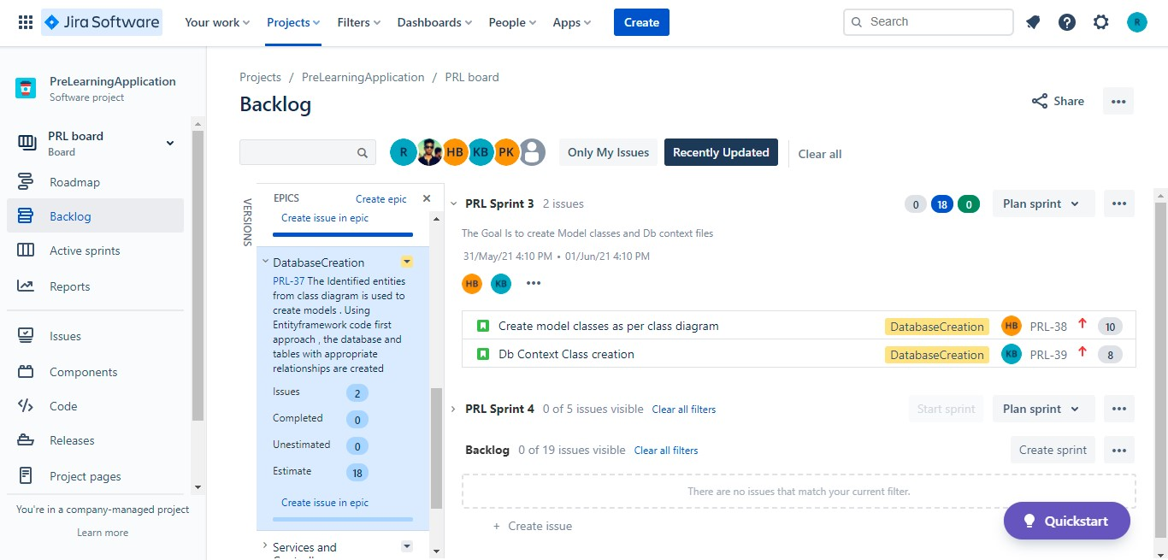
Sprint

Slide 11
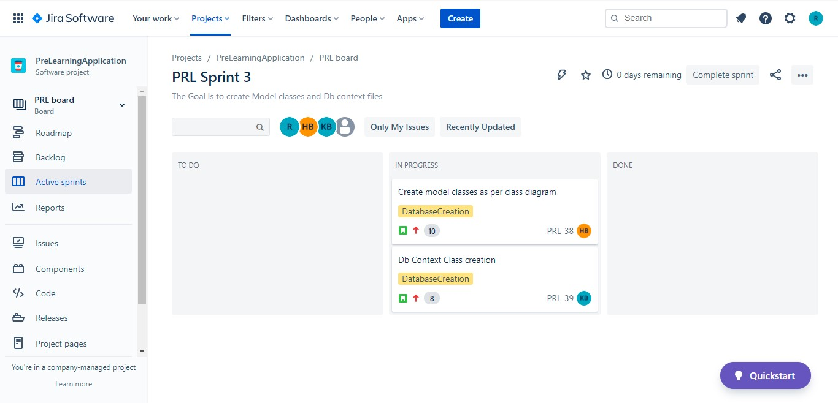
Active Sprints

Slide 12
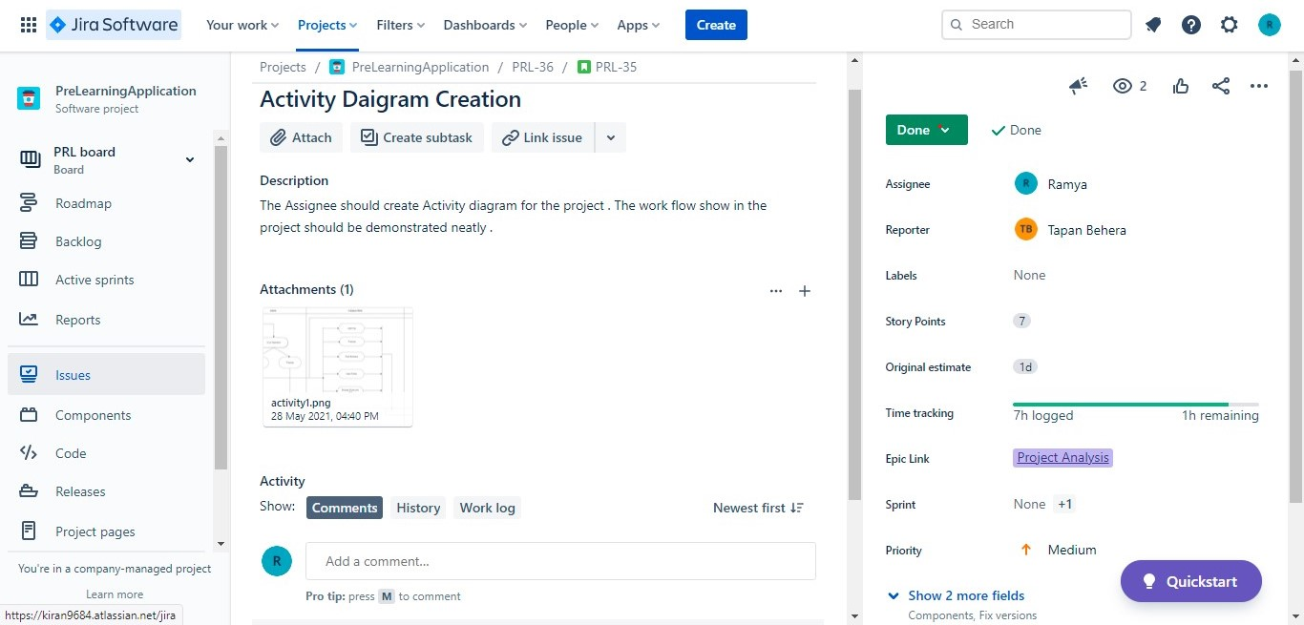
Issues

Slide 13
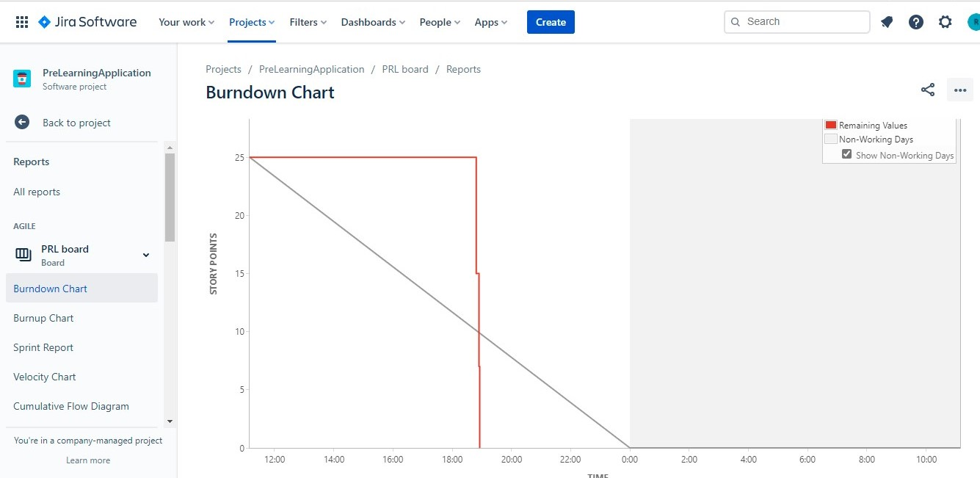
Burndown Chart

Slide 14
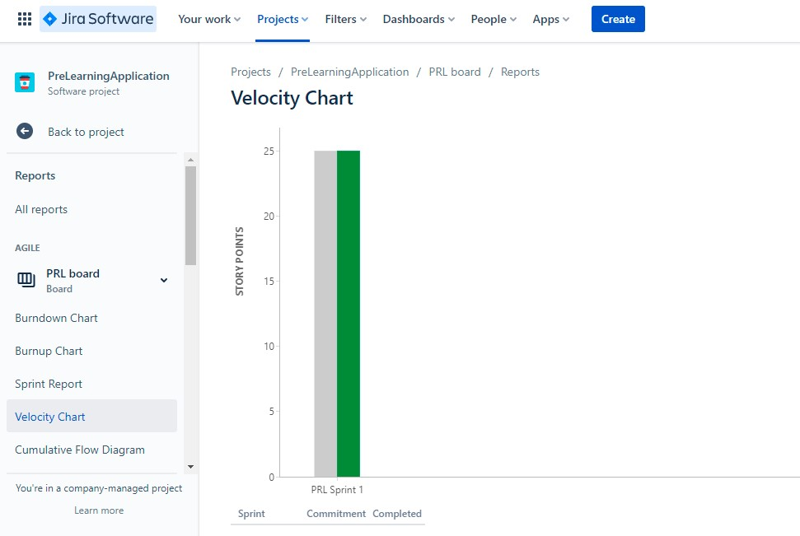
Velocity Chart

Slide 15
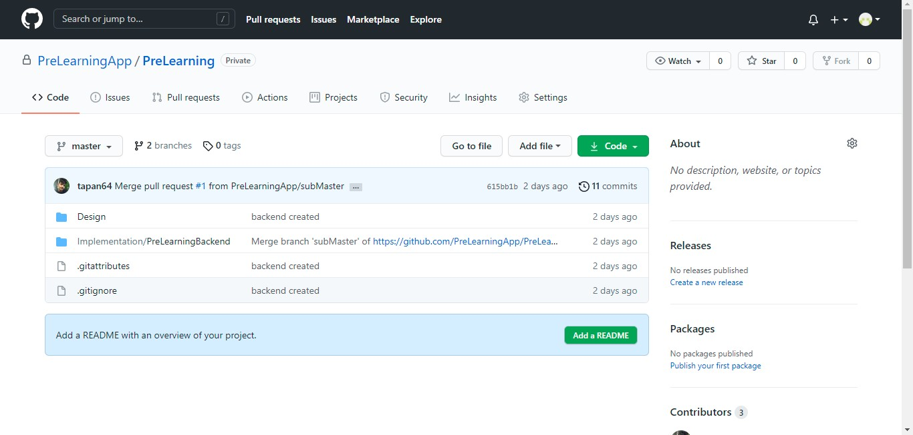
GIT Repository

Slide 16
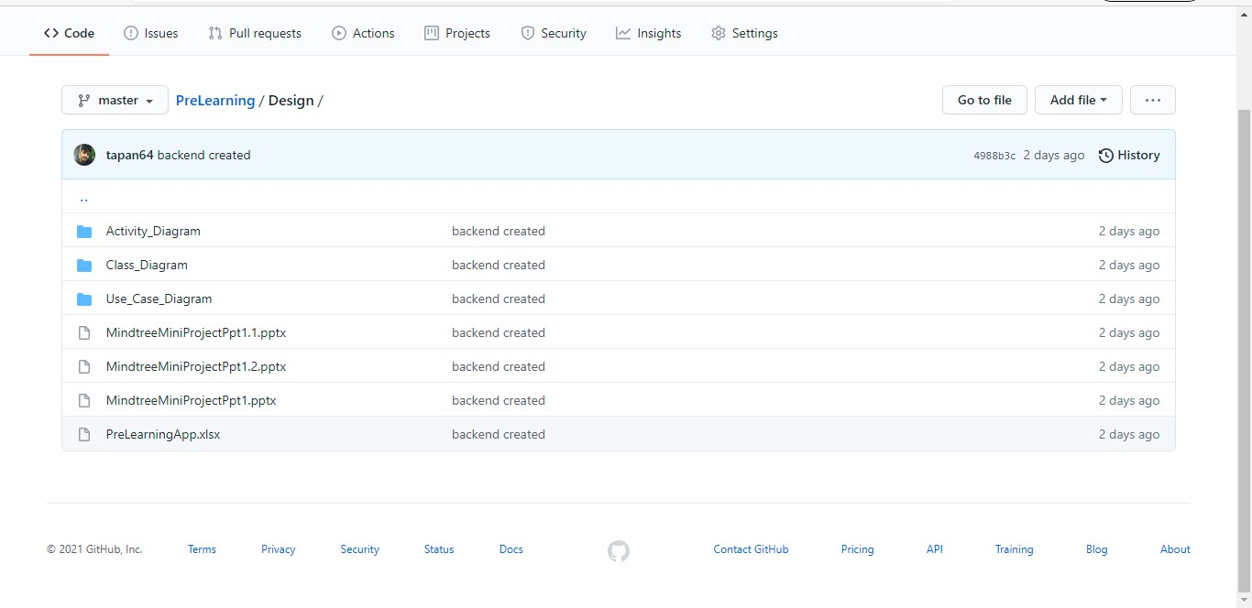
GIT Repository

Slide 17
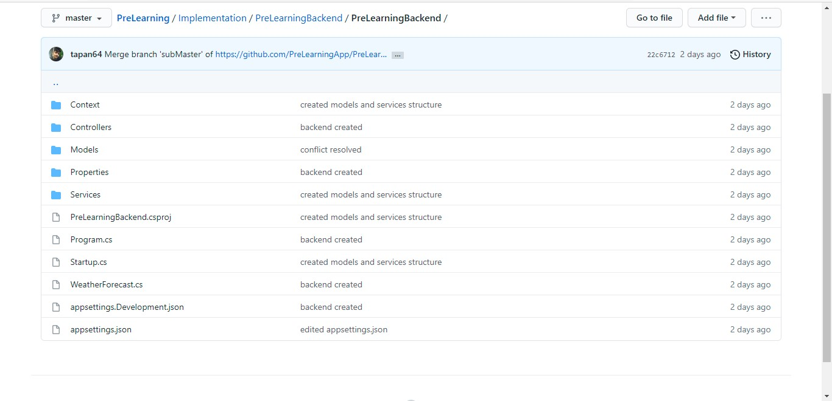
GIT Repository

Slide 18
THANK YOU

