Slide 1
PreLearningApp
TEAM MEMBERS:
KIRAN BS (M1064186),
TAPAN BEHERA (M1064210),
ANIKET DHANAWADE (M1064349),
PAVAN KUMAR (M1064299),
SAI HARSHA VARDHAN BOKAM(M1064236),
SURAJKUMAR LOCHAR(M1064384),
RAMYA (M1064228)

Slide 2
Requirements
User Authentication
Access Study Materials and Resources
Practice and assess programming concepts
Post doubts
Resolve doubts
User Profile
Share and Care page for motivation

Slide 3
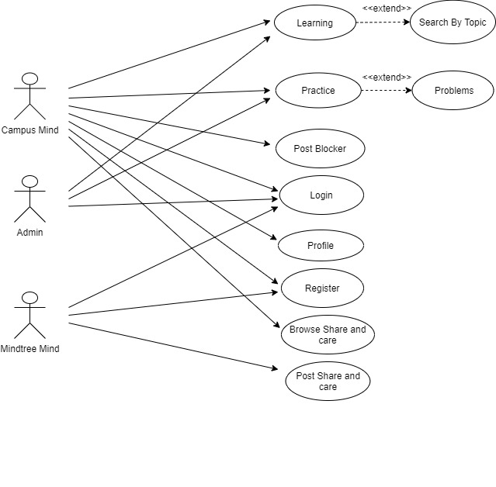
Use case diagram

Slide 4
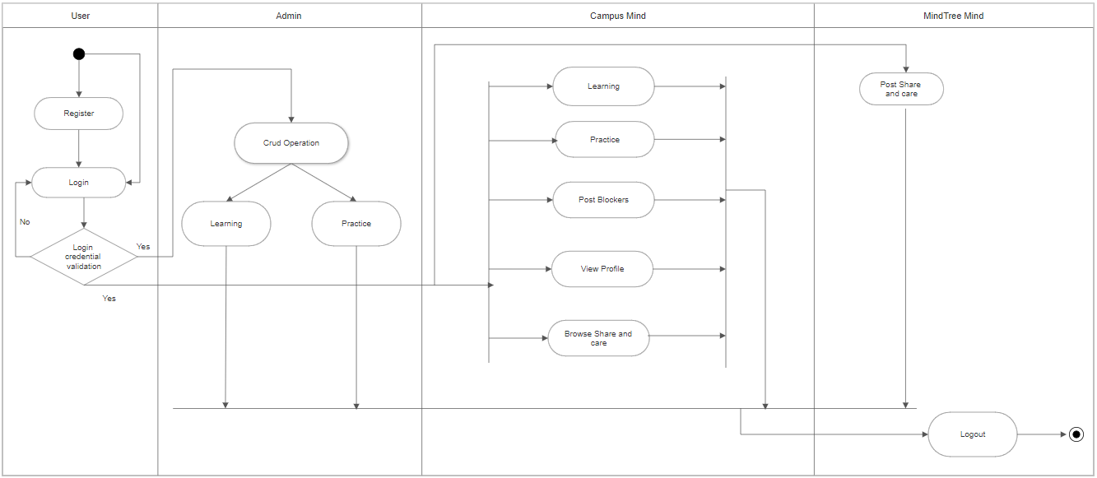
Activity Diagram

Slide 5
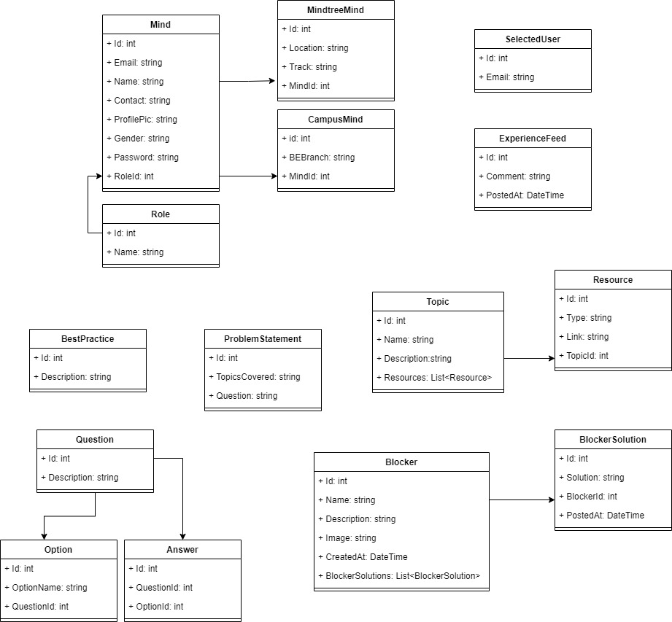
Class Diagram

Slide 6
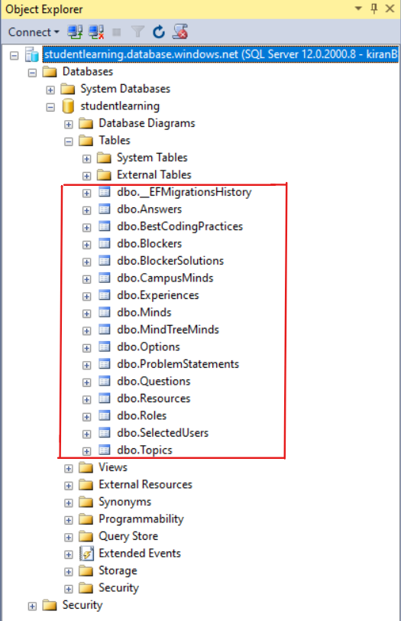
Database

Slide 7
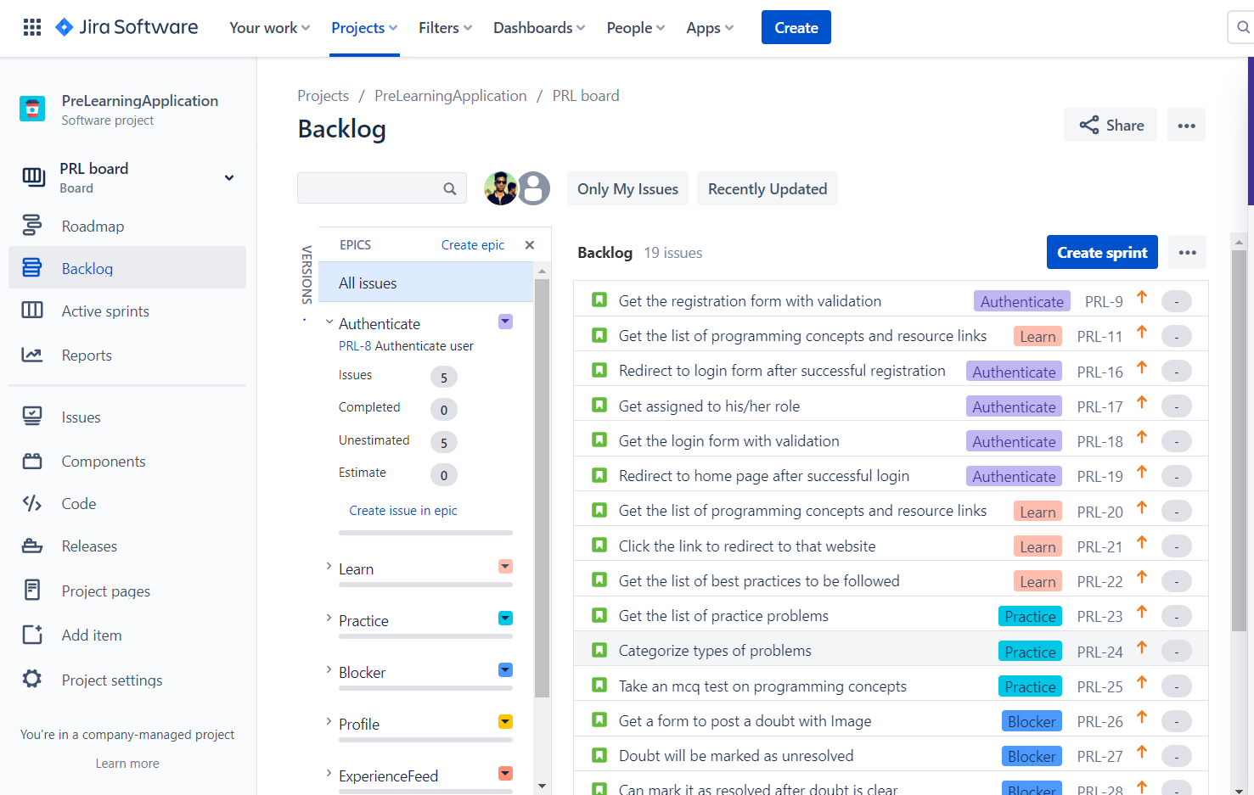
Jira

Slide 8
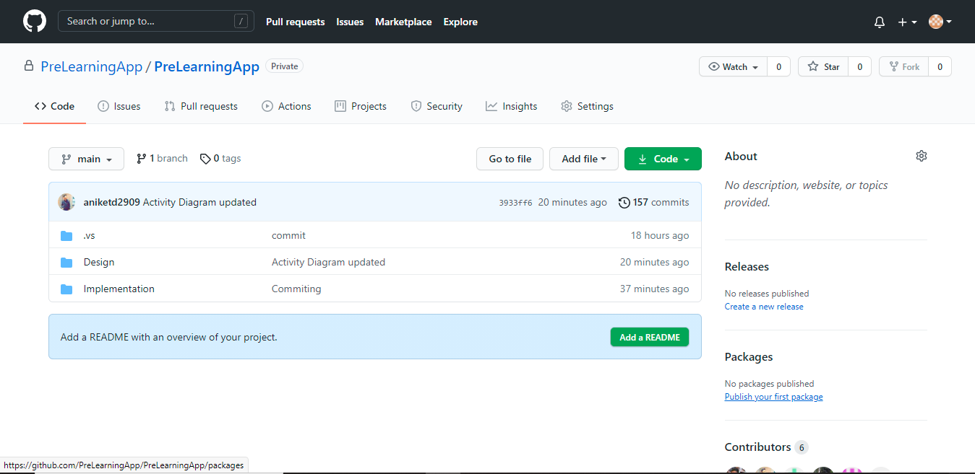
GIT Repository

Slide 9
THANK YOU

