Slide 1
PreLearningApp
Team members:
KIRAN BS (M1064186),
TAPAN BEHERA (M1064210),
ANIKET DHANAWADE (M1064349),
pavan KUMAR (m1064299),
SAI HARSHA VARDHAN BOKAM(M1064236),
SURAJKUMAR LOCHAR(M1064384),
Ramya (M1064228)

Slide 2
Requirements:
As a User I Should Authenticate Myself
As a User I should Access Study Materials and Resources
As a User I should practice and assess my programming concepts
As a User I should able to post my doubts
As a User I should able to resolve other doubts
As a User I should access my profile
As a User I should see previous batch people experiences and tips for motivation

Slide 3
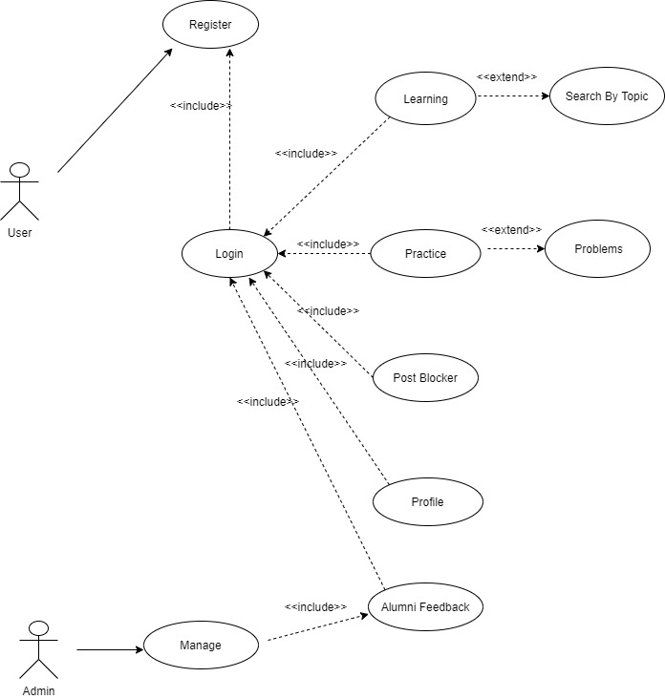
Use case diagram:

