Slide 1
PreLearningApp
TEAM MEMBERS:
KIRAN BS (M1064186),
TAPAN BEHERA (M1064210),
ANIKET DHANAWADE (M1064349),
PAVAN KUMAR (M1064299),
SAI HARSHA VARDHAN BOKAM(M1064236),
SURAJKUMAR LOCHAR(M1064384),
RAMYA (M1064228)

Slide 2
Requirements
User Authentication
Access Study Materials and Resources
Practice and assess programming concepts
Post doubts
Resolve doubts
User Profile
Share and Care page for motivation

Slide 3
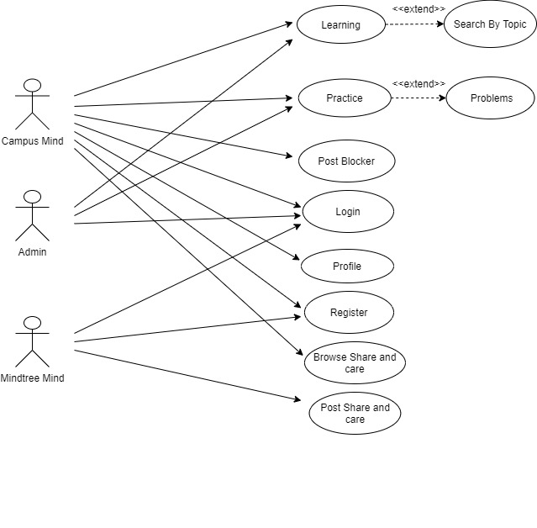
Use case diagram

Slide 4
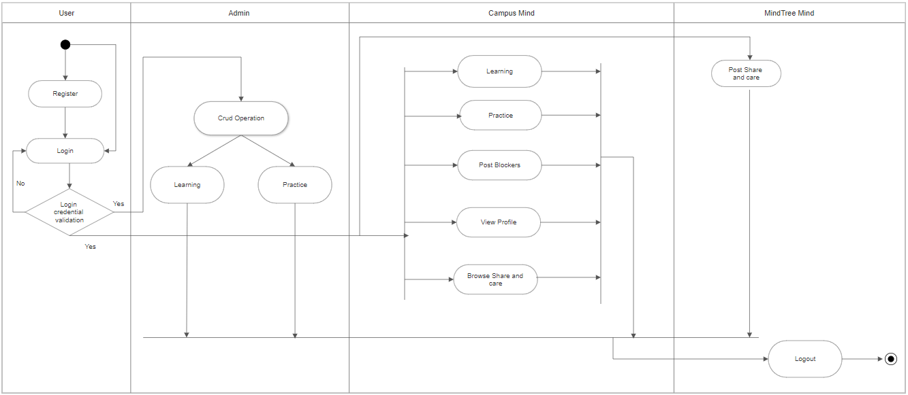
Activity Diagram

Slide 5
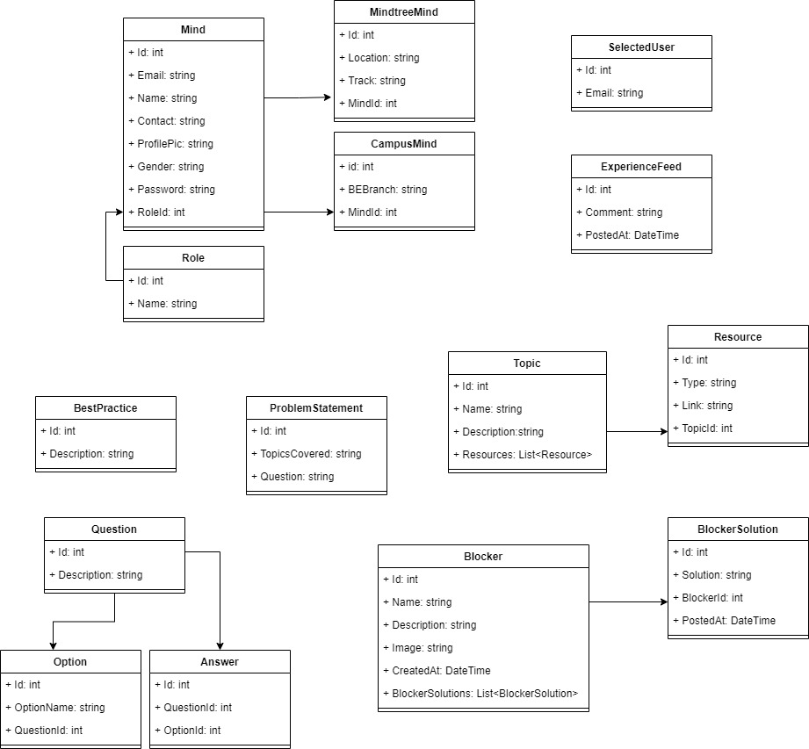
Class Diagram

Slide 6
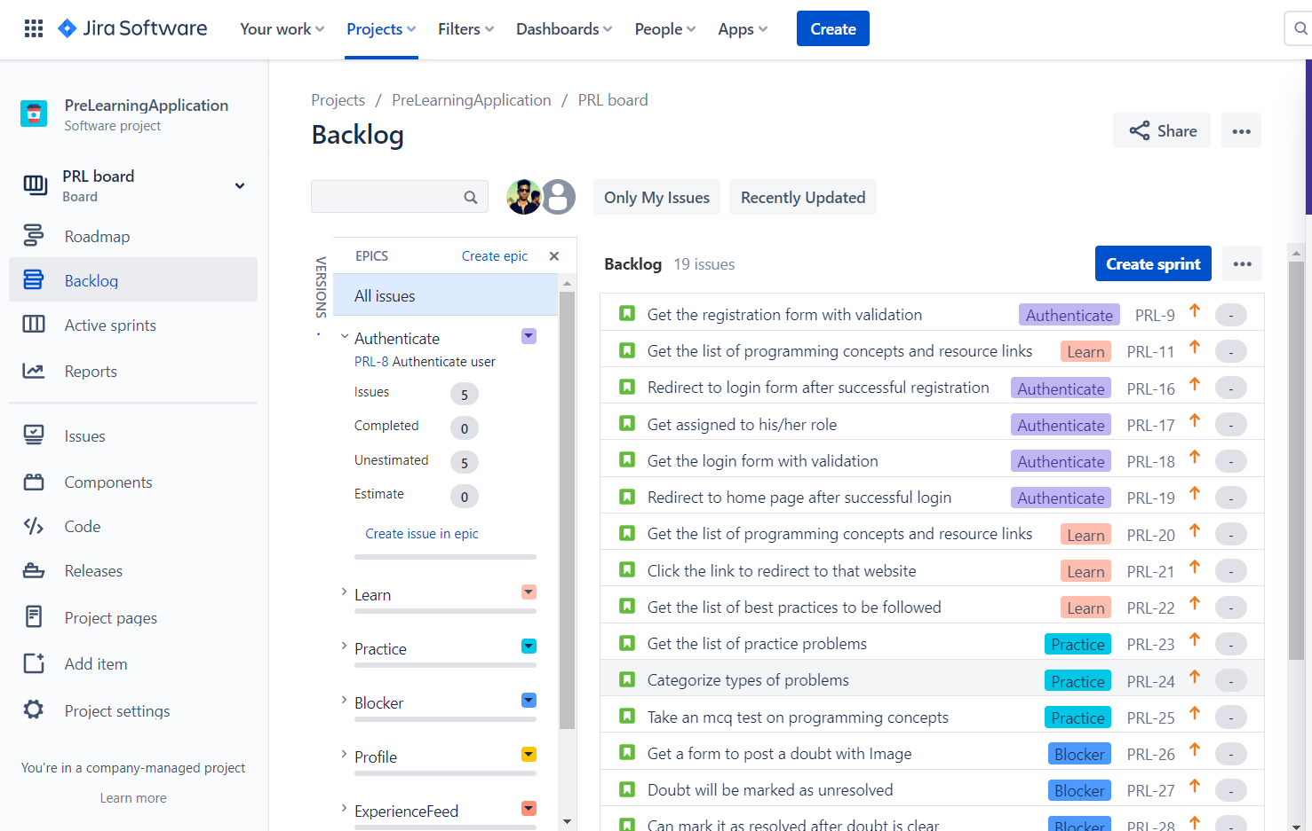
Backlog

Slide 7
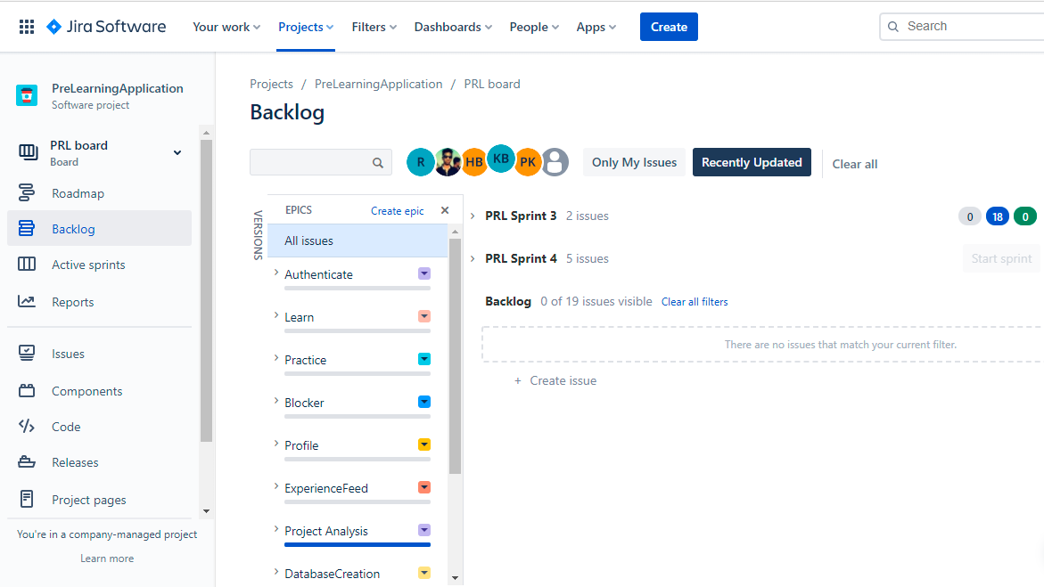
Epics

Slide 8
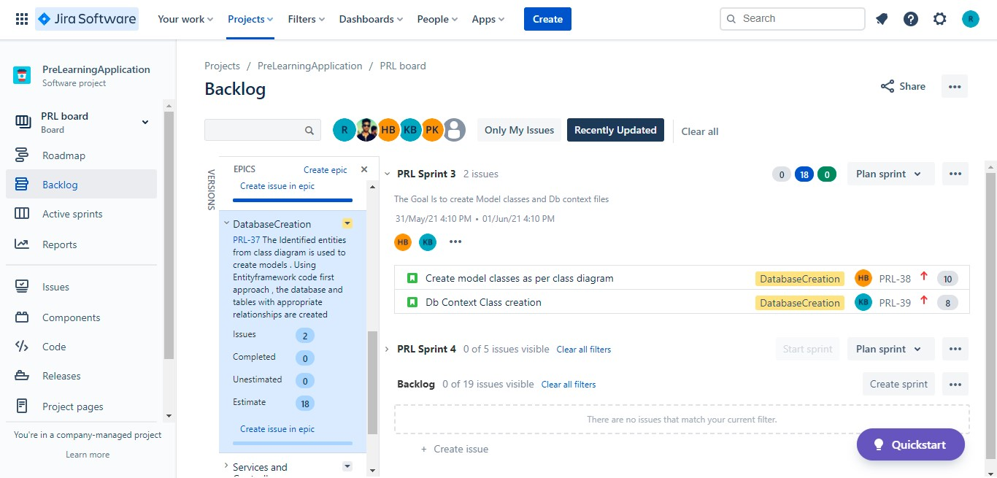
Sprint

Slide 9
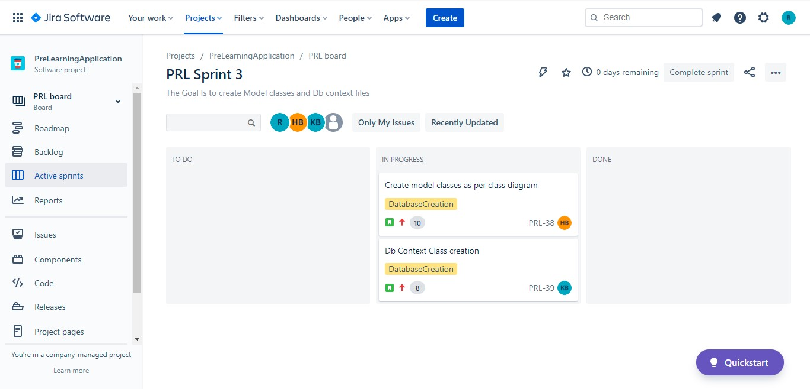
Active Sprints

Slide 10
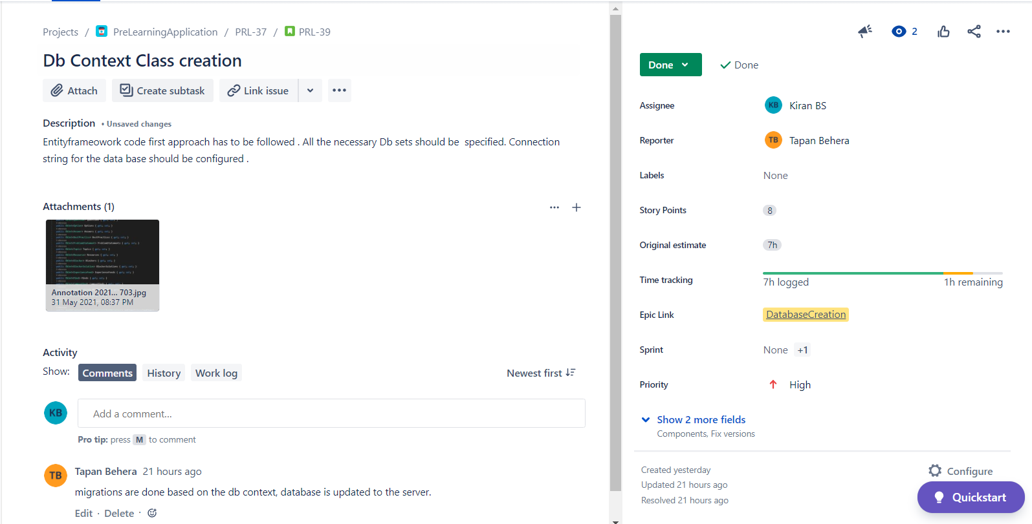
Issues

Slide 11
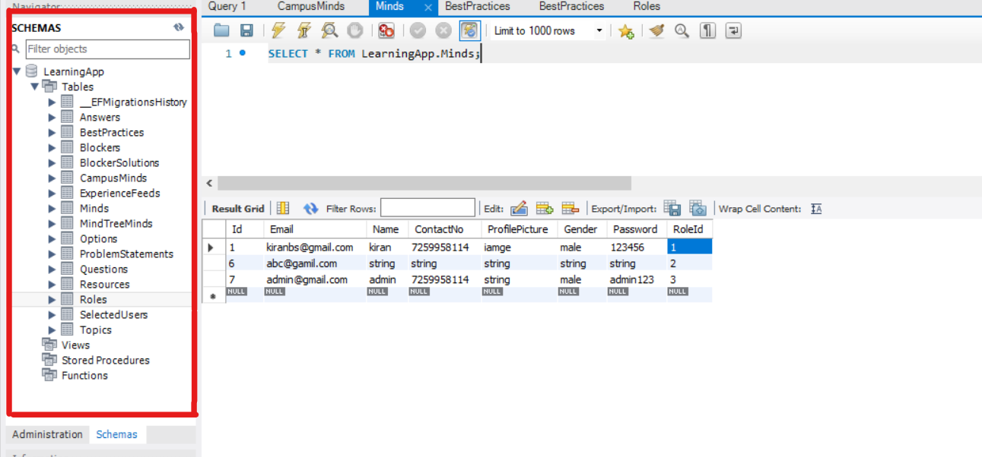
Database

Slide 12
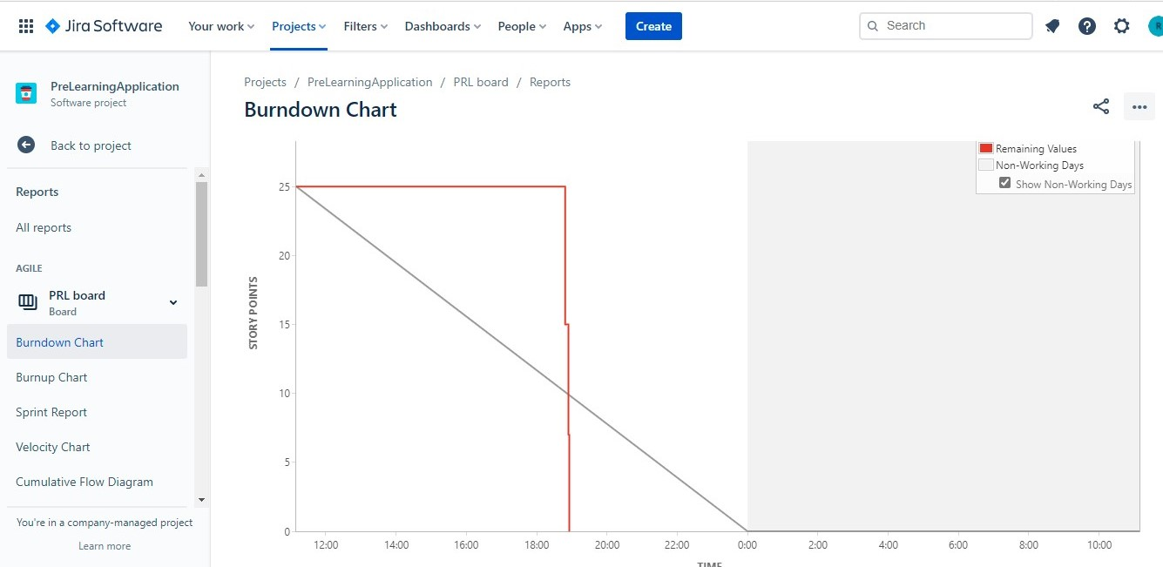
Burndown Chart

Slide 13
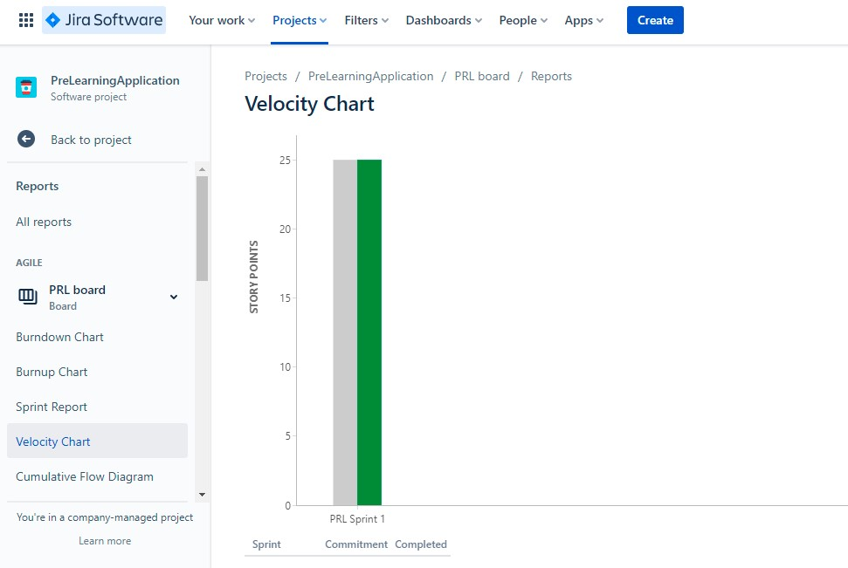
Velocity Chart

Slide 14
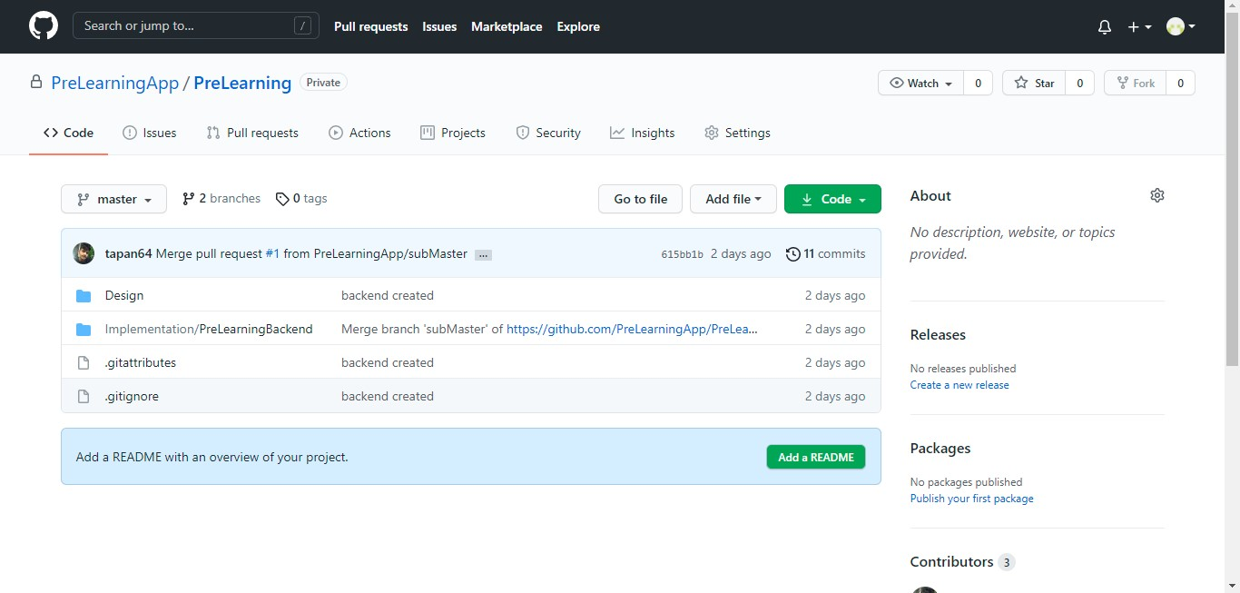
GIT Repository

Slide 15
THANK YOU

