Slide 1

TEAM MEMBERS
KIRAN BS (M1064186)
TAPAN BEHERA (M1064210)
ANIKET DHANAWADE (M1064349)
PAVAN KUMAR (M1064299)
SAI HARSHA VARDHAN BOKAM(M1064236)
SURAJKUMAR LOCHAR(M1064384)
RAMYA (M1064228)

Slide 2
Objective
The Main Objective of the project is to give enhanced preLearning experience to the MindTree joiner’s prior to date of joining

Slide 3
Requirements
Register And Login
Resource Management
Learn And Practise
Doubt Management
Experience Sharing

Slide 4
Use case diagram
Use Cases are typically used to describe the typically visible interactions that the system will have with users and external systems.
In our project we have three user action as Admin, Mindtree mind and User
The Admin can add the resource and post questions
The User can view resources, attempt assessments, Post doubts and view Mindtree mind Feedback
The Mindtree Mind can add their valuable feedback about their experience in Orchard

Slide 5
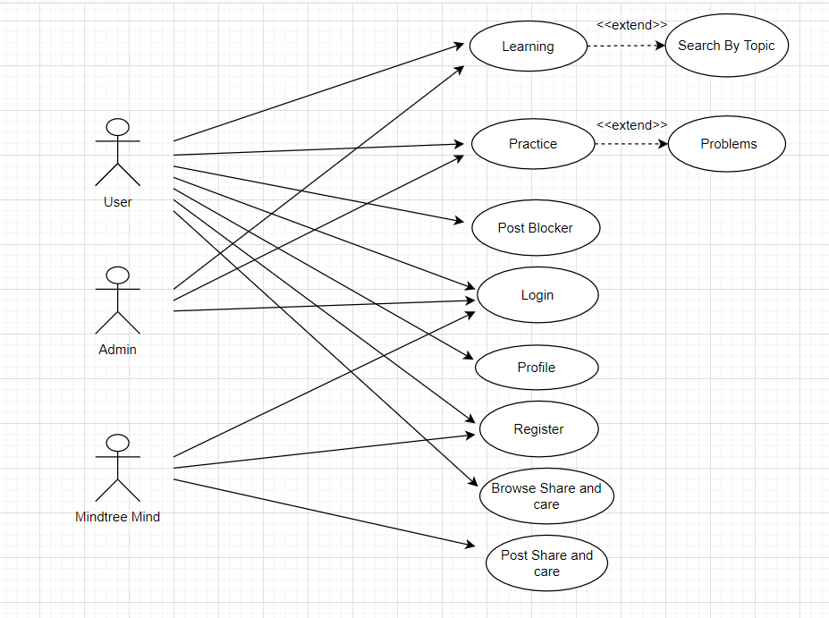
Use case diagram

Slide 6
Class Diagram
The class diagram is the main building block of object-oriented modeling
A class diagram in the Unified Modelling Language (UML)
It is a type of static structure diagram that describes the structure of a system by showing the system's classes, their attributes, operations (or methods), and the relationships among, objects.

Slide 7
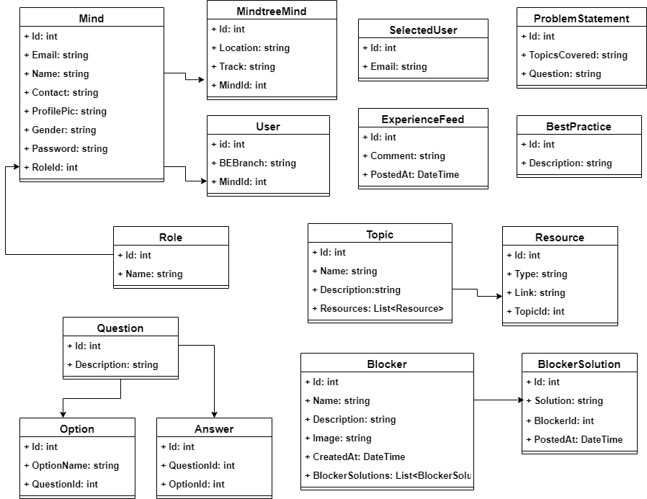
Class Diagram

Slide 8
Activity Diagram
Activity diagrams are graphical representations of workflows of stepwise activities and actions with support for choice, iteration and concurrency.
An activity diagram visually presents a series of actions or flow of control in a system similar to a flowchart or a data flow diagram.
Activity diagrams are often used in business process modeling.

Slide 9
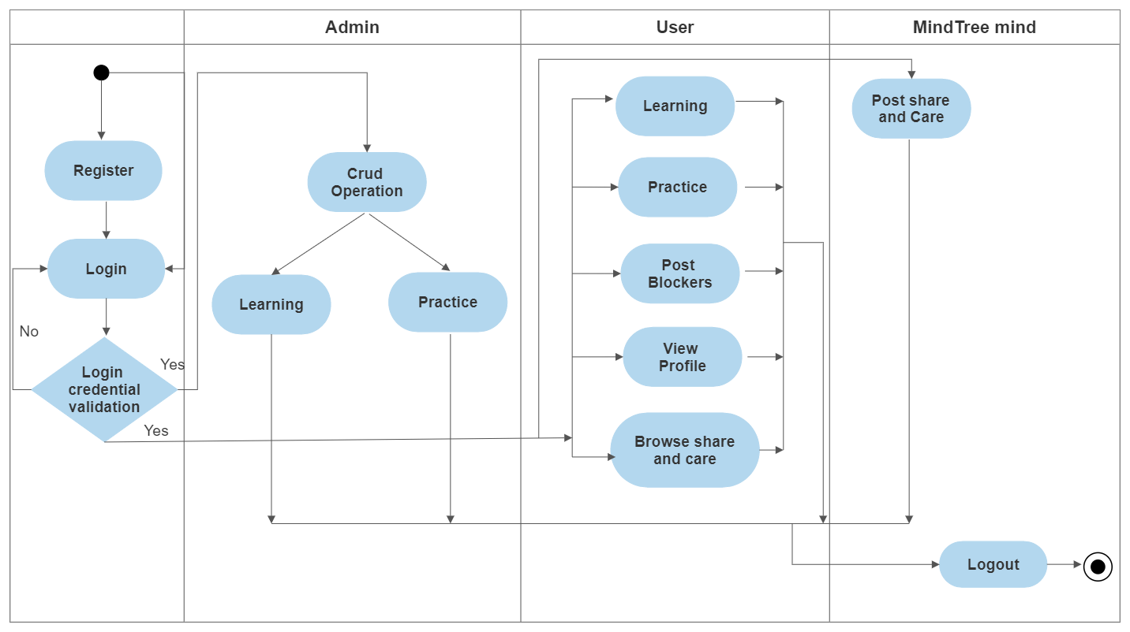
Activity Diagram

Slide 10
GIT Repository
In Git, the repository to store metadata for a set of files and directories.
It contains the collection of the files as well as the history of changes made to those files.
Repository in Git is considered as your project folder.
A repository has all the project-related data.
Distinct projects have distinct repositories.

Slide 11
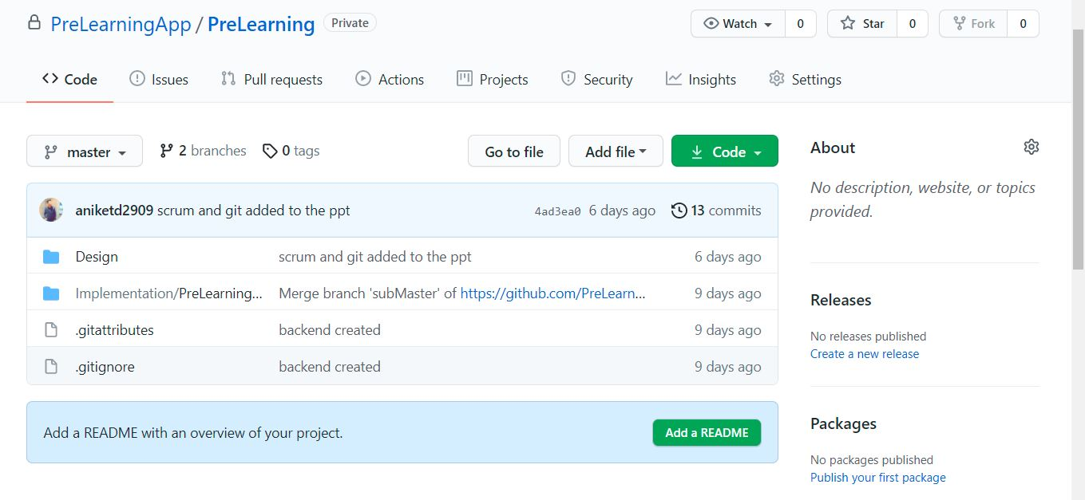
GIT Repository

Slide 12
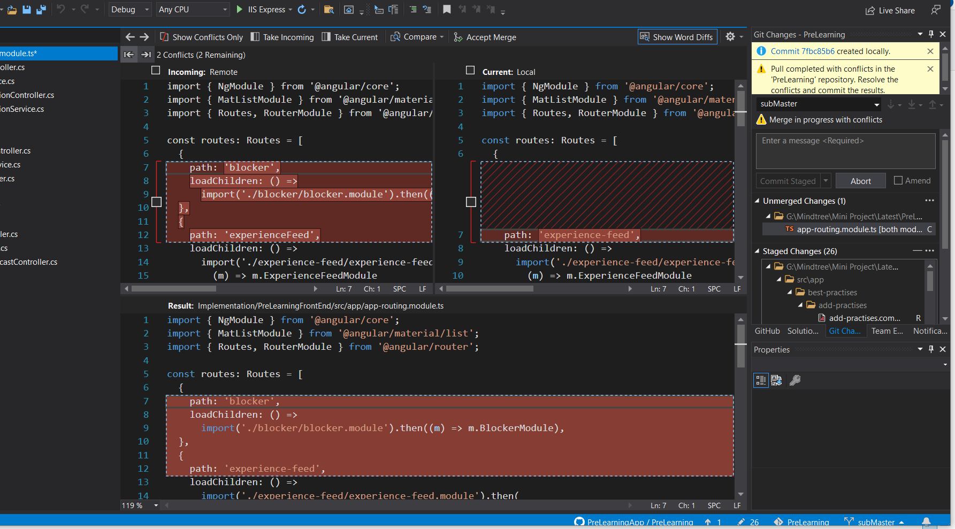
Git Merge conflict When two user are trying to merge, and both are edited at the same time and in the same file, Git won't be able to identify which version is to take for changes.

Slide 13
Scrum
It is the most popular agile framework
It concentrates particularly on how to manage tasks within a team-based development environment.
Scrum uses iterative and incremental development model, with shorter duration of iterations.
Scrum is relatively simple to implement and focuses on quick and frequent deliveries.

Slide 14
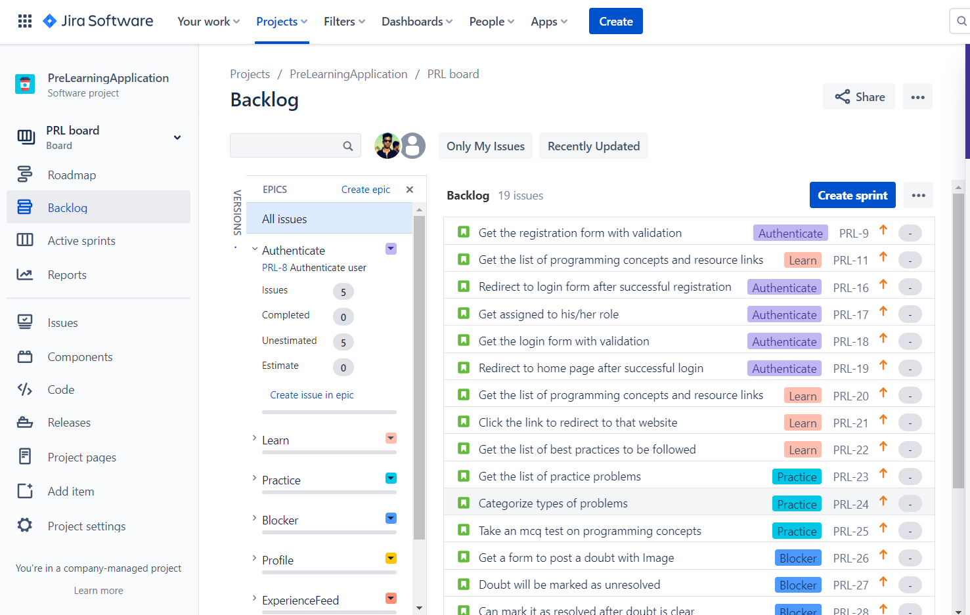
Backlog Product backlog is a prioritized list of deliverables (such as new features) that should be implemented as part of a project or product development.

Slide 15
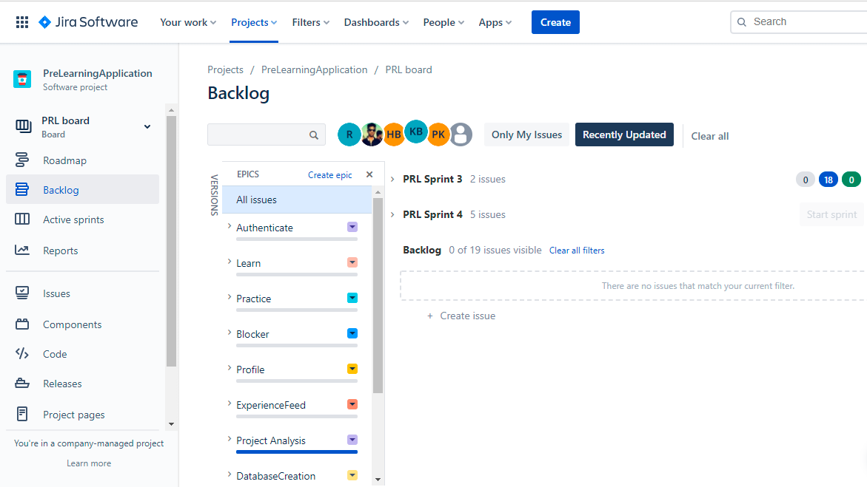
Epics An Epic can be defined as a big chunk of work that has one common objective.

Slide 16
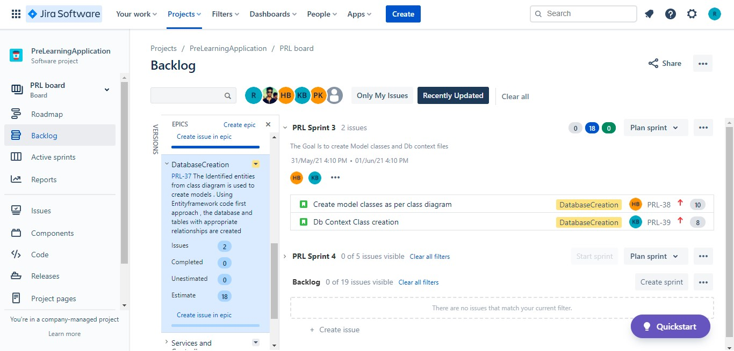
Sprint Sprints are the heartbeat of Scrum, where ideas are turned into value. They are fixed length events of one month or less to create consistency.

Slide 17
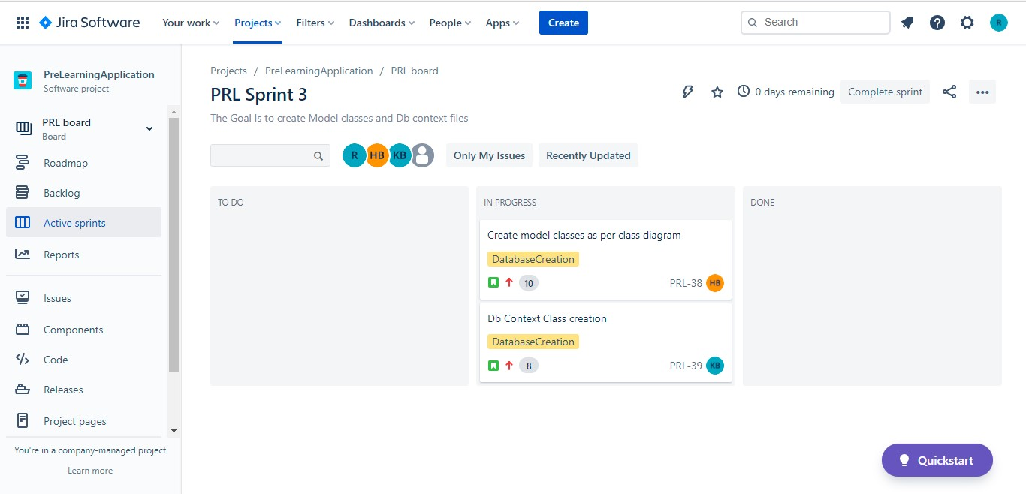
Active Sprints The Active sprints of a Scrum board displays the issues that your team is currently working on

Slide 18
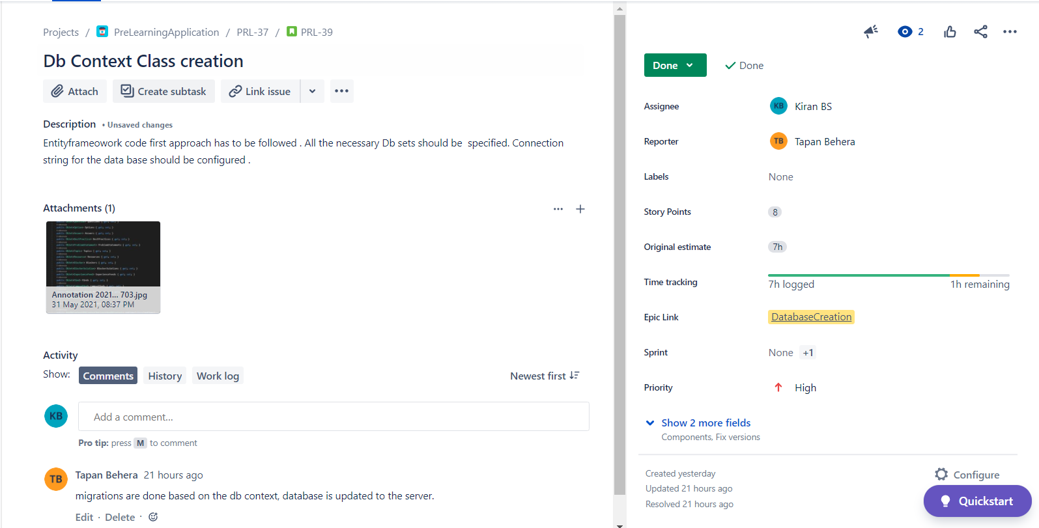
Issues

Slide 19
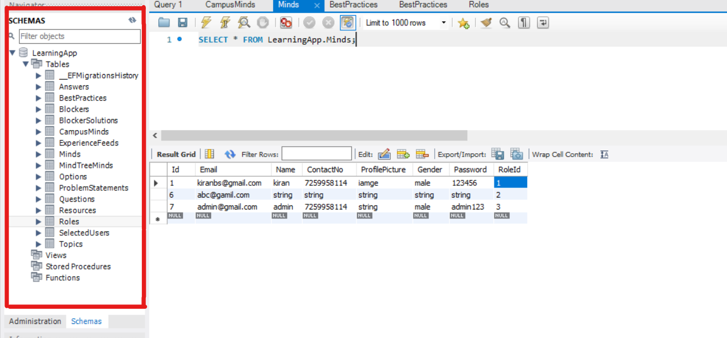
Database

Slide 20
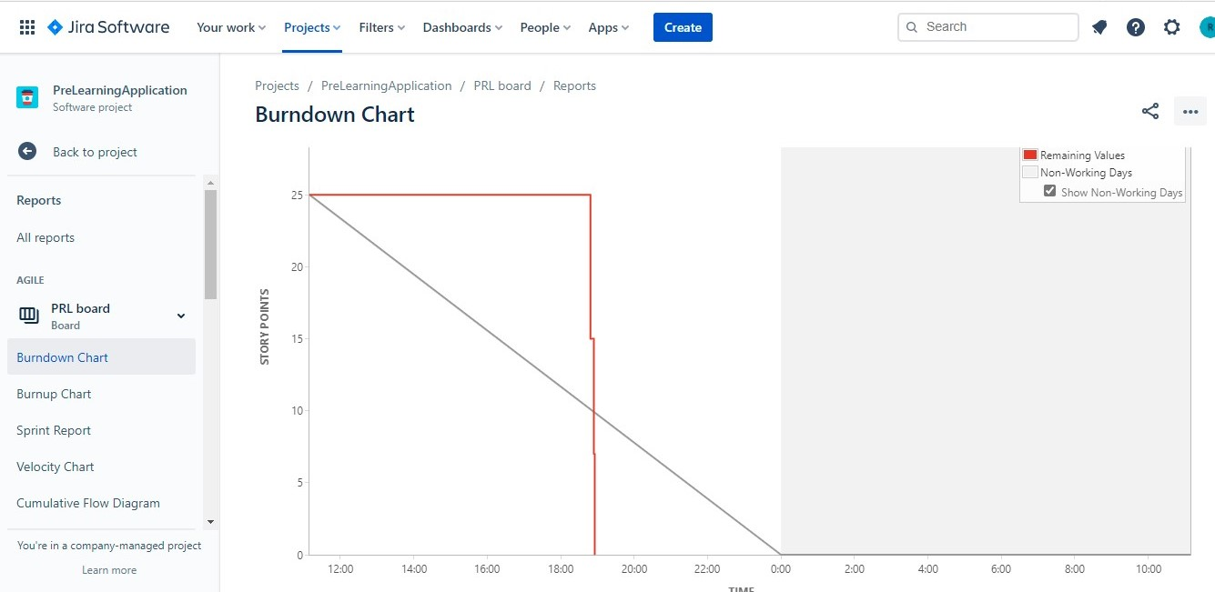
Burndown Chart A Burndown chart shows the team’s progress toward completing all of the points they agreed to complete within a single sprint.

Slide 21
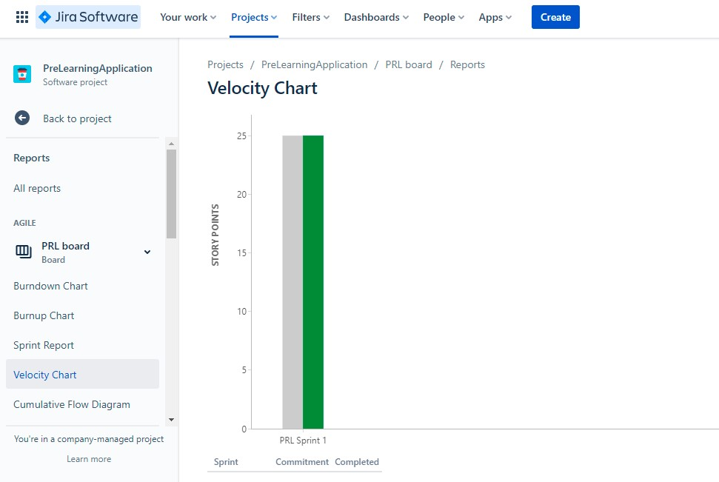
Velocity Chart The main purpose of the velocity chart is to overview how much work has been delivered for each sprint.

Slide 22
Project Demonstration

Slide 23


