Slide 1

BLUESTOCK FINTECH
Prepared By: Aniket Dhumal
Technology Stack: Python | SQLite | Power BI | Pandas | Plotly
Date: June 2026

Slide 2
Problem Statement & Objectives
Problem Statement
The mutual fund industry offers thousands of investment schemes across different categories, making fund selection a challenging task for investors. Most investors focus primarily on historical returns while ignoring important factors such as risk, volatility, portfolio diversification, and benchmark performance. Additionally, investor behavior patterns and industry trends are often scattered across multiple data sources, making comprehensive analysis difficult. Therefore, there is a need for a centralized analytics platform that can evaluate fund performance, measure risk, analyze investor behavior, and provide actionable insights for informed investment decisions.
Project Objectives
Build an end-to-end Mutual Fund Analytics platform.
Design an ETL pipeline for data ingestion, cleaning, and storage.
Perform Exploratory Data Analysis (EDA) to identify industry and investor trends.
Calculate performance metrics such as CAGR, Sharpe Ratio, Alpha, Beta, and Drawdown.
Conduct advanced analytics including VaR, CVaR, Cohort Analysis, SIP Continuity, and HHI.
Develop an interactive Power BI dashboard for visualization and decision support.
Create a risk-based mutual fund recommendation engine.

Slide 3
Data Sources
Datasets Used in the Project
Dataset | Description | Purpose
Fund Master | Scheme details, category, fund house, risk grade | Master reference table
NAV History | Historical daily NAV values | Return & performance analysis
Investor Transactions | SIP, Lumpsum, Redemption records | Investor behavior analysis
Portfolio Holdings | Stock-level fund holdings and sector allocation | Diversification & HHI analysis
Industry AUM | Industry Assets Under Management data | Industry growth analysis
SIP Inflows | Monthly SIP contribution statistics | SIP trend analysis
Benchmark Indices | Nifty 50 & Nifty 100 index data | Benchmark comparison

Slide 4
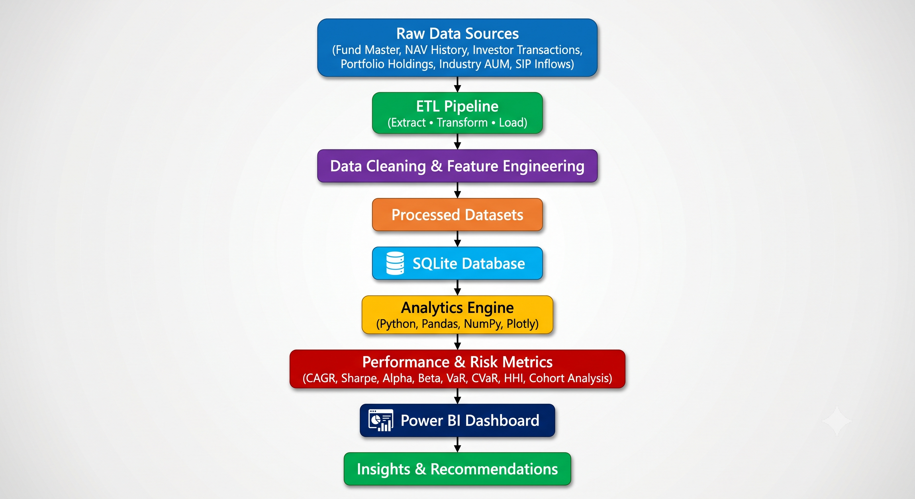
Project Architecture

Slide 5
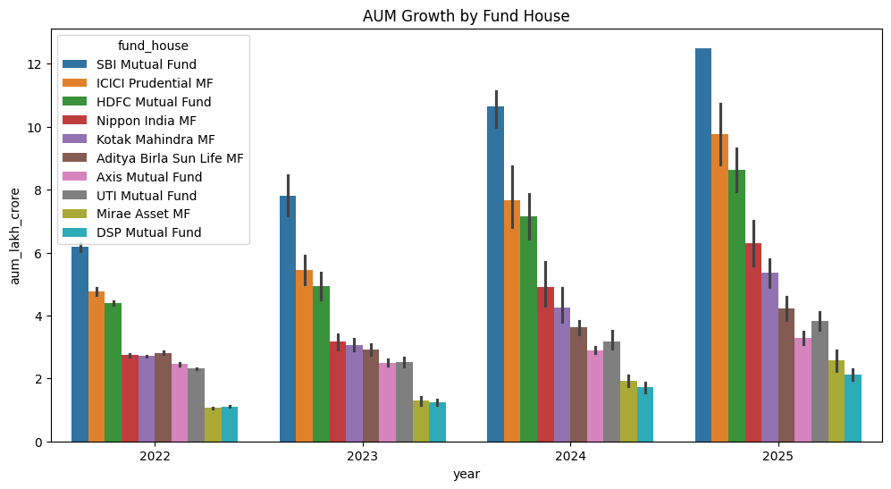
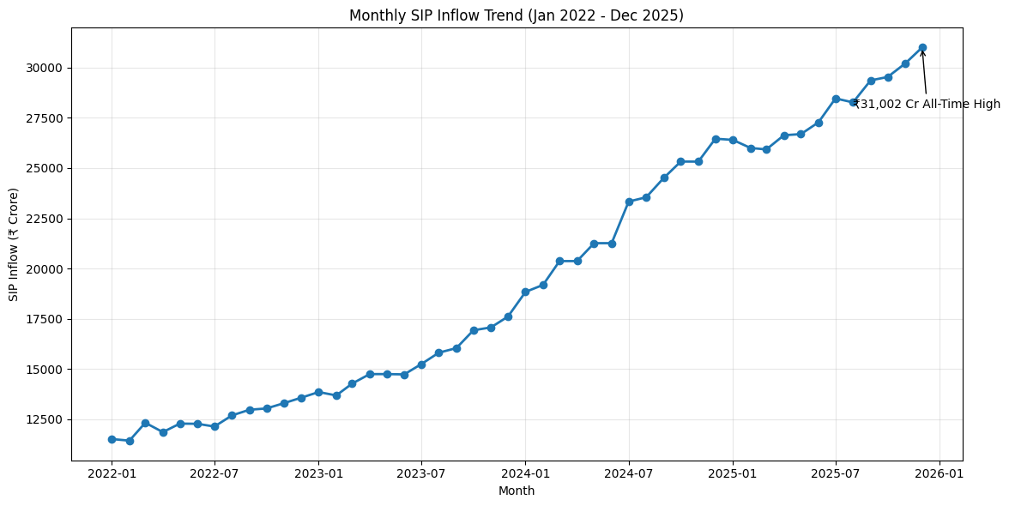
EDA Highlights
Industry AUM Growth
Assets Under Management (AUM) increased consistently from 2022 to 2025 across all major fund houses.
SBI Mutual Fund remained the largest AMC throughout the analysis period.
ICICI Prudential MF and HDFC Mutual Fund showed strong year-on-year growth.
The steady increase in AUM reflects growing investor confidence in mutual fund investments.
SIP Inflow Trend
Monthly SIP inflows increased from approximately ₹11,500 Cr in January 2022 to ₹31,002 Cr in December 2025.
SIP contributions nearly tripled during the analysis period.
Despite market fluctuations, retail investors continued systematic investments.
The all-time high SIP inflow of ₹31,002 Cr highlights the increasing adoption of disciplined investment strategies.

Slide 6
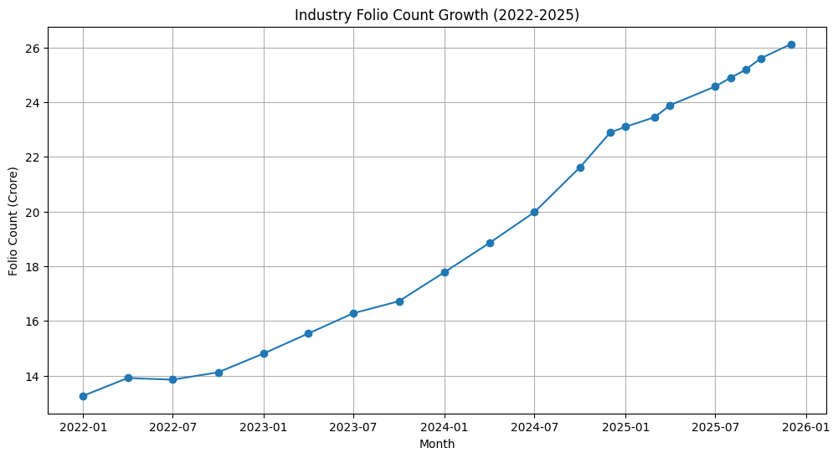
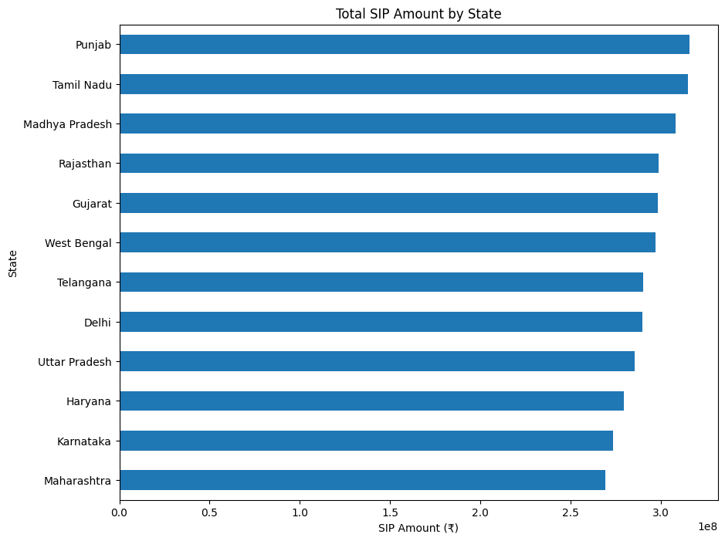
Folio Count Analysis
Industry folio count increased from approximately 13 Cr to 26 Cr between 2022 and 2025.
Number of investor accounts nearly doubled.
Growth reflects increasing awareness and adoption of mutual fund investments.
State-wise SIP Analysis
Investment participation varied across states.
Punjab, Tamil Nadu, and Madhya Pradesh recorded higher SIP contributions.
Geographic diversification highlights nationwide mutual fund adoption.

Slide 7
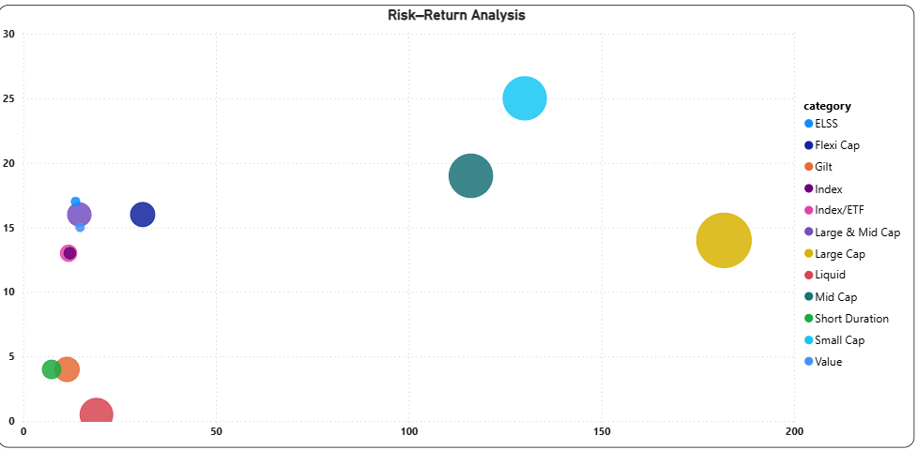
Fund Performance Analytics
Performance Evaluation Framework
Return Analysis | Risk Analysis | Risk-Adjusted Analysis
CAGR (1Y, 3Y, 5Y) | Standard Deviation | Sharpe Ratio
Benchmark Return | Maximum Drawdown | Sortino Ratio
Growth Comparison | Volatility Assessment | Alpha & Beta
Key Performance Metrics
1.CAGR (1Y, 3Y, 5Y)
Measures long-term growth and compounding returns.
2.Alpha & Beta Analysis
Alpha indicates benchmark outperformance.
Beta measures market sensitivity and volatility.
3.Sharpe & Sortino Ratio
Evaluates risk-adjusted returns.
Sortino focuses specifically on downside risk.
4.Maximum Drawdown
Measures the largest decline from peak to trough.
Indicates downside risk during market corrections.

Slide 8
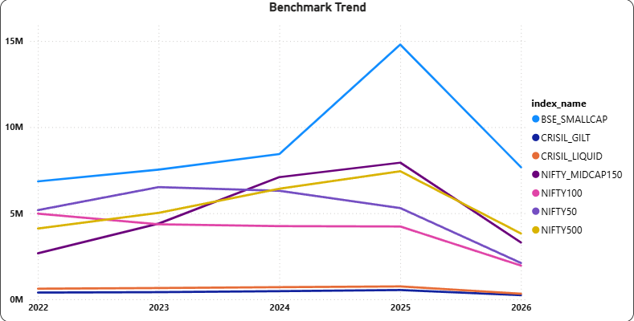
Benchmark Return Analysis Framework
Benchmark Comparison | Market Performance | Fund Evaluation
Nifty 50 Comparison | Market Trend Analysis | Alpha Generation
Nifty 100 Comparison | Relative Performance | Outperformance Assessment
Fund vs Benchmark | Growth Comparison | Investment Efficiency
Key Benchmark Metrics
1.Nifty 50 Benchmark
Measures fund performance against the top 50 companies listed on NSE.
2.Nifty 100 Benchmark
Provides broader market comparison across the top 100 companies.
3.Alpha Analysis
Measures excess return generated beyond benchmark expectations.
4.Tracking Performance
Analyzes consistency of fund returns relative to benchmark movement.

Slide 9
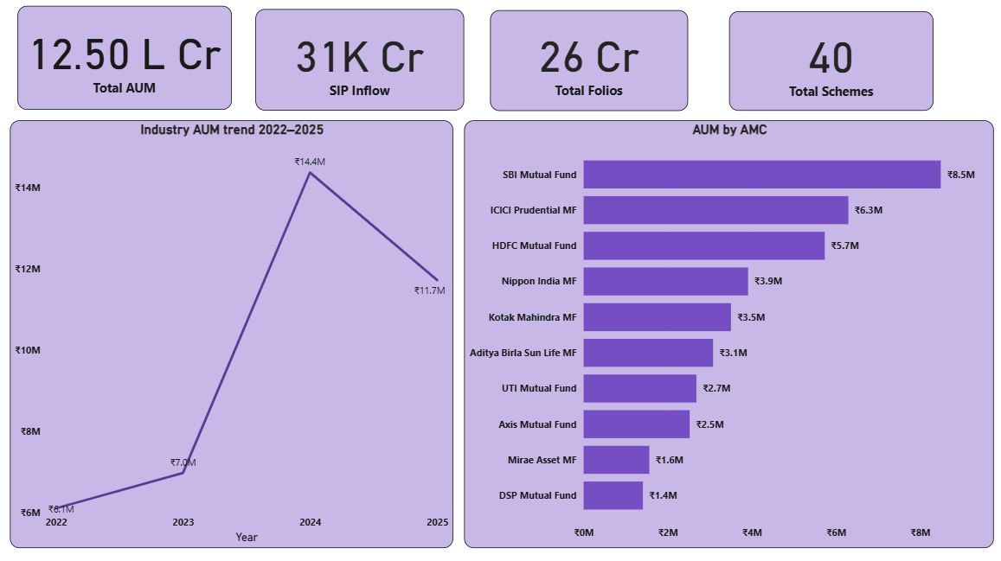
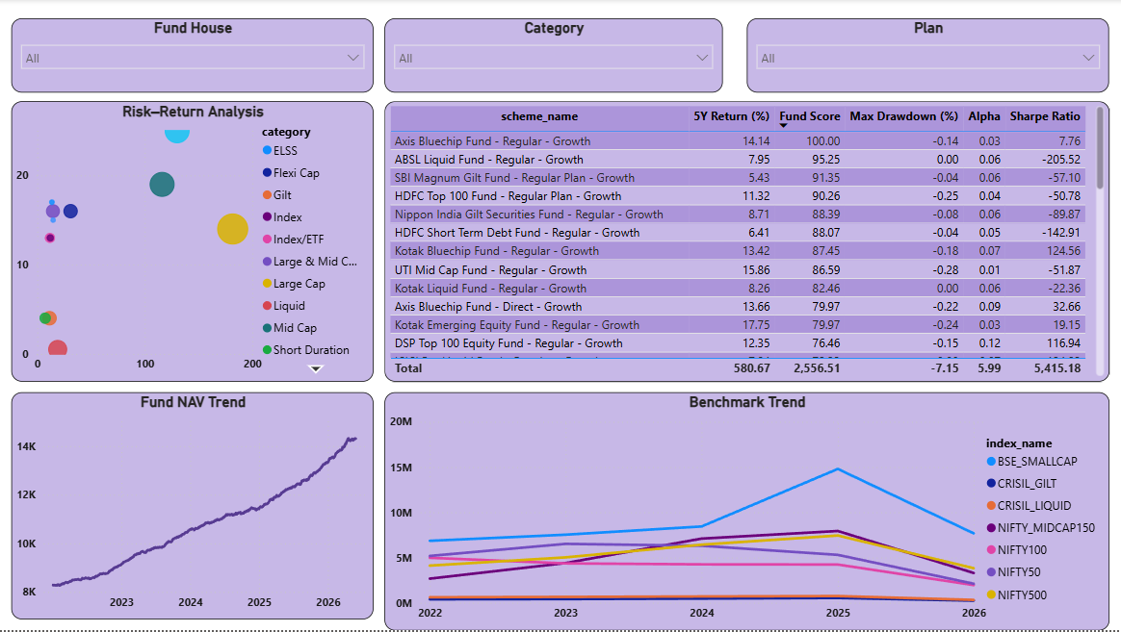
Dashboard Overview – Industry & Fund Performance
Industry Overview
KPI cards displaying Total AUM, SIP Inflows, Folios, and Schemes.
Industry AUM trend analysis from 2022–2025.
AMC-wise asset distribution and market share comparison.
High-level view of mutual fund industry growth.
Fund Performance
Risk vs Return analysis across fund categories.
Fund scorecard with performance and risk metrics.
NAV trend tracking over time.
Benchmark comparison against major market indices.
Interactive slicers for Fund House, Category, and Plan.

Slide 10
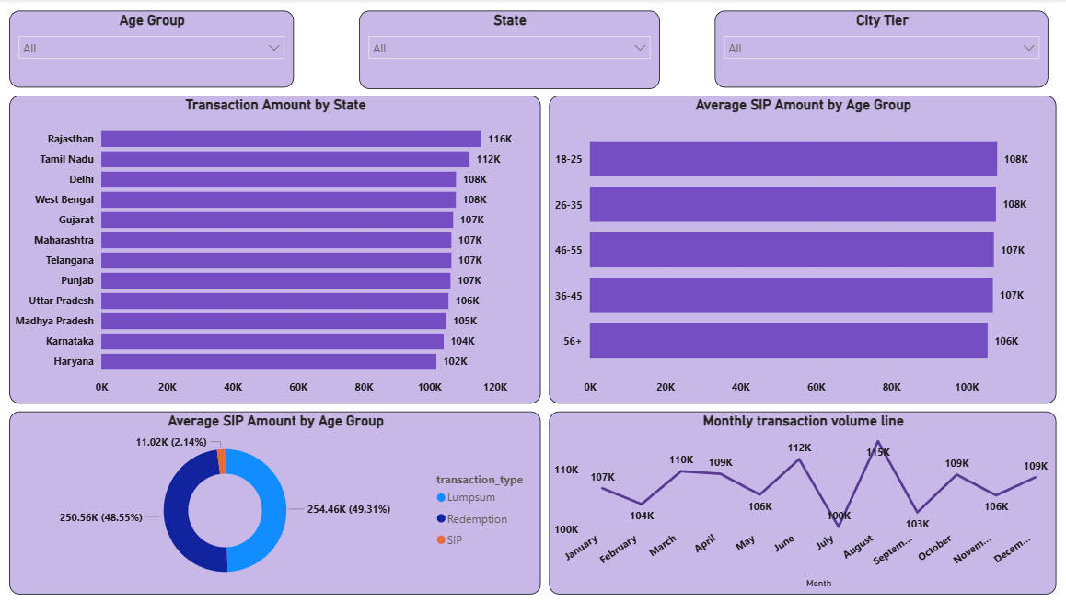
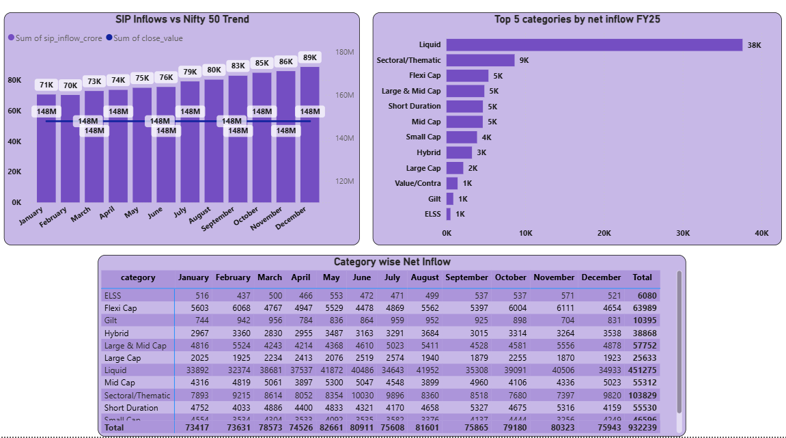
Dashboard Overview – Investor Analytics &
SIP Trends
Investor Analytics
State-wise transaction analysis.
Age-group based SIP behavior.
Transaction type distribution (SIP, Lumpsum, Redemption).
Monthly transaction volume tracking.
SIP & Market Trends
SIP inflows compared with Nifty 50 movement.
Category-wise net inflow analysis.
Top-performing categories by inflows.
Category wise Net Inflow.

Slide 11
Key Findings
1.Industry Growth
Industry AUM increased significantly from 2022–2025, reaching approximately ₹12.5 Lakh Crore.
2.Strong SIP Participation
Monthly SIP inflows reached an all-time high of ₹31K Crore, indicating growing retail investor confidence.
3.Market Leadership
SBI Mutual Fund emerged as the leading AMC by Assets Under Management.
4.Risk-Adjusted Performance Matters
Sharpe Ratio, Alpha, and Drawdown analysis showed that high returns alone do not guarantee better investment quality.
5.Investor Participation Expanded
Folio count nearly doubled from 13 Cr to 26 Cr, reflecting increased mutual fund adoption.
6.Portfolio Diversification
Most equity funds maintained moderate sector concentration with average HHI around 0.14, indicating reasonable diversification.
7.Top AMC Performance
SBI Mutual Fund maintained the highest AUM among major fund houses.

Slide 12
ThankYou

