Slide 1
From Chemistry to History via Kernel Embedding

Slide 2
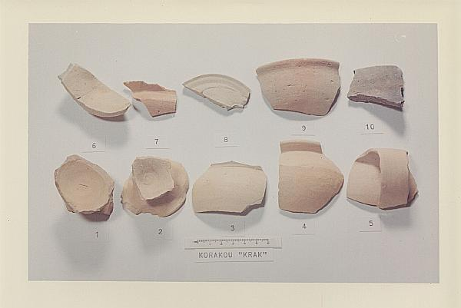
Problem statement

Slide 3
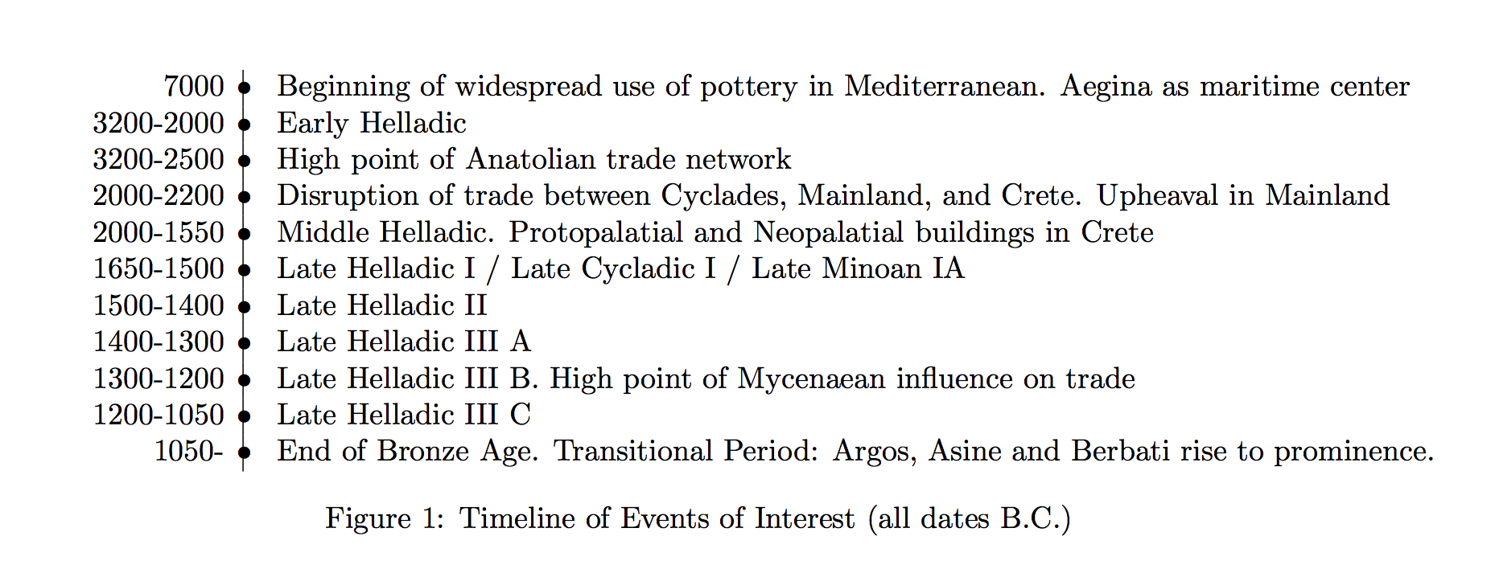
Problem statement

Slide 4
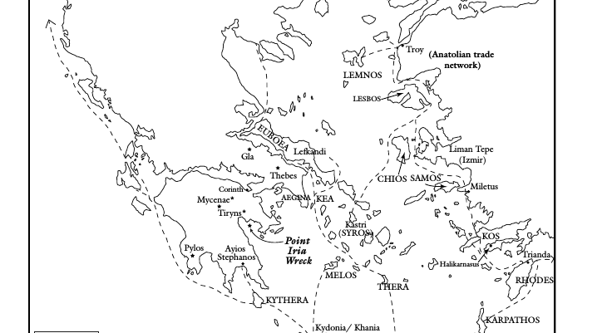
Problem statement

Slide 5
Data Set
1) Dataset from Lawrence Berkeley National Laboratory (LBNL) Nuclear Archaeology Program
2) Contains geographical, historical records and chemical compositions of the artifact
3)886 pieces of artifacts from ancient Greece, discovered from 31 archaeological sites
4) The time frame in our sample covers from the Early Helladic era (around 3200 BC) to Roman Republic

Slide 6
Previous Work
(On the board)

Slide 7
Methodology
(On the board)

Slide 8
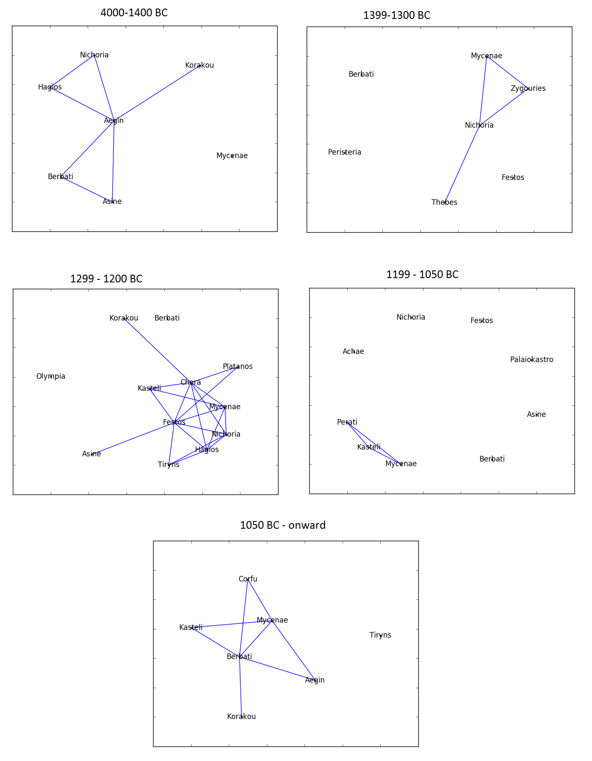
Results

Slide 9
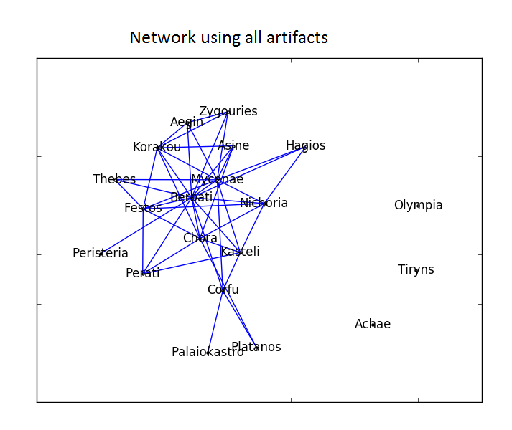
Results

Slide 10
Results

Slide 11
Results: Site Classificiation
(On the board)

