Slide 1
From Chemistry to History via Kernel Embedding

Slide 2
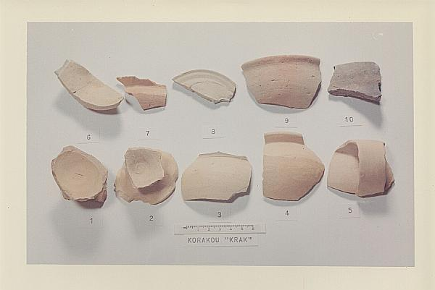
Problem statement

Slide 3
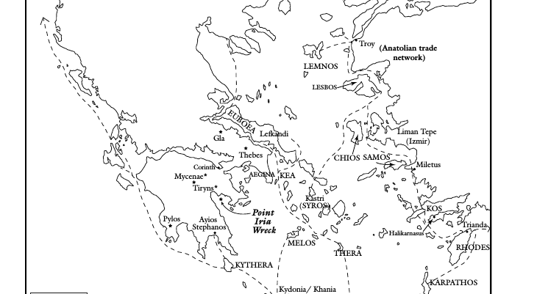
Problem statement

Slide 4
Data Set

Slide 5
Previous Work

Slide 6
Methodology
(On the board)

Slide 7
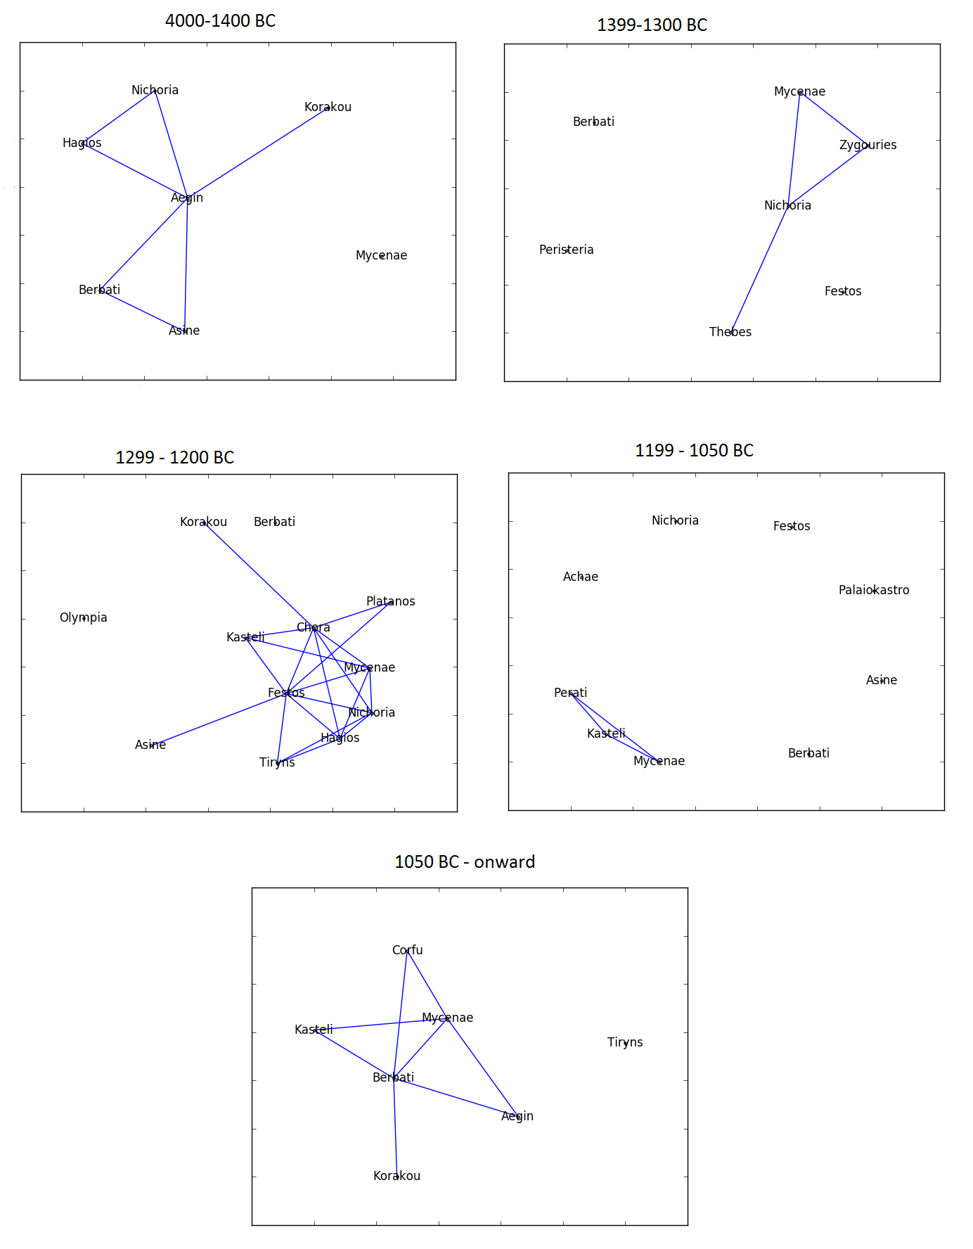
Results

Slide 8
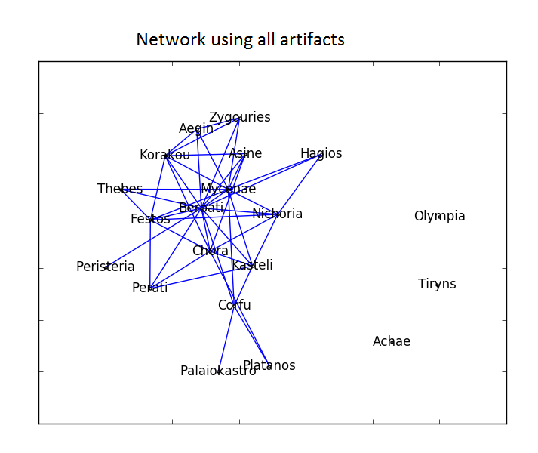
Results

Slide 9
Conclusion

