Slide 1


Data Analyst Project
(Educational Center)
Aniket Gami
+91 9029614478
aniketgami64@gmail.com

Slide 2




Technology and Tools Utilized
Python Lastest Version
Microsoft
Excel
Microsoft
Power BI
Visual Studio
Code

Slide 3
According to the task, the work is completed

Slide 4
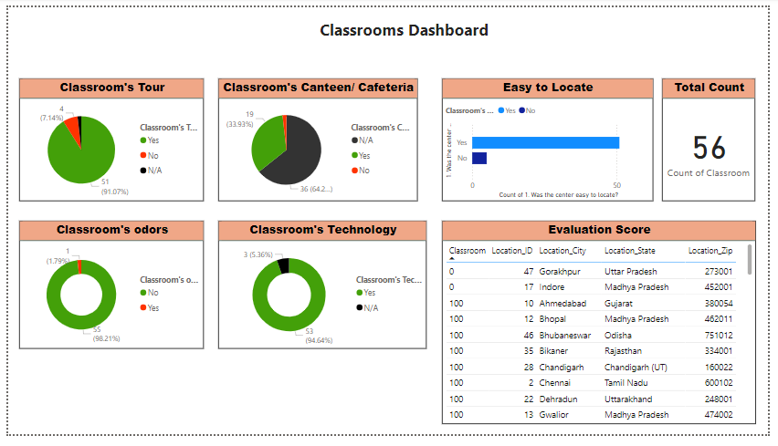
1) Visualize some questions on the interiors of the Classroom

Slide 5
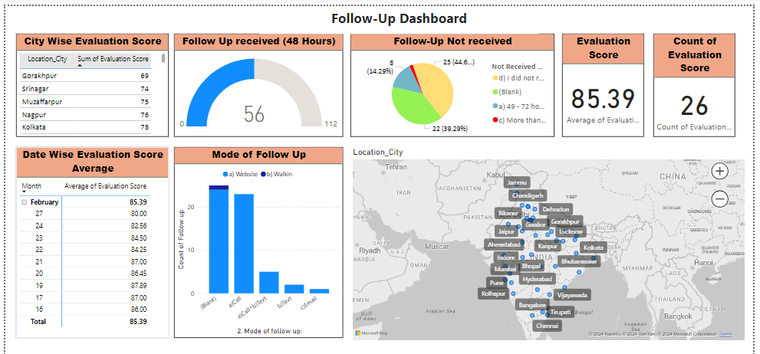
2) Present date-wise average evaluation score
3) Present the graph on follow-up received within 48 hours
4) Present the graph on the 'Mode of Follow-Up'

Slide 6
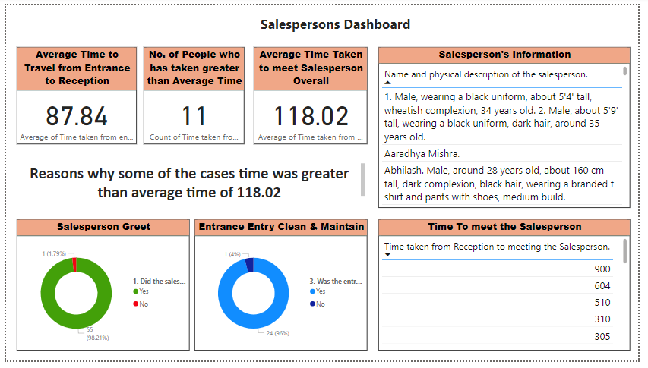
5) Calculate the Average Time taken from reception to meet the Salesperson. List the reasons why in some cases the time was greater than average time.

Slide 7
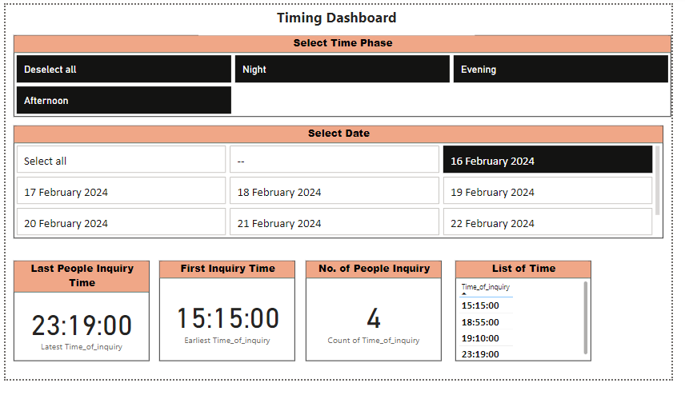
6) Visualize what time of the day evaluators visited the center. Create a bucket of Morning, Afternoon, and Evening.

Slide 8
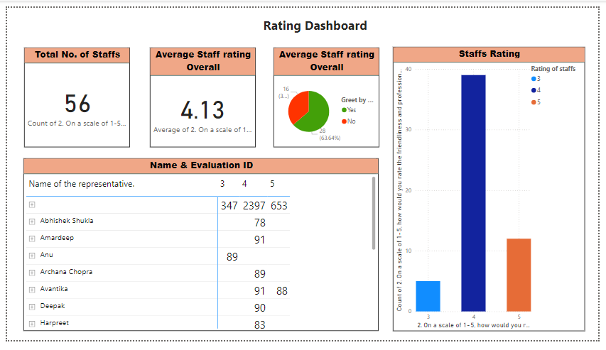
7) Top 5 Traits of the Staff when Evaluators rated Staff Interaction 5 on a scale of 1 to 5
8) Enlist the factors that made the customers feel 'Highly Satisfied' and rate the service '5' on a scale of 1 to 5.

Slide 9
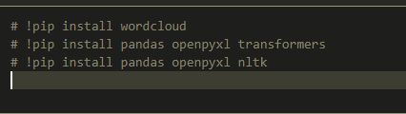
9) Extract negative factors encountered when assessing the Website Enquiry Section. Refer to question '12. Please elaborate on the website inquiry section. Highlight all the positives and negatives encountered.' Read comments and extract negative experiences.
By Using Python Library
I am Using NLP to identified the Reviews of the persons

Slide 10
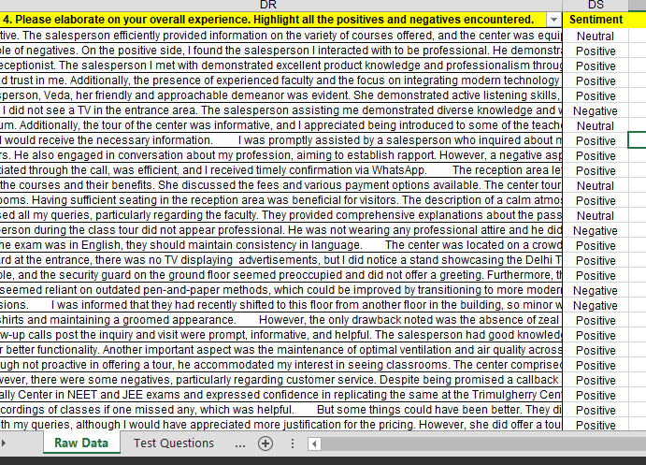
Result
We can create a new column named "Sentiment" in Python to categorize the reviews.
Similarly, by using python, and Power Bi, we can analyze more things. & get various insight.

Slide 11
Thank You

