Slide 1
Project Presentation of CO-OP Project at Industry (Module-2) (22CS421)
On
Rise of UPI Fraud in India: Vulnerability Analysis and Prevention Framework
Aniket Garg : 2210991264
Supervised By
Dr. Ajay Kumar
Department of Computer Science and Engineering,
Chitkara University, Punjab

Slide 2
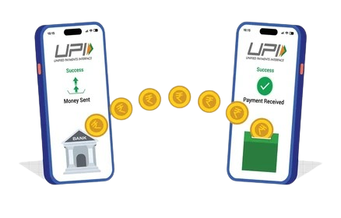
Introduction
UPI has changed the way people make digital payments in India.
It allows users to transfer money instantly using mobile applications.
People use UPI for shopping, bill payments, ticket booking, and online transfers.
Due to its fast and simple process, UPI usage is increasing rapidly.
Along with its growth, online fraud and cyber scams are also increasing.
Fraudsters target users through fake links, QR codes, and scam calls.

Slide 3

Background and Evolution
Earlier, people mainly used cash, debit cards, and net banking for payments.
Digital payments were slower and required more banking procedures.
UPI made transactions easier, faster, and available 24/7.
QR-code payments and mobile apps increased the
popularity of UPI.
Today, millions of transactions happen daily through UPI
platforms.
With technological growth, fraud techniques have also become
more advanced

Slide 4
Problem Statement
UPI fraud cases are growing rapidly across India.
Many users are unaware of online scams and fraud techniques.
Fraudsters misuse fake customer-care calls, phishing links, and QR-code scams.
Instant money transfer makes it difficult to recover lost money.
Weak verification and lack of awareness increase security risks.
There is a need for better fraud prevention and user education.

Slide 5

Objectives of the study
To study the rapid increase of UPI fraud in India.
To identify major vulnerabilities in digital payment systems.
To understand different types of UPI frauds and scams.
To analyze security and privacy risks faced by users.
To study prevention methods introduced by RBI and NPCI.
To suggest ways to improve digital payment security.

Slide 6
Literature Review
Research shows that digital payment fraud has increased with UPI growth.
Most frauds happen because users trust fake calls and messages.
Studies highlight phishing, QR scams, and impersonation as common threats.
AI-based scams and deepfake technology are making fraud more dangerous.
Experts recommend stronger authentication and better awareness programs.
Previous studies also emphasize the need for secure digital payment systems.

Slide 7
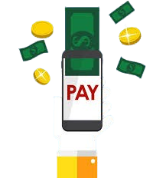
Ethical Implications
UPI fraud causes financial loss to users and businesses.
Victims may lose trust in online payment systems.
Cybercrime and online scam activities continue to increase.
Banks and financial institutions receive more fraud complaints.
Fraud cases create stress and fear among digital payment users.
More investment is needed in cybersecurity and fraud prevention systems.

Slide 8

Types Of UPI Frauds
Phishing Fraud
Fraudsters send fake SMS, emails, or links to steal banking details.
Users may unknowingly share OTPs and UPI PINs.
QR-Code Scam
Fake QR codes are used to trick users into making payments.
Many users think scanning a QR code will help them receive money.
Collect Request Fraud
Attackers send fake “collect money” requests for approval.
Users accidentally approve the request and lose money.

Slide 9

SIM-Swap Fraud
Fraudsters duplicate the victim’s SIM card.
They gain access to OTPs and banking services.
Fake Customer-Care Scam
Scammers pretend to be bank officials or support agents.
They manipulate users into sharing confidential information.
Screen-Sharing Fraud
Victims are asked to install remote-access applications.
Fraudsters then control the device and perform transactions.

Slide 10
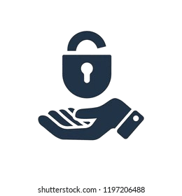
Security and privacy risks
UPI systems store important financial and personal information.
Data breaches can expose sensitive banking details.
Users often share OTPs and PINs unknowingly during scams.
Fake apps and malicious links can steal user information.
Instant payment systems reduce the time available for fraud recovery.
Lack of digital awareness increases privacy and security risks.

Slide 11
Methodology
This study is based on qualitative and analytical research.
Data was collected from RBI, NPCI, CERT-In reports, and research papers.
Case studies and cybersecurity reports were also analyzed.
Different fraud patterns and vulnerabilities were studied carefully.
The study focused on fraud causes, impacts, and prevention methods.

Slide 12
Results and analysis
UPI transactions have increased rapidly in recent years.
Fraud cases are also increasing with digital payment growth.
Most frauds are based on social engineering and user manipulation.
Users are commonly targeted through phishing and QR-code scams.
AI-based frauds and deepfake scams are becoming more common.
Better security systems and user awareness can reduce fraud risks.

Slide 13

Conclusion
UPI has made digital payments fast, simple, and convenient.
However, increasing usage has also increased cyber fraud risks.
Most frauds happen because of lack of awareness and weak security practices.
Strong authentication and real-time monitoring are important for safety.
Users, banks, and regulators must work together to prevent fraud.
Safe digital practices can help create a secure payment ecosystem.

Slide 14
Thank You
14

