Slide 1

A Project Stage – II Presentation
on
“AI-Powered Image Analysis for Industrial object Quality Assurance”
by
under the guidance of,
Prof. Kantilal. B. Kharat
at
Aniket Narayan Gaware | [XXXXXXX]
Anish Bharat Bawdhankar | [XXXXXXX]
Rushikesh Madhusudan Patil | [XXXXXXX]
Department of Electronics & Telecommunication Engineering
Sinhgad Technical Education Society’s
NBN Sinhgad Technical Institutes Campus Ambegaon(Bk), Pune -41
2024-2025

Slide 2
Contents
Introduction
Motivation
Scope & Objective
Literature Survey
Problem Statement
Hardware & Software Requirement
Block Diagram
Implementation
Circuit Diagram
Advantages & Disadvantages
Applications
Result
Conclusion
References
AI-Powered Image analysis for Industrial Object Quality Assurance

Slide 3
Introduction
The "AI-Powered Image Analysis for Industrial Object Quality Assurance" project is designed to automate the quality inspection process in manufacturing environments. By integrating AI and image processing, the system aims to identify and classify defects in industrial objects efficiently and accurately. This project utilizes high-resolution cameras and Machine Learning algorithms to ensure that every object produced meets the desired quality standards, thereby reducing manual inspection time and increasing overall productivity.
AI-Powered Image analysis for Industrial Object Quality Assurance

Slide 4
Motivation
The project idea "AI-Powered Image Analysis for Industrial Object Quality Assurance" likely comes from the need to improve how factories check the quality of their products. As factories need to be faster and more precise, they are using AI and cameras to automatically inspect and judge the quality of objects.
Example:
Industry: Automotive Manufacturing
Application: AI-powered image analysis for quality assurance of automotive components during assembly.
AI-Powered Image analysis for Industrial Object Quality Assurance

Slide 5
Scope & Objective
Automated Gear Inspection: Develop an AI-powered system for automatic detection of defects in gears, focusing on surface cracks, wear, misalignments, and structural irregularities.
Integration with Industrial Systems: Enable seamless integration of the system into existing manufacturing and quality control processes to streamline inspection workflows.
Enhance Quality Control: Minimize defective gears in industrial output by implementing a precise, non-contact inspection system.
Reduce Downtime and Manual Errors: Replace traditional inspection methods with an automated solution to reduce inspection time, human error, and production downtime.
AI-Powered Image analysis for Industrial Object Quality Assurance

Slide 6
Literature Survey
Quality control has advanced from manual inspection to sophisticated AI-powered systems, significantly enhancing efficiency and accuracy. This project focuses on applying machine learning and image processing for real-time defect detection in manufacturing, particularly in additive manufacturing processes. Key studies in thermographic imaging, acoustic monitoring, and supervised and unsupervised learning demonstrate the potential of ML for identifying defects like delamination, porosity, and surface anomalies. Leveraging CNNs for image analysis, edge computing using Raspberry Pi, and optimized cross-validation, the system aims for accuracy, cost-effectiveness, and scalability. Designed with small and medium-sized enterprises (SMEs) in mind, it offers an affordable alternative to high-end systems, enabling immediate, edge-based feedback directly on the production line. The project aligns with Industry 4.0 by promoting automation, IoT integration, and real-time data analysis, enhancing production efficiency, reducing waste, and improving product quality across various manufacturing environments..
AI-Powered Image analysis for Industrial Object Quality Assurance

Slide 7
Problem Statement
“Traditional quality control methods, often relying on manual inspection, are time-consuming, labor-intensive, and prone to human error. This is especially challenging in high-speed production lines, where rapid and accurate defect detection is crucial. This project aims to address these challenges by implementing an AI-powered image analysis solution optimized for edge-based, real-time quality control in diverse manufacturing environments.”
AI-Powered Image analysis for Industrial Object Quality Assurance

Slide 8
Hardware & Software Requirement
Hardware Requirement
  Raspberry Pi 4B
  Camera Module
  DC Motor
  Servo Motor
  Conveyor Belt
  Ultrasonic Sensor
Software Requirement
  Programming Language: Python.
  Libraries: OpenCV , TensorFlow/Keras
AI-Powered Image analysis for Industrial Object Quality Assurance

Slide 9
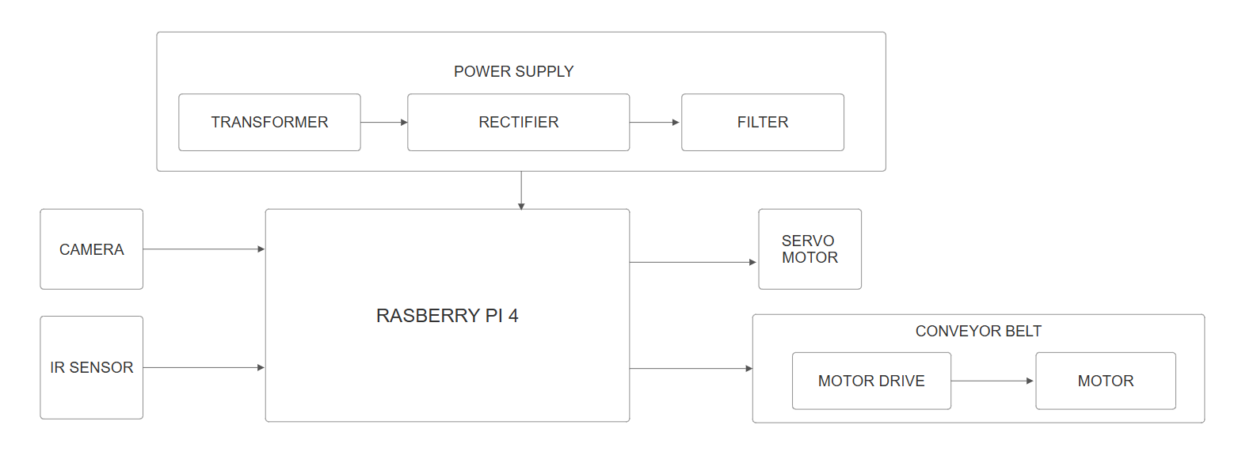
Block Diagram
ULTRA-
SONIC
SENSOR
Fig. 1 Block Diagram of gear detection
AI-Powered Image analysis for Industrial Object Quality Assurance

Slide 10
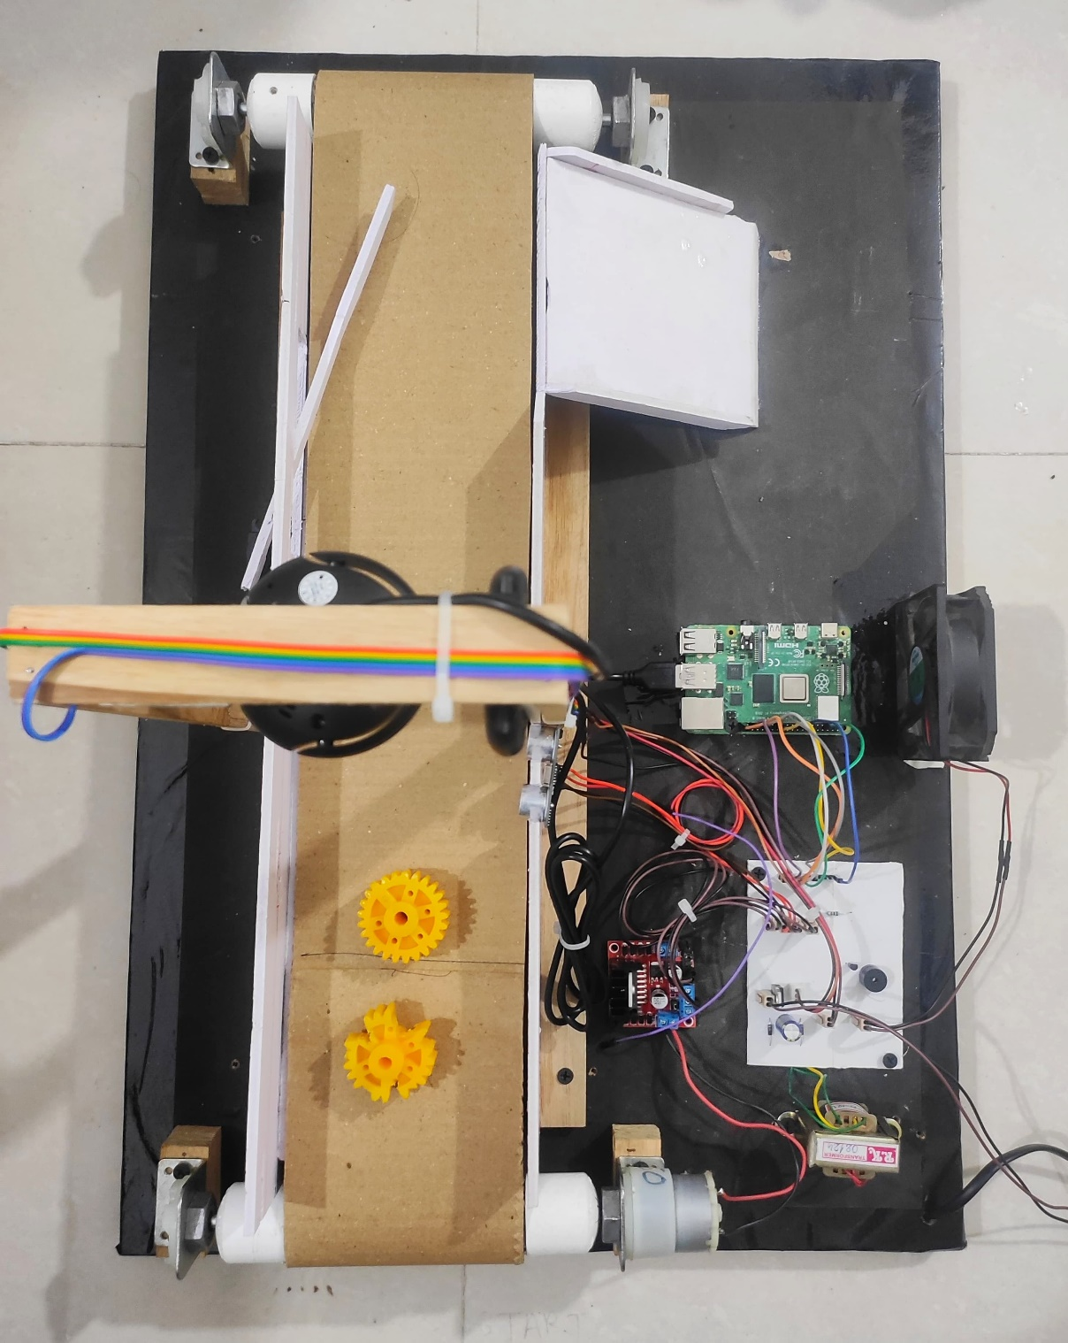
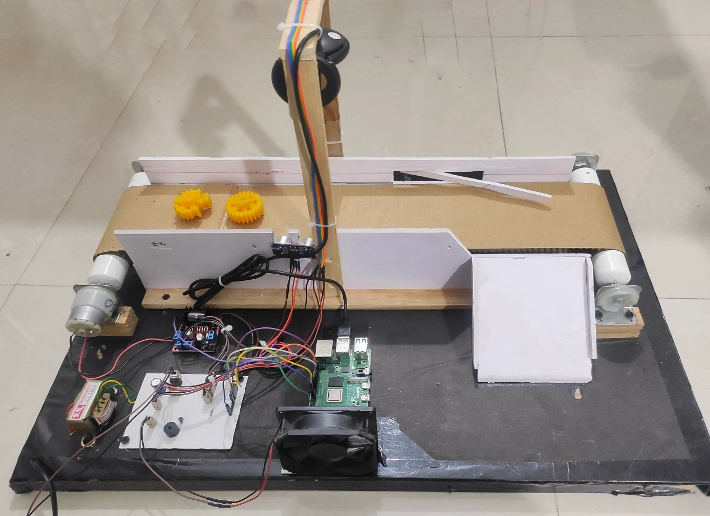
Implementation
Fig. 2 Setup-1
Fig. 3 Setup-2
AI-Powered Image analysis for Industrial Object Quality Assurance

Slide 11
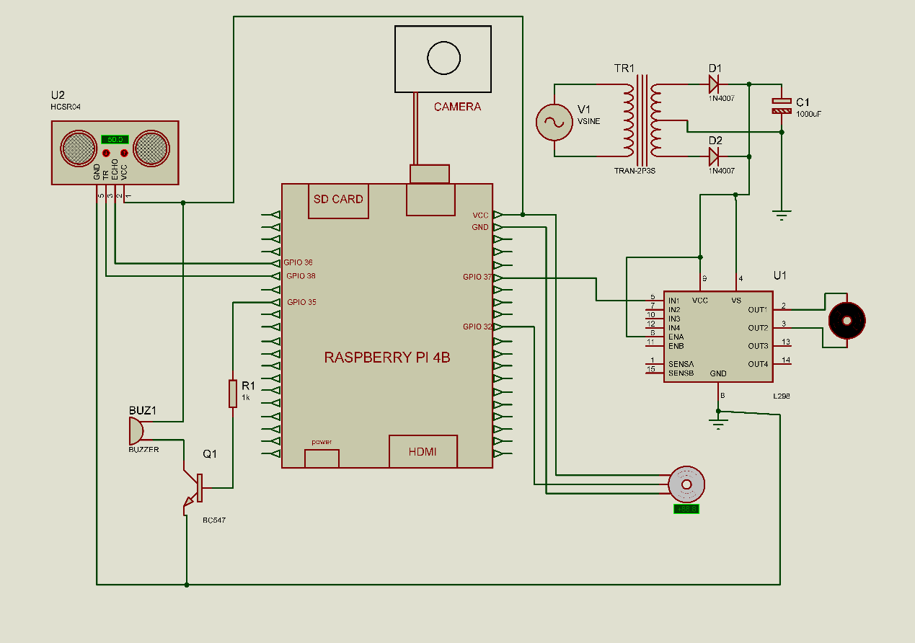
Circuit Diagram
AI-Powered Image analysis for Industrial Object Quality Assurance

Slide 12
Advantages & Disadvantages
Advantages:
  Increased Inspection Speed
  High Accuracy and Consistency
  Non-Contact and Non-Destructive
  Cost-Effective Over Time
  Real-Time Monitoring and Reporting
Disadvantages:
  High Initial Setup Cost
  Technical Complexity
  Limitations in Low-Quality Images
  Adaptability Challenges
AI-Powered Image analysis for Industrial Object Quality Assurance

Slide 13
Applications
  Automotive Industry
  Aerospace Industry
  Manufacturing and Industrial Machinery
  Railway maintenance workshop
AI-Powered Image analysis for Industrial Object Quality Assurance

Slide 14
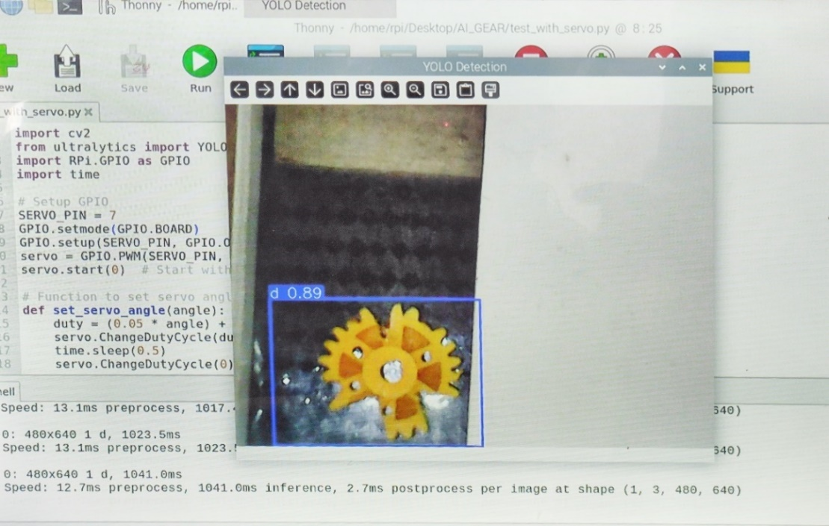
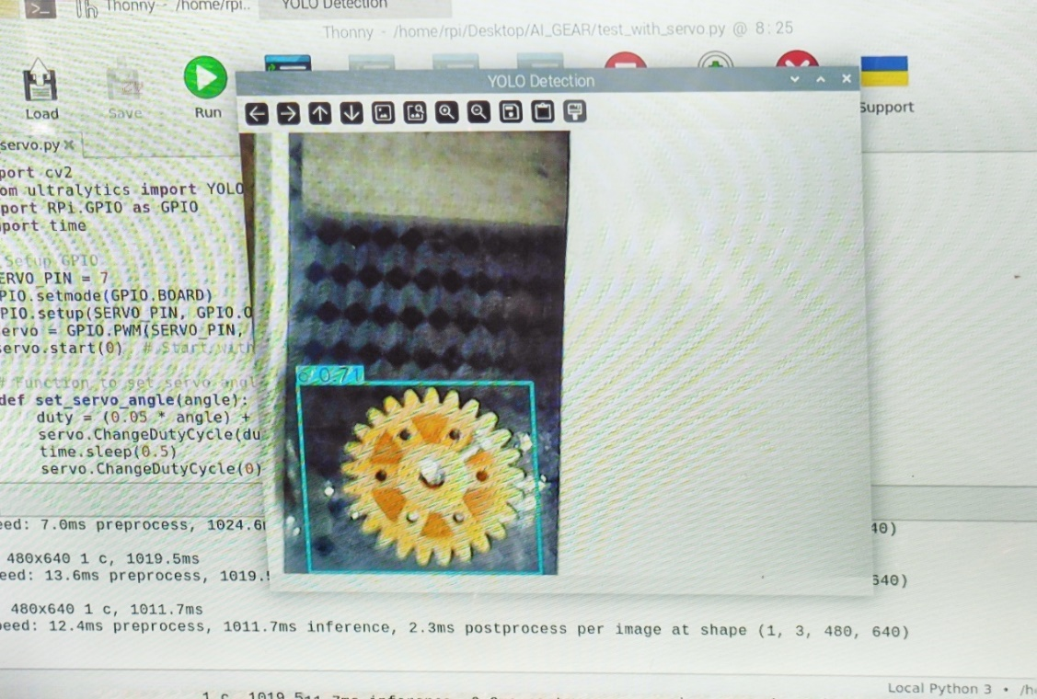
Result
Fig No 5 Damaged Gear
Fig No 6 Correct Gear
AI-Powered Image analysis for Industrial Object Quality Assurance

Slide 15
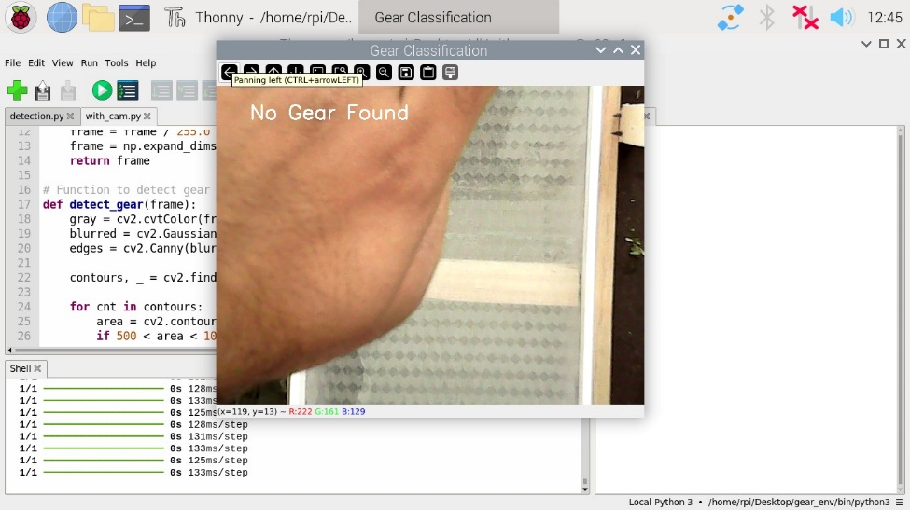
Result
Fig No 5 No Gear
AI-Powered Image analysis for Industrial Object Quality Assurance

Slide 16
Conclusion
This project presents the successful development of an intelligent, real-time quality inspection system that leverages machine learning and image processing technologies to detect manufacturing defects with high accuracy and efficiency. By utilizing Raspberry Pi for edge computing, OpenCV for image processing, and TensorFlow for deep learning-based classification, the system offers a low-cost, scalable, and automated solution suitable for various industrial environments. The design ensures quick, reliable defect detection, significantly reducing dependency on manual inspection methods, which are prone to human error and inconsistency.
AI-Powered Image analysis for Industrial Object Quality Assurance

Slide 17
References
[1] .Mohandas, R., Southern, M., O’Connell, E., & Hayes, M. (2024), “A Survey of Incremental Deep Learning for Defect Detection in Manufacturing”, Big Data and Cognitive Computing, 8(1), 7.
[2] Chen, Y., Ding, Y., Zhao, F., Zhang, E., Wu, Z., & Shao, L. (2021). “Surface defect detection methods for industrial products A review”, Applied Sciences, 11(16), 7657.
[3] Czimmermann, T., Ciuti, G., Milazzo, M., Chiurazzi, M., Roccella, S., Oddo, C. M., & Dario, P. (2020). “Visual-based defect detection and classification approaches for industrial applications—a survey”, Sensors, 20(5), 1459.
[4] Tulbure, A. A., Tulbure, A. A., & Dulf, E. H. (2022). “A review on modern defect detection models using DCNNs–Deep convolutional neural networks”, Journal of Advanced Research, 35, 33-48.
[5] Ren, Z., Fang, F., Yan, N., & Wu, Y. (2022). “State of the art in defect detection based on machine vision”, International Journal of Precision Engineering and Manufacturing-Green Technology, 9(2), 661-691.
AI-Powered Image analysis for Industrial Object Quality Assurance

