Slide 1

CRIMEGUARD AI
Crime Resolution, Predicted. Actioned.
AI-Powered Crime Resolution Prediction & Investigation Support
· CAPSTONE PROJECT PRESENTATION
· MACHINE LEARNING
CRIMEGUARD AI
01

Slide 2



Problem statement
In an era of rising urban challenges and limited law enforcement resources, the critical question is
How can we predict and improve crime resolution rates while enhancing overall public safety ?
Crime incidents vary significantly depending on multiple environmental and operational factors such as crime severity, police response time, officer allocation, weapon involvement, population density, CCTV coverage, and prior crime history. Traditional crime analysis methods depend mainly upon historical reports and descriptive statistics, making it difficult to identify patterns and optimize law enforcement strategies.
CrimeGuard AI turns historical case data into Actions Insights — so investigators can focus effort where it matters most.
Rising Caseloads
Limited Officers
Inconsistent Prioritisation
Crime volume keeps growing while investigative teams stay the same size.
Departments can't put full effort behind every single reported case.
Without data, urgent, solvable cases can get the same attention as cold ones.
CRIMEGUARD AI
02

Slide 3



OBJECTIVE
What CrimeGuard AI Delivers
CrimeGuardAI is an advanced, AI-powered web application designed to predict the likelihood of a reported crime being resolved. By analyzing historical crime data and leveraging machine learning, it provides investigators and analysts with a statistical probability of a successful outcome based on case characteristics.
CrimeGuard AI is designed for police departments, law enforcement agencies, crime analysts, and government organizations to help predict crime resolution probability and support faster decision-making.
Instant Prediction
Risk Scoring
Officer Recommendation
Action Plan
Resolution likelihood for any case in under a second.
Four-tier risk badge — Low to Critical — at a glance.
A severity-driven suggested deployment count.
Prioritised, rule-based next steps for the investigation.
CRIMEGUARD AI
03

Slide 4
DATA FOUNDATION
The Dataset Behind the Model
7,799+
9
15
CASE RECORDS
MODEL INPUT FEATURES :
( Country • Area Type • Crime Type • Crime Severity • Weapon Used • CCTV Coverage • Gang Related • Suspect Status • Lighting Condition)
COUNTRIES COVERED
6
15
2021–25
SUSPECT STATUS:
( Arrested • At Large • Under Investigation • Unknown • Convicted
• Acquitted )
CRIME TYPES
YEARS OF DATA
CRIMEGUARD AI
04

Slide 5

MACHINE LEARNING
Model Comparison & Selection
Model | Accuracy | F1 Score | ROC-AUC
Logistic Regression ★ | 0.7614 | 0.7493 | 0.8010
Random Forest | 0.7620 | 0.7365 | 0.7895
Decision Tree | 0.7310 | 0.7238 | 0.7458
Clean & Encode Data
Train 3 Models
Compare F1 / ROC-AUC
Tune Winner (GridSearchCV)
Selected: Logistic Regression, tuned
Save Model + Columns (joblib)
GridSearchCV → C=100, solver=’lbfgs’, class_weight=None
Chosen for the best balance of F1 and ROC-AUC — not just raw accuracy — since resolved/unresolved cases are imbalanced in the data (~30% resolved).
CRIMEGUARD AI
05

Slide 6



SYSTEM DESIGN
System Architecture
A single Flask application serves both the HTML pages and the prediction API — no separate frontend/backend split.
Browser (Client)
Flask Server
• HTML5 / CSS3 / JS
• Jinja2 page routes
Trained Model
HTTP / JSON
Logistic Regression
(joblib .pkl)
• fetch() → /api/predict
• /api/predict (JSON)
• localStorage — case history
• Data preprocessing + model inference
Loaded once at
server startup
• window.print() → case ticket PDF
• Risk / officers / action-plan rules
CRIMEGUARD AI
06

Slide 7

USER JOURNEY
From Form Submit to Case Report
01
02
03
04
05
Fill Incident Report
POST /api/predict
Model Inference
Save to localStorage
View Case Report
9 case fields on the Home page.
fetch() sends form data to Flask.
Encode → predict → risk → actions.
Result stored in the browser.
Redirected to the full dashboard.
Every prediction is fully traceable: each number on the report comes from either the model's own output or a documented rule — nothing is a placeholder.
CRIMEGUARD AI
07

Slide 8
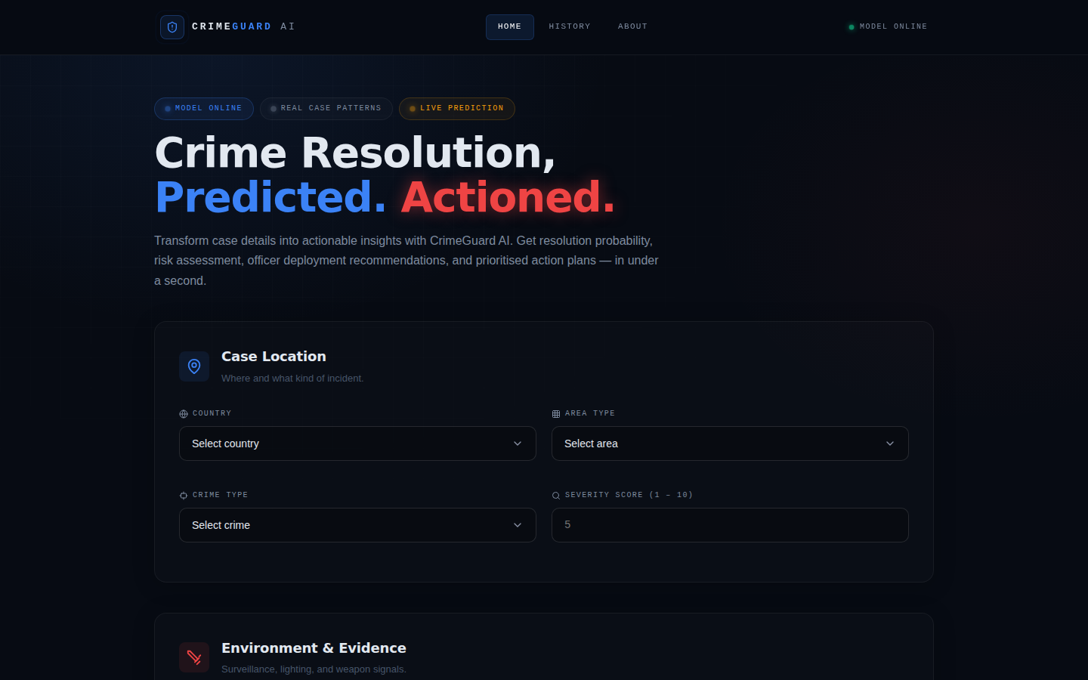
FEATURE WALKTHROUGH
Home — Incident Report Form
Case data organised into three sections: Location, Evidence & Environment, Suspect Profile.
All 9 model features shown directly — nothing hidden, nothing defaulted.
Dark “dispatch terminal” design system used across the whole app.
CRIMEGUARD AI
08

Slide 9
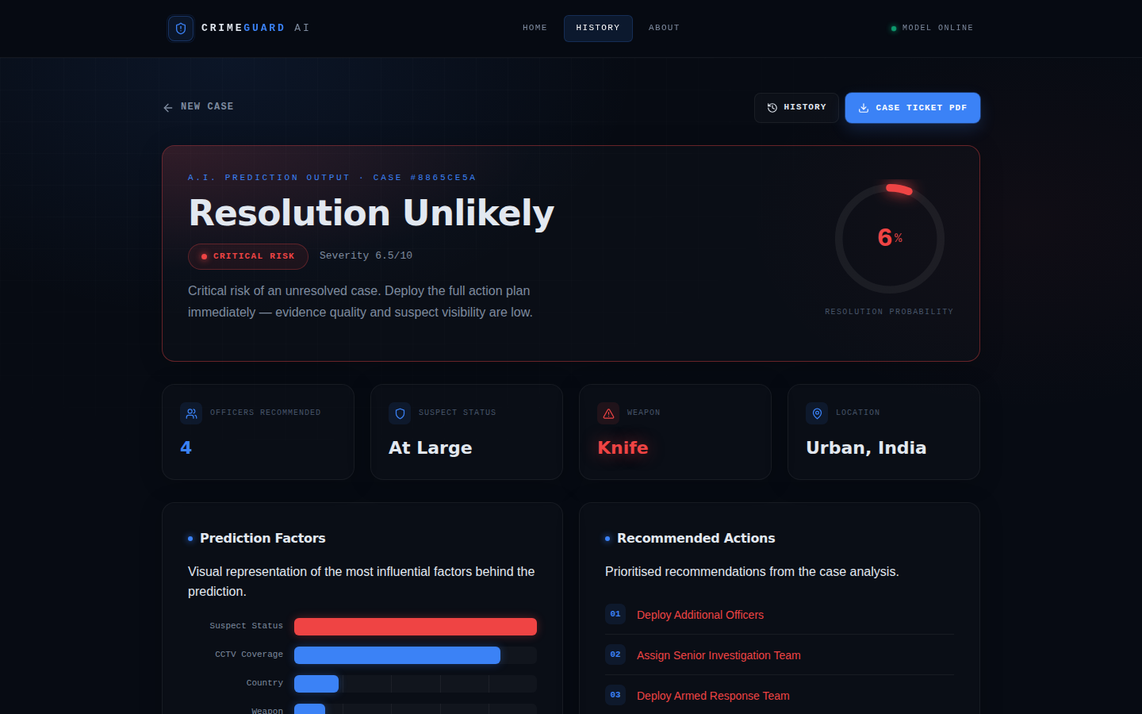
FEATURE WALKTHROUGH
Case Report — AI Verdict
Animated probability ring shows resolution likelihood at a glance.
Risk badge, officer recommendation, and per-case signal contribution chart.
Numbered action plan + a live-style prediction log, plus a printable Case Ticket.
CRIMEGUARD AI
09

Slide 10
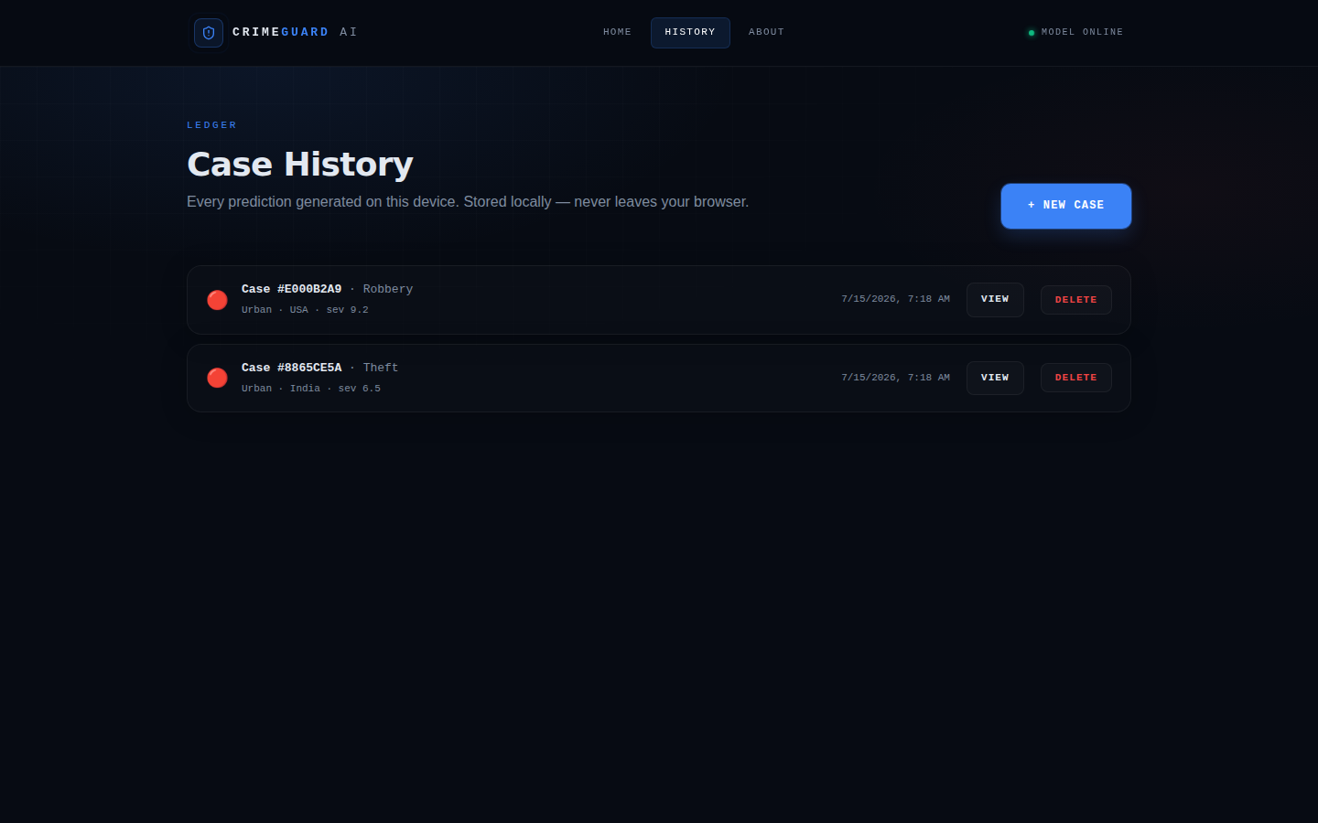
FEATURE WALKTHROUGH
Case History — Ledger
Every prediction made in this browser is listed with quick View / Delete actions.
Stored entirely in localStorage — private to the device, nothing sent to a server.
Empty state guides first-time users straight back to the form.
CRIMEGUARD AI
10

Slide 11
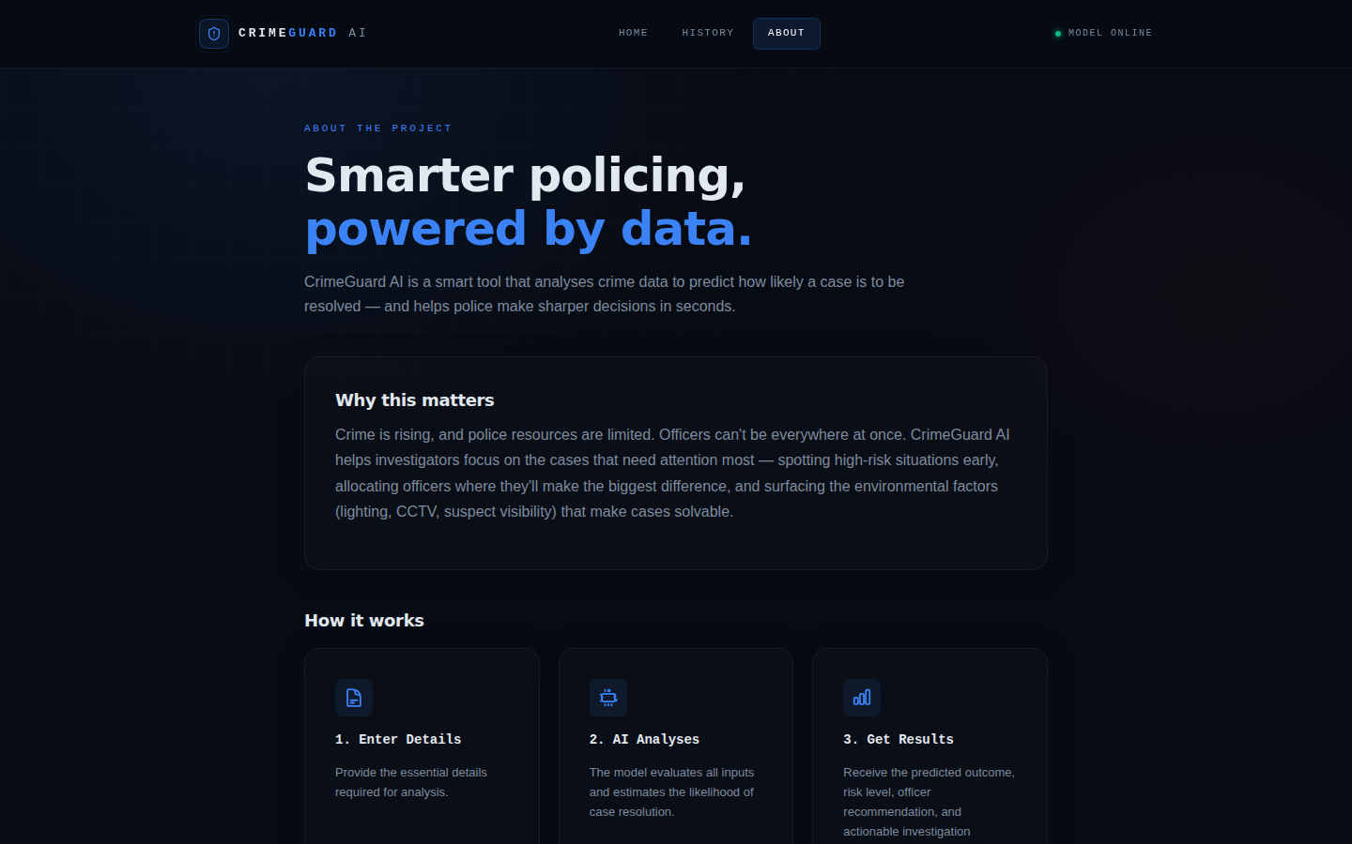
FEATURE WALKTHROUGH
About — Plain-Language Explainer
Why the tool matters, in non-technical language for any reader.
3-step “How it works” and a benefits list.
A clear disclaimer: supports investigators, doesn't replace their judgement.
CRIMEGUARD AI
11

Slide 12

WHAT'S NEXT
Limitations & Future Scope
Current Limitations
Planned Enhancements
• Trained on a limited dataset
• Live Police Database
• No real-time police database integration
• Crime Trend Analytics Dashboard
• No authentication / multi-user support
• User Authentication & Role Management
• Case history stored locally
• Real-time Crime Analytics
CRIMEGUARD AI
14

Slide 13

CONCLUSION
Bringing It All Together
CrimeGuard AI successfully predicts crime resolution likelihood using a tuned Logistic Regression model, wrapped in a full-stack, investigator-ready web application.
End-to-End ML Pipeline
Fully Functional Web App
Consistent, Professional UI
Data cleaning → model comparison → tuning → deployment.
Form → live prediction → risk scoring → action plan.
One design system across every page.
This project demonstrates how a trained ML model can move from a Jupyter notebook to a usable, real-time decision-support tool — directly addressing the resource-allocation problem raised at the start of this presentation.
CRIMEGUARD AI
15

Slide 14
Thank You
Questions & Discussion
CRIMEGUARD AI · CAPSTONE PROJECT · MACHINE LEARNING
CRIMEGUARD AI
15

