Slide 1

BidEasy
B. Tech Final Semester Project Presentation
Date : 17/04/2014
Mentor : Dr. Siddhartha Ghosh, Professor & HOD, CSE, KMIT
Guide : Mr. Mohd. Abdul Rehman, Assistant Professor, CSE, KMIT
Presented by :
S. Vineel, 10BD1A1249
Anith Vishwanath M., 10BD1A1258
Vaibhav Agarwal, 10BD1A1260
@ Copy Right : Dr. Siddhartha Ghosh, January 2014

Slide 2
ConTents : -
1. Problem Definition
2. Study of Existing Systems and outcomes
3. Drawback with existing systems
4. Main Features of proposed system
5. System Requirement Specification – Major Pts.
6. UML Diagrams
7. Software Requirements
8. SE Model Followed: Spiral Model
9. Screenshots of the Website
10. Conclusion

Slide 3
Problem Definition
Online Auctions are very influential e-commerce applications.
The main objective of the project is to build a user friendly online auction marketplace.

Slide 4
Study of existing systems and outcomes..
1. Intuitive graphical user interface.
2. Real-time auctions.
3. Varying auction times.
4. Auction time extensions.
5. Imperative login portal.
6. Different roles (users - sellers, bidders, administrator) get different information.
7. Report of auction results.

Slide 5
STUDY OF EXISTING SYSTEMS AND OUTCOMES
References:
“Online Auctions” by Bernhard Rumpe, Software and Systems Engineering, Munich University of Technology
“Online Auction Business Model” - http://en.wikipedia.org/wiki/Online_auction_business_model

Slide 6
Drawback with existing systems
1. Internationalization not supported.
2. No chat/messaging function.
3. Customized search not available.
4. Redundant links/advertisements everywhere.
5. No feedback system.

Slide 7
The main features of the proposed system
1. C2C business model.
2. Chat feature.
3. Internationalization support.
4. Feedback and complaint system implementation.
5. An Help Section to guide users.

Slide 8
System requirement specification
Major Points – Functional Requirements
User Registration
User Authentication
Post Auction
View Auctions
Feedback/Complaints
Language Setting
Chat

Slide 9
SYSTEM REQUIREMENT SPECIFICATION
Major Points – Non-Functional Requirements
Usability
Portability
Scalability
Testability
Security

Slide 10
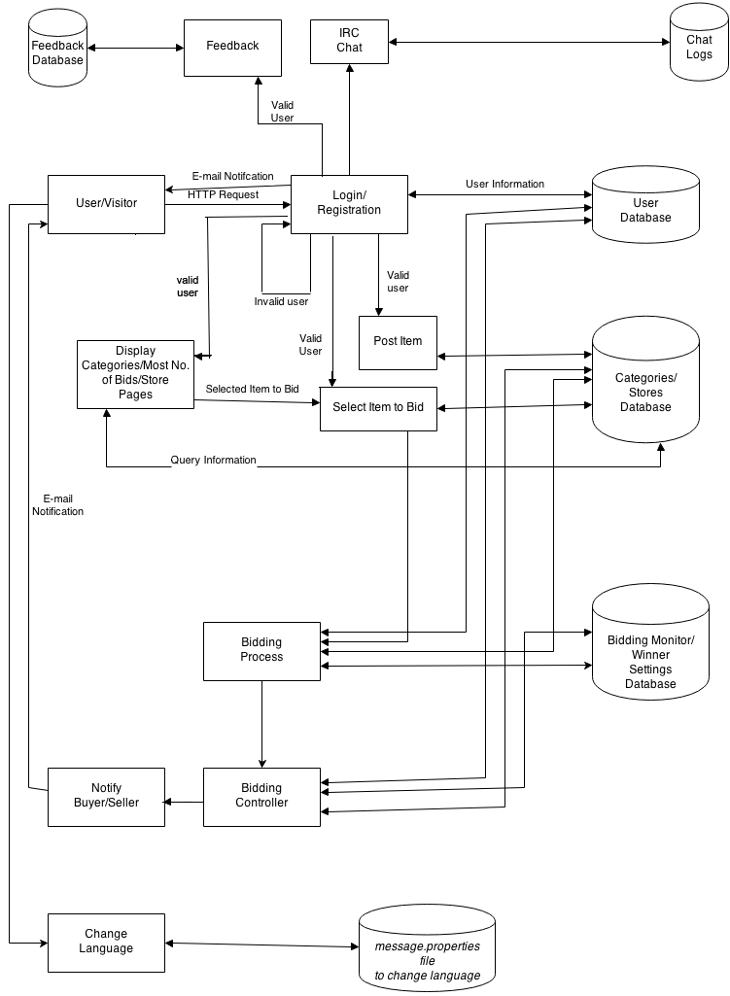
ARCHITECTURE DIAGRAm

Slide 11
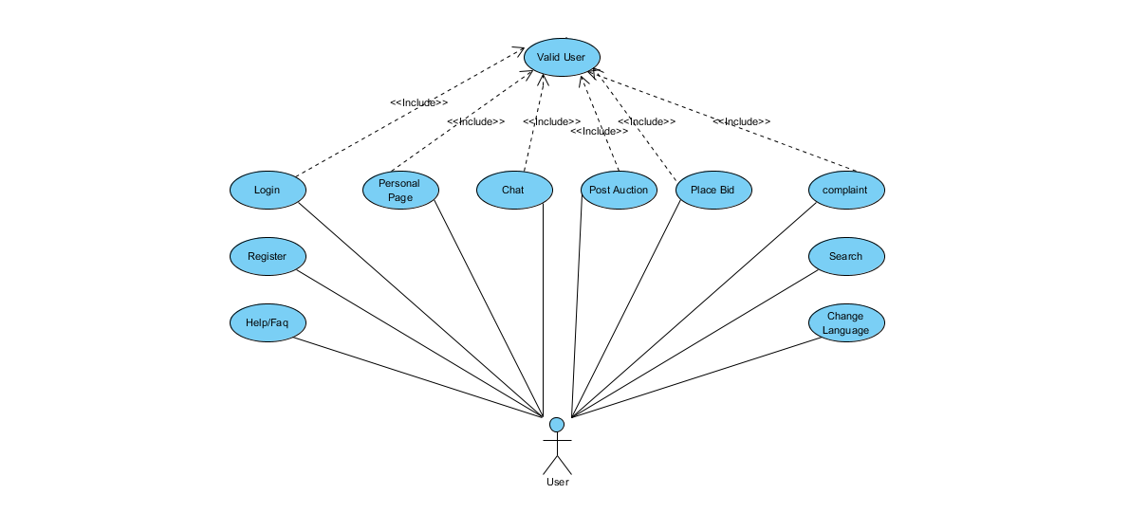
Design : use case diagram 1 (USER)

Slide 12
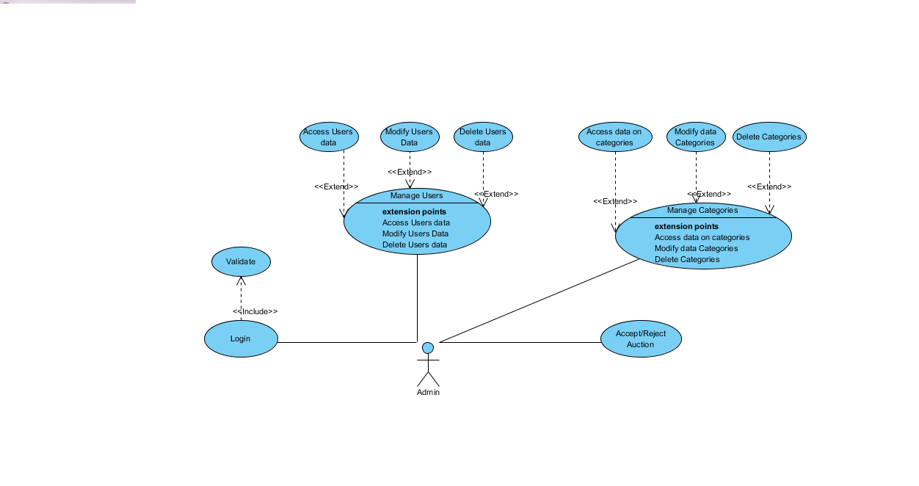
DESIGN: USE CASE DIAGRAM 2 (ADMIN)

Slide 13
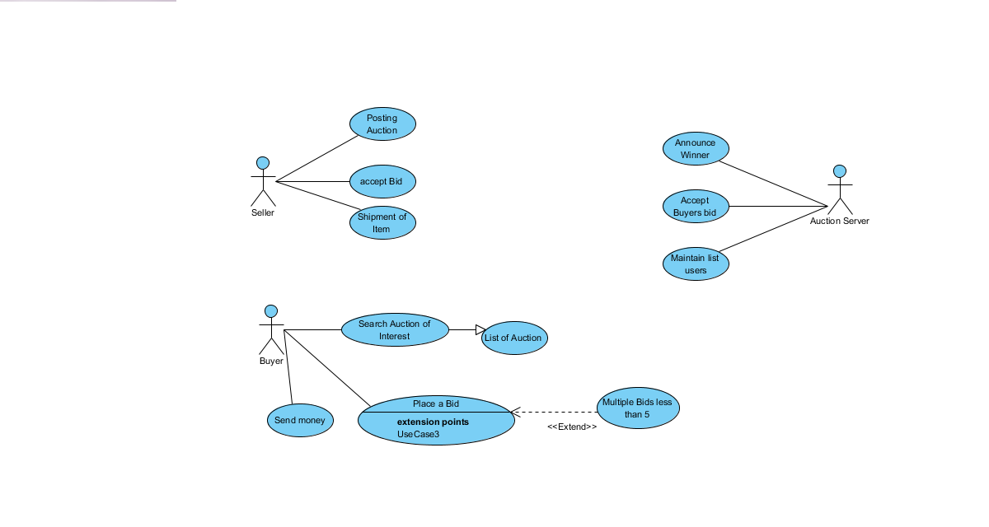
DESIGN: USE CASE DIAGRAM 3

Slide 14
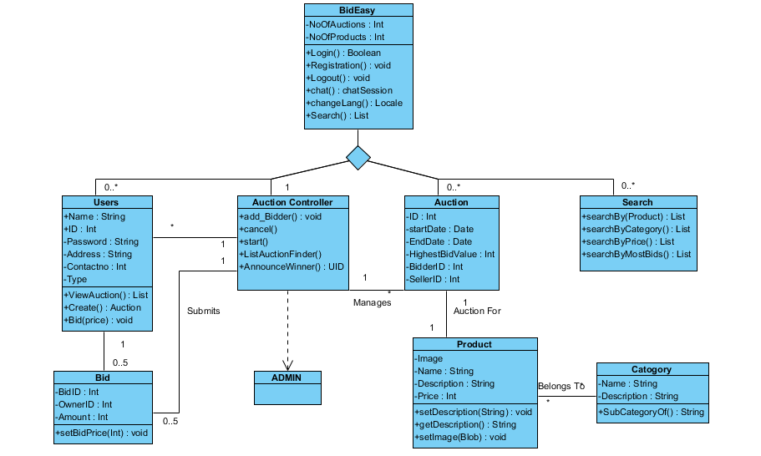
Design : class diagram 1 (OVERALL)

Slide 15
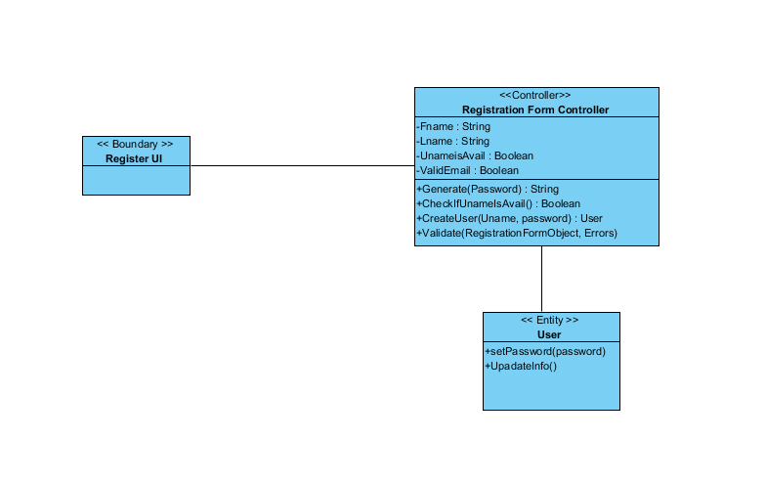
DESIGN: Class diagram 2 (REGISTRATION)

Slide 16
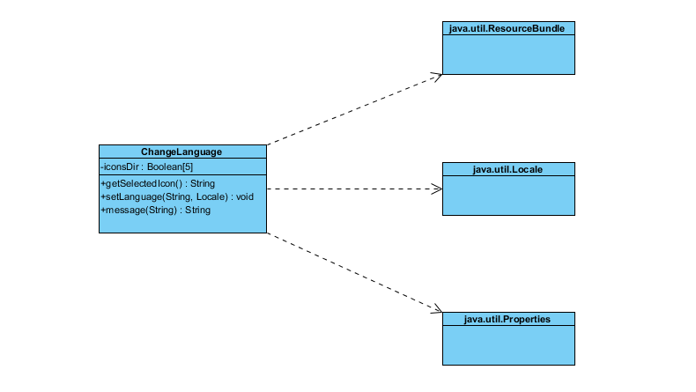
DESIGN: CLASS DIAGRAM 3 (INTL.)

Slide 17
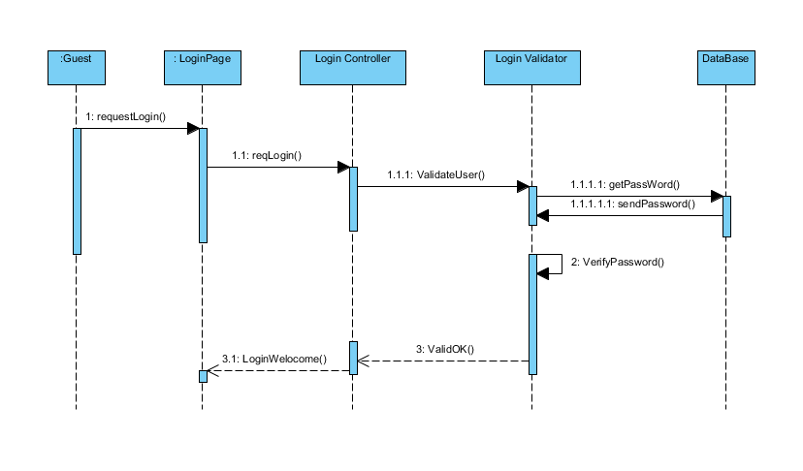
Design : sequence diagram1 (SIGN IN)

Slide 18
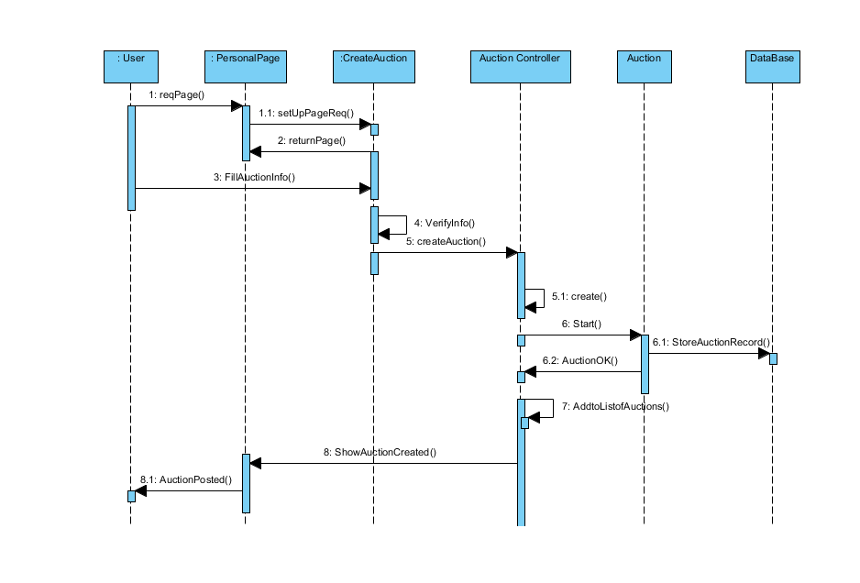
Design : sequence diagram2 (Post AUction)

Slide 19
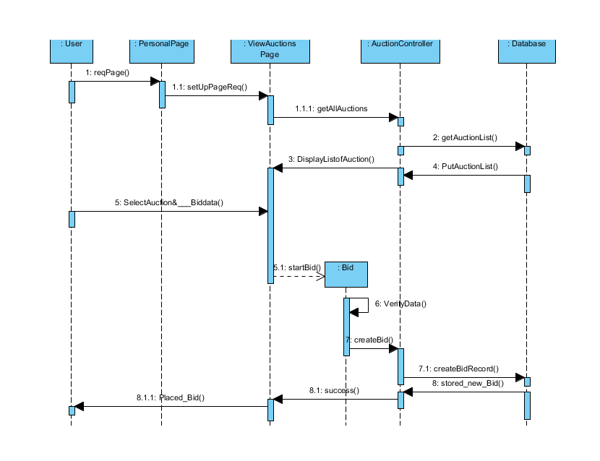
Design : sequence diagram3 (BIDDING)

Slide 20
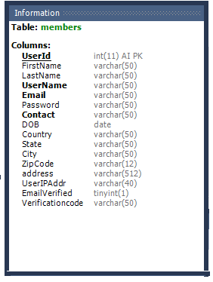
DATABASE TABLES – MEMBERS TABLE

Slide 21
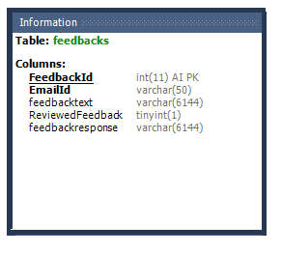
DATABASE TABLES – FEEDBACK TABLE

Slide 22
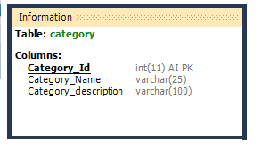
DATABASE TABLES – CATEGORY TABLE

Slide 23
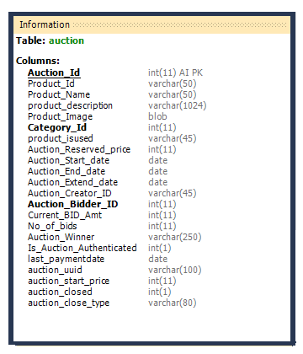
DATABASE TABLES – AUCTION TABLE

Slide 24
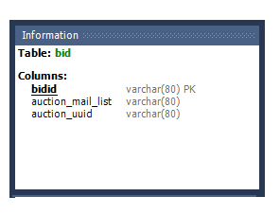
DATABASE TABLES – BID TABLE

Slide 25
SOFTWARE REQUIREMENTS
Client on Internet: Web Browser, Operating System (Windows xp minimum)
Application Server: Apache Tomcat
Database Server: MySQL
Network: Internet
Development Tools: Eclipse IDE (Juno), Visual Paradigm, MySQL Workbench, Apache Tomcat 7

Slide 26
Se model followed : spiral model
What is the Spiral Model?
Iterative software development model.
Combination of waterfall and prototype models.
Activities arranged in the form of a spiral.
Generally implemented in high-risk software projects.

Slide 27
SPIRAL MODEL PHASES
Each loop in a spiral represents a development phase .Each loop has four sections or quadrants :
Customer Communication & Planning.
Risk Analysis
Engineering
Customer Evaluation

Slide 28
Advantages OF Spiral Model
Risk management is easily carried out.
Project Monitoring is very easy and effective.
Changes can be introduced later in the life cycle as well.
It is suitable for high risk projects.
A highly customized product can be developed using this.

Slide 29
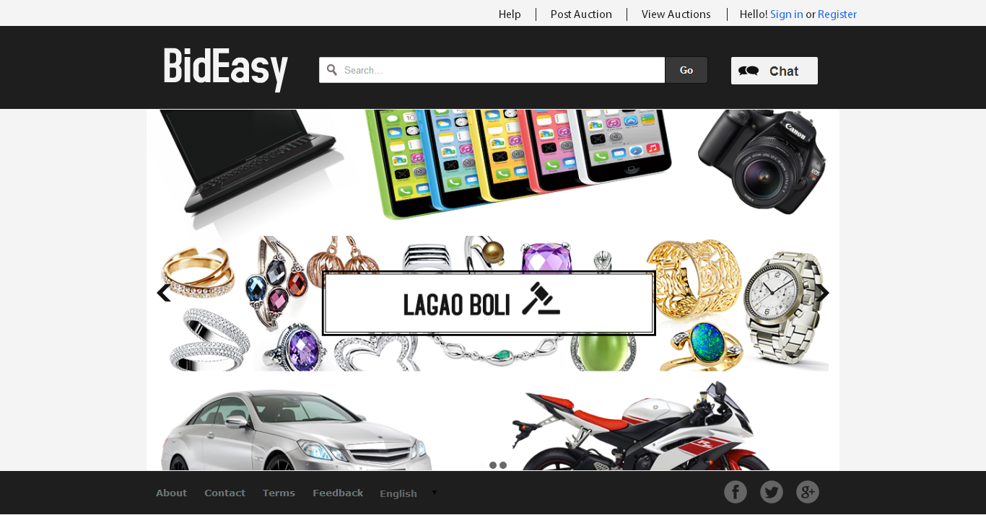
MAIN PAGE (INDEX)

Slide 30
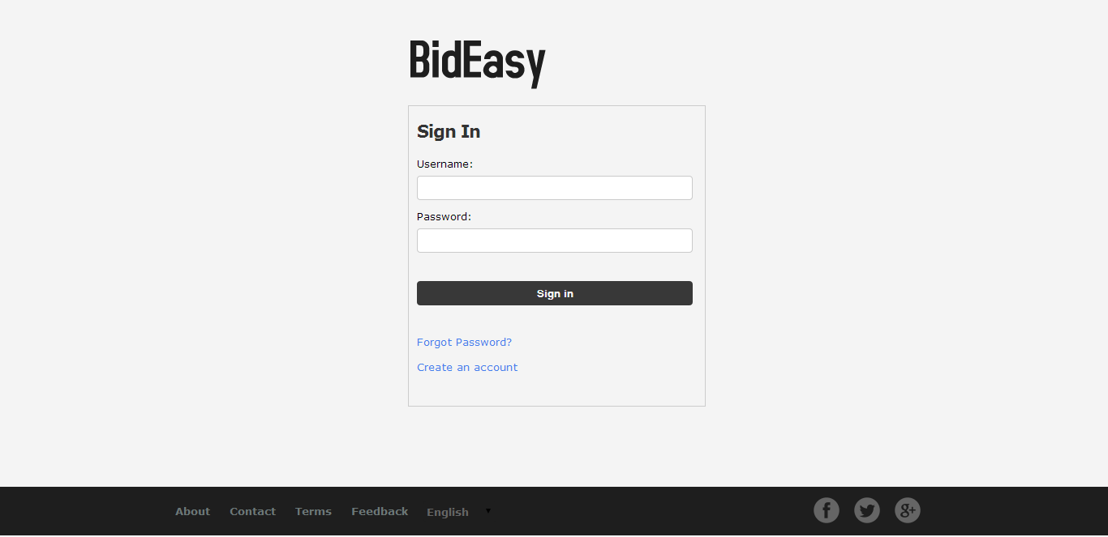
LOGIN SCREEN

Slide 31
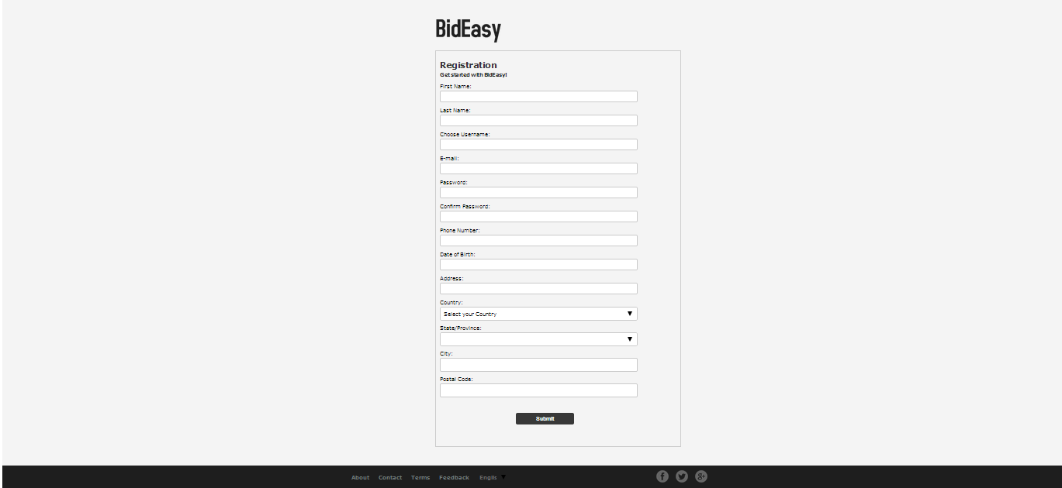
REGISTRATION SCREEN

Slide 32
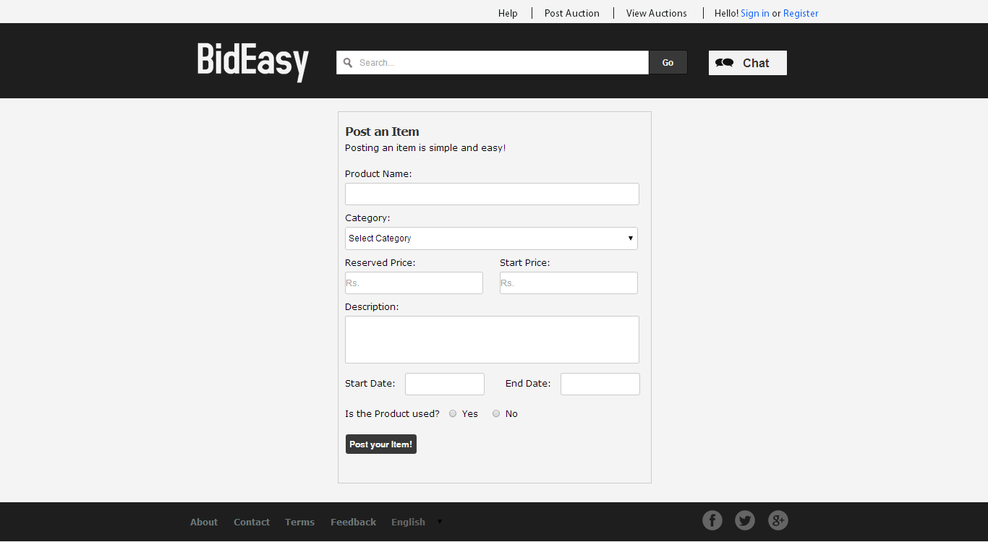
POST AUCTION SCREEN

Slide 33
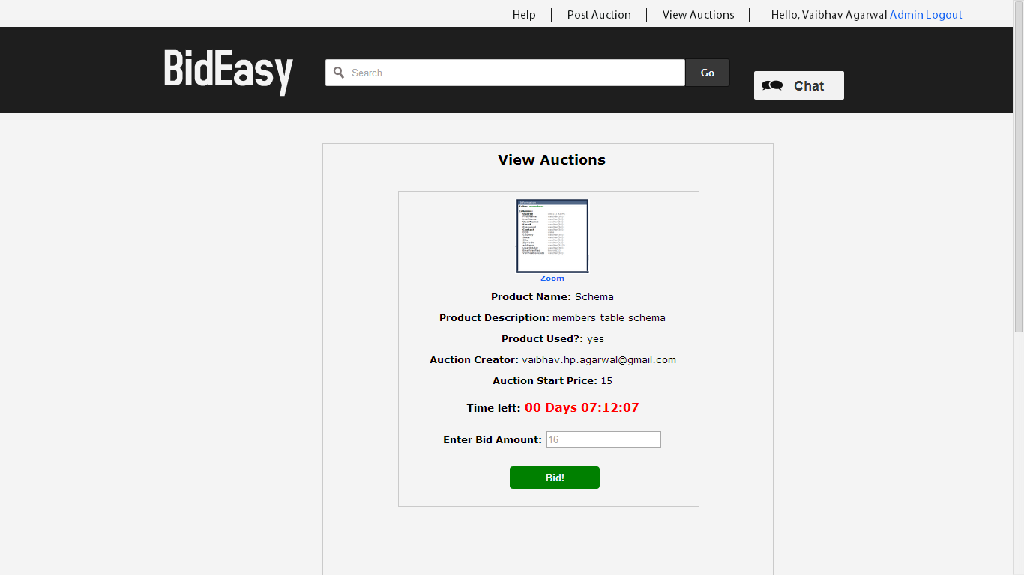
VIEW AUCTION SCREEN

Slide 34
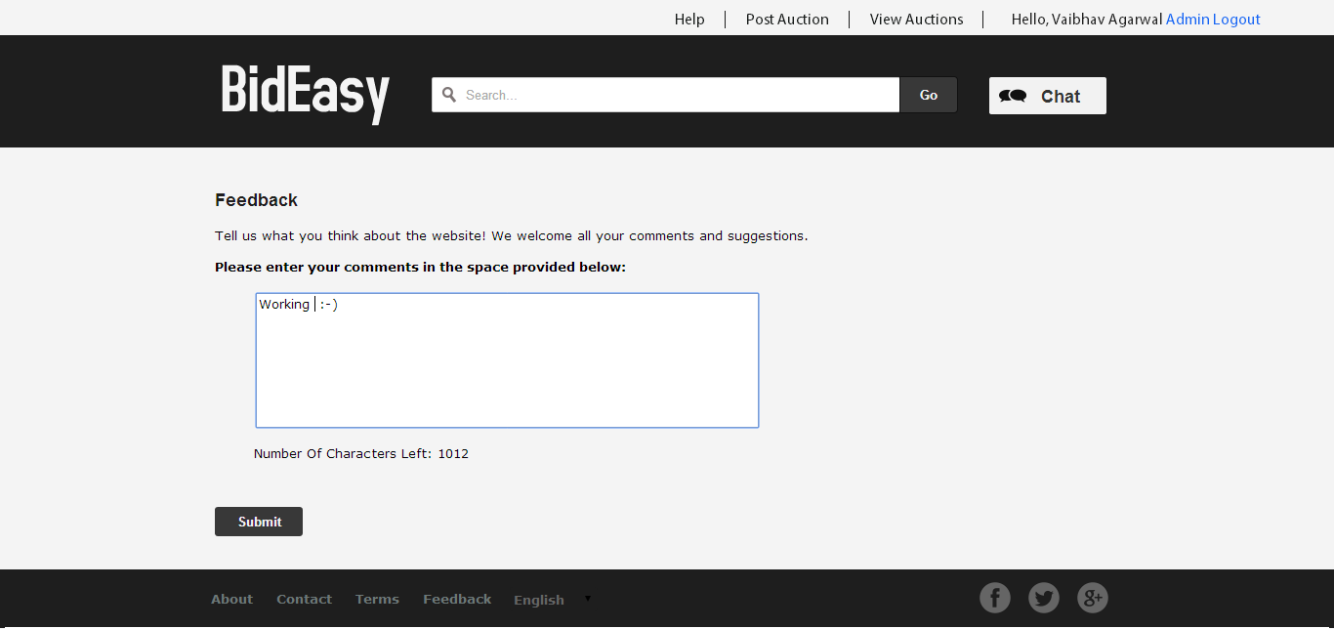
FEEDBACK SCREEN

Slide 35
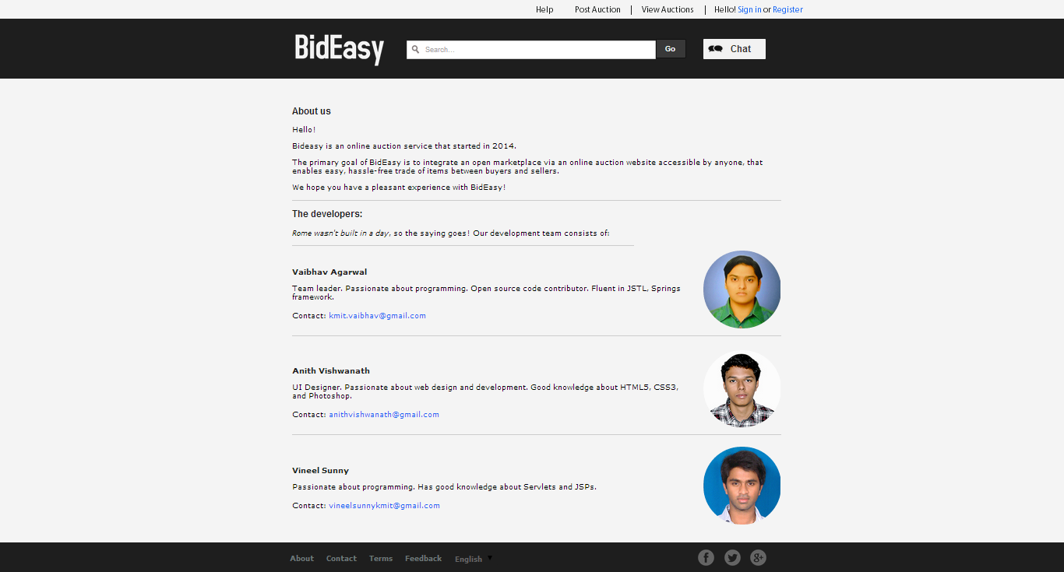
ABOUT SCREEN

Slide 36
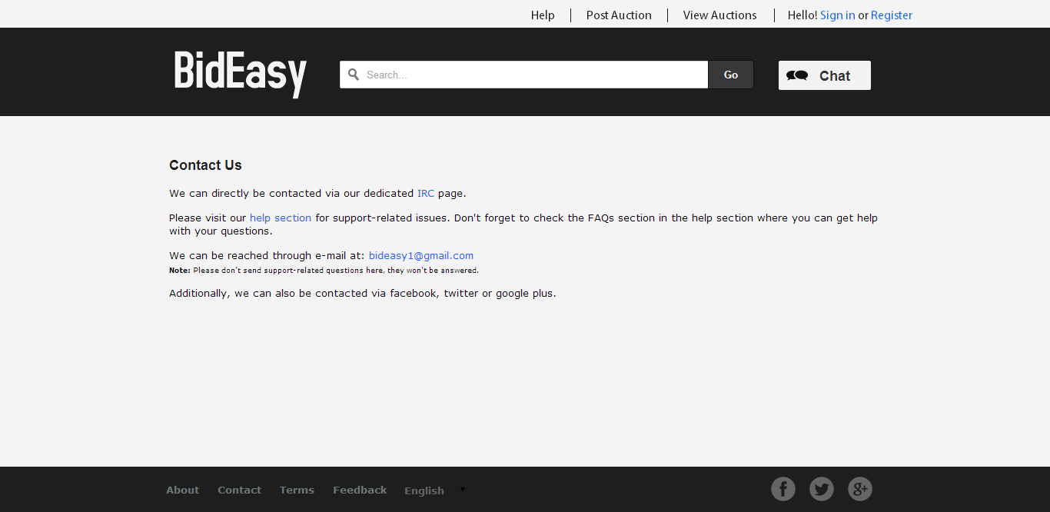
CONTACT SCREEN

Slide 37
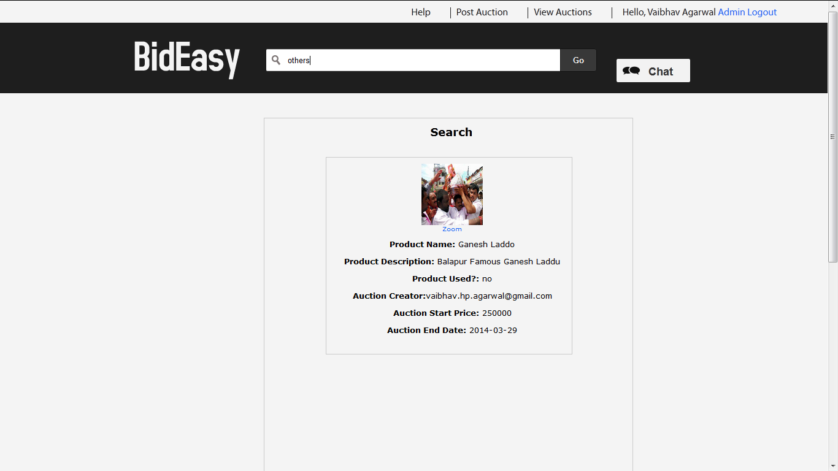
SEARCH SCREEN

Slide 38
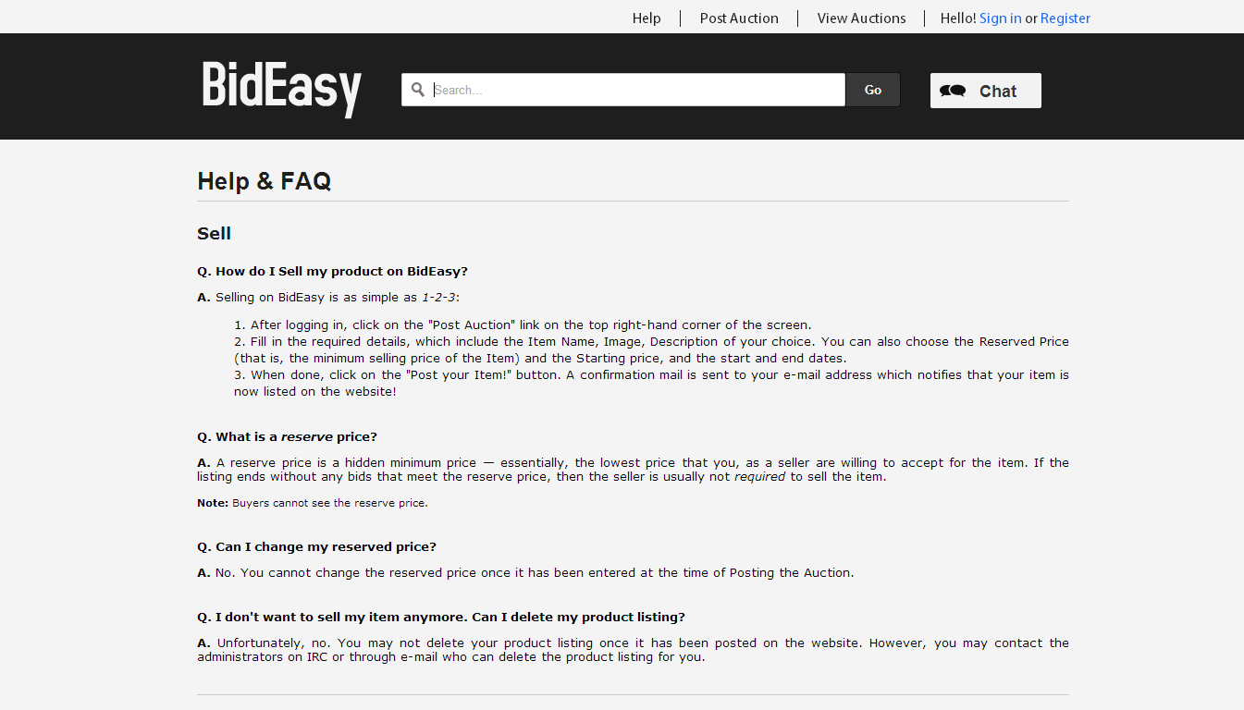
HELP SCREEN

Slide 39
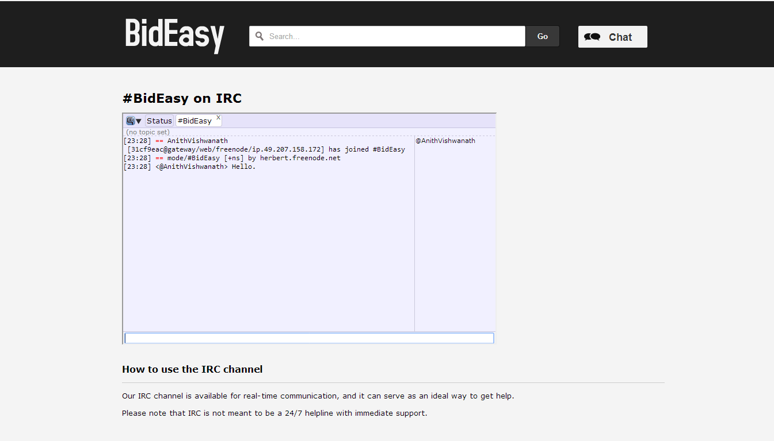
CHAT SCREEN

Slide 40
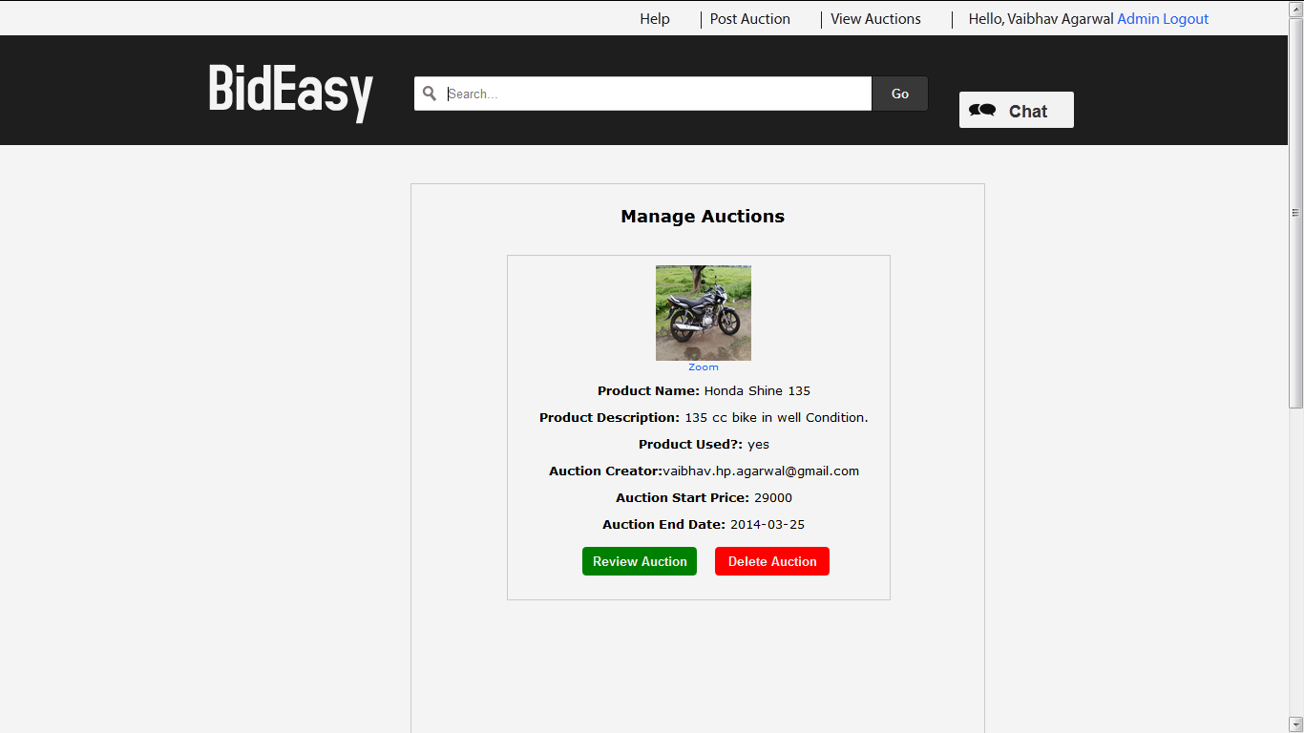
MANAGE AUCTION SCREEN

Slide 41
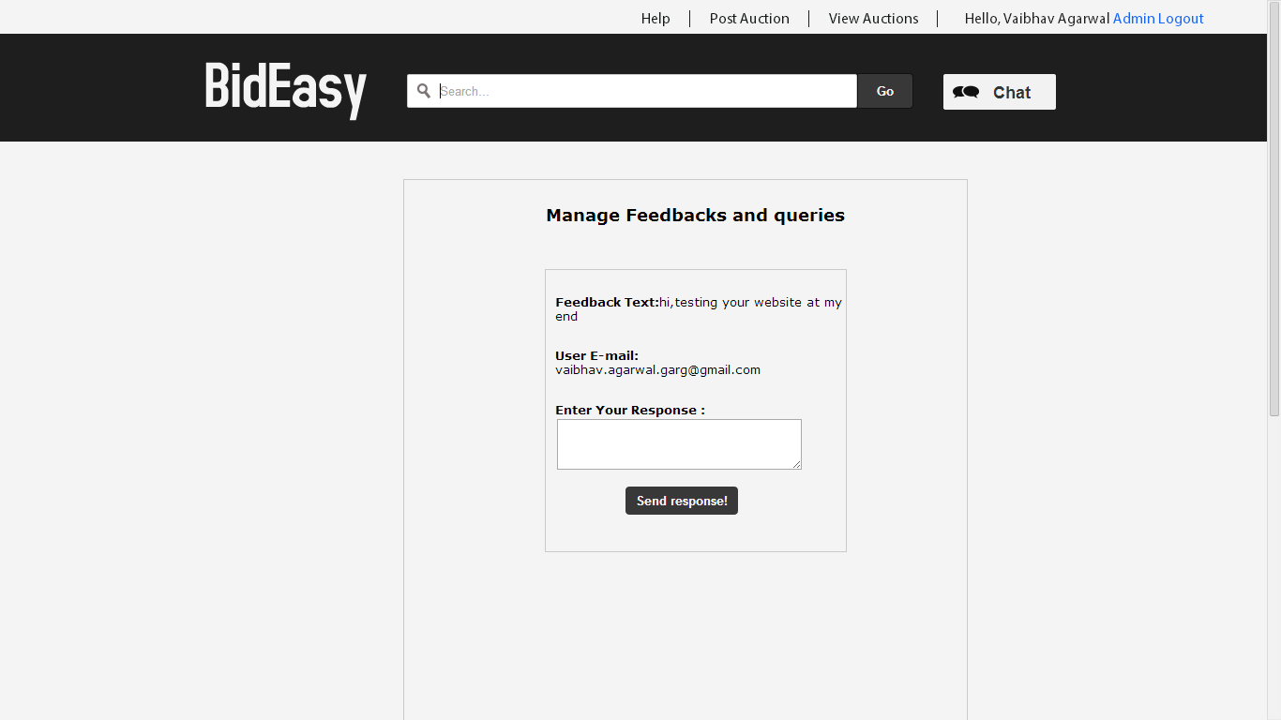
MANAGE FEEDBACK SCREEN

Slide 42
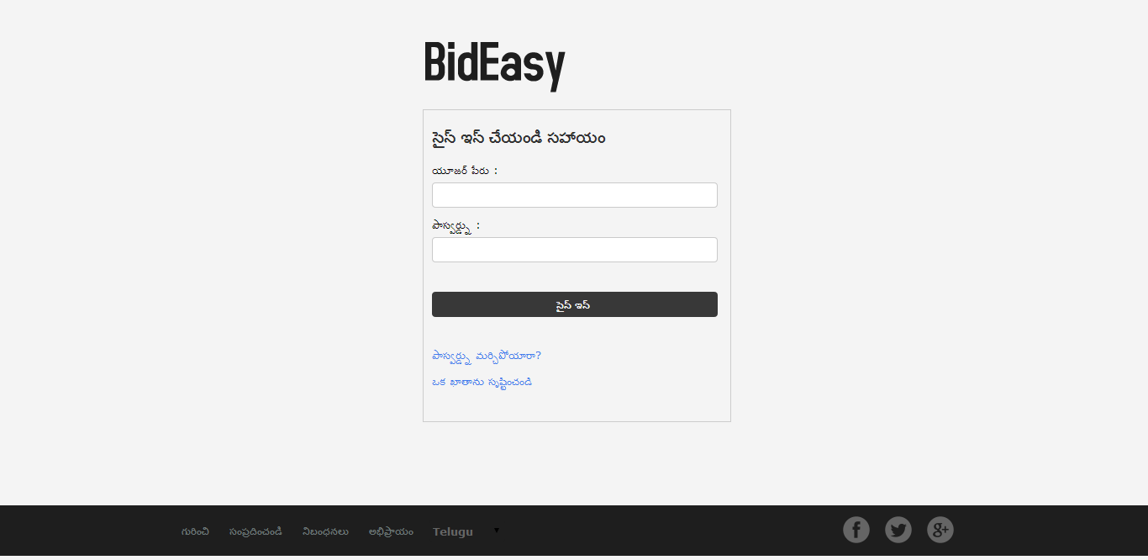
INTERNATIONALIZED SCREEN (LOGIN)

Slide 43
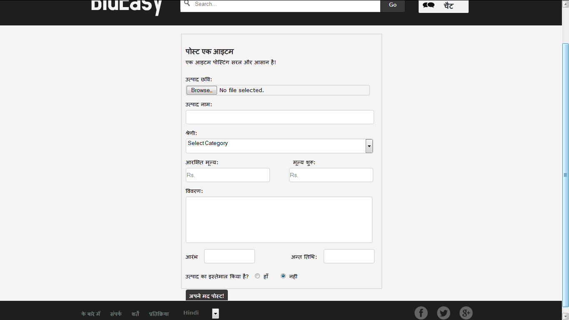
INTERNATIONALIZED SCREEN (POST AUCTION)

Slide 44
FUTURE ENHANCEMENTS
Add attractive Graphical User Interface to some components of the website.
Add Credit Card/Paypal payment system.
Work on improved search system.
Use a suitable framework. (Struts/Springs/Salesforce)
Add notification feature. (Instead of mass e-mail messages to users)

Slide 45
CONCLUSION
We conclude that our website has extra functionality compared to the existing online auction websites such as internationalization, chat, search and feedback, and also a simple module for posting and bidding of items.

Slide 46
Thank you!!

