Slide 1
RESPONSIVE WEB DESIGN

Slide 2
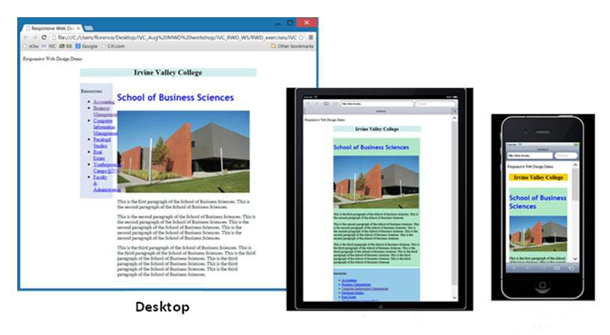
What is Responsive Web Design (RWD)?
Tablets
Smart phones
A design when the layout and content adapts to the user’s devices: screen size, platform and orientation
The design and development should respond to the user’s behavior
The website that have the technology to automatically respond to the user’s preferences.
Notes:
<number>

Slide 3
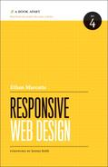
History of the Responsive Web Design
The term Responsive Web Design was first coined by Ethan Marcotte in his article A List Apart in May 2010
http://alistapart.com/article/responsive-web-design
He defined the technique of RWD by using fluid grids, flexible images, and media queries to deliver different visual experiences for different screen sizes.
Ethan expanded his RWD theory and
published his book titled
Responsive Web Design.
Notes:
<number>

Slide 4
Why Should We Build a Responsive Web?
Each year new devices are pouring into the market, responsive web design let us build one site, and modify it to adapt the new device’s screen size
Build once for all devices
Easy to manage content editing through a single CMS (Content Management System)
If we have a working website:
Not need to rebuild new websites to adapt the new devices
We can convert the existing working website to a responsive Web site to adapt all kind of devices
Notes:
<number>

Slide 5
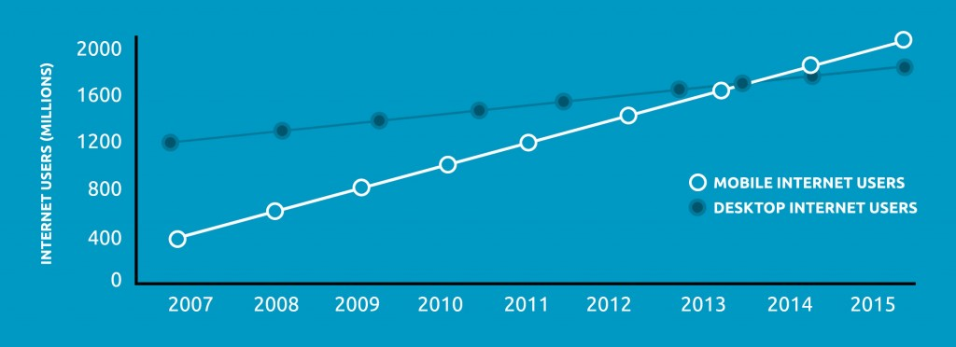
Paradigm Shift towards Mobile
International Data Corporation predicted that by the end of 2013, tablet sales will exceed that of portable PCs.
Mobiles Vs. Computers: 2007-2015
Global internet user projection research by Morgan Stanley
Notes:
<number>

Slide 6
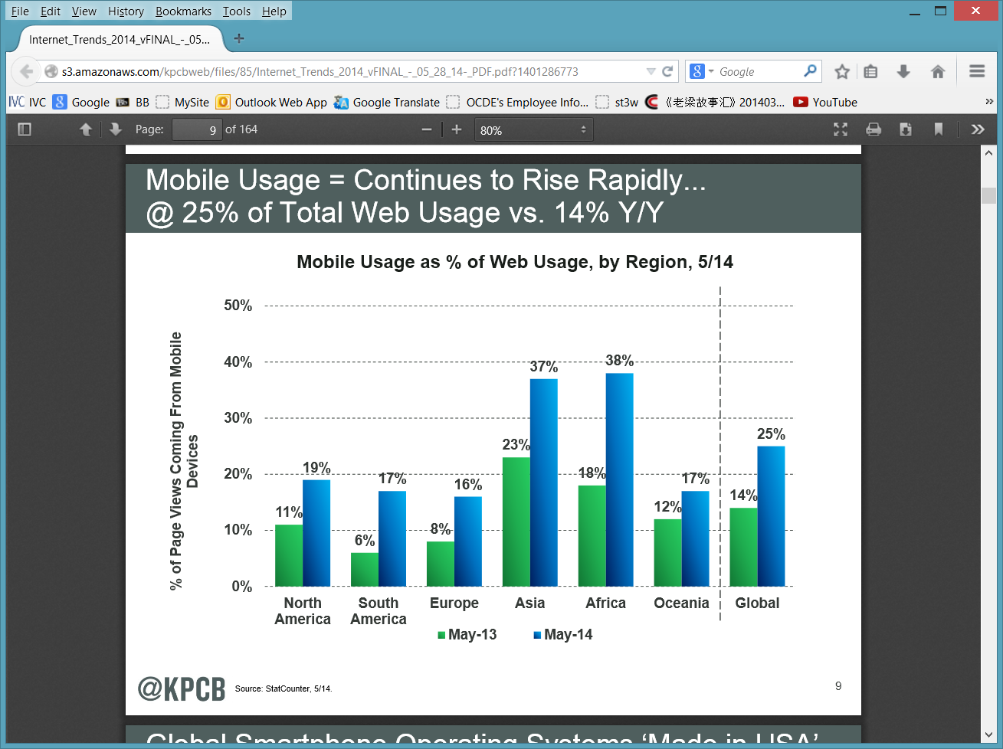
Paradigm Shift towards Mobile (continued)
Mary Meeker in her 2012 internet Trends Report notes mobile makes up 15% of Web traffic, up from 10% a year ago
Her recent report showed the following chart
Notes:
<number>

Slide 7
Advantages of RWD
One single HTML document to be maintained
One single CSS file to be maintained
The site is easily accessible on any type of device.
Better user experience.
Users will have a similar experience using the site when they access the site from different devices.
Responsive Web is flexible and adaptable
Maintaining a RWD is:
Easier than maintaining several website for different devices.
Notes:
<number>

Slide 8
Fundamental Techniques for RWD
There are three parts in Responsive Wed design:
Flexible, grid-based layouts
The web sites are built using percentage for the widths
Media queries
Use a module from the CSS3 specification
Flexible media & images
When screen size begins to change, the media/images need to be flexible to suit the screen size
Notes:
<number>

Slide 9
Techniques for RWD: Flexible, grid-based, Layout
Idea behind liquid layout: it’s more carefully designed in terms of proportion→ use percentage
Proportion of each page element is the target element divided by the context
Example:
suppose your desktop layout has the main wrapper with the width of 960px and
suppose that the target element is 300px wide
then the proportion would be 31.25%
300px / 960px = 31.25%

Slide 10
Techniques for RWD: Media Queries
Media queries is the backbone of RWD
Media queries provide the ability to
Specify different styles for individual browser device circumstances
Specify the width of the viewport or device orientation
Using Media queries in the CSS file to change the styling of the HTML elements is based on certain breakpoints.

Slide 11
Techniques for RWD: Flexible Media & Images
Using media queries, designers are able to:
Extend the media declarations to include various media properties, based on device being used. Such as:
screen size, orientation, and color
write a rule that prevents images from exceeding the width of their container

Slide 12
The viewport meta tag
Viewport meta tag:
Tells the browser how to behave when rendering the page – you tell the browser how big the viewport will be
Use the viewport meta tag in the <head> section
If we are using RWD, it’s good to have the meta tag viewport as
<meta name="viewport" content="width=device-width, initial-scale=1">
No zooming
Adapt to the width of the device
Notes:
<number>

Slide 13
Coding Meta Viewport tags
There are two ways to add the viewport tag for overriding the default viewport by user agent.
Use the @viewport CSS rule.
This is still relatively new and mostly unsupported for now.
/* CSS Document */
@viewport {width: 480px; zoom: 1;}
Use the viewport meta tag
This is almost supported universally.
<meta name="viewport" content="width=device-width, initial-scale=1">

Slide 14
Coding Meta Viewport tags (continued)
<meta name="viewport" content="width=device-width,
initial-scale=1">
width=device-width:
The page adapts to the device’s width
Syncs with the device’s width
initial-scale=1:
Make the initial scale at 100%
When the viewport is larger than the screen width, the scale factor will shrink down to fit the width within the viewport.

Slide 15
Coding Media Queries
The following code will display the font-size at 100% if the width is at least 1024 px
The following code tests the orientation and the device-width
The logical operators are pretty interchangeable:
The operator “and” can be replaced with “not”. The orientation “portrait” with “landscape”.
@media screen and (min-width: 1024px) {
body {font-size: 100%;}
}
@media screen and (min-device-width: 480px) and (orientation: landscape) {
body { font-size: 100%; }
}

Slide 16
Coding Media Queries (Continued)
The following code renders a page that the body background color will change to blue only between 500px and 700px.
The following code displays an orange background color when a device hits 1024px width and changes to yellow when the display of a device drop into mobile territory.
@media screen (min-width:500px)and (Max-width:700px){
body {background: blue;}
}
@media (max-width: 1024px) {
body { background: orange;}
}
@media (max-width: 768px) {
body {background: yellow;}
}

Slide 17
Definitions
Width = width of the display area
Device-width = width of device
Orientation = orientation of the device
Aspect-ratio = ratio of width to height
It is expressed by two numbers separated by a slash
Device-aspect-ratio = ratio of device-width to device-height
Resolution – density of pixels of output device (dpi)
Notes:
<number>

Slide 18
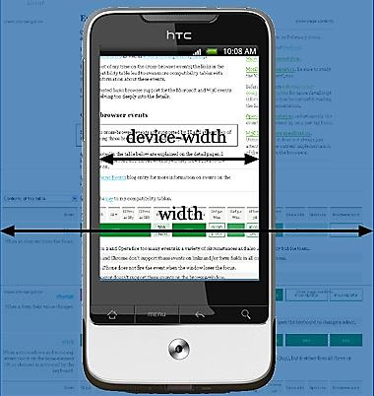
Media Queries Together with Viewport
It is not a good idea to use the media queries without a meta viewport tag
Some mobile browsers have a default layout viewport of around 850 to 1000 pixels
The page will be much larger than the device width

Slide 19
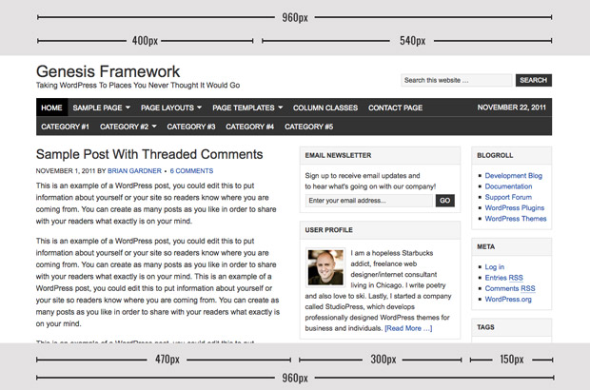
Converting an Existing Page to RWD
Let’s say the existing page has the following layout
Notes:
<number>

Slide 20
Converting an Existing page to RWD (continued)
Assume the existing page has the following basic structure of HTML code
<div id="wrap">
<div id="header">
<div id="title-area"></div>
<div class="widget-area"></div>
</div>
<div id="inner">
<div id="content-sidebar-wrap">
<div id="content"></div>
<div id="sidebar"></div>
</div>
<div id="sidebar-alt"></div>
</div>
</div>
Notes:
<number>

Slide 21
Converting an Existing page to RWD (continued)
Assume the existing page has the following basic structure of CSS code
#wrap {width: 960px; }
#header {width: 960px;}
#title-area {width: 400px;}
#header .widget-area {width: 540px;}
#inner {width: 960px;}
#content-sidebar-wrap {width: 790px;}
#content {width: 470px;}
#sidebar {width: 300px;}
#sidebar-alt {width: 150px;}
Notes:
<number>

Slide 22
Converting an existing page to RWD (continued)
Suppose the target goal is 960px wide
#wrap {width: 100%; }
#header {width: 100%;}
#title-area {width: 41.666667%;}
#header .widget-area {width: 56.25%;}
#inner {width: 100%;}
#content-sidebar-wrap {width: 82.291667%;}
#content {width: 48.958333%;}
#sidebar {width: 31.25%;}
#sidebar-alt {width: 15.625%;}
Formula:
(original pixels/target goal pixels)* 100%
Example for the #title-area:
(400px/960px)*100% = 41.666667%
Notes:
<number>

Slide 23
Converting an existing page to RWD (continued)
The ul in the sidebar
Flexible images
img { max-width: 100%; }
/*The pixel for the margin is 25px */
.widget-area ul {
margin: 10px 0 0 25px;}
/*the percentage conversion of the target margin*/
.widget-area ul {
margin: 10px 0 0 16.666667%;}
This pixel is 150 because that is the width of the sidebar.
(25/150) * 100%)= 16.666667%;

Slide 24
Converting Exercise: Do not Round up!
Do not round up, keep the long decimal points
Because each browser rounds the percentage differently, if you round the percentage, you need to tweak each section

Slide 25
Converting Exercise, inserting media queries
Add two media query break points at the end of the style section
Note: The two media queries are provided for you at the right.
@media screen and (max-width:830px) {
#content {
float: left;
width: 98%;
margin-top:5px;
}
nav li;
nav a {
display:block;
}
}
@media screen and (max-width:480px) {
#content {
float: none;
width:95%;
}
}

Slide 26
Testing the Responsive design
Test with the new media queries to see whether or not they're hitting the right breakpoints.
Resize the browser window to see the changes
This is helpful and gives immediate feed back, however:
The feed back is not really the actual trigger points
It does not show how the site will render
It overlooks the performance
Notes:
<number>

Slide 27
Testing the Responsive design (continued)
Use online simulator testing tools
There are many free online testing tools to help test more precisely and to speed up the process.
Using online mobile emulators:
programs that simulate a specific mobile device, browser, or operating system
Test on actual devices, best way, but it is expensive to have all the devices on hand and to purchase more new ones.
Notes:
<number>

Slide 28
Online Simulator Testing Tools
Benjamin Keen Bookmarklet
http://www.benjaminkeen.com/open-source-projects/smaller-projects/responsive-design-bookmarklet/
The following online simulator allows you to just enter the URL
Responsivepx by Remy Sharp: users have control of the precise width
http://responsivepx.com/
Responsive.is: it provides icon for difference devices: http://www.headlondon.com/
Mobiltest: user can chose the devices, also provides the average load time
http://mobitest.akamai.com/m/index.cgi
Notes:
<number>

Slide 29
Online Emulator Testing Tools
TestiPhone.com
Opera's Mini simulator
Download and install emulators:
Opera's Mobile emulator
Apple SDK, the emulators comes with Apple's iOS
Android SDK, the emulators comes with Android OS.
Notes:
<number>

Slide 30
Debugging Tools
Tools for debugging when the behavoir is not expected after testing
Opera's Remote Debugger
Dragongly: Debug on the desktop with the site on a mobile device
WebKit remote debugging
Weinre
Web Inspector
Notes:
<number>

