Slide 1


Slide 2

When a particular time period is to be given as gap between same or different events to be performed we use timing events.
The window object allows execution of code at specified time intervals.
These time intervals are called timing events.

Slide 3

The two key methods to use with JavaScript are:
setTimeout(function, milliseconds)
Executes a function, after waiting a specified number of milliseconds.
setInterval(function, milliseconds)
Same as setTimeout(), but repeats the execution of the function continuously.

Slide 4
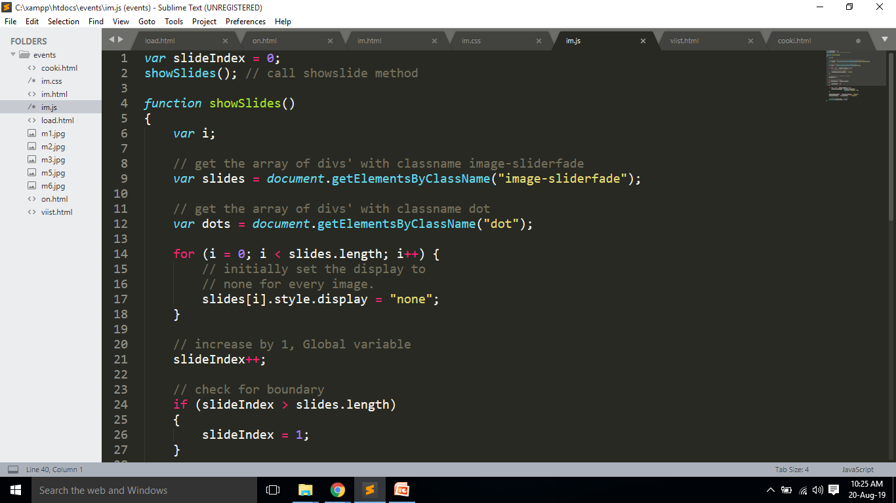

Slide 5

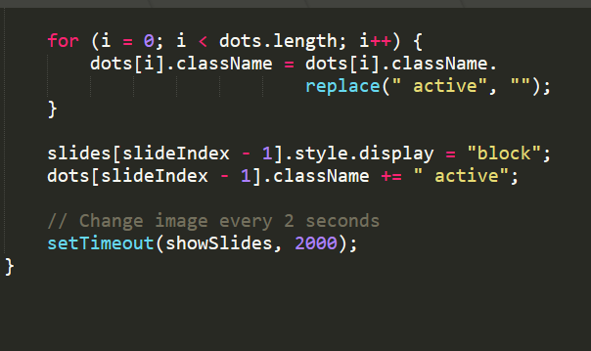

Slide 6

(session management)

Slide 7

A cookie is a method for a Web server to maintain state information about users as users navigate different pages on the site, and as users return to the site at a later time.

Slide 8
Cookies are little bits of information that you can leave on a user's hard drive, where they stay even after the user leaves your site or turns off the computer, which is extremely useful when you want to remember information about visitors.

Slide 9
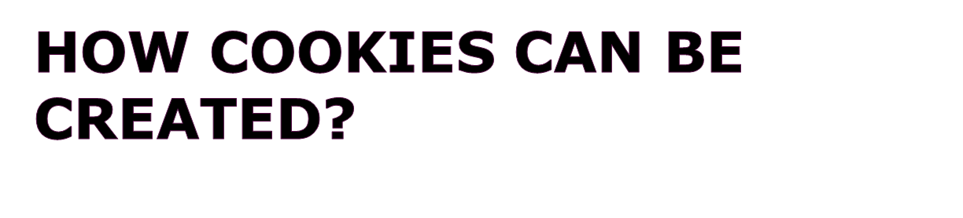
By client-side script in a HTML page
Win32 programs that use the Microsoft Win32 Internet functions,
By server-side script (for example, [ASP] page, Common Gateway Interface [CGI] script, PHP, ASP .NET etc….)

Slide 10
Cookies allow you to give your pages a personal touch. For instance,
With a cookie you can "remember" people's names and show warm greeting every time they re-visit.
You can also remember user preferences — if a visitor generally comes in on a slow connection, a cookie lets you know to automatically serve them minimal graphics.

Slide 11
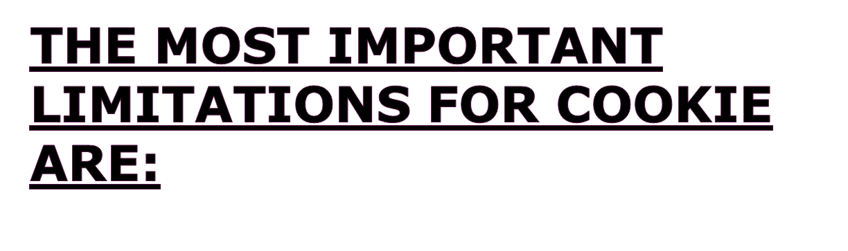
Not everyone has a cookie-friendly browser (but most do).
Not everyone who has a cookie-friendly browser will accept your cookies (but most will).
Each domain is allotted only 20 cookies, so use them sparingly.
Cookies must be no larger than 4 KB. That's just over 4,000 characters, which is plenty.

Slide 12
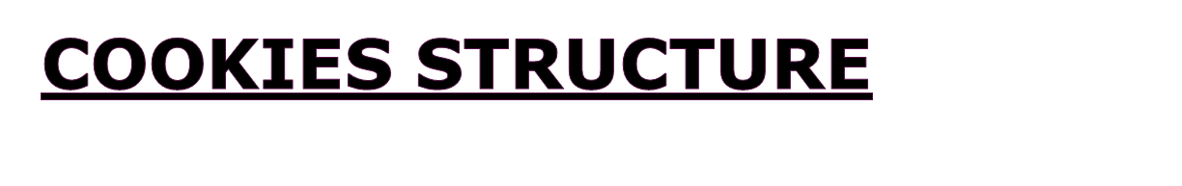
Cookies are always stored in “name=value” format.
Setting Cookies
To set cookie we have to create a string in the form of cookie_name=value and then set the document.cookie property to that. Cookie values cannot have spaces, commas, or semicolons.

Slide 13

<html><head>
<script language=javascript>
function setCookie() {
var the_name=prompt("What's your name?","")
var the_cookie = "wm_javascript=" + escape("username:" + the_name);
document.cookie = the_cookie;
alert("Thanks, now go to the next page."); }

Slide 14
function readCookie() {
var the_cookie = document.cookie;
var broken_cookie = the_cookie.split(":");
var the_name = broken_cookie[1];
alert("Your name is: " + the_name);
}
setCookie()
readCookie()
</script></head>
<body></body></html>

Slide 15
The name/value pair must not contain any white space characters, commas, or semicolons. Using such characters can cause the cookie to be truncated or even discarded.
When you assign a new cookie value to document.cookie, the current cookies are not replaced. The new cookie is parsed and its name/value pair is appended to the list. If we use same name, path and domain then previous cookie is replaced by new cookie. The syntax for setting cookies is:

Slide 16

