Slide 1
INTRODUCTION TO HTML

Slide 2
What is front end?
Converting data into graphical interface

Slide 3
HTML
What is HTML?
What is XHTML?
What is HTML5?

Slide 4
XHTML
XHTML stands for EXtensible HyperText Markup Language.
It is the next step to evolution of internet.
The XHTML was developed by World Wide Web Consortium (W3C).

Slide 5
XHTML
DOCTYPE: It is used to declare a DTD
head: The head section is used to declare the title and other attributes.
body: The body tag contains the content of web pages. It consists many tags.
Creating a XHTML web page, it is necessary to include DTD (Document Type Definition) declaration
Transitional DTD
Strict DTD
Frameset DTD

Slide 6
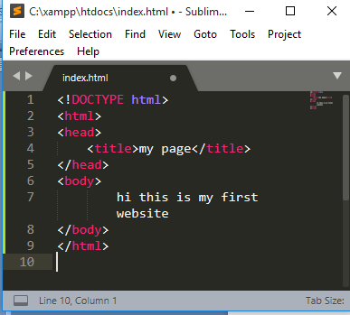
HTML
A simple HTML document:

Slide 7
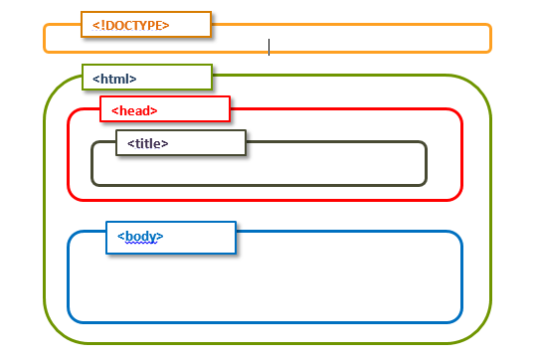
HTML
HTML tags
< angular brackets>
Page Structure

Slide 8
HTML Editors
Note pad or text edit
Professional HTML editors
Notepad--→ write +save +run in web browser

Slide 9
HTML
Heading
<h1> to <h6>
Paragraph
<p>----- </p>

Slide 10
HTML
Image
<img src=“ “ alt=“ ”>
Render the image size by specifying width and height as
<img src =“ “ alt=“ “ width=“ “ height=“ “>

Slide 11
HTML
Link : Interpage and Intrapage
Create a new page and provide the link
Specify the website address
Back to top (using id)
Instead of text even images can be used as links.

Slide 12
HTML
Link:
<a href="https://www.nitk.ac.in/" target="_blank"> visit the new page </a>
to top :
<h1 id="top">this is here</h1>
------------------------------------------
<a href="#top">back to top</a>

Slide 13
HTML
Superscript, Subscript
<sup> -------- </sup>
<sub> -------- </sub>

Slide 14
HTML
Strong , Emphasized
<strong> ----------- </strong>
<em> -------------- </em>

Slide 15
HTML
Special character
eg: copyright
<h1> copyright &copy; </h1>

Slide 16
HTML
List
Ordered list
<ol>
<li> aaa </li>
<li>bbb </li>
</ol>
Unordered list
<ul>
<li> aaa </li>
<li>bbb </li>
</ul>

Slide 17
HTML
Table
Row <tr> </tr>
Column <td> </td>
Heading <th> </th>

Slide 18
HTML
Form
Collect some kind of data
<form action=“ “ method = “ “> ---- </form>
Action= where
Method= how (get,Post)
Input can be multiple type (text, email etc)
<input type= “ ” name= “ “ id= “ “>
Type (any form) name (used for collecting data)
id (Used for label)

Slide 19
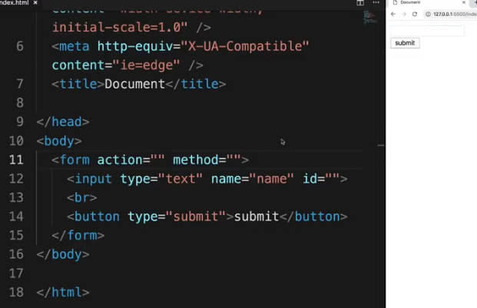
HTML
Button
<button type=“ submit“> submit </button>

Slide 20
HTML
Input
Password
Email
<input type=“password” placeholder=“password”>
<input type=“email” value=“aaa@gmail.com”>
<input type=“submit” value=“submit here”>

Slide 21
HTML
Text area
<textarea name=“ “ id=“ “ cols=“20” rows=“40”>
</textarea>
Radio button
<input type=“radio” name=“gender” id=“ “ value =“male”> male
<input type=“radio” name=“gender” id=“ “ value =“Female”> Female

Slide 22
HTML
Checkbox
<input type=“checkbox” name=“gender” id=“ “ value =“male”> male

Slide 23
CSS(Cascading Style Sheet)

Slide 24
Styling with CSS

Slide 25
THANK YOU

