Slide 1
HTML5 add-ons

Slide 2
Elements
<article> -- specifies it as an article
<aside> --- defines some content aside from the content it is placed in.
<mark> --- highlights the text that is present in mark tag.
<nav> --- used for providing navigation property
<meter> -- defines a scalar measurement within a known range, or a fractional value.
Summary – details on dropdown

Slide 3
<Time> --- just to specify it as time
<Section> --- different sections in a file
<wbr>----Word break
<Date> -- date format ( input type)
Figure caption
<section> tag defines sections in a document, such as chapters, headers,
footers, or any other sections of the document.

Slide 4
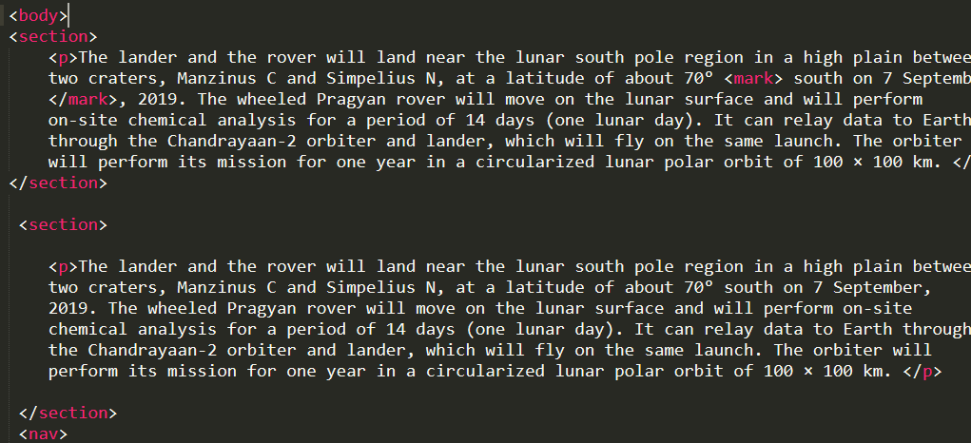
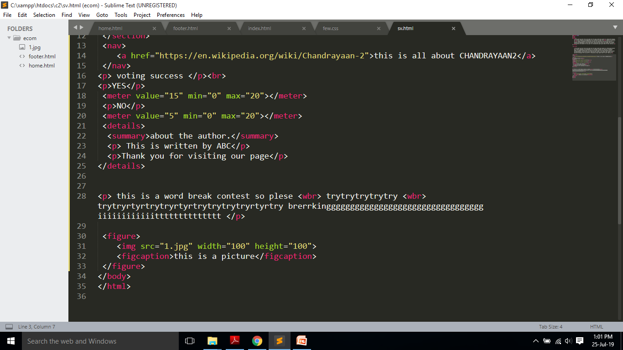
Tags and output

Slide 5
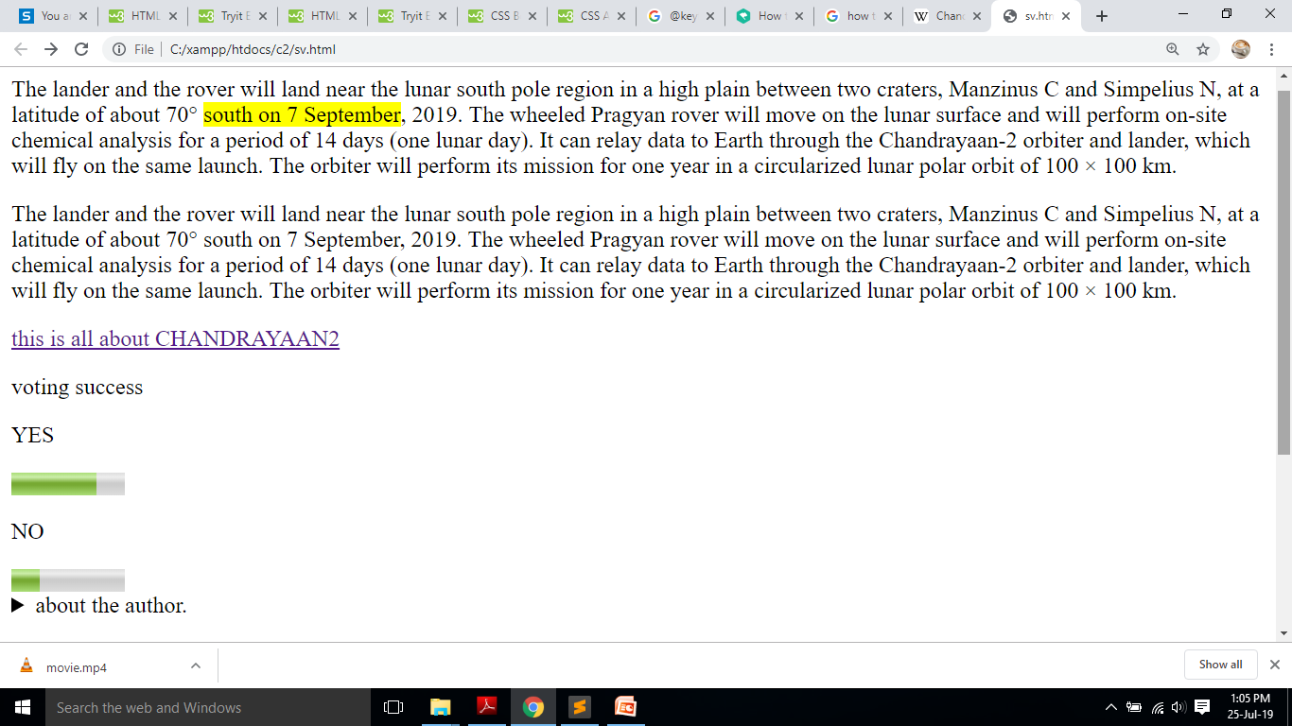
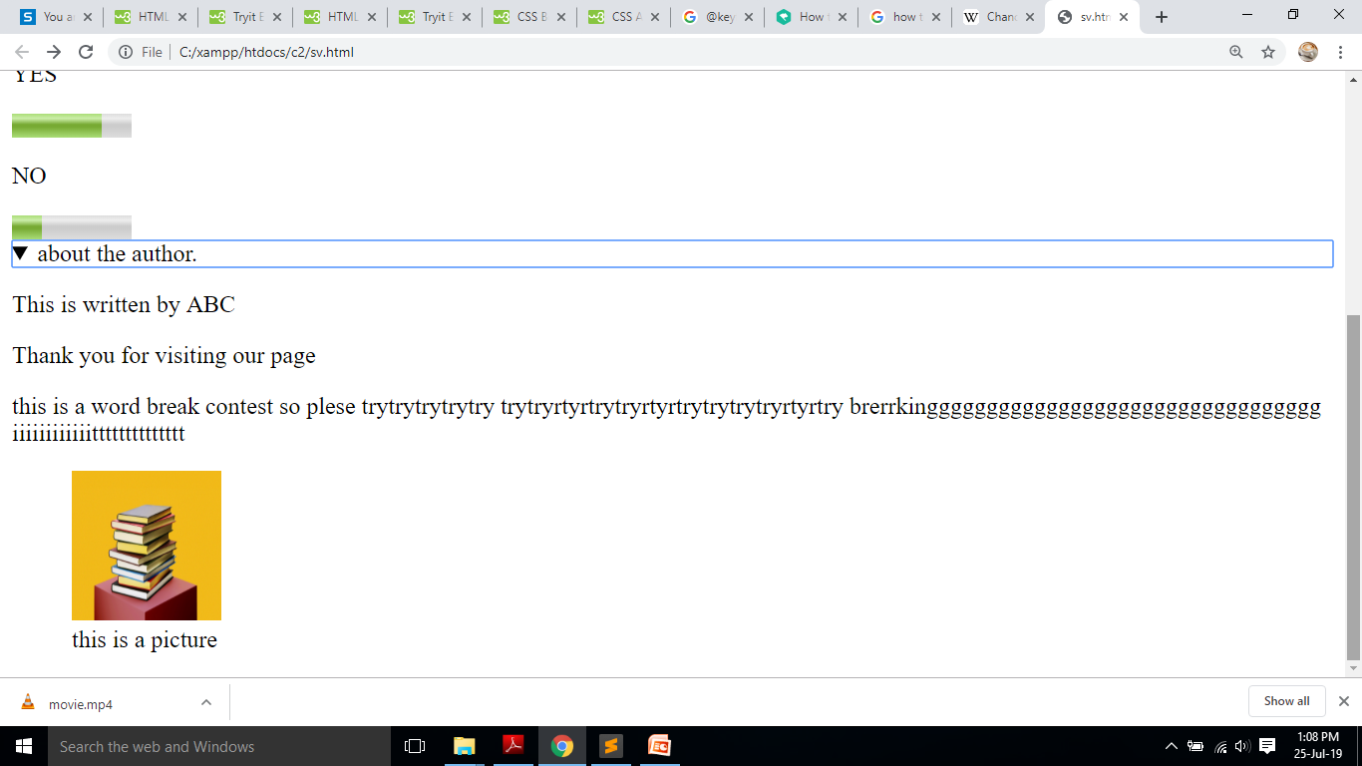
Tags and output

Slide 6
Graphics
<canvas> --- container for graphics, needs javascript to be embedded to draw elements.
-game application
SVG --- Scaleable Vector Graphics
Circle, rectangle, rounded rectangle, polygon
SVG- 2D ,predefined, event handling

Slide 7
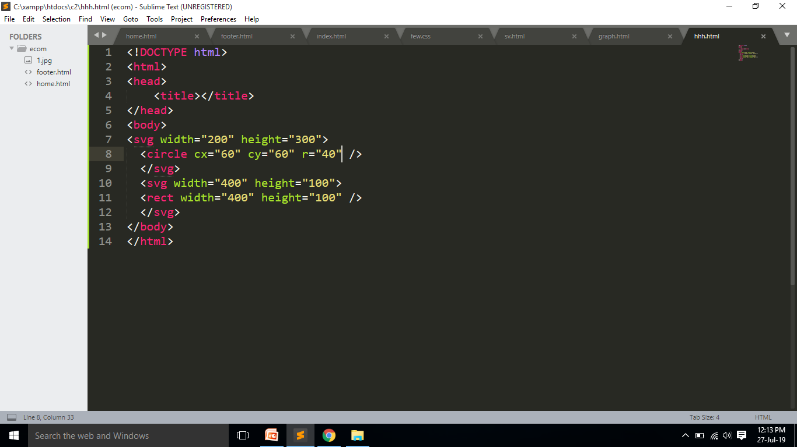
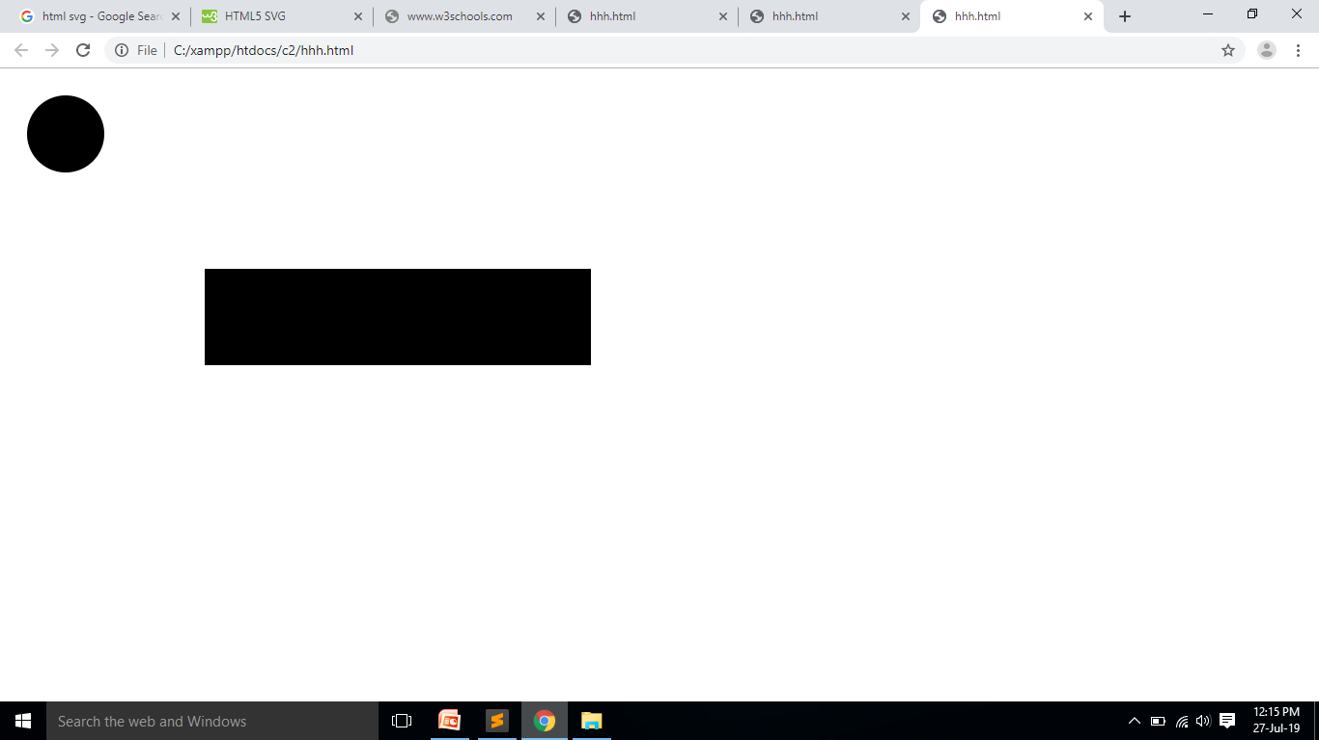
Tags and output

Slide 8
Multimedia
Video : before HTML5 we need plug-in
It specifies a standard way to embedded video in a webpage.
<video width=“ “ height=“ “ controls>
<source src=“ “ type=“ “>
</video>
Controls- play, pause,volume.

Slide 9
Multimedia
Audio-adding audio files to the page.
<audio controls>
<source src=“ “ type=“ “>
</audio>

Slide 10
Multimedia
ADD YOUTUBE VIDEO.

Slide 11
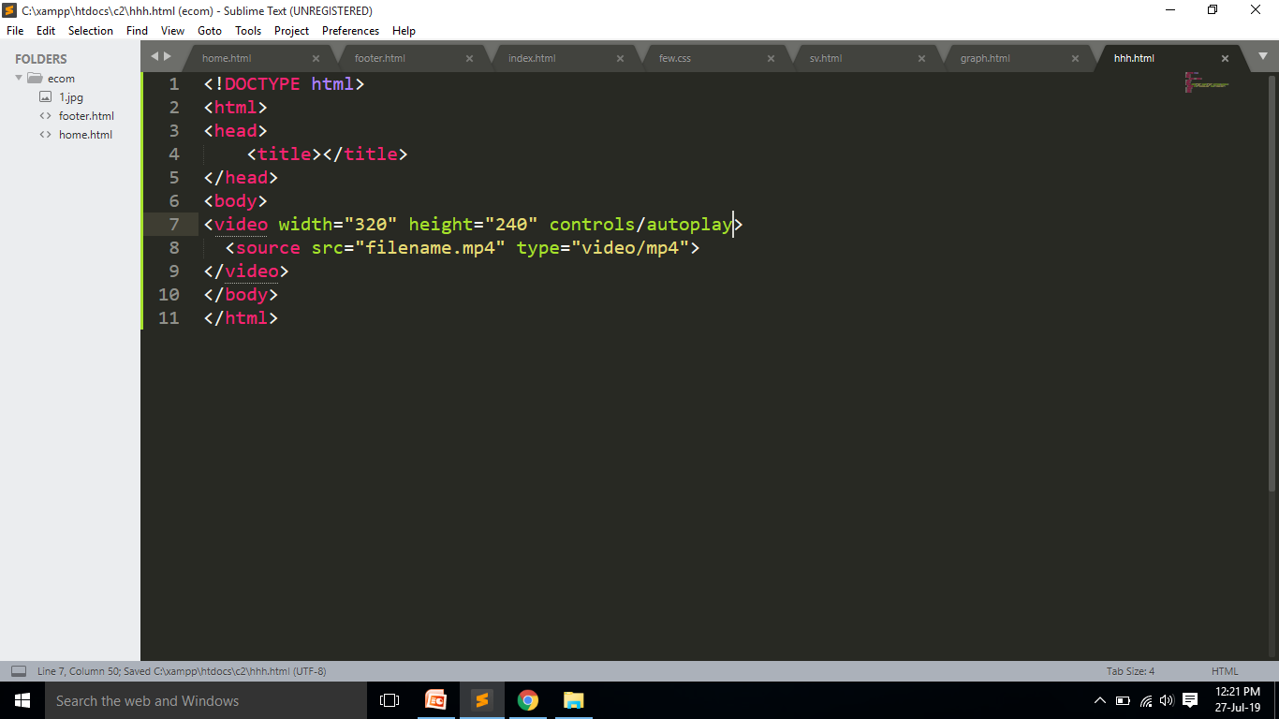
Tags and output

Slide 12
CSS add-ons

Slide 13
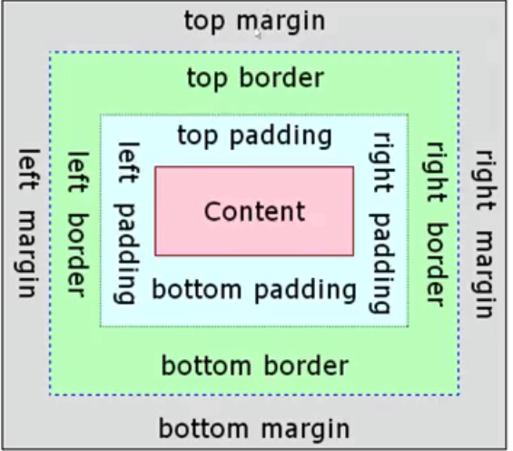
CSS
BOX Model

Slide 14
Outline
Outline style-- must
Outline color
Outline width
Outline offset– space to margin and outline

Slide 15
Pseudo class
When mouse is moved over change the style of the content.
:hover
:focus

Slide 16
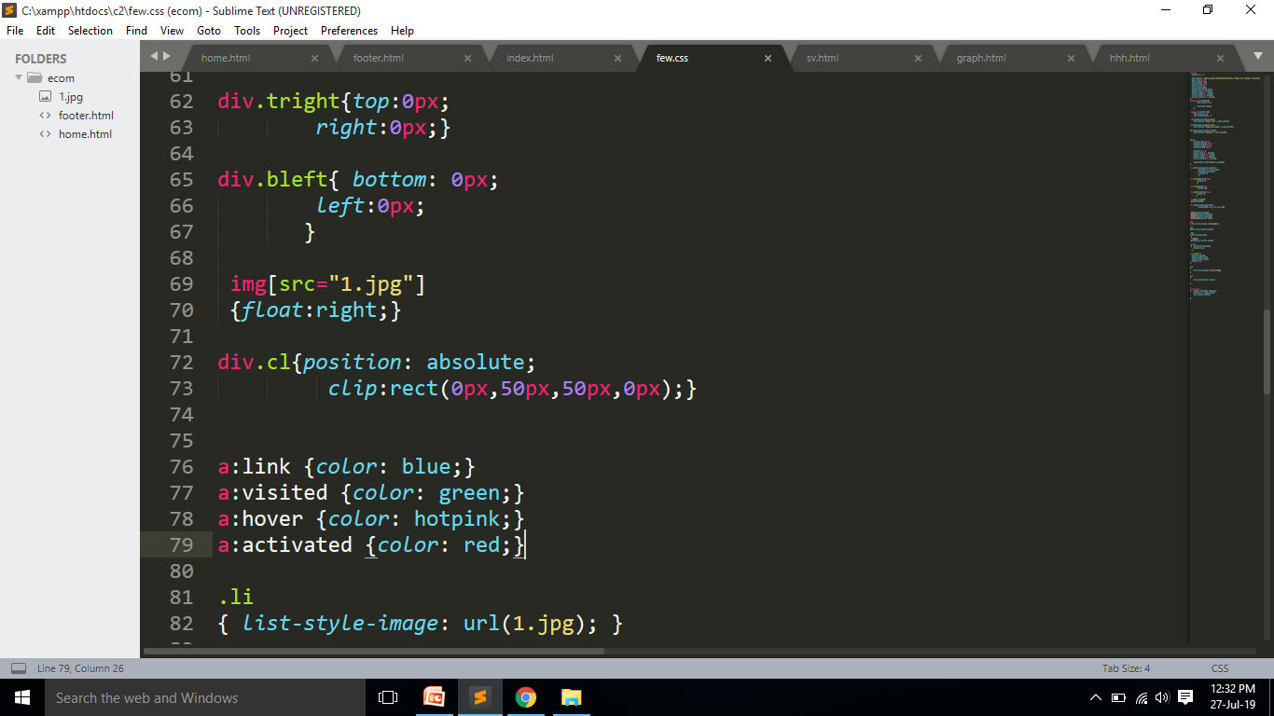
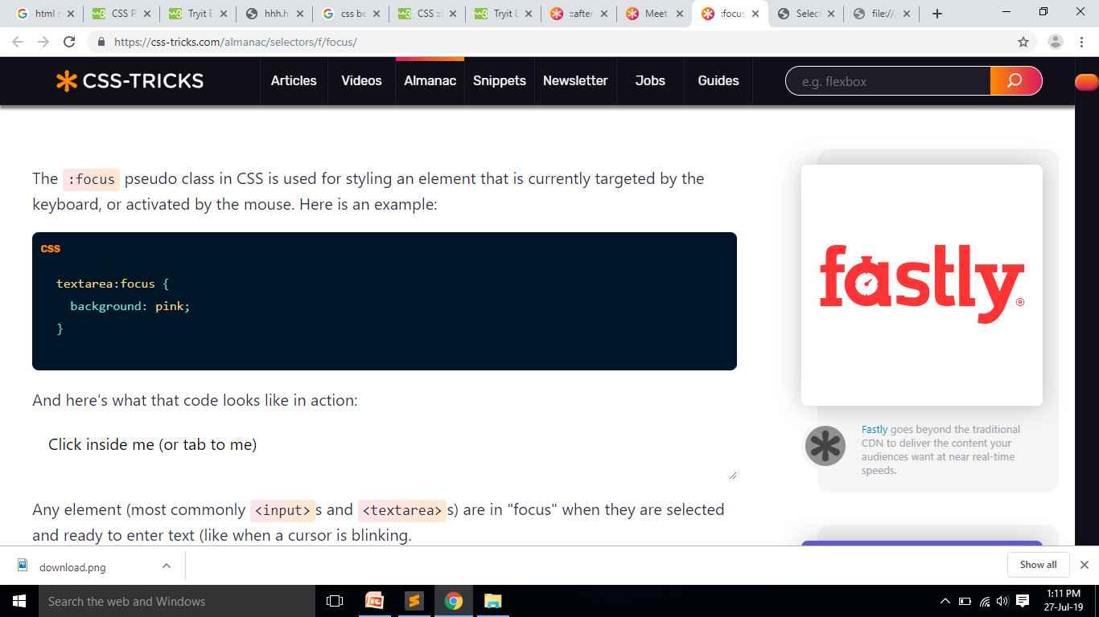
Tags and output

Slide 17
Pseudo element
Standard change of few elements in a particular way.
We can use elements in such cases.

Slide 18
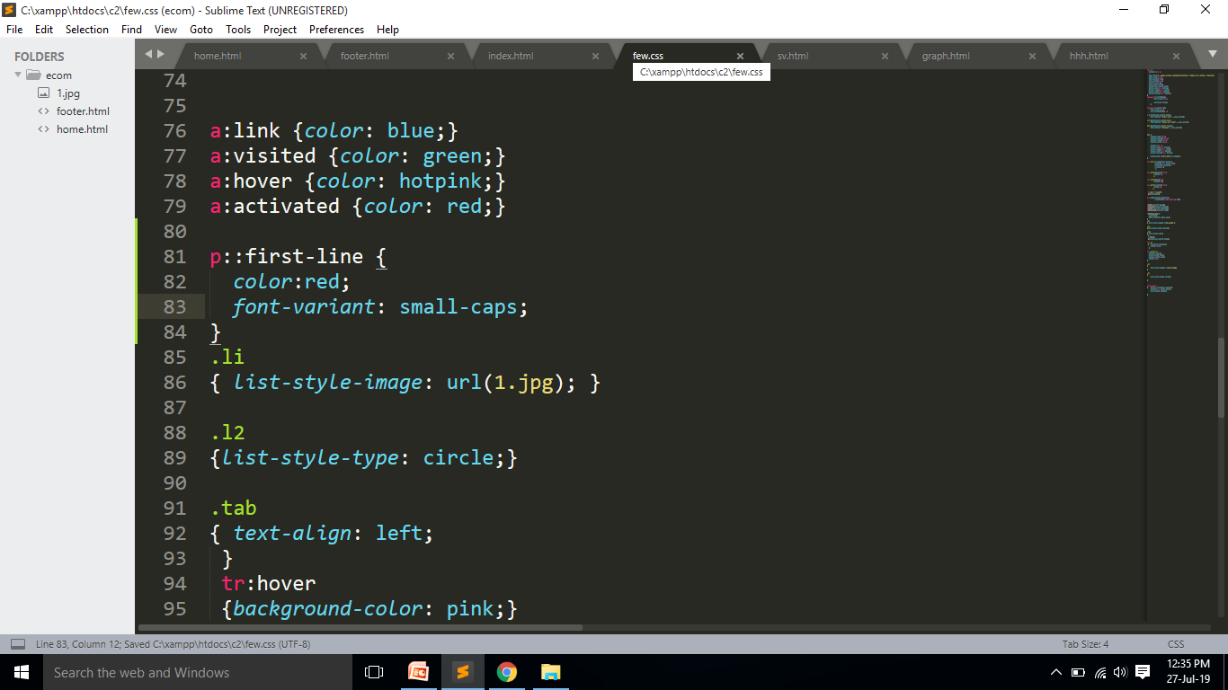
Tags and output

Slide 19
Before ,After selector
::after is a pseudo element which allows you to insert content onto a page from CSS.
::before is exactly the same only it inserts the content before any other content in the HTML instead of after.
Eg: p ::after p ::before
{
}
{
}

Slide 20
Opacity
Making the image dull or making it more transparent.
When applying for body which has images in background the text also turns opaque how to solve it?
Opacity 0.1;

Slide 21
Other styles
Rounded corner-- border-radius: 15px;
Images in border– design
{
border: 10px solid transparent;
border-image: url(border.jpg) 30 round;}

Slide 22


Other styles
Shadows in box
box shadow: 2px 2px 2px red;
Shadows in text
Text shadow : 2px 2px 2px red;
Multiple shadow- separated by ,

Slide 23
Transformations
2D transformation
transform : rotate(30 deg);
transform :translate(x,y);
Scale --- x,y scale
Skew- x,y

Slide 24
3D transformations???

Slide 25
Transition
Transition – State change smoothly
transition-delay
transition-duration - must
transition-property
transition-timing-function

Slide 26
Animations
Animation-changing from one style to another.
Animation name
Animation duration
Animation delay
Animation direction
Animation iteration count

Slide 27
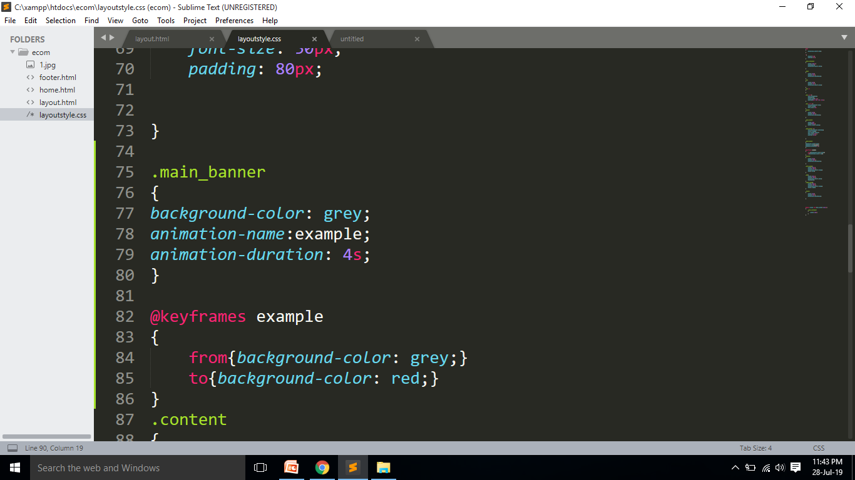
Animation

Slide 28
Explore
Pagination
Button styling
Resizing
Column
Tooltip

Slide 29
WEB LAYout

Slide 30
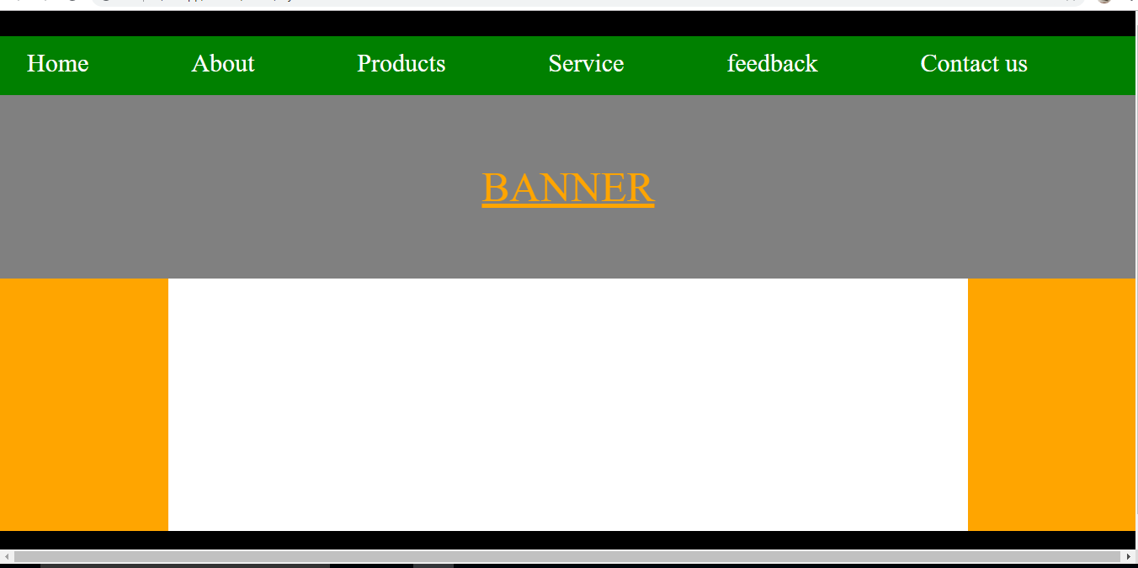
Web Layout

