Slide 1
Working with Forms and Regular Expressions
Validating a Web Form with JavaScript

Slide 2
Introducing Regular Expressions
A regular expression is a text string that defines a character pattern
One use of regular expressions is pattern-matching, in which a text string is tested to see whether it matches the pattern defined by a regular expression

Slide 3
Introducing Regular Expressions
Creating a regular expression
You create a regular expression in JavaScript using the command
re = /pattern/;
This syntax for creating regular expressions is sometimes referred to as a regular expression literal

Slide 4
Introducing Regular Expressions
Matching a substring
The most basic regular expression consists of a substring that you want to locate in the test string
The regular expression to match the first occurrence of a substring is /chars/

Slide 5
Introducing Regular Expressions
Setting regular expression flags
To make a regular expression not sensitive to case, use the regular expression literal /pattern/i
To allow a global search for all matches in a test string, use the regular expression literal /pattern/g

Slide 6
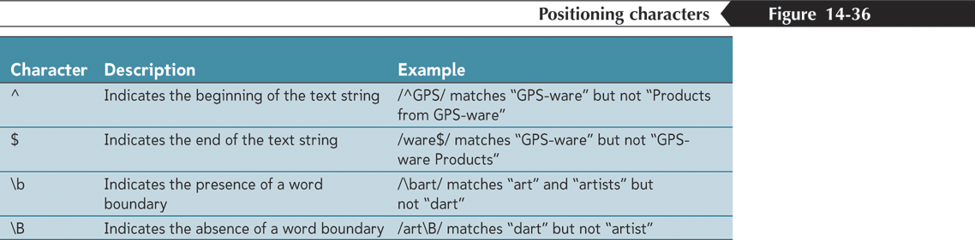
Introducing Regular Expressions
Defining character positions

Slide 7
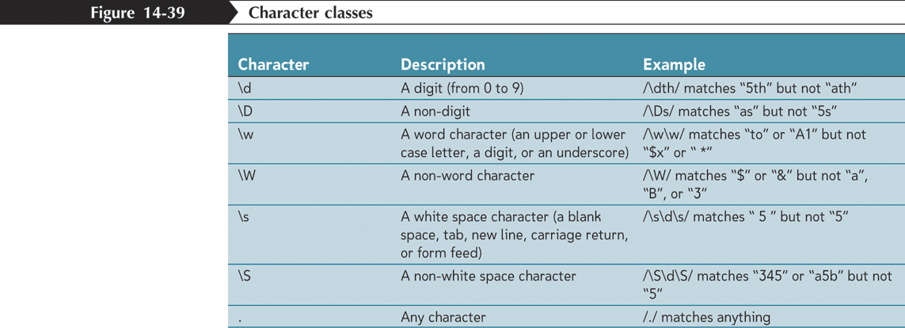
Introducing Regular Expressions
Defining character positions

Slide 8
Introducing Regular Expressions
Defining character positions
Can specify a collection of characters known a character class to limit the regular expression to only a select group of characters

Slide 9
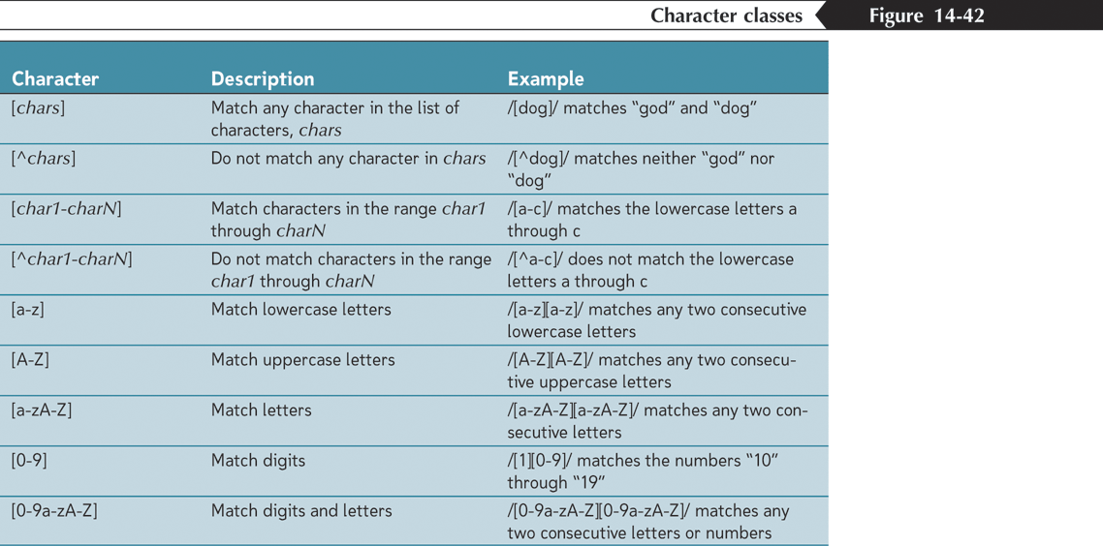
Introducing Regular Expressions
Defining character positions

Slide 10
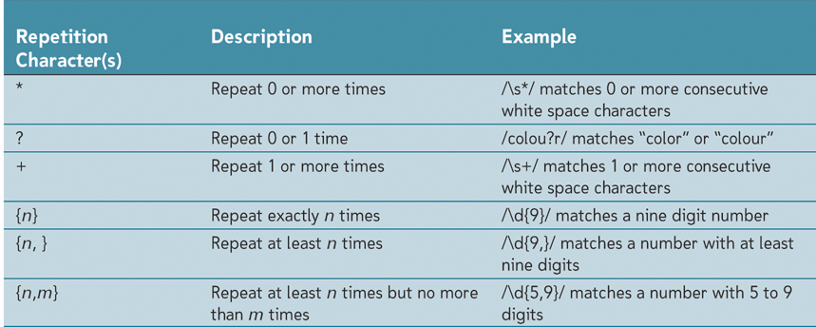
Introducing Regular Expressions
Repeating characters

Slide 11
Introducing Regular Expressions
Escape Sequences
An escape sequence is a special command inside a text string that tells the JavaScript interpreter not to interpret what follows as a character
The character which indicates an escape sequence in a regular expression is the backslash character \

Slide 12
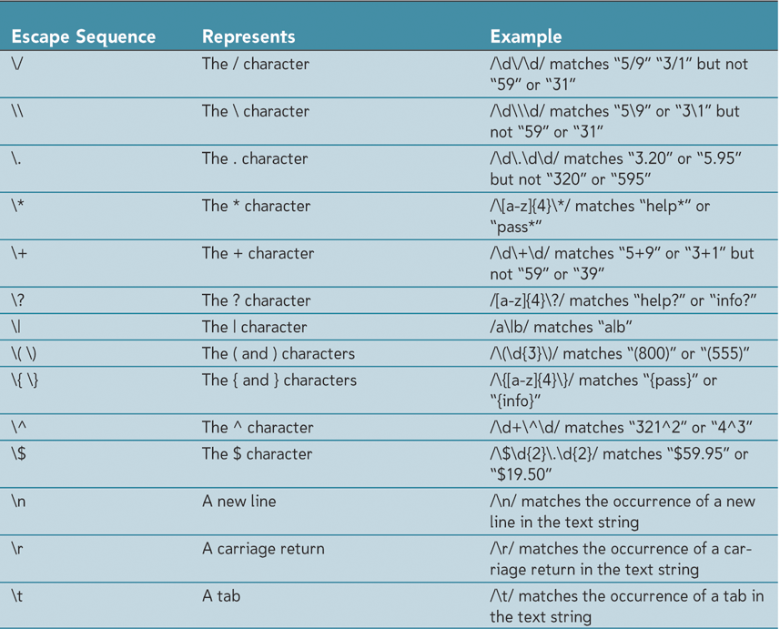
Introducing Regular Expressions
Escape Sequences

Slide 13
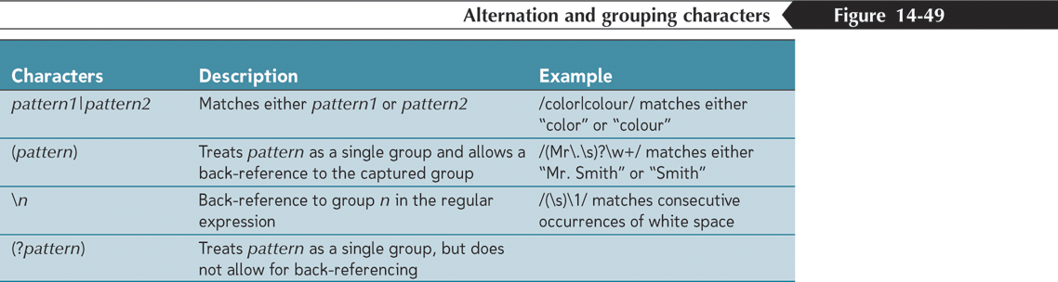
Introducing Regular Expressions
Alternating Patterns and Grouping

Slide 14
Introducing Regular Expressions
The regular expression object constructor
To create a regular expression object
re = new RegExp(pattern, flags)
re is the regular expression object, pattern is a text string of the regular expression pattern, and flags is a text string of the regular expression flags

Slide 15
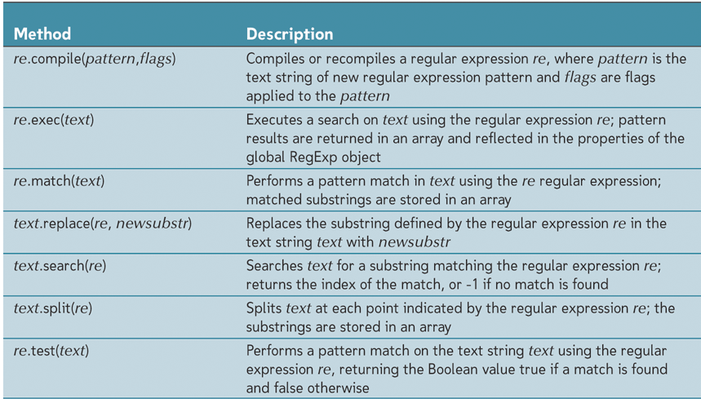
Working with the Regular Expression Object
Regular Expression methods

Slide 16
Tips for Validating Forms
Use selection lists, option buttons, and check boxes to limit the ability of users to enter erroneous data
Indicate to users which fields are required, and if possible, indicate the format that each field value should be entered in
Use the maxlength attribute of the input element to limit the length of text entered into a form field

Slide 17
Tips for Validating Forms
Format financial values using the toFixed() and toPrecision() methods. For older browsers use custom scripts to format financial data
Apply client-side validation checks to lessen the load of the server
Use regular expressions to verify that field values correspond to a required pattern

Slide 18
Tips for Validating Forms
Use the length property of the string object to test whether the user has entered a value in a required field
Test credit card numbers to verify that they match the patterns specified by credit card companies
Test credit card numbers to verify that they fulfill the Luhn Formula

