Slide 1
XHTML

Slide 2
From HTML to XHTML
up XHTML version 1.0
Allows only a document’s content and structure to appear in a valid XHTML document, and not its formatting
Formatting is specified with Cascading Style Sheets
XHTML documents must be well-formed
<html> <head> ... </head> <body> ... </body> </html>
XHTML elements must be properly nested
<head><title>hello</head></title>
XHTML tag names must be in lowercase
<HTML>
All XHTML elements must be closed
If an HTML tag is not a container, close it like this: <br />, <hr />, <image src="smile.gif" />

Slide 3
From HTML to XHTML (Cont.)
Attribute names must also be in lower case
Example: <table width="100%">
Attribute values must be quoted
Example: <table width="100%">
Attribute minimization is forbidden
Example: <frame noresize="noresize">, cannot be abbreviated to <frame noresize>
The id attribute replaces the name attribute
Wrong: <img src="picture.gif" name="picture1" />
Right: <img src="picture.gif" id="picture1" />
Best: <img src="picture.gif" name="picture1" id="picture1" />

Slide 4
SGML and DTDs
SGML stands for “Standard Generalized Markup Language”
HTML, XHTML, XML and many other markup languages are defined in SGML
A DTD, or “Document Type Definition” describes the syntax to use for the current document
There are three different DTDs for XHTML--you can pick the one you want
These DTDs are public and on the web
You must start your XHTML document with a reference to one of these DTDs

Slide 5
DOCTYPE declaration
Every XHTML document must begin with one of the DOCTYPE declarations (DTDs):
The three main DTDs are as follows:
Strict
Use for really clean markup, with no display information (no font, color, or size information)
Use with CSS (Cascading Style Sheets) if you want to define how the document should look
Transitional
Use with standard HTML and/or with CSS
Allows deprecated HTML elements
Frameset
Use if your document uses HTML frames

Slide 6
DTD
<!DOCTYPE html PUBLIC "-//W3C//DTD XHTML 1.0 Strict//EN" "http://www.w3.org/TR/xhtml1/DTD/xhtml1-strict.dtd">
<!DOCTYPE html PUBLIC "-//W3C//DTD XHTML 1.0 Transitional//EN" "http://www.w3.org/TR/xhtml1/DTD/xhtml1-transitional.dtd">
<!DOCTYPE html PUBLIC "-//W3C//DTD XHTML 1.0 Frameset//EN" "http://www.w3.org/TR/xhtml1/DTD/xhtml1-frameset.dtd">

Slide 7
An XHTML Structure
This is an XHTML document with a minimum of required tags:
<!DOCTYPE Doctype goes here> <html xmlns="http://www.w3.org/1999/xhtml"> <head> <title>Title goes here</title> </head> <body> </body> Note: The xmlns attribute in <html>, specifies the xml namespace for a document, and is required in XHTML documents. However, the HTML validator at w3.org does not complain when the xmlns attribute is missing. This is because the namespace "xmlns=http://www.w3.org/1999/xhtml" is default, and will be added to the <html> tag even if you do not include it.
This declaration tells the schema-validator that all the elements used in this XML document are declared in that namespace.
W3C HTML Validation Tool http://validator.w3.org/ is an HTML form for checking (but not fixing) HTML and XHTML documents

Slide 8
First XHTML Example
In XHTML, text is marked up with elements delimited by tags that are names contained in pairs of angle brackets
Every XHTML document contains a start
<html> tag and an end </html> tag
Some elements may contain attributes that provide additional information about the element
Comments in XHTML always begin with <!-- and end with -->. The browser ignores all text inside a comment
Every XHTML document contains a head element which generally contains:
A title
A body element
head element
generally is not rendered in the display window

Slide 9
First XHTML Example (Cont.)
The title element:
Names a web page
Usually appears in the colored bar (called the title bar) at the top of the browser window
Is the text identifying a page when users add your page to their list of Favorites or Bookmarks
The body element:
Contains the document’s content, which may include text and tags
All text placed between the <p> and </p> tags forms one paragraph
XHTML documents delimit an element with start and end tags
A start tag consists of the element name in angle brackets (e.g., <html>)
An end tag consists of the element name preceded by a forward slash (/) in angle brackets (e.g., </html>)

Slide 10
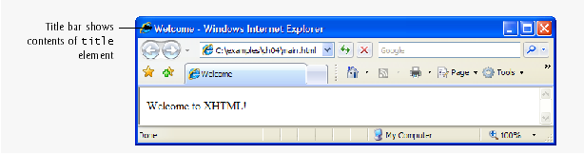
Many start tags have attributes that provide additional information about an element
Each attribute has a name and a value separated by an equals sign (=)
XHTML comments, not interpreted by the browser
Creates a head element
Creates a title element, which contains the text Welcome
Creates a p element within the body, which displays welcome text

Slide 11
Headings
XHTML provides six headings (h1 through h6) for specifying the relative importance of information
Heading element h1 is considered the most significant heading and is rendered in the largest font
Each successive heading element (i.e., h2, h3, etc.) is rendered in a progressively smaller font
The text size used to display each heading element can vary significantly between browsers.
Placing a heading at the top of every XHTML page helps viewers understand the purpose of each page.
Use larger headings to emphasize more important sections of a web page.

Slide 12
Linking
A hyperlink references or links to other resources, such as XHTML documents and images
Web browsers typically underline text hyperlinks and color them blue by default
Users can insert links with the a (anchor) element.
The href attribute specifies the resource (e.g., page, file, e-mail address) being linked
Anchors can link to an e-mail address using a mailto: URL
When a user clicks this type of anchored link, most browsers launch the default e-mail program (e.g., Outlook Express) to initiate an e-mail message addressed to the linked address
The strong element typically causes the browser to render text in a bold font

Slide 13
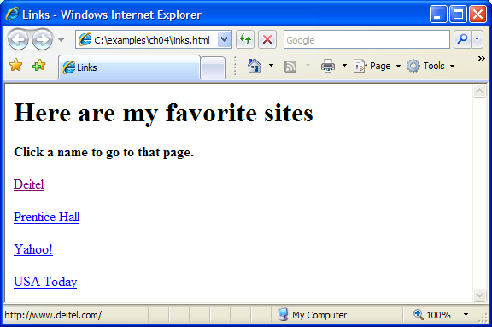
Creates anchor elements that link to the URL specified in the href attribute

Slide 14
Hyperlink that creates a message to the address deitel@deitel.com with the computer’s default e-mail program

Slide 15
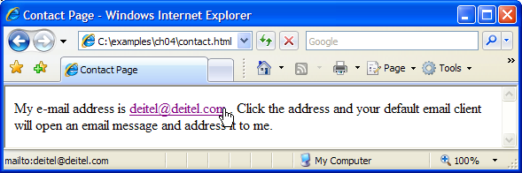
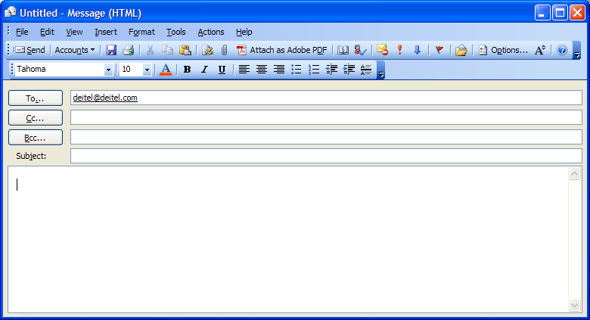

Slide 16
Images
The img element’s src attribute specifies an image’s location
Every img element must have an alt attribute, which contains text that is displayed if the client cannot render the image
The alt attribute makes web pages more accessible to users with disabilities, especially vision impairments
Width and height are optional attributes
If omitted, the browser uses the image’s actual width and height
Images are measured in pixels
Always include the width and the height of an image inside the <img> tag. When the browser loads the XHTML file, it will know immediately from these attributes how much screen space to provide for the image and will lay out the page properly, even before it downloads the image.

Slide 17
Including the width and height attributes in an <img> tag can result in the browser’s loading and rendering pages faster.
Entering new dimensions for an image that change its inherent width-to-height ratio distorts the appearance of the image. For example, if your image is 200 pixels wide and 100 pixels high, you should ensure that any new dimensions have a 2:1 width-to-height ratio.
Some XHTML elements are empty elements that contain only attributes and do not mark up text
Empty elements (e.g., img) must be terminated, either by using the forward slash character (/) inside the closing right angle bracket or by explicitly writing an end tag

Slide 18
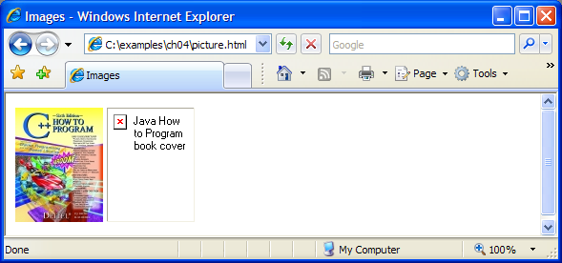
Specifies the image file’s location
Specifies the image’s width
Specifies the image’s height
Specifies text to display if the image is unavailable

Slide 19
Create an image hyperlink by nesting an img element in an anchor element
Creates a hyperlinked image

Slide 20
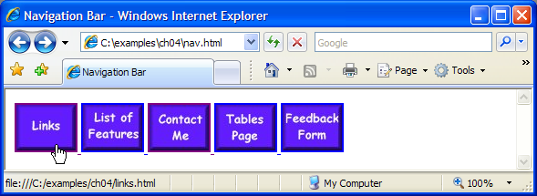

Slide 21
Special Characters and Horizontal Rules
XHTML provides special characters or entity references (in the form &code;) for representing characters that cannot be rendered otherwise
The code can be:
Word abbreviations
Numbers
Decimal
Hexadecimal
Example: & character represented by:
&amp
&#38 (decimal)
&#x26 (hexadecimal)
Most browsers render a horizontal rule, indicated by the <hr /> tag, as a horizontal line
The hr element also inserts a line break above and below the horizontal line

Slide 22
Inserts a horizontal rule, with a line break before and after
Inserts the special characters © and &

Slide 23
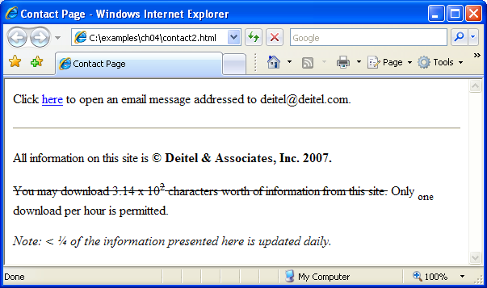
Creates a strikethrough effect
Makes the 1 subscript
Makes the 2 superscript
Emphasizes text
Inserts the special symbols < and ¼

Slide 24
Lists (unordered and ordered)
Unordered list element ul
creates a list in which each item in the list begins with a bullet symbol (called a disc)
Each entry is an li (list item) element. Most web browsers render these elements with a line break and a bullet symbol at the beginning of the line
Ordered list element ol
creates a list in which each item begins with a number
Lists may be nested to represent hierarchical data relationships

Slide 25
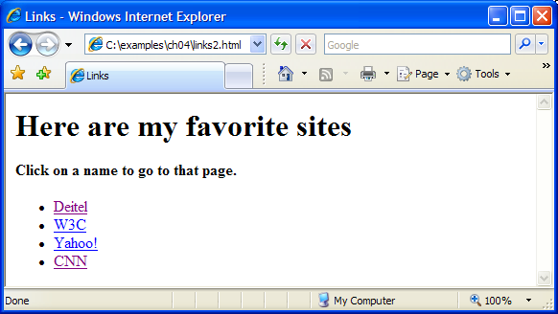
Creates an unordered list
Makes hyperlinked elements into individual list items

Slide 26
List- Nested and ordered list
A single list element

Slide 27
Creates an ordered list within a list element
Ends nested list
Ends the list element
Another single unordered list element
Creates an ordered list within this list element

Slide 28
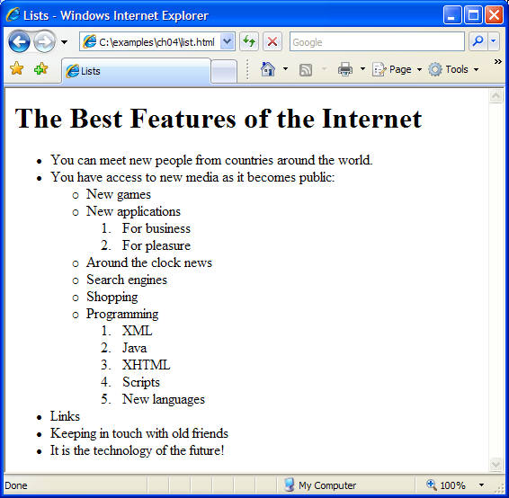

Slide 29
Tables
table element
defines an XHTML table
Attribute summary summarizes the table’s contents and is used by speech devices to make the table more accessible to users with visual impairments
Element caption describes the table’s content
The text inside the <caption> tag is rendered above the table in most browsers
A table can be split into three distinct sections:
Head (thead element)
Table titles
Column headers
Body (tbody element)
Primary table data

Slide 30
Foot (tfoot element)
Calculation results
Footnotes
Above body section in the code, but displays at the bottom in the page
Element tr
Defines individual table rows
Element th
Defines a header cell
Element td
Contains table data elements
You can merge data cells with the rowspan and colspan attributes
The values of these attributes specify the number of rows or columns occupied by the cell
Can be placed inside any data cell or table header cell

Slide 31
Begins a new XHTML table
Sets the table’s border to be one pixel wide
Sets the table’s width to 40% of the screen
Describes the table’s contents in the summary attribute
Sets the text above the table
Creates a head element
Creates a table heading cell in the new table row
Makes a new table row
Creates the next cell in the row

Slide 32
Creates a foot section
Creates table header cells at the bottom of the table
Creates a body section
Inserts a cell in the body of the table
Ends the table

Slide 33
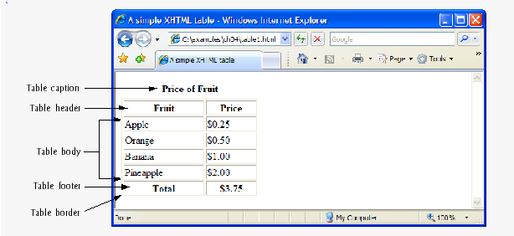
Tables-Basic table

Slide 34
Forms
XHTML provides forms for collecting information from users
Forms contain visual components, such as buttons, that users interact with
Forms may also contain nonvisual components, called hidden inputs, which are used to store any data that needs to be sent to the server, but is not entered by the user
A form begins with the form element
Attribute method specifies how the form’s data is sent to the web server
The action attribute of the form element specifies the script to which the form data will be sent

Slide 35
Appends form data to the browser request
No URL is used to process this form’s data
Creates hidden inputs not visible to the user

Slide 36
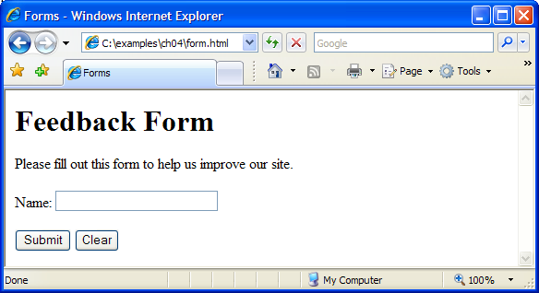
Creates a label for the text field
Inserts a text box called “name” with 25 characters visible and a 30 character limit
Inserts a submit button with “Submit” written on it
Inserts a reset button with “Clear” written on it
Ends the XHTML form

Slide 37
Forms-

Slide 38
Inserts a text area with 4 rows and 36 columns, whose initial text is “Enter comments here.”
Inserts an input field that displays entered text as asterisks (or another character)
Inserts several checkboxes with different labels

Slide 39
Initially sets this radio button as selected
Inserts a group of radio buttons, only one of which can be selected

Slide 40
Create a drop-down list named “rating”
Sets “Amazing” as the initially selected option

Slide 41
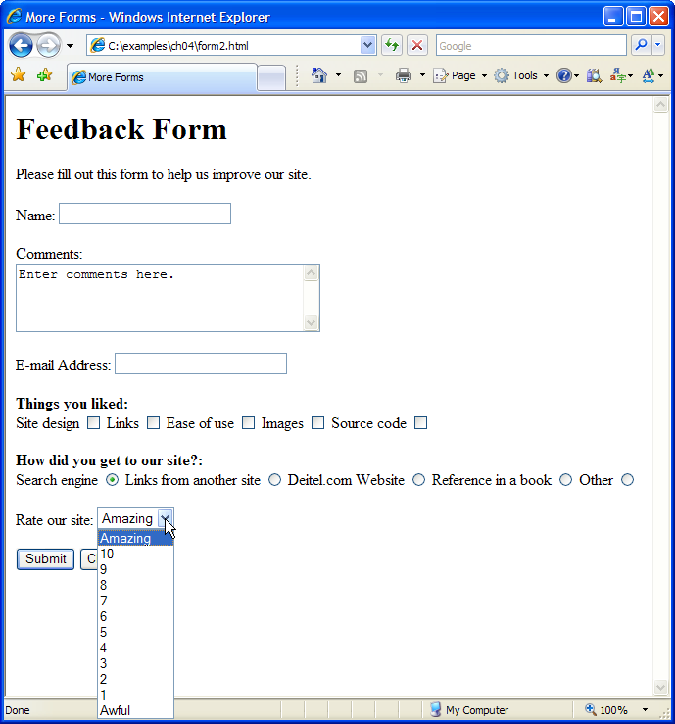

Slide 42
Form- Common Programming Error
When your form has several checkboxes with the same name, you must make sure that they have different values, or the scripts running on the web server will not be able to distinguish them.
Not setting the name attributes of the radio buttons in a form to the same name is a logic error because it lets the user select all of them at the same time.

Slide 43
Internal Linking
The a tag can be used to link to another section of the same document by specifying the element’s id as the link’s href.
To link internally to an element with its id attribute set, use the syntax #id.
Internal hyperlinks are useful in XHTML documents that contain large amounts of information. Internal links to different parts of the page make it easier for users to navigate the page—they do not have to scroll to find the section they want.
Following example shows how internal links make pages more navigatable

Slide 44
Sets the id attribute for the h1 element
Creates a link to the element in this document with id = bugs

Slide 45
Sets the id attribute for this h1 element
Creates a link to the element in this document with id = features

Slide 46
