Slide 1
Inclusion
  A conventional signature is included in the document; it is part of the document. But when we sign a document digitally, we send the signature as a separate document.
  Sender sends the two documents: the message and the signature.
  Recipients receives both documents and verifies that the signature belongs to the supposed sender. If this is proven, the message is kept; otherwise it is rejected.

Slide 2
Verification Method
Second difference between the two types of signatures is the method of verifying the signature.
For a conventional signature, when the recipients receives a document, she compares the signature on the document with the signature on file. If they are same, the document is authentic. The recipients needs to have a copy of this signature on file for comparison.
For a digital signature, the recipients receives the message and the signature. A copy of the signature is not stored anywhere. The recipient needs to apply a verification technique to the combination of the message and the signature to verify the authenticity.

Slide 3
Relationship
For a conventional signature, there is normally a one-to-many relationship between a signature and documents. A person uses the same signature to sign many documents.
For a digital signature, there is a one-to-one relationship between a signature and a message. Each message has its own signature.
Signature of one message cannot be used for another message.
If receiver receives two messages one after the another form sender, receiver cannot use the signature of the first message to verity the second.
Each message needs a new signature.

Slide 4
Duplicity
Another difference between the two types of signature is a quality called Duplicity.
In conventional signature, a copy of the signed document can be distinguished from the original one on file.
In digital signature, there is no such distinction unless there is a factor of time on the document.

Slide 5
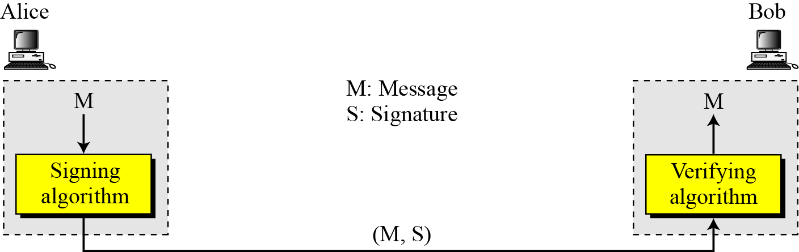
PROCESS
Figure 13.1 shows the digital signature process. The sender uses a signing algorithm to sign the message. The message and the signature are sent to the receiver. The receiver receives the message and the signature and applies the verifying algorithm to the combination. If the result is true, the message is accepted; otherwise, it is rejected.
Digital Signature Process

Slide 6
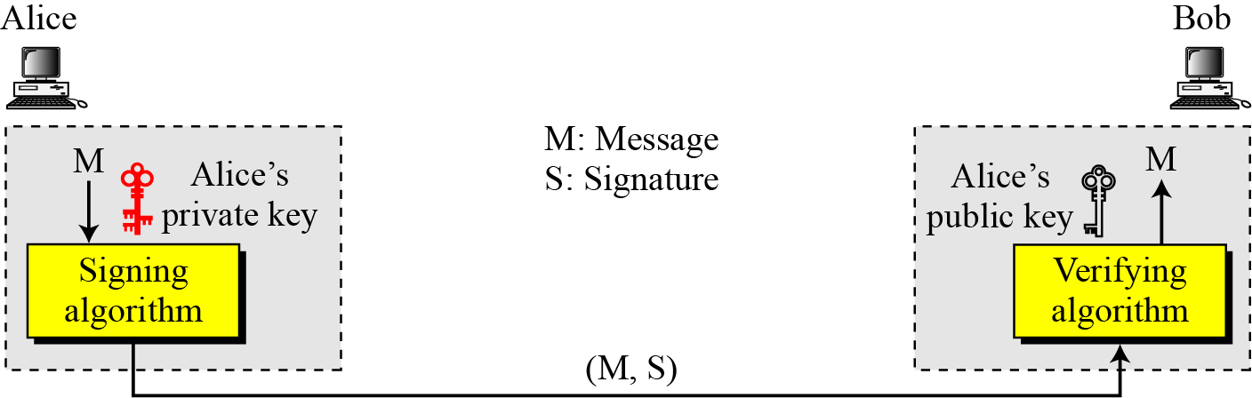
Need for Keys
Can we use a secret (Symmetric) key to both sign and verify a signature?
The answer is negative for several reasons
First, a secret key is known by only two entities.
Second, creating a secret key for a session involves authentication, which uses a digital signature.
Third, Bob could use the secret key between himself and Alice, sign a document send it to Ted, and pretend that it came from Alice

Slide 7
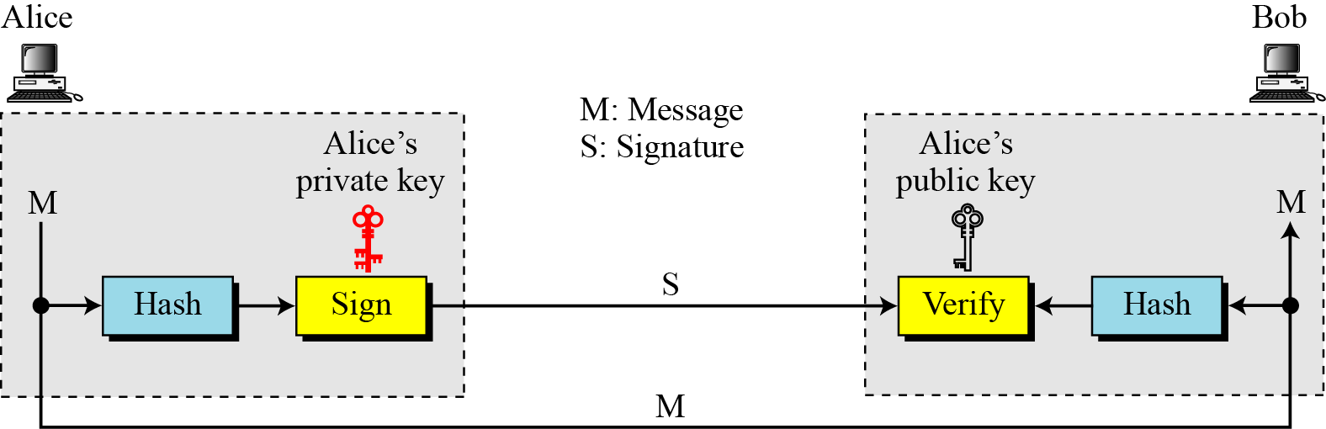
Signing the Digest

Slide 8
SERVICES
We discussed several security services including message confidentiality, message authentication, message integrity, and nonrepudiation.
A digital signature can directly provide the last three; for message confidentiality we still need encryption/decryption.
Message Authentication
Message Integrity
Nonrepudiation
Confidentiality

Slide 9
Message Authentication
A secure digital signature scheme, like a secure conventional signature can provide message authentication.
A Digital Signature Provides Message Authentication.

Slide 10
Message Integrity
The integrity of the message is preserved even if we sign the whole message because we cannot get the same signature if the message is changed.
A Digital Signature Provides Message Integrity

Slide 11
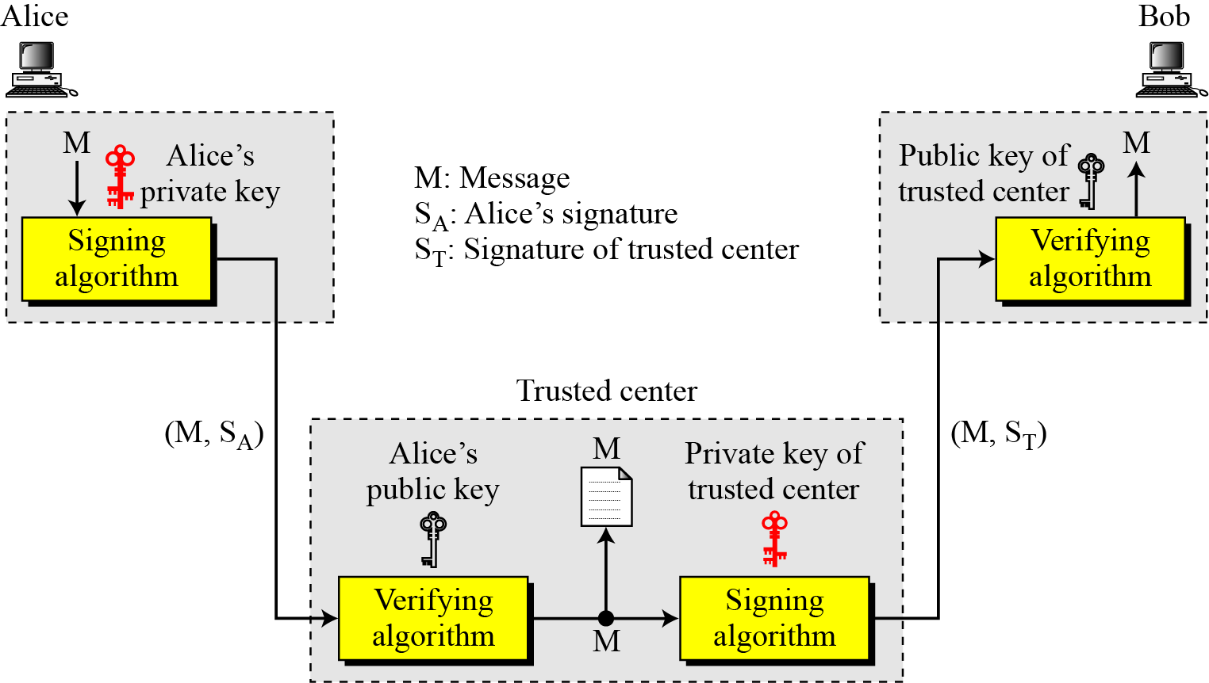
Nonrepudiation
Using a Trusted Center For Nonrepudiation
Nonrepudiation can be provided using a trusted party.

Slide 12
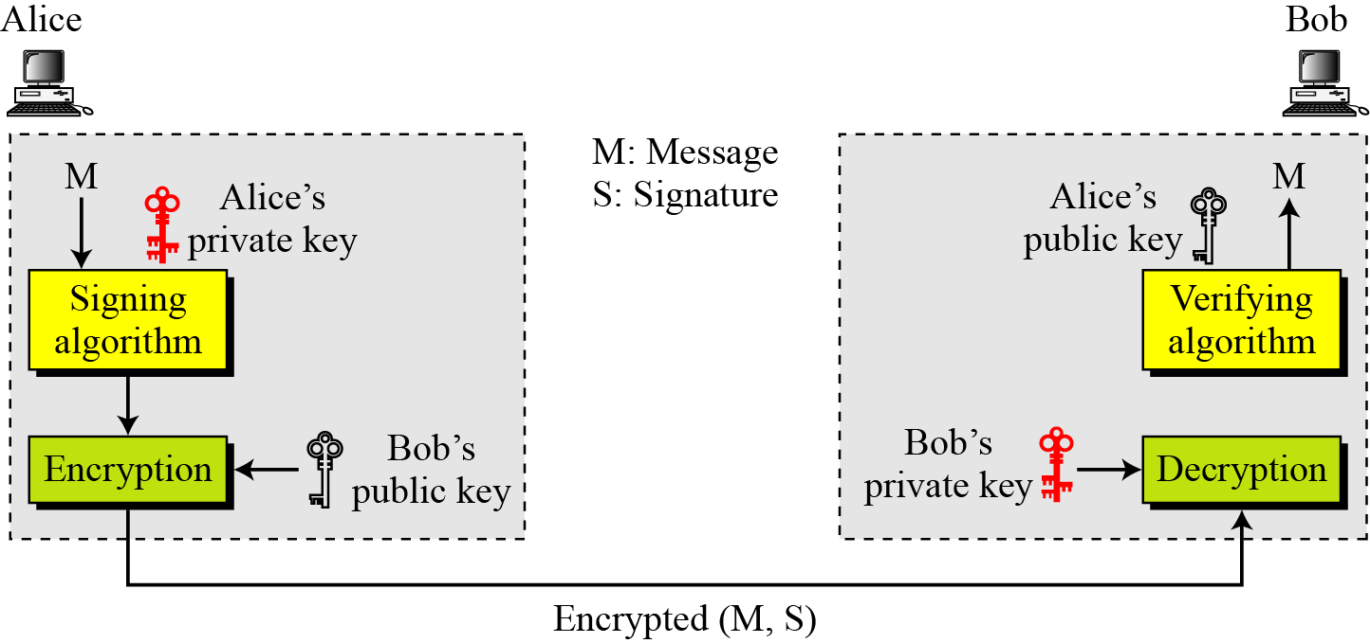
Confidentiality
Adding Confidentiality to a Digital Signature Scheme
A Digital Signature does not Provide Privacy.
If there is a need for Privacy, another layer of Encryption/Decryption must be applied.

Slide 13
Several digital signature schemes have evolved during the last few decades. Some of them have been implemented.
Digital Signature Scheme
ElGamal Digital Signature Scheme
Schnorr Digital Signature Scheme
Digital Signature Standard (DSS)
Elliptic Curve Digital Signature Scheme

Slide 14
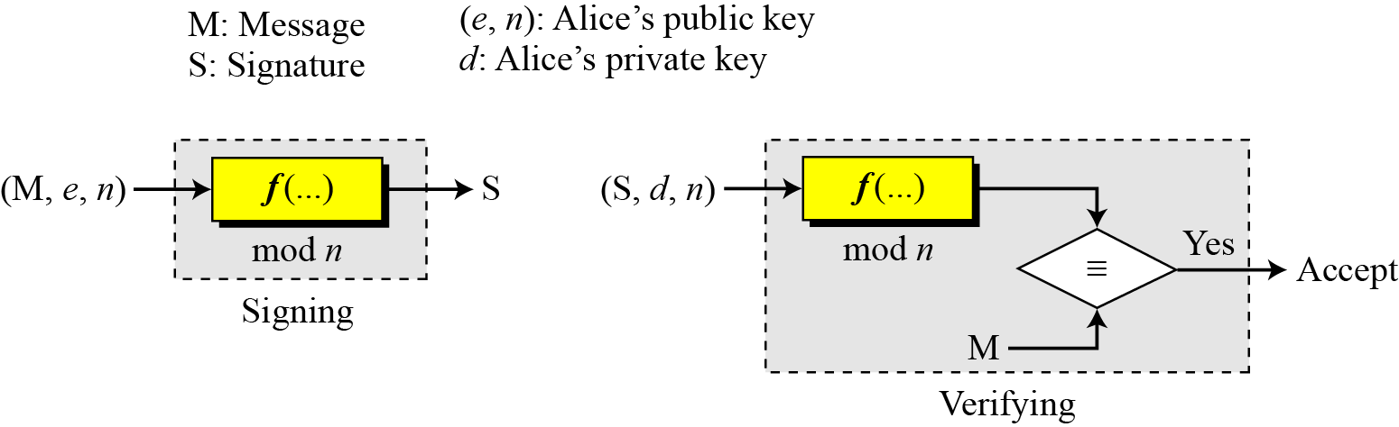
RSA Digital Signature Scheme
General Idea Behind the RSA Digital Signature Scheme

Slide 15
Key Generation
Key generation in the RSA digital signature scheme is exactly the same as key generation in the RSA
In the RSA digital signature scheme, d is private;
e and n are public.

Slide 16
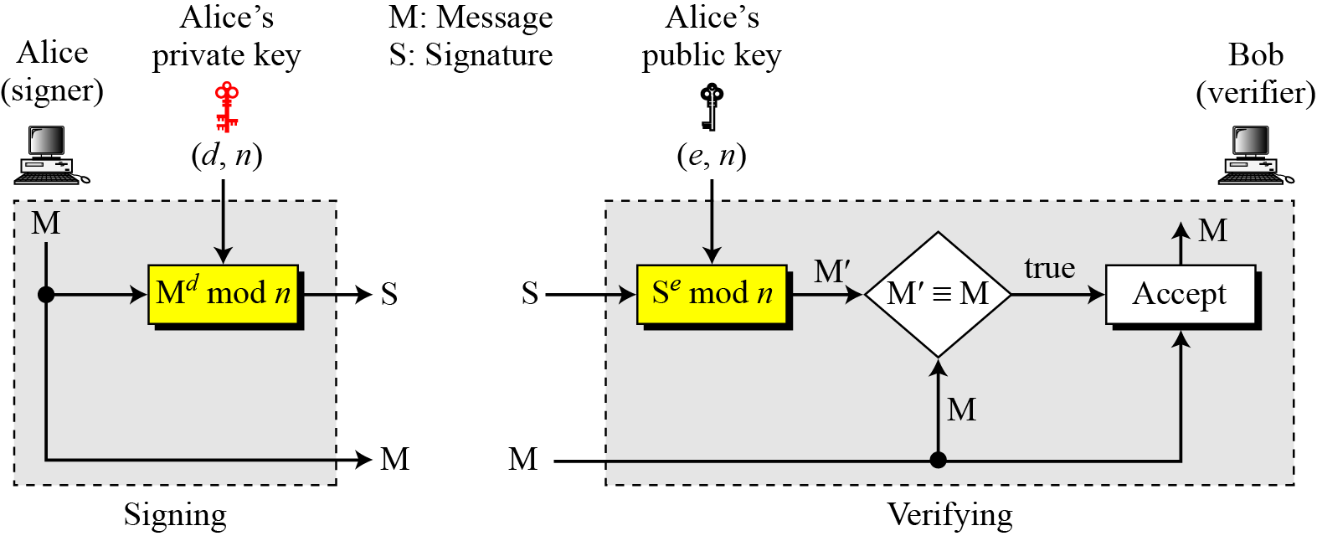
Signing and Verifying
RSA Digital Signature Scheme

Slide 17
Example 13.1
As a trivial example, suppose that Alice chooses p = 823 and q = 953, and calculates n = 784319. The value of φ(n) is 782544. Now she chooses e = 313 and calculates d = 160009. At this point key generation is complete. Now imagine that Alice wants to send a message with the value of M = 19070 to Bob. She uses her private exponent, 160009, to sign the message:
Alice sends the message and the signature to Bob. Bob receives the message and the signature. He calculates
Bob accepts the message because he has verified Alice’s signature.

Slide 18
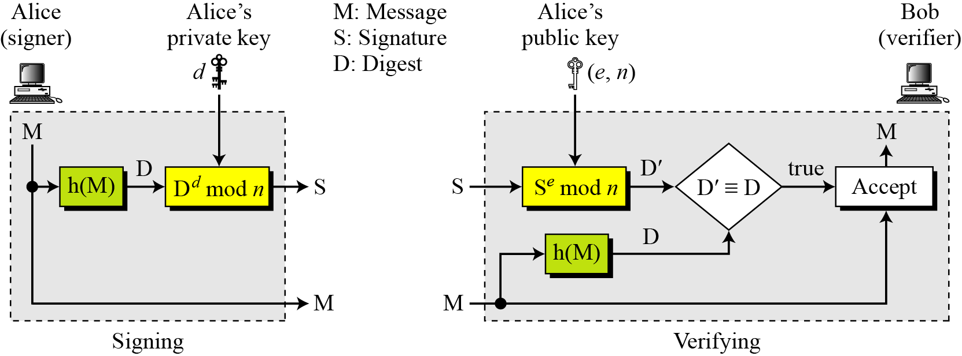
RSA Signature on the Message Digest
The RSA signature on the message digest

