Slide 1
Graph Betweenness
Centrality for Sparse Graphs using CUDA
Instructor :
Neelima B
Done By :
Aniketh Anagawadi 171IT208
Sai Siddharth 171IT236
Ayush Gupta 171IT212

Slide 2

Introduction
Betweenness centrality is a measure of the influence of a vertex in a graph
It measures the ratio of shortest paths passing through a particular vertex to the total number of shortest paths between all pairs of vertices.
Betweenness centrality is calculated using Brande’s algorithm on the graph

Slide 3
Motivation
Betweenness centrality is widely used to find best locations for stores within cities, power grid contingency analysis and community detection.
The naive implementation of solving the all-pairs shortest paths problem is of the order of O(n^^3) by Floyd-Warshall technique and Betweenness Centrality is calculated by counting the necessary shortest paths.
Brande's algorithm reuses the already calculated shortest distances by using partial dependencies of shortest paths between pairs of nodes for calculating BC of a given vertex w.r.t a fixed root vertex.

Slide 4

Problem Statement
A recursive relation for defining the partial dependency(𝛿) w.r.t root node s is:
This is the Brande's Partial Dependency equation
The project aims to parallelise the Brandon’s algorithm using CUDA and show the improvements with respect to a serial implementation of the same.

Slide 5
Methodology
Effectively the calculation of BC values can be divided into 2 steps:
Calculating the partial dependencies w.r.t all nodes. This is done by fixing a root and doing a forward Breadth First Search (BFS) to calculate the depth of other nodes w.r.t the fixed root s
Accumulating the partial dependencies for all root nodes to calculate the BC value. can be done using a reverse Breadth First Search by level-order traversal from the deepest level towards the root to calculate partial dependencies of the shortest paths between the current node to the fixed root which passes for all the predecessor nodes, i.e. the nodes which are immediately one level above of the current node and the shortest path from root to the current elements passes through them.
This gives a running Time of O(V*E)

Slide 6
Implementation
Serial Implementation Of Brande’s Algorithm
Multiple blocks in a CUDA grid can be used for parallelising partial dependencies for independent roots.
This can achieve a coarse grained parallelism by processing each source independently in parallel.
Fine grained parallelism can be achieved by running a parallel BFS using optimal work distribution strategies.
A top down BFS can be used to calculate the distance and number of shortest paths to each node with respect to a given source.
Using these values, dependency values can be calculated by traversing the graph bottom up, using a multi-sourced bottom up Breadth First Search in parallel.

Slide 7
Implementation
Compressed Sparse Row (CSR) format is a common way to store Graphs for GPU computations
It consists of 2 arrays:
Adjacency List array (Column Indices): The Adjacency List array is a concatenation of adjacency list of each vertex into an array of E elements.
Adjacency List Pointers array (Row Offset): Array of V+1 element that points at where adjacency list of each vertex begins and ends within the column indices array.

Slide 8
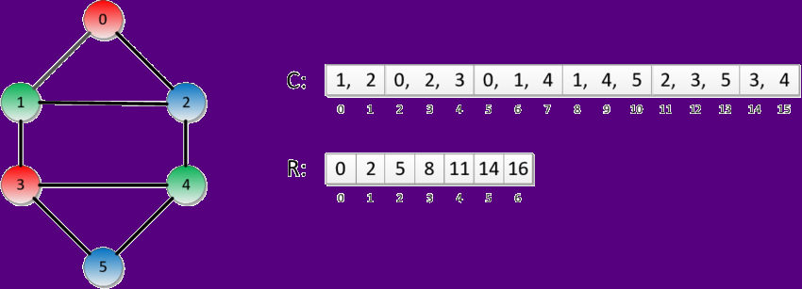
Implementation
An example of the Compressed Sparse Row format :

Slide 9
Expected Results
Parallel Implementation of Brandon’s algorithm is much more efficient than the serial implementation of the same
For a large number of nodes, coarse grained parallel implementation should have a higher execution time than fine grained parallel implementation

Slide 10
References
https://devblogs.nvidia.com/accelerating-graph-betweenness-centrality-cuda/
https://ieeexplore.ieee.org/stamp/stamp.jsp?tp=&arnumber=7013034
http://matteo.rionda.to/centrtutorial/BonchiDeFrancisciMoralesRiondato-CentralityBigGraphsTutorial-Slides.pdf

