Slide 1

GenSafe: Machine Learning & Generative AI for Construction Accident Severity Prediction
Presented by:
Aniketh Bharat | PS ID: 2381419
Sai Avinash Vanka | PS ID: 2413874
Sree Vardhan Sunkara | PS ID: 2410539
Mohan Lakshmi Deepak Marrapu | PS ID: 2380846
Naga Rahul Chowdary Kakani | PS ID: 2380842

Slide 2
Contents
Introduction
Problem Overview
Existing Research
Goals
Data & Preprocessing
Data Exploration (EDA)
Methodology
Generative AI component
Results & Analysis
Key Findings
Future Directions
References

Slide 3
Introduction
Overview: This project predicts the severity of construction accidents using advanced machine learning and generative AI techniques. In addition to predictive models, we integrated OpenAI GPT to generate automated safety reports, offering actionable insights based on model outputs.
Context: Machine learning techniques can classify accidents as fatal or non-fatal by analyzing risk factors such as environmental conditions, task-related hazards, human behavior, and project-specific characteristics.
Safety: Concerns Despite safety advancements, construction sites remain high-risk environments, with accidents frequently resulting in severe injuries or fatalities.
Challenges: Accurate prediction is difficult due to the complex interactions between environmental, task-related, and human factors contributing to accidents.
Goal: Develop a machine learning model that effectively classifies accident severity and provides actionable insights to guide proactive safety interventions.

Slide 4
Problem Overview
Construction environments are inherently risky, often leading to injury or death. Despite existing safety measures, it's hard to anticipate accident outcomes due to the mix of influencing factors.

Slide 5
Existing Research
Traditional models rely on expert judgment or simple statistics.
Gen Ai included with Machine learning offers more accurate, data-driven predictions.
Key methods explored: Random Forest, XGBoost, LightGBM,GenAI.
Challenges include imbalanced data, feature selection, and data quality.

Slide 6
Goals
Categorize
Categorize accidents as fatal or non-fatal using multiple risk factors.
Deliver
Deliver safety report for managers and policymakers to avoid severe incidents.
Strengthen
Strengthen safety planning through actionable data.
Forecast
Forecast risks and offer tailored safety suggestions.

Slide 7
Data and Preprocessing
Dataset: 4,847 records, 25 attributes.
Important Features: Event type, fall height, human behavior, environment, task, project cost, injury type.
Steps:
Handle missing data (mean/mode imputation).
Encode categories (One-Hot, Frequency).
Normalize numerical data.
Detect and manage outliers.

Slide 8
EDA
Categorical Variables: Event types, human behavior, environment, task.
Numerical Variables: Fall height, cost.
Correlation: Checked between numerical attributes.
Target Analysis: Severity distribution vs. other variables.

Slide 9
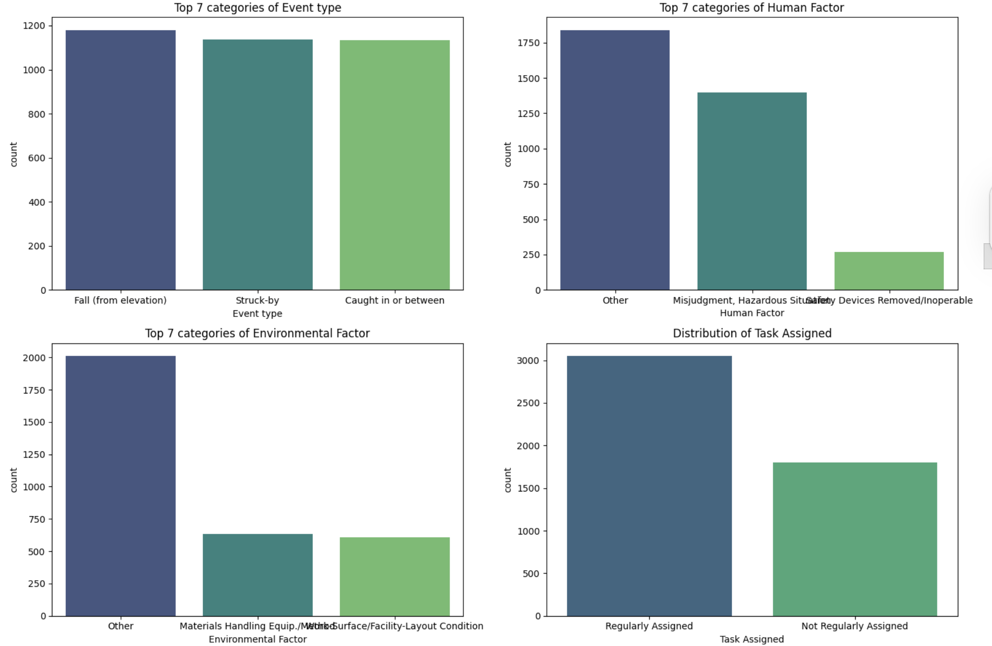
Distrubution of Categorical Fields

Slide 10
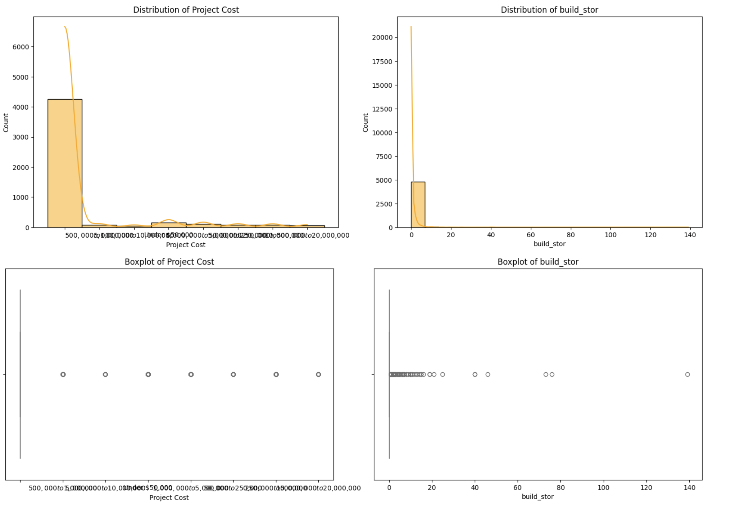
Distrubution of Numerical Fields

Slide 11
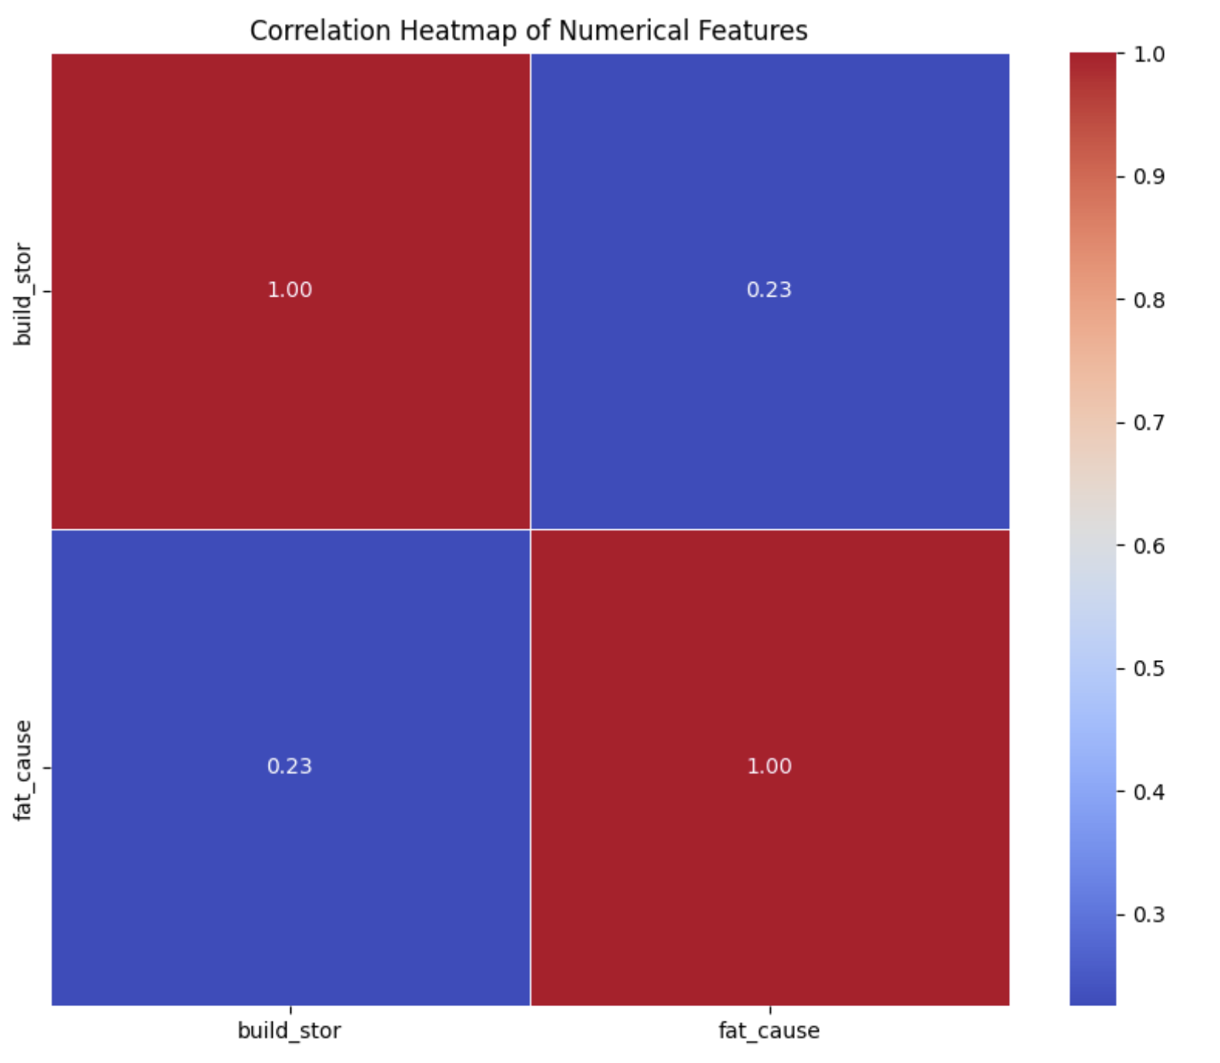
Correlation of Numerical Fields

Slide 12
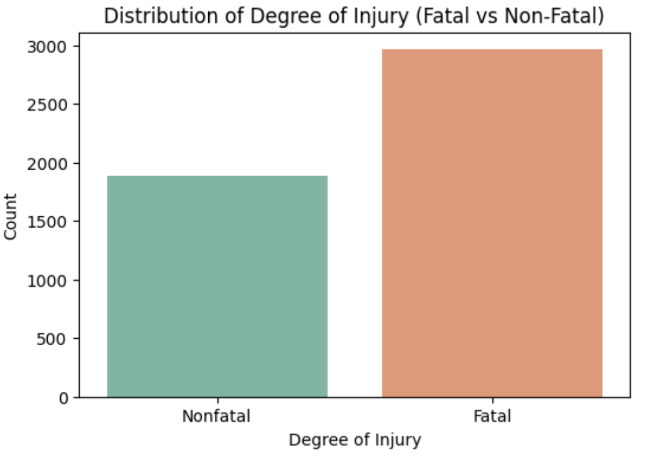
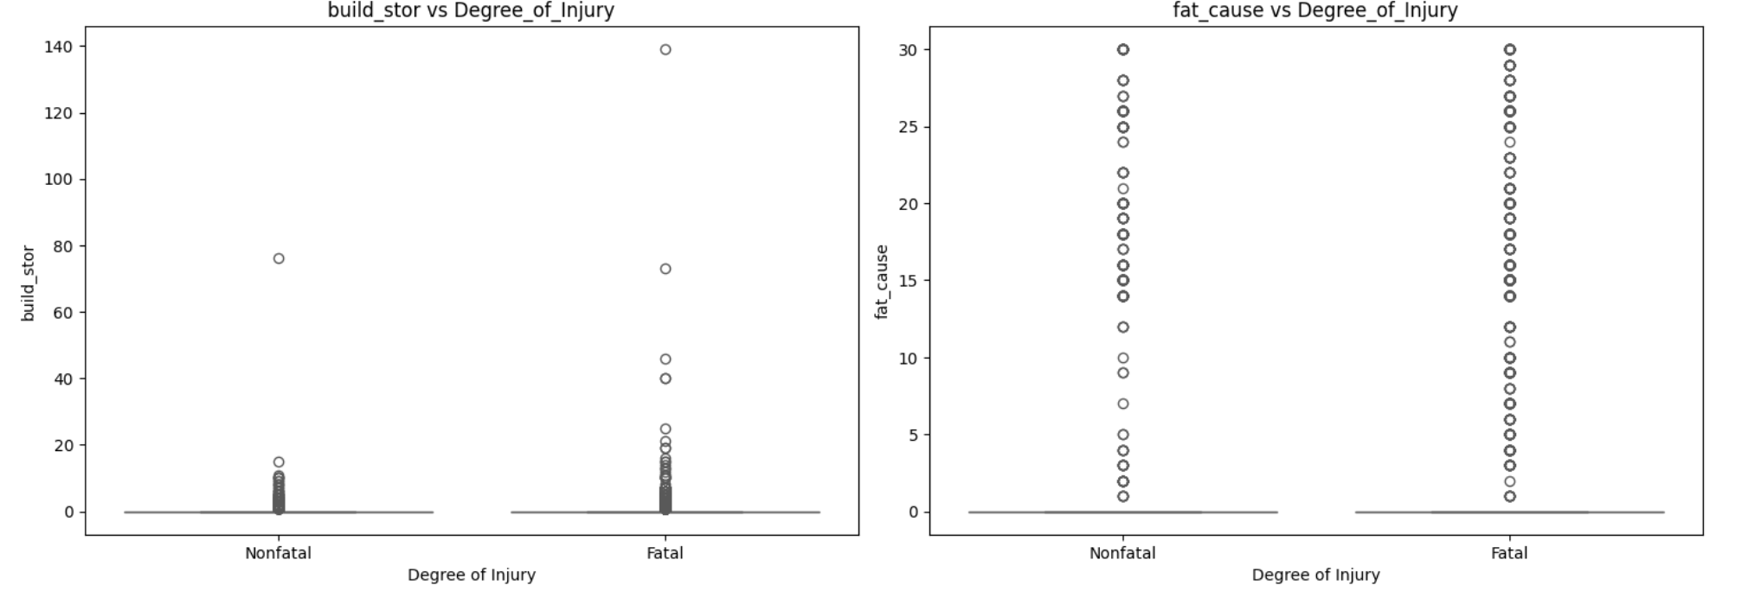
Distrubution of Target Feature against Numerical Features

Slide 13
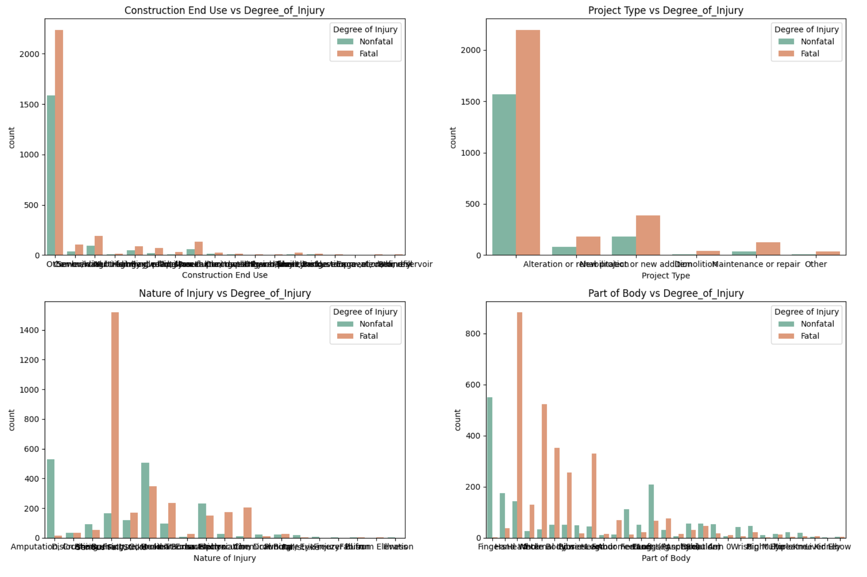
Distrubution of target feature against categorical feature

Slide 14

Generative AI component
We enhanced our project with a Generative AI element using OpenAI's GPT model to create detailed, automated safety reports based on model predictions.
Input: Key accident features (Event Type, Fall Height, Human Factor, etc.)
Output: AI-generated text explaining risks and suggesting safety measures.

Slide 15
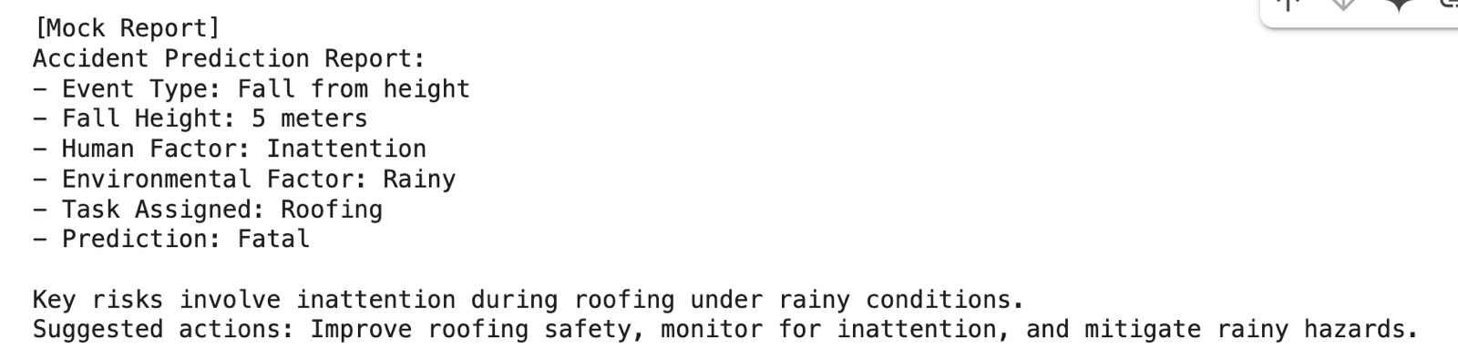
Example Output:

Slide 16
Methodology Overview
Applied multiple models: Logistic Regression, Random Forest, SVM, KNN, XGBoost, LightGBM, CatBoost.
Models evaluated using accuracy, precision, recall, F1-score.
Hyperparameters optimized for each model.
Visual evaluation: ROC, AUC, PR curves.
Generative AI: OpenAI GPT used for safety report generation.

Slide 17
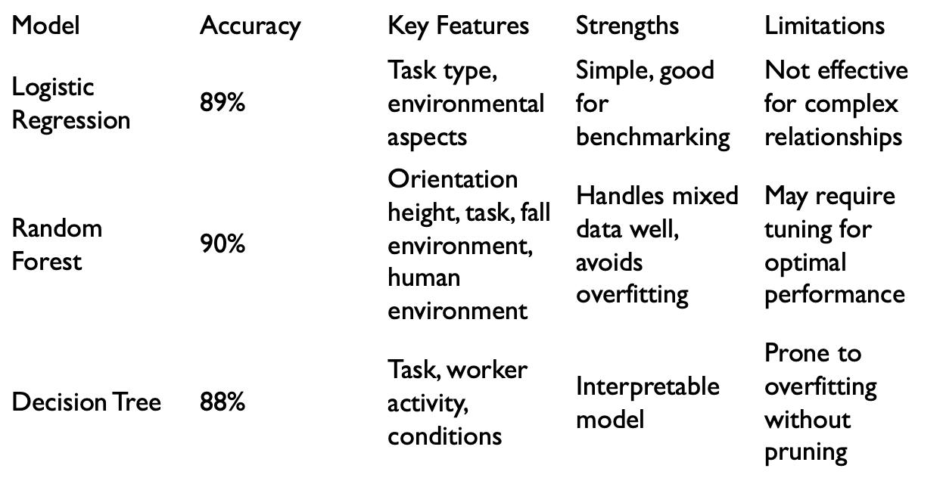
Model Comparision Table

Slide 18
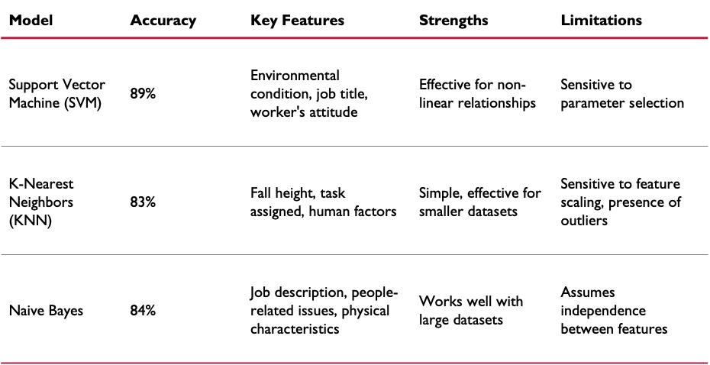

Slide 19
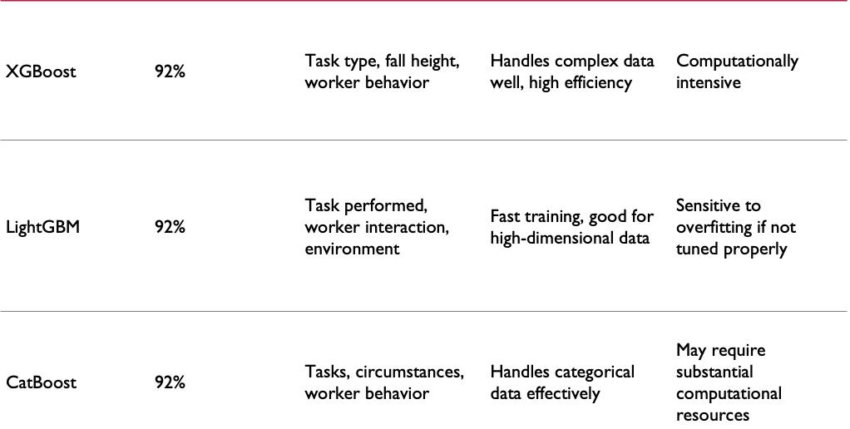

Slide 20
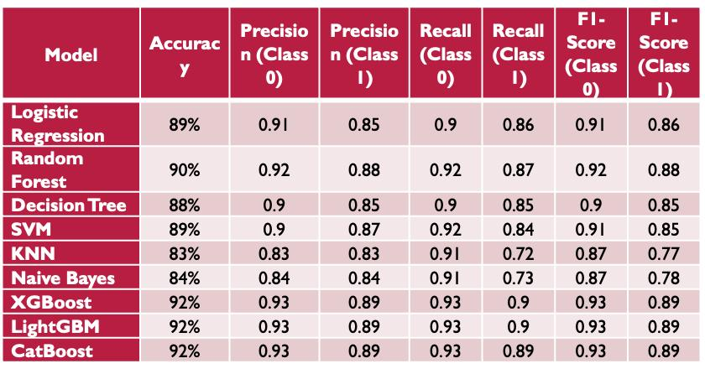
Model Evaluation Metrics

Slide 21
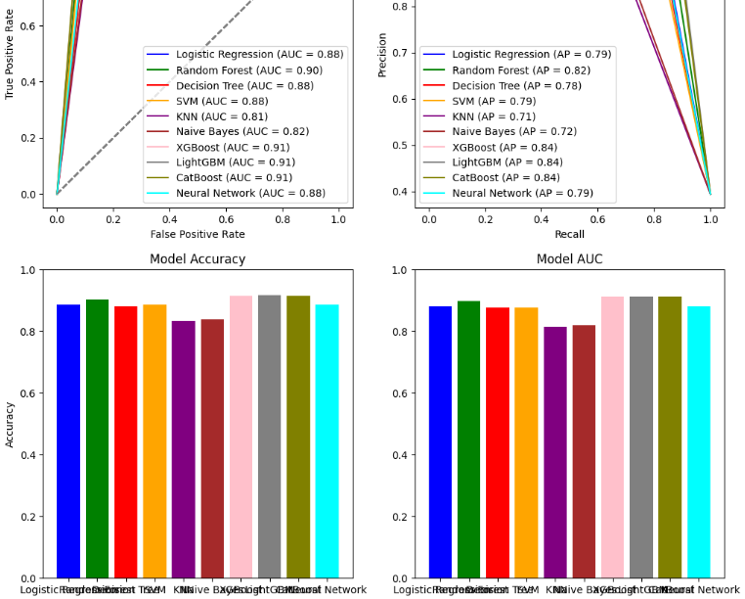
ROC AUC and PR Curves

Slide 22
Model Performance Summary
Top Performers: XGBoost, LightGBM, CatBoost (92% accuracy).
Mid-Level: Random Forest (90%), Logistic Regression (89%).
Lowest: KNN (83%).
Ensemble models excel at identifying complex patterns.

Slide 23
Applications
Improve construction safety by forecasting accident severity.
Focus safety actions on high-risk activities.
Tailor worker training to specific risk areas.
Streamline inspections based on predicted hazards.
Inform better safety policies and resource use.
Automated Safety Reports: Generated via GPT for actionable insights

Slide 24
Conclusion
Machine learning models can reliably classify accident outcomes.
Feature selection and balancing improved model reliability.
Visual tools helped interpret performance.
Models can support real-time monitoring and smart city safety efforts.

Slide 25
Future Scope
Integrate
Integrate live data: time, weather, traffic, tech environment.
Refine
Refine algorithms for better handling of imbalanced data.
Implement
Implement continuous risk alerts using sensor inputs.
Link
Link to smart city systems for proactive safety management.
GenAI
Expand Generative AI to support multi-language safety reporting and real-time alert explanations.

Slide 26
References
Zhang, L., & Tam, V. W. (2008). "A review of accident modeling and prediction techniques in construction industry." Journal of Safety Research, 39(5), 463-469.
Chien, S., Ding, Y., Wei, C., & Lee, C. (2018). "Application of machine learning algorithms for predicting construction accident severity." Automation in Construction, 96, 164-177.
Breiman, L. (2001). "Random forests." Machine Learning, 45(1), 5-32.
Chen, T., & Guestrin, C. (2016). "XGBoost: A scalable tree boosting system." Proceedings of the 22nd ACM SIGKDD International Conference on Knowledge Discovery and Data Mining, 785-794.
Vasquez, A., & Liu, M. (2019). "Data-driven approaches for safety risk assessment in construction projects." Automation in Construction, 107, 102904.
Kuhn, M., & Johnson, K. (2013). Applied Predictive Modeling. Springer.
Zhang, Z. (2016). "A survey on multi-class classification methods." IEEE Access, 4, 1-10.
Yang, Y., & Wang, X. (2019). "Real-time construction site monitoring and accident prediction with IoT and machine learning." Automation in Construction, 107, 102904.

Slide 27

THANK YOU

