Slide 1
AEGIS
Privacy-Preserving On-Device Combat Motion Intelligence
Explainable real-time motion awareness designed for Snapdragon-powered HP PCs
Participant: Aniket Kapgate | Snapdragon AI Lab Build & Present Challenge

Slide 2
/// CHALLENGE & MARKET NEED
The Problem: Latency, Fragility, and Surveillance Exposure
01 / REACTIVE REVIEW
02 / CLOUD DEPENDENCE
03 / TEMPORAL BLINDNESS
04 / PRIVACY VULNERABILITY
Incident Review Happens After the Fact
In athletic coaching and facility safety, video is examined hours or days later. Supervisors lack real-time warning to intervene before injuries or trauma occur.
High Latency & Single Point of Failure
Cloud video analytics streams high-bandwidth video over public internet, introducing 200-800ms delays and completely collapsing during network outages.
Single-Frame Models Miss Motion Context
Static single-frame object detectors cannot distinguish a high-velocity punch from an open high-five or a stumble from a dynamic athletic slide.
Biometric Harvesting & Facial Exposure
Streaming surveillance footage to external cloud servers creates catastrophic risks of non-consensual biometric data scraping and surveillance abuses.

Slide 3
/// PRODUCT VISION
The Solution: Edge-Native Biomechanical Intelligence
LOCAL PROCESSING
ANONYMIZED SKELETONS
TEMPORAL WINDOWS
100% On-Device Execution
Processes video frames entirely in local RAM on Snapdragon PCs. Video buffers are analyzed and immediately overwritten—never uploaded.
Human Pose Landmarks
Extracts 9 normalized 2D skeletal landmarks (wrists, shoulders, hips, ankles). Aegis does not perform face recognition, face identification, facial embeddings or biometric identity tracking. One coarse nose keypoint is used only for pose geometry.
Multi-Frame Motion Context
Maintains a 12-frame sliding window to calculate true physical velocities, body scale growth rates, and torso aspect ratios.
ACTION VOCABULARY
TRANSPARENT METRICS
HUMAN-IN-THE-LOOP
6 Biomechanical Patterns
Deterministically detects Neutral, Guard, Punch-like extension, Kick-like extension, Rapid Approach, and Fall-like recumbent postures.
Explainable Telemetry
Outputs human-verifiable evidence strings (e.g., 'right arm reach 1.65x, speed 1.15/s') alongside bounded 0-100% threat scores.
Decision-Support Telemetry
Empowers coaches and safety supervisors with visual gauges and opt-in local logging. Autonomous enforcement is strictly prohibited.

Slide 4
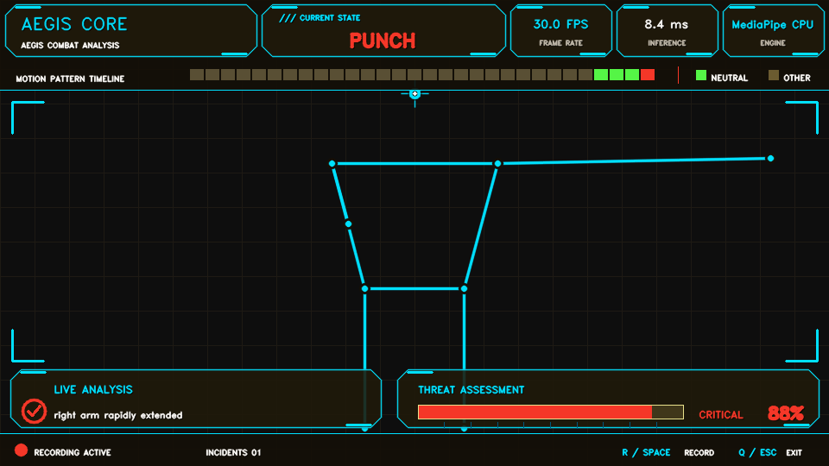
/// ENGINEERING PIPELINE
Technical Architecture: From Raw Pixels to Explainable Alerts
1. Optical Input: Live Webcam (720p/1080p) or Prerecorded Video Clip
AEGIS CORE TELEMETRY INTERFACE
2. Frame Normalization: OpenCV Ingestion & Downsampling to 960x540 Buffer
3. Pose Estimation: MediaPipe Pose Estimator (Active Provider: MediaPipe CPU; QNN Planned)
4. Landmark Extraction: 9 Normalized Keypoints with Visibility Confidence Gating (>0.40)
5. Temporal Sliding Window: 12-Frame Deque Tracking Velocity & Scale Growth
6. Kinematic Pattern Engine: Rule Evaluator: Fall > Punch > Kick > Approach > Guard > Neutral
7. Threat Fusion & Telemetry: Graduated Threat Scoring (0.0 - 1.0) & Rationale Generation
Current Verified Engine: MediaPipe CPU (Active)
Heads-up display running at 960x540. QNN Hexagon NPU execution is planned via ONNX/QNN pose adapter.
8. Output & Storage: AEGIS CORE Dynamic HUD Display & Local JSONL Incident Log

Slide 5
/// RESPONSIBLE AI ARCHITECTURE
Innovation, Privacy, and Responsible Safety Safeguards
ZERO FACIAL RECOGNITION
VOLATILE FRAME MEMORY
OPT-IN LOCAL LOGGING
Biometric Privacy by Design
Aegis does not perform face recognition, face identification, facial embeddings or biometric identity tracking. One coarse nose keypoint is used only for pose geometry.
No Cloud Video Uploads
All frame computations execute in volatile RAM on the local workstation. Video streams are analyzed frame-by-frame and immediately overwritten.
Operator-Controlled Storage
Incident logging is strictly opt-in via manual toggle (R or Space). Log records reside exclusively on the host PC in artifacts/incidents.jsonl.
INTENT VS. MOTION
DECISION-SUPPORT ONLY
SYNTHETIC EVALUATION
Kinematic Signals, Not Guilt
Aegis measures biomechanical movement patterns; it does not and cannot infer criminal intent, malice, or moral culpability. Human context is mandatory.
Prohibition of Autonomous Action
Outputs are engineered strictly for human review. Under no circumstances should Aegis trigger automated physical enforcement or disciplinary interlocks.
Camera-Free Demonstration
A deterministic synthetic demonstration mode (--demo and --export-preview) enables comprehensive validation without exposing real users or spaces.

Slide 6
/// HARDWARE ACCELERATION STRATEGY
Qualcomm Snapdragon Optimization & NPU Deployment Path (Planned)
[STAGE 1: FUNCTIONAL BASELINE] Current MediaPipe CPU Pipeline
The validated MVP runs MediaPipe CPU to establish ground-truth algorithmic correctness, temporal stability, and deterministic test suites.
[STAGE 2: MODEL SELECTION] Qualcomm AI Hub Model Catalog
Select an edge-optimized pose model (e.g., YOLOv8n-pose or RTMPose) from Qualcomm AI Hub with proven low-latency edge topology.
[STAGE 3: COMPILATION & QUANTIZATION] INT8 / FP16 Hexagon Compilation
Utilize Qualcomm AI Hub cloud toolchains to compile and quantize the model for the Hexagon NPU on Snapdragon X Elite/Plus platforms.
[STAGE 4: RUNTIME ADAPTATION (PLANNED)] ONNX/QNN Pose-Estimator Adapter
Implement adapter that preprocesses frames, calls session.run(), converts outputs to normalized PoseFrame landmarks, and replaces MediaPipePoseEstimator via QNN.
[STAGE 5: RIGOROUS BENCHMARKING (PLANNED)] Identical-Video CPU vs QNN Benchmark
Execute scripts/benchmark.py on an identical 1080p clip to measure real throughput (FPS), p95 latency reduction, and CPU offload.
* Architectural Transparency Note: Supplying AEGIS_MODEL_PATH does not connect model outputs to pose estimation. Runtime diagnostics only verify provider availability. MediaPipe CPU is the only currently verified active pose provider; QNN is planned.

Slide 7
/// VERIFICATION & FUTURE VISION
Evidence, Real-World Impact, and Project Roadmap
VERIFIED CURRENT EVIDENCE
DEVELOPMENT ROADMAP
CLOSING VALUE STATEMENT
• Functional Live Pipeline: Real-time webcam ingestion, landmark tracking, threat scoring, and HUD.
• 17 / 17 Tests Passing: Deterministic pytest suite verifying heuristics, safety bounds, and deduplication.
• Synthetic Demo Suite: Complete camera-free demonstration and visual preview exporter.
• Truthful Telemetry: HUD reports MediaPipe CPU. QNN NPU execution is planned via pose adapter.
• Public GitHub Repository: github.com/aniketkapgate7-crypto/Aegis-Fight-Pattern-Analyzer
• QNN Pose Model Integration (Planned): Implement ONNX/QNN pose adapter replacing MediaPipe on Hexagon NPU.
• Snapdragon PC Benchmarking: Evaluate throughput, latency, and power on Snapdragon X Elite HP laptops.
• Multi-Person Interaction: Extend kinematic engine to multi-subject spatial distance tracking.
• Curated Validation Dataset: Benchmark against controlled athletic sparring clips for recall/precision metrics.
Edge-Native Motion Intelligence
Aegis proves that advanced physical motion intelligence can run fully on-device without compromising personal privacy, streaming raw video to cloud servers, or harvesting facial biometrics.
Designed for Snapdragon-powered HP PCs, Aegis showcases the transformative potential of edge NPU acceleration for human-in-the-loop safety and athletic intelligence.

