Slide 1

PSEUDOHOME
-By Aniket keshri ,B-04 ,5th sem

Slide 2
INTRODUCTION
PseudoHome is a online platform to search PG’s, Mess ,stationary e.t.c
In today’s world of internet people want everything with ease ,ordering food,clothes daily essentials and everything now people have shifted their move towards online shopping and transaction .
PseudoHome will provide a better chain of needs of students of colleges and universities
Now they can easily search for Pg’s and mess and their daily needs with easy.
This website will provide a well rated and inspected contents for students to get benifited with daily needs.

Slide 3

Tools and terminology used
VISUAL STUDIO CODE–
Visual Studio Code is a source-code editor made by Microsoft for Windows, Linux and macOS. Features include support for debugging, syntax highlighting, intelligent code completion, snippets, code refactoring, and embedded Git. Users can change the theme, keyboard shortcuts, preferences, and install extensions that add additional functionality.
HTML: HYPERTEXT MARKUP LANGUAGE
It’s a coding language used to create pages that a web browser can display. Most of the web pages you find on the internet, including the one you’re reading this article on right now, are stored as an HTML file. Websites are a bunch of related HTML pages stored on a server somewhere. That’s why the language is frequently called the “backbone of the internet.”

Slide 4

CSS: CASCADING STYLE SHEETS
Cascading Style Sheets (CSS) is a stylesheet language used to describe the presentation of a document written in HTML or XML (including XML dialects such as SVG, MathML or XHTML). CSS describes how elements should be
rendered on screen, on paper, in speech, or on other media.
ReactJS is JavaScript library used for building reusable UI components. According to React official documentation.
JAVASCRIPT
It is a scripting language used to create and control dynamic website content, i.e., anything that moves, refreshes, or otherwise changes on your screen without requiring you to manually reload a web page. Features like:
animated graphics
photo slideshows
autocomplete text suggestions
interactive forms

Slide 5

Project overview
In today’s world of internet people want everything with ease ,ordering food,clothes daily essentials and everything now people have shifted their move towards online shopping and transaction .
Moreover everyone nowadays wants easy in everything thus this PseudoHome will get oneself a
Better platform to find ones daily essential needs easily .

Slide 6
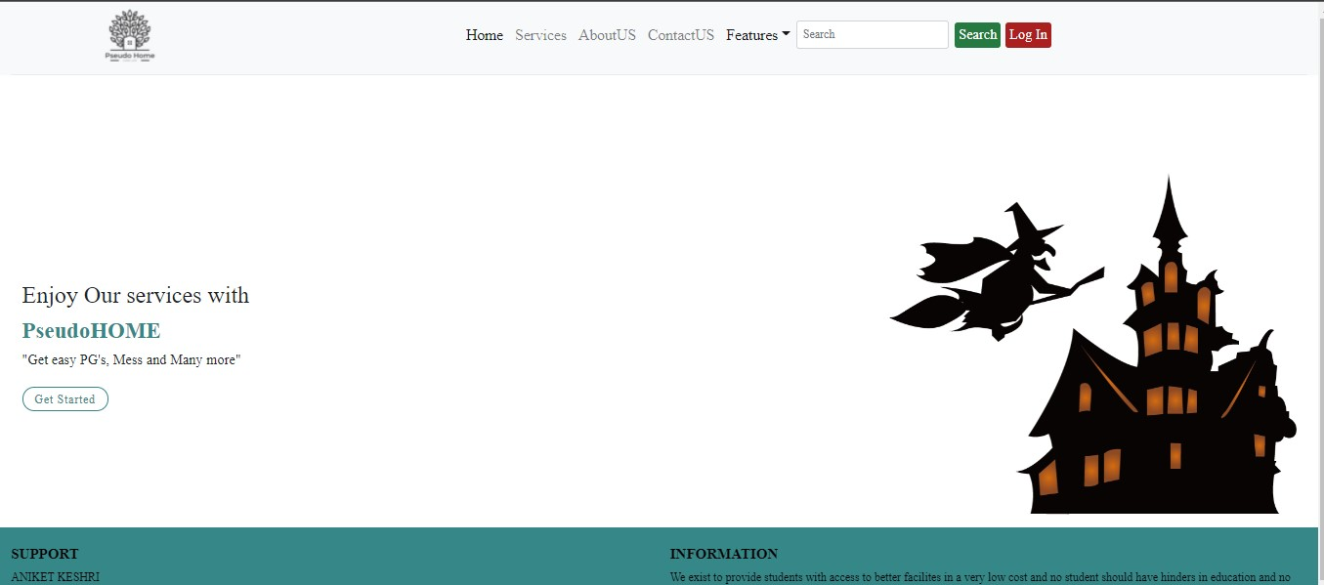
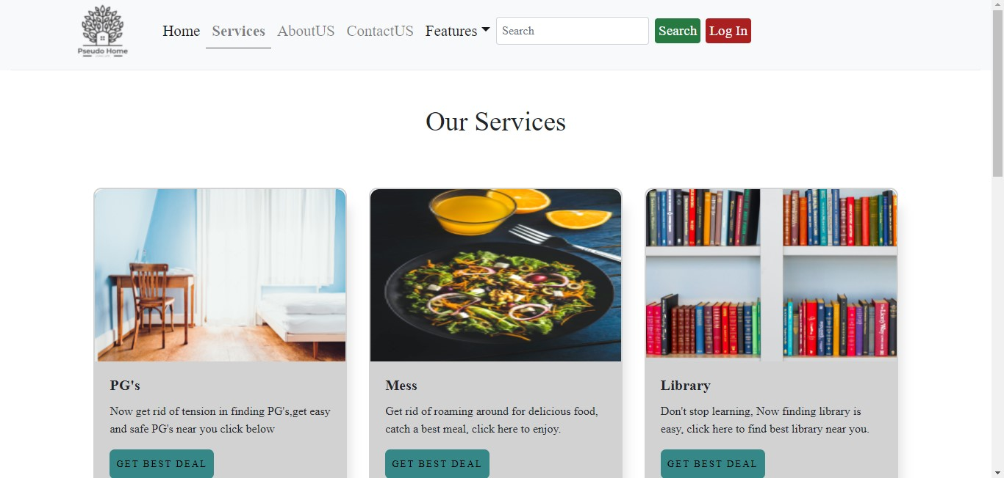
Project snip

Slide 7
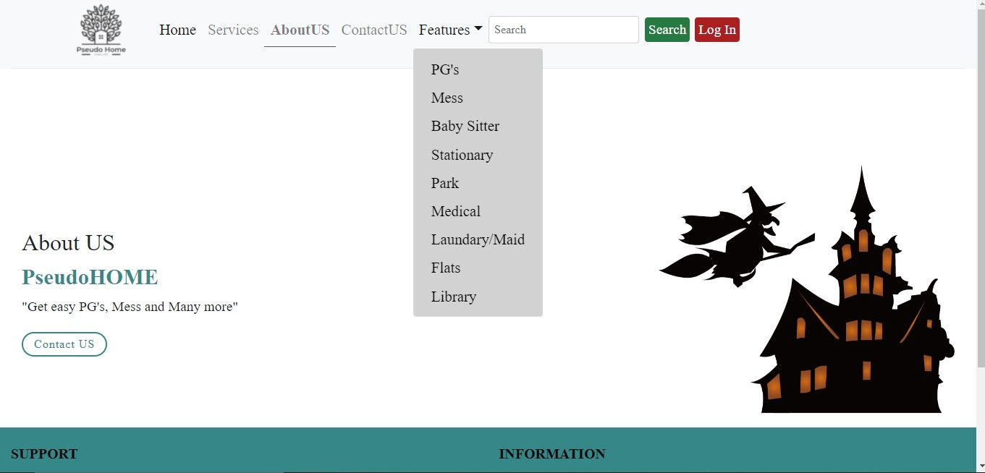
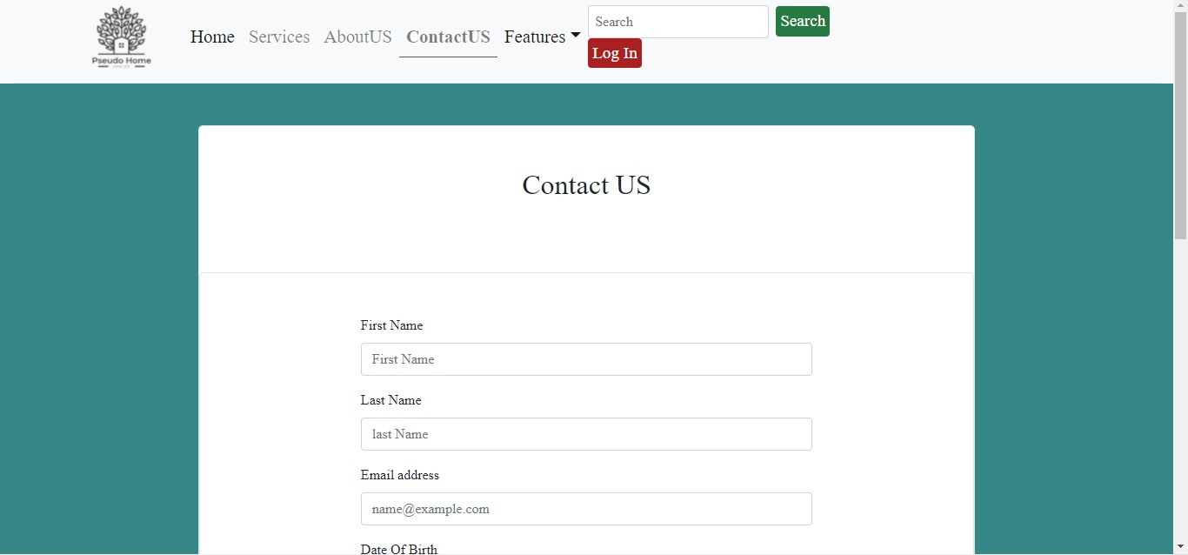
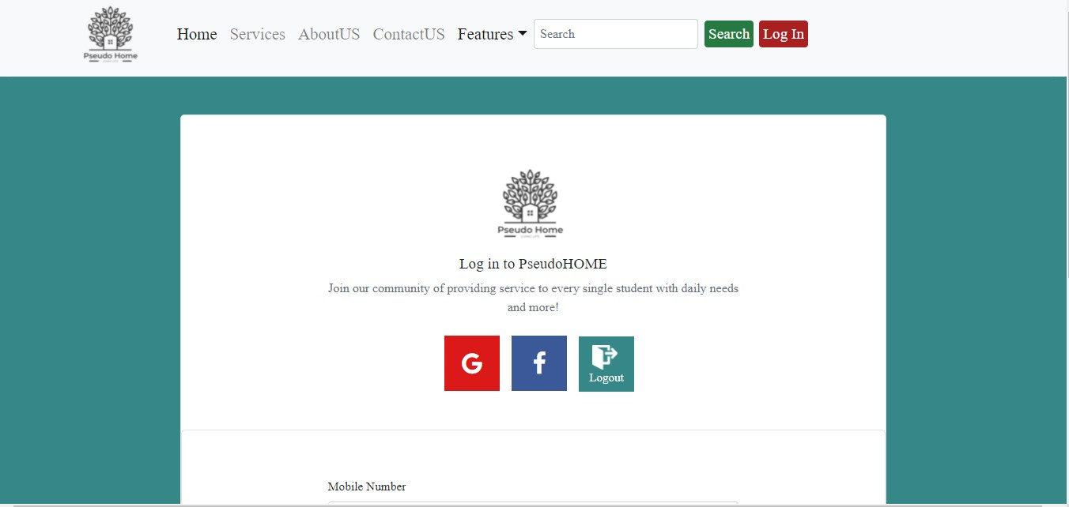

Slide 8

FUTURE SCOPE AND CONCLUSION
Our future is full of AI and data science and everything is gtting shorter and smaller and people nowadays wants to do nothing hard work everyone wants easy in everything thy are doing
Students are going and will be going in future too to other cities to study and that’s where this website PseudoHome will provide with all daily functions in a single place with proper ratings and visuals .

Slide 9
Thank you

