Slide 1
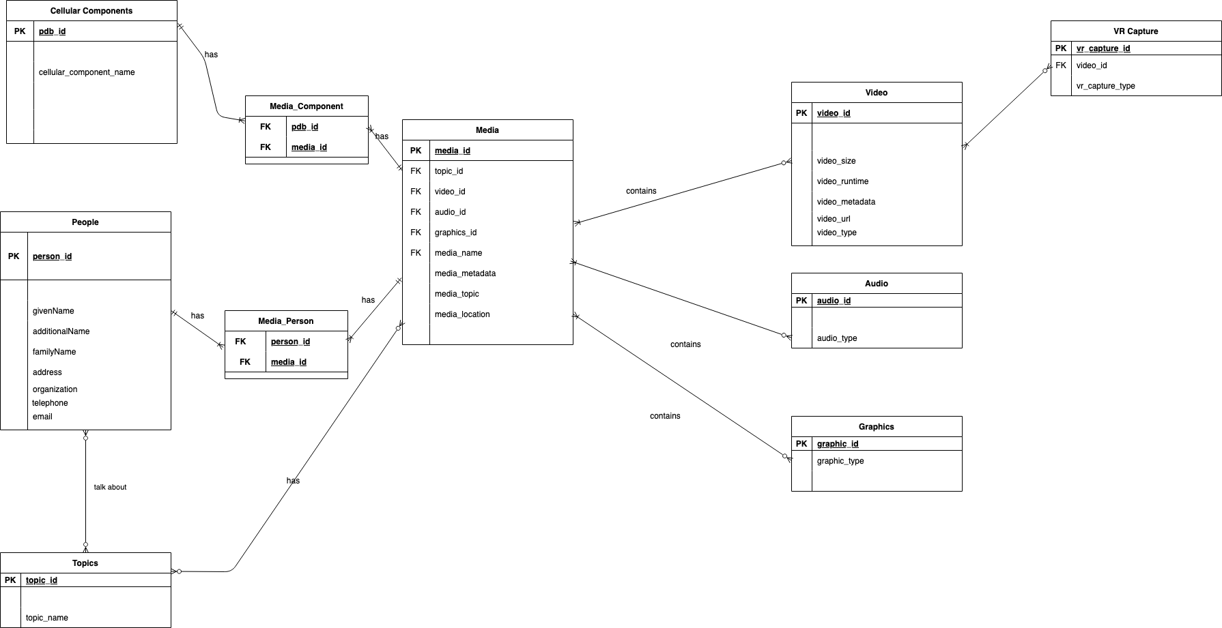

Slide 2
// Query to Select Videos which have Insulin as a cellular component in them.
SELECT
M.video_id,
M.media_name,
MC.pdb_id
FROM Media M
INNER JOIN Media_Component MC ON (M.media_id = MC.media_id)
INNER JOIN Cellular_Component C ON (C.pdb_id = MC.pdb_id)
WHERE C.cellular_component_name LIKE '%Insulin%'
GROUP BY
V.video_id,

Slide 3
Query 1
pdb_id | person_id | topic_id | video_id | audio_id | graphics_id | media_name | media_metadata | media_topic | media_location
1 | 2 |  | 328612 | 3 | 561436 | World in a Cell_Nick Promo_Draft 5_0309
2 | 5 |  | 579023 | 24 | 85749 | WiaC_Trailer_v1_20190630
3 | 4 |  | 914482 | 45 | 4654 | AlexHR_2min_20191218_v3
4 | 1 |  | 709172 | 4564 | 65445 | WiaC_5min_Video_v2_20190630
5 | 6 |  | 711575 | 1654 | 544 | WiaC_Demo_Trailer_07242020
6 | 3 |  | 989690 | 6546 | 45 | WbML Intro Outro_WIAC Teaser 50"
7 | 7 |  | 581778 | 54656 | 88 | Video_15_mRNA_animation
Media Table
 | Cellular Components
pdb_id | cellular_component_name
1 | Insulin Vesicle
2 | Glucose
3 | Insulin Vesicle
4 | GLP1
5 | PKA Catalytic Domain
6 | Insulin Vesicle
7 | Mitochondrion
 |  | Video
video_id | video_size | video_runtime | video_metadata | video_url | video_type
328612 | 123 | 12:01 |  |  | Animation
579023 | 3423 | 12:23 |  |  | Animation
914482 | 323 | 5:04 |  |  | Animation
709172 | 4343 | 3:09 |  |  | Animation
711575 | 24342 | 4:07 |  |  | Animation
989690 | 4 | 2:00 |  |  | Animation
581778 | 34 | 1:05 |  |  | Animation
Inner Join Final Result
video_id | Media Name | pdb_id
914482 | AlexHR_2min_20191218_v3 | 3
328612 | World in a Cell_Nick Promo_Draft 5_0309 | 1
989690 | WbML Intro Outro_WIAC Teaser 50" | 6

Slide 4
// Query about such a video which has a Person 1 (Alex) and Person 2(Helen) talking about cellular component X
SELECT
M.video_id,
M.media_name,
C.cellular_component_name
P.name
FROM Media M
INNER JOIN Media_Component MC ON (M.media_id = MC.media_id)
INNER JOIN Cellular Components C ON (MC.pdb_id = C.pdb_id)
INNER JOIN Media_Person ON MP.media_id = M.media_id
INNER JOIN Person P ON (MP.person_id = P.person_id)
WHERE C.cellular_component_name LIKE '%Insulin%' AND
WHERE P.person_name = 'Alex' OR P.person_name = 'Helen'
GROUP BY
P.person

Slide 5
// Query to look for interviews about VR captures
SELECT
V.video_id,
M.media_name
FROM Media M ,Video V
INNER JOIN Video V ON (M.video_id = V.video_id)
WHERE V.video_type = 'Interview' AND
M.media_type CONTAINS ('VR')
GROUP BY
M.media_name

