Slide 1
Myntra Men's Jeans Data Analysis
End-to-End Data Analytics Project | July 2026

Slide 2
Problem Statement
Analyze Myntra's men's jeans catalog to uncover pricing and brand insights
Support data-driven decisions for merchandising, marketing, and partnerships
52,120 raw products → 31,527 cleaned records across 371 brands

Slide 3
Dataset Overview
7 features: brand, description, price, MRP, discount, ratings, # ratings
Average price: ₹1,697 | Median: ₹1,484 | Range: ₹337 – ₹54,000
Average rating: 3.98/5 | No missing values in raw data

Slide 4
Data Cleaning Process
Removed 17,047 exact duplicate rows
Removed 3,546 records with inconsistent discount format (discount_percent > 1)
Validated data types and discount format (decimal 0–1)
Final clean dataset: 31,527 unique product records

Slide 5
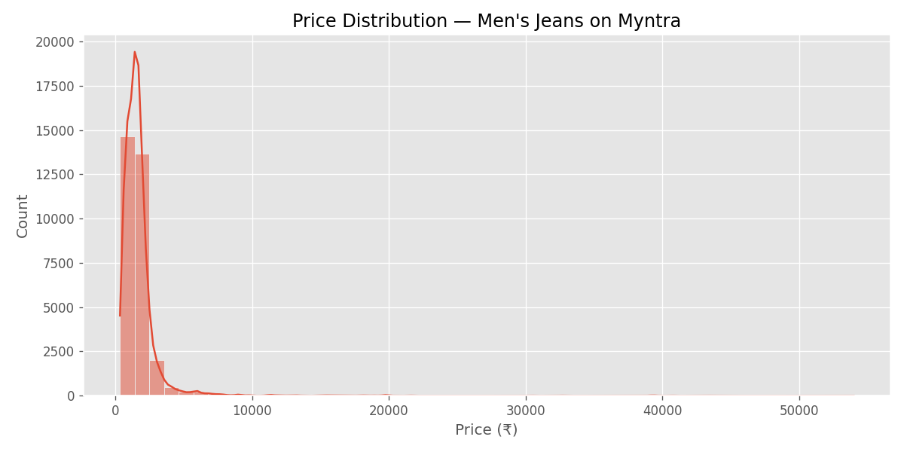
EDA Highlights
Mid-range pricing dominates the catalog (50% between ₹899–₹1,829)
Right-skewed price distribution — few luxury items pull mean up
Roadster, HIGHLANDER lead in customer engagement

Slide 6
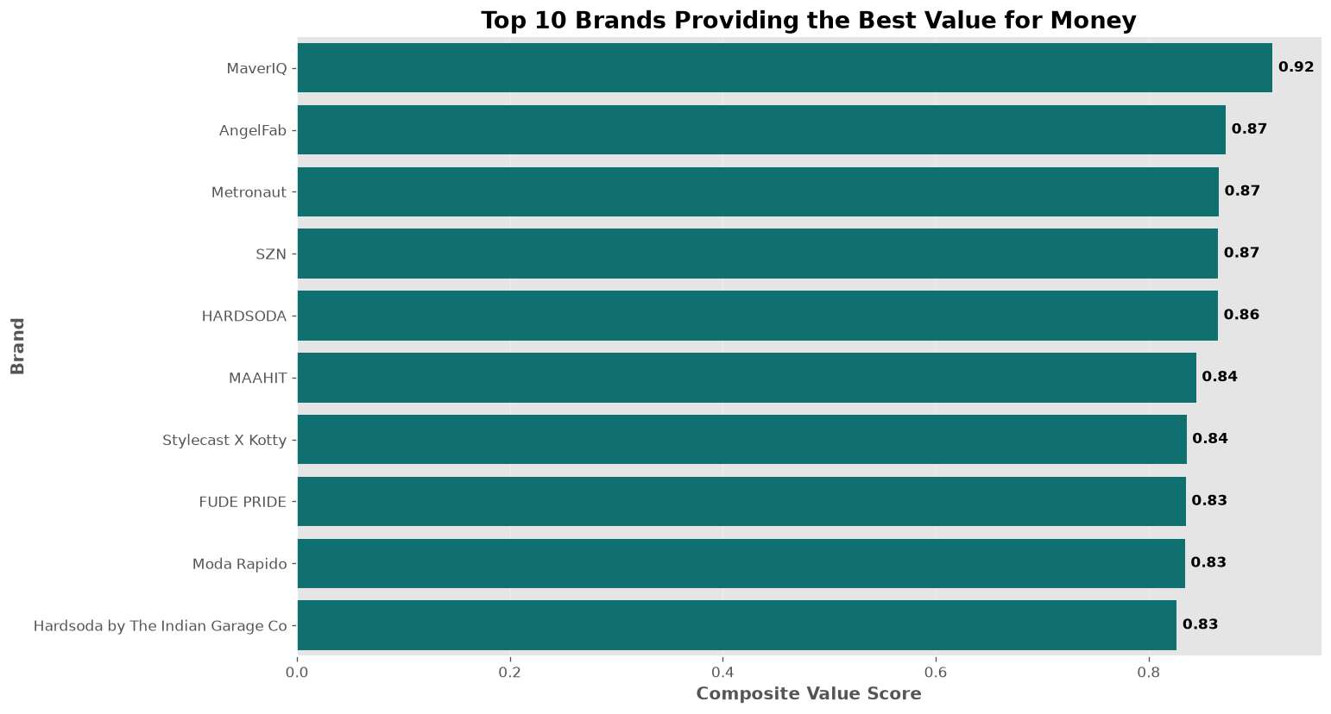
BQ1: Best Value for Money
Composite Value Score = ratings + discount + price competitiveness
Top brands: MarvelQ, AngelFab, Metronaut, SZN, HARDSODA
Success comes from balanced pricing, not a single metric

Slide 7
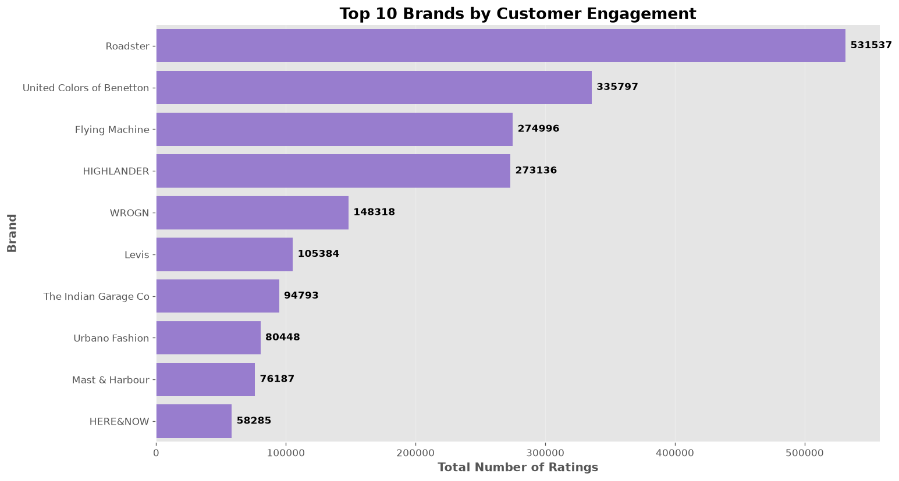
BQ2: Customer Engagement
HIGHLANDER: highest engagement efficiency (ratings per product)
Roadster: highest total engagement (large catalog)
Evaluate both total and per-product metrics for full picture

Slide 8
BQ3: Promotional Discounts
Some brands rely heavily on high average discounts
A few products show 100% discounts (promotional anomalies)
Strategic discounting preserves profitability and brand value

Slide 9
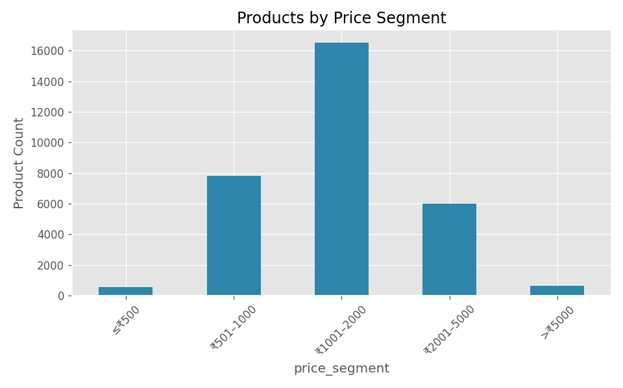
BQ4: Price Segment Performance
Mid-price (₹1,001–2,000): largest catalog, strongest engagement
Premium: higher ratings but fewer total ratings
Core revenue driver = mid-range segment

Slide 10
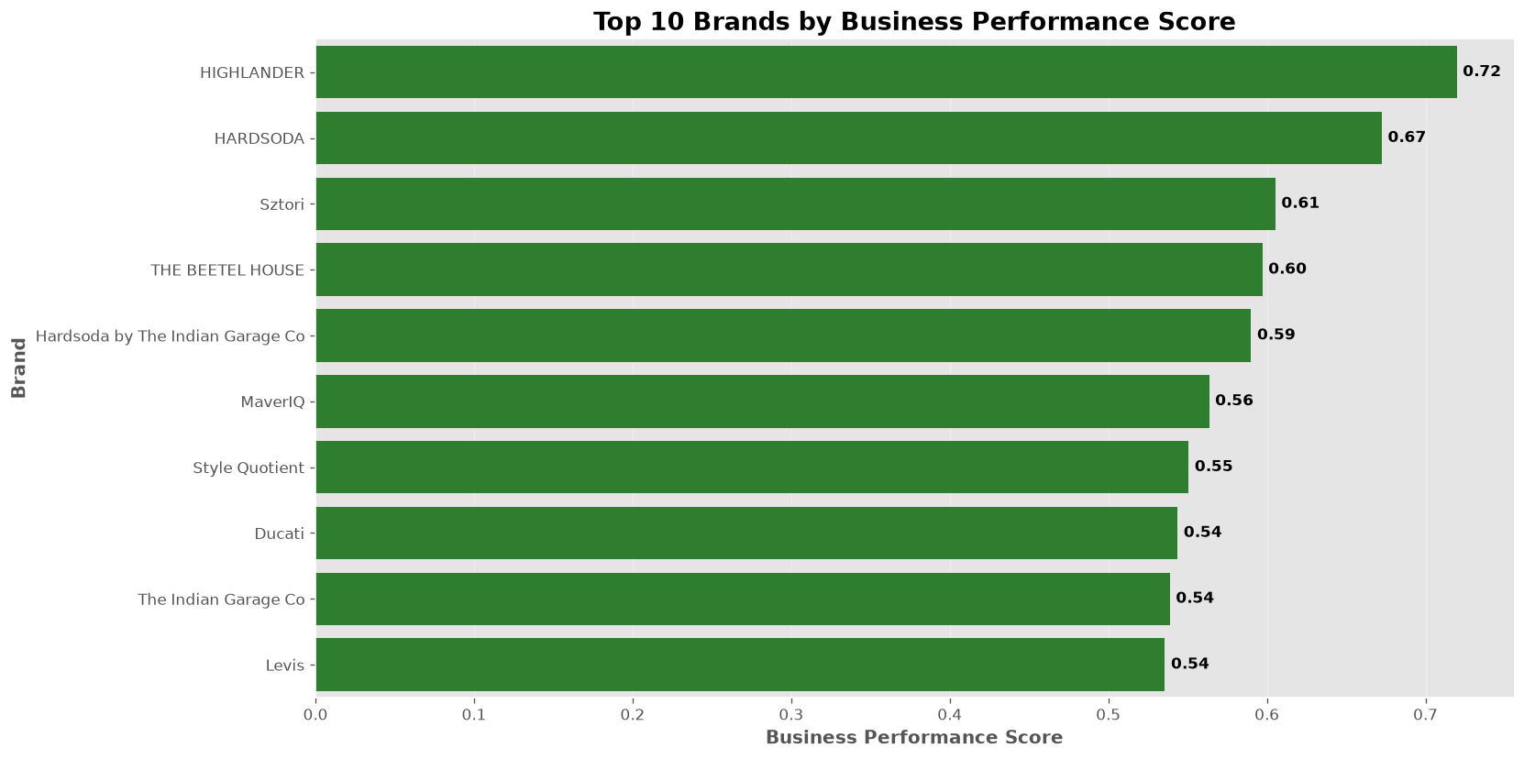
BQ5: Brand Prioritization
Business Performance Score integrates all key metrics
Top brands: HIGHLANDER, HARDSODA, Sztori, THE BEETEL HOUSE
Prioritize for featured collections and inventory expansion

Slide 11
Final Recommendations
Feature HIGHLANDER, HARDSODA, Sztori in campaigns
Strengthen mid-price portfolio as core revenue segment
Market premium via exclusivity, not discounts
Use Streamlit dashboard for ongoing brand monitoring

Slide 12
Thank You
Questions & Discussion

