Slide 1
Property Based Testing : Hypothesis
- Aniket Maithani

Slide 2
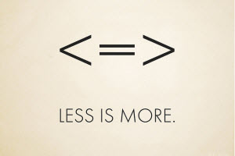
Property based Testing
Property-based tests make statements about the output of your code based on the input, and these statements are verified for many different possible inputs.
A property-based testing framework runs the same test over and over with generated input
The main efficiency parameter of a property testing algorithm is its query complexity, which is the maximum number of input symbols inspected over all inputs of a given length (and all random choices made by the algorithm)

Slide 3
Difference between example based testing & Property based testing

Slide 4
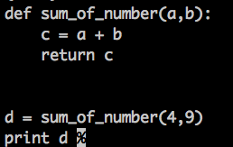
Normal testing (example based)
Define a function which we want to write test for :

Slide 5

Normal Testing (Example Based)
Write down the test function
Write down exact inputs
Write down the expected result(s)
Run the test and checks if assertion matches or not

Slide 6

Aahh…. EASY & Elegant…. OR IS IT??

Slide 7
Issues with Example based testing
You may miss the boundary/edge cases!
Writing code for test(s) becomes complex and time consuming as your underlying feature-set grows
Maintaining tests in itself becomes a task : and that’s why most of the devs don’t like to write test cases!! [SAD BUT TRUE]

Slide 8
Most important of all
Writing random, unbiased examples is hard...

Slide 9
This is where property based testing comes in…

Slide 10
Property based testing
YOU DEFINE THE INPUTS
DEFINE EXPECTED RESULTS
LET THE FRAMEWORK DO THE REST OF THE WORK!!
SOUNDS IMPOSSIBLE??? LET’S HAVE A LOOK AT IT

Slide 11
EXAMPLE

Slide 12

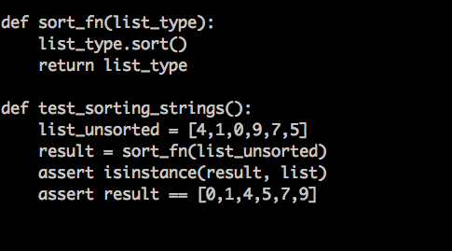

Normal Test(s)
Suppose we want to write test for Sorting a list

Slide 13
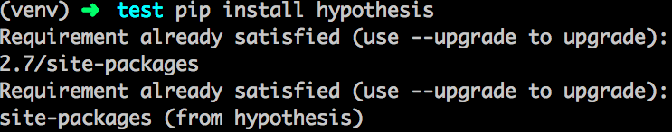
Before we start… .Installation

Slide 14
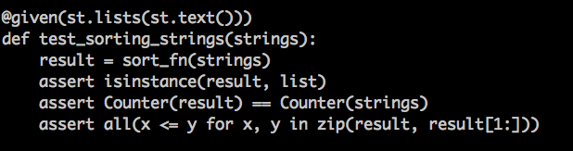

Writing Test(s) with Hypothesis

Slide 15
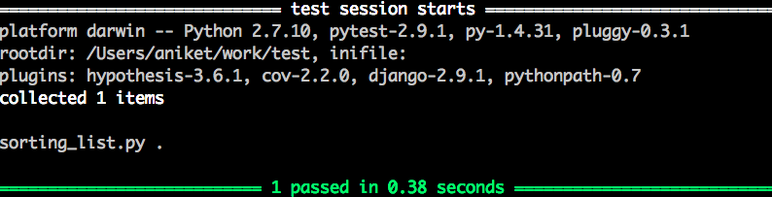
Running the test

Slide 16
Let’s dive into it a bit more
Strategy is a basic building block of test(s) while using Hypothesis.
Hypothesis has built in types : Numbers, Strings, Collections, Dates.
One can write their own strategies!
Write Less Do More!

Slide 17
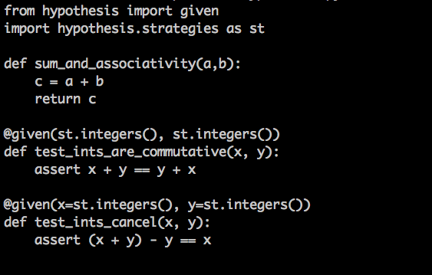
Example

Slide 18
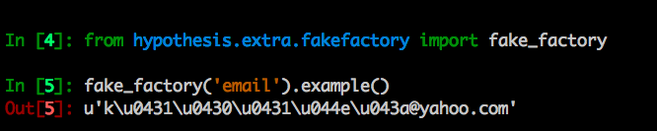

How hypothesis generate data
Fake_factory :

Slide 19
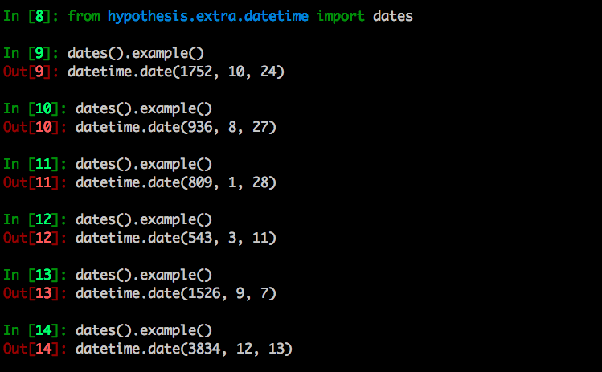
date strategy

Slide 20
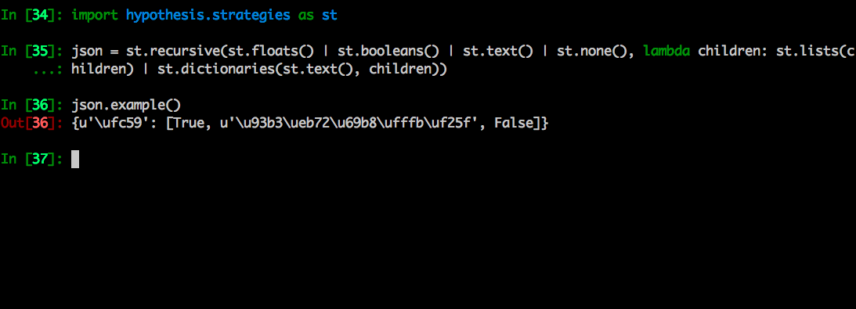
Strategy for json

Slide 21
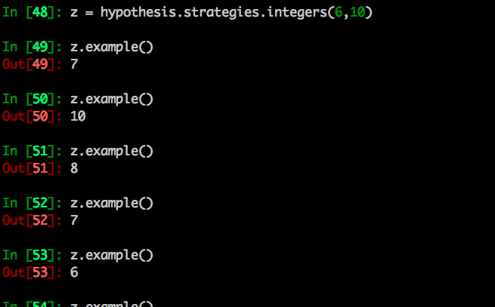
Strategy for integers

Slide 22
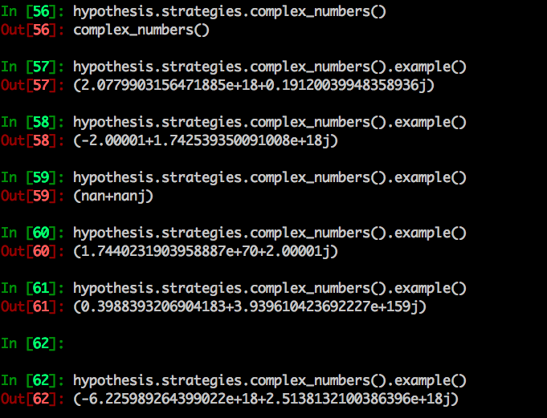
Strategy for complex numbers

Slide 23
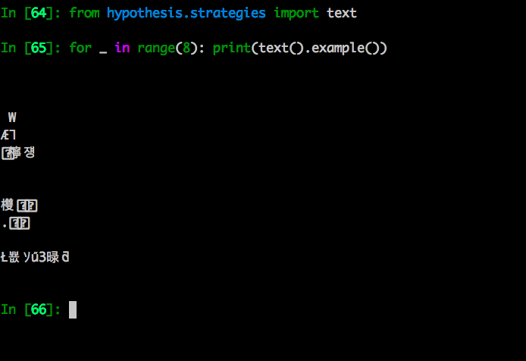
Strategy for text(s)

Slide 24
What more you can generate and how??
Example Link : http://hypothesis.readthedocs.io/en/latest/data.html

Slide 25
Rare example / Failing test
One has to be very particular about failing test because of Property Based Testing since the data is randomly generated!
We don’t want flakey counterexamples – that leads to flakey tests.
Also, Hypothesis remembers failing tests.

Slide 26
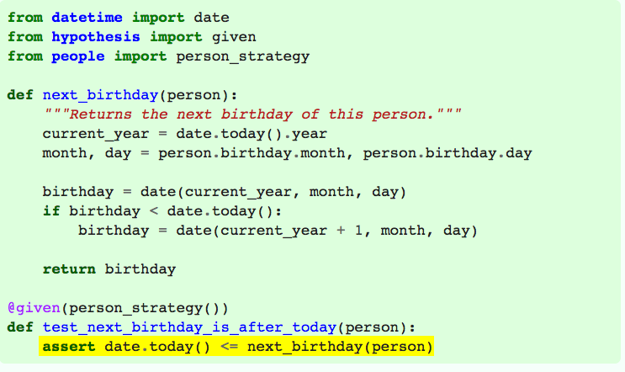
Example :

Slide 27
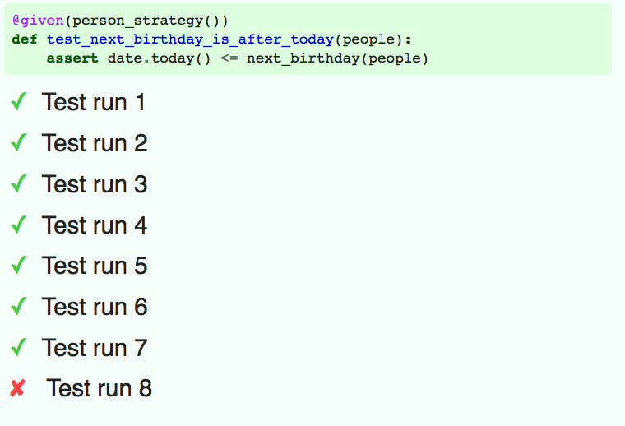
Failing point!!!!

Slide 28
This is all Good…. But…
How many times will Hypothesis run my test?
People generally assume that the number of tests run will depend on the specific strategies used, but that’s generally not the case. Instead Hypothesis has a fairly fixed set of heuristics to determine how many times to run, which are mostly independent of the data being generated.
The short answer is 200. Assuming you have a default configuration and everything is running smoothly, Hypothesis will run your test 200 times.
The longer answer is “It’s complicated”. It will depend on the exact behaviour of your tests and the value of some settings
For the passing case there are two other settings that affect the answer: max_examples and max_iterations.

Slide 29
Wanna Learn More??
http://hypothesis.readthedocs.io/
http://hypothesis.works/
http://hypothesis.works/articles/details/

Slide 30
That’s all Folks!

Slide 31
About me :
Aniket Maithani
Nature Lover, FOSS Enthusiast, Python Programmer
Learner
Loves to Travel and Make Friends
@2aniketmaithani
in.linkedin.com/in/aniketmaithani
Github.com/aniketmaithani

