Slide 1
Testing Your ”TESTS”
- Aniket Maithani

Slide 2
$: whoami
Aniket Maithani
Codes in Python
Works @Corseco Technologies
Foodie
-----”MAI--_THA--_NI”
@2aniketmaithani
https://github.com/aniketmaithani

Slide 3
TESTING 101
Test(s) in Software scenario refers to the investigating the internal “health” of the code about the quality of the product or service.
As the number of possible tests for even simple software components is practically infinite, all software testing uses some strategy to select tests that are feasible for the available time and resources
But testing cannot identify all the defects within software at all times

Slide 4

“Software testing proves the existence of bugs not their absence.”
–
CHUCK NORRIS

Slide 5
Types of Testing
TESTS
Functional Testing
UI
MODULE
FLOW
Unit Testing
Integration Testing
MANUAL TESTING
AUTOMATED TESTING

Slide 6
Popular Python Testing Modules
Nose
Unittest
Doctest
PyTest
Tox

Slide 7
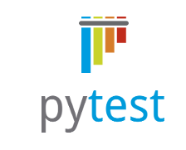
PyTest
Easy To Use
Popular
Concise
Easy Assertions
Plugins
POWER OF FIXTURES!

Slide 8
INSTALLATION

Slide 9
The objective of Unit testing is to isolate a unit and validate its correctness.
Unit Testing

Slide 10
Let’s Get Started

Slide 11
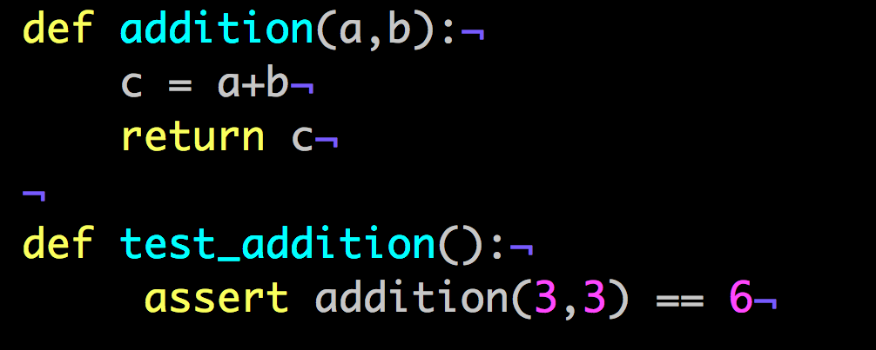
Basic Python Program

Slide 12
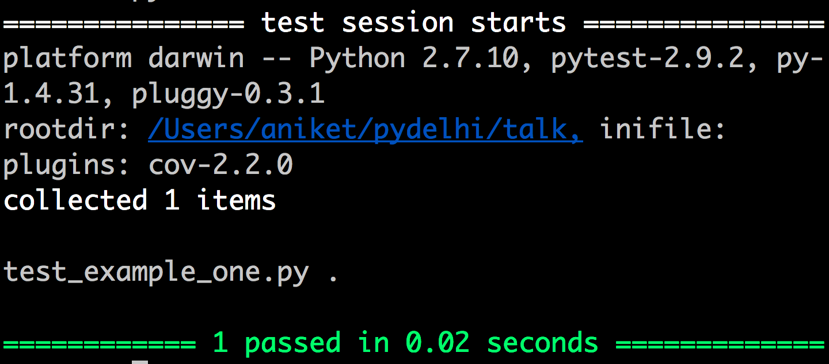
Now Run `py.test`

Slide 13
How Py-Test discovers your tests??
Filename should start from test_foo_bar_etc.py
Function name should be test_foo_bar_etc()
Configuration defined in setup.cfg or setup.ini settings file

Slide 14
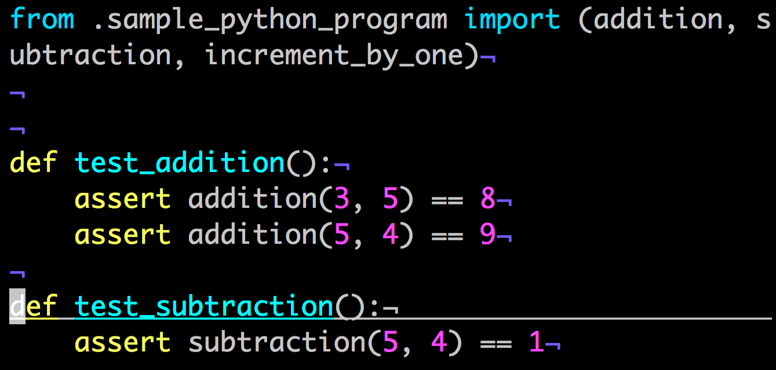
Example

Slide 15
Let’s Dive a Bit More Deep……..
SETUP & TEARDOWN
FIXTURES

Slide 16
SETUP & TEARDOWN
TO BE WRITTEN

Slide 17
Fixtures
The purpose of test fixtures is to provide a fixed baseline upon which tests can reliably and repeatedly execute.
fixtures have explicit names and are activated by declaring their use from test functions, modules, classes or whole projects.
fixtures are implemented in a modular manner, as each fixture name triggers a fixture function which can itself use other fixtures.
fixture management scales from simple unit to complex functional testing, allowing to parametrize fixtures and tests according to configuration and component options, or to re-use fixtures across class, module or whole test session scopes.

Slide 18
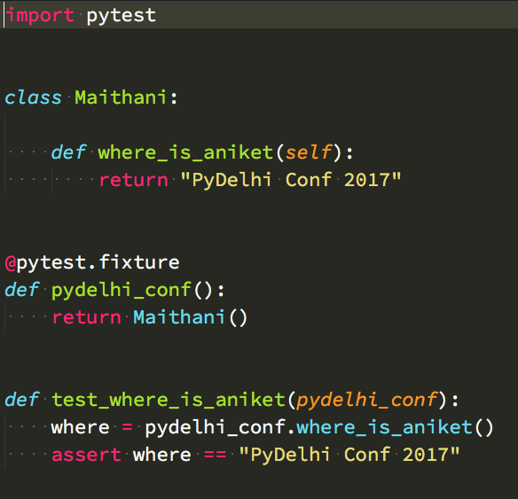
Dependency Injection & Fixtures Example

Slide 19
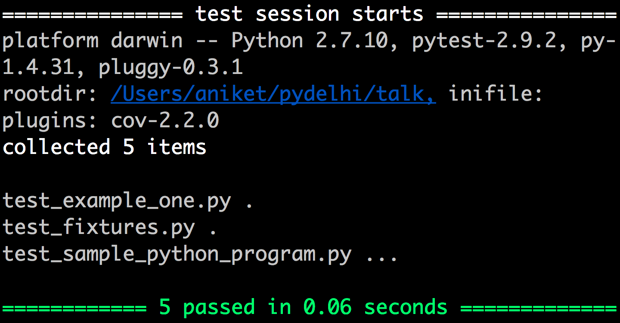
Running The Test Again

Slide 20
More About Fixture
1 More slide to be added . Content To be decided

Slide 21
MOCK
mock is a library for testing in Python. It allows you to replace parts of your system under test with mock objects and make assertions about how they have been used.
Installation is simple :

Slide 22
Examples to Be added
Mocking Request
Mocking Objects
Etc. etc.
Content to be decided

Slide 23
MonkeyPatch / Patching
Content To be Added

Slide 24
Py.Test & PDB
Content To be added

Slide 25
That’s all FOLKS!

