Slide 1



GOOGLY
PRESENTED BY
CARPEDIUM
TEAM MEMBERS:
ANIKET DINDE
VAIBHAV KACHARE
RUSHIKESH JADHAV

Slide 2
SLIDE 2:
Problem statement
SUN
SUN
MON
MON
TUE
TUE
30
30
31
31
01
01
MANUAL COORDINATION:
AMD HACKATHON
MEETING SCHEDULING OFTEN INVOLVES REPETITIVE BACK-AND-FORTH COMMUNICATION, CONSUMING VALUABLE TIME AND RESOURCES.
How-to tutorials
06
06
07
07
08
08
13
13
LACK OF FLEXIBILITY:
EXISTING SCHEDULING TOOLS STRUGGLE TO AUTONOMOUSLY ADAPT TO SHIFTING PRIORITIES, CANCELLATIONS, OR URGENT UPDATES IN REAL-TIME.
20
20
21
21
TIME MANAGEMENT:
MISMANAGEMENT OF TIME ZONES, MEETING DURATIONS, AND BUFFER PERIODS CAN RESULT IN SCHEDULING ERRORS AND CAUSE MEETINGS TO RUN OVER, REDUCING PRODUCTIVITY.
New product poster

Slide 3
SLIDE 3:
Solution
DAILY REMINDER
NATURAL LANGUAGE PROCESSING (NLP):
DYNAMIC ADAPTABILITY:
AUTONOMOUS COORDINATION:
1
2
3
EXISTING SCHEDULING TOOLS STRUGGLE TO AUTONOMOUSLY ADAPT TO SHIFTING PRIORITIES, CANCELLATIONS, OR URGENT UPDATES IN REAL-TIME.
ADJUSTS TO TIME ZONES, RESOLVES CONFLICTS, AND ADAPTS TO LAST-MINUTE CHANGES TO ENSURE ACCURATE AND EFFICIENT SCHEDULING.
AUTOMATICALLY PROCESSES MEETING REQUESTS, FETCHES RELEVANT CALENDAR DATA, AND SCHEDULES MEETINGS WITHOUT MANUAL INPUT.

Slide 4
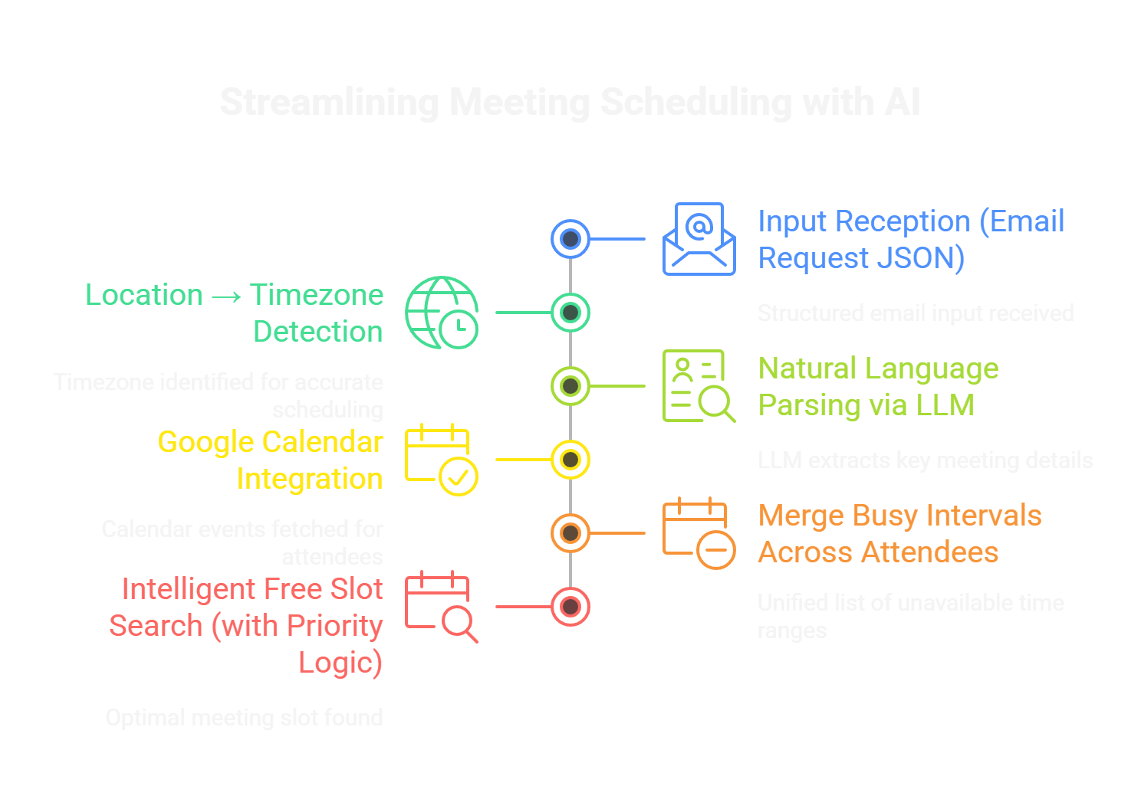
SLIDE 4:
Architecture
INPUT RECEPTION (EMAIL REQUEST JSON)
THE SYSTEM RECEIVES A STRUCTURED INPUT JSON CONTAINING:
EMAIL CONTENT (NATURAL LANGUAGE)
SENDER ("FROM") AND LIST OF "ATTENDEES"
LOCATION (E.G., "IIT BOMBAY")
OPTIONAL EVENT FIELDS: START, END, DURATION
THIS SIMULATES A HUMAN WRITING "LET'S MEET ON THURSDAY FOR 30 MINS" IN AN EMAIL.
2. LOCATION → TIMEZONE DETECTION
USING GEOPY AND TIMEZONEFINDER, THE LOCATION STRING IS GEOCODED TO LATITUDE/LONGITUDE, THEN CONVERTED TO A VALID TIMEZONE (E.G., "ASIA/KOLKATA"). THIS TIMEZONE IS CRITICAL TO NORMALIZE ALL TIMESTAMPS AND CALENDARS.
3. NATURAL LANGUAGE PARSING VIA LLM
THE EMAIL BODY IS SENT TO A FINE-TUNED LLM (DEEPSEEK 7B VIA VLLM). IT EXTRACTS:
EXACT DATE FROM WORDS LIKE "THURSDAY" → "2025-07-17"
DURATION (E.G., "30 MINUTES")
TIME OF DAY HINTS (E.G., "MORNING")
PRIORITY LEVEL (E.G., IF MARKED “URGENT” OR “ASAP”)
THIS USES LANGCHAIN'S STRUCTUREDOUTPUTPARSER TO SAFELY EXTRACT STRUCTURED FIELDS FROM FREE-TEXT.

Slide 5

SLIDE 5:
Architecture
THE AGENT FETCHES CALENDAR EVENTS FOR EACH ATTENDEE USING GOOGLE CALENDAR API:
QUERIES FOR THE ENTIRE DAY (E.G., 00:00–23:59) OF THE TARGET DATE
RETURNS STARTTIME, ENDTIME, AND SUMMARY FOR EACH EVENT
EACH ATTENDEE’S EVENTS ARE STORED IN A DICTIONARY FOR FURTHER PROCESSING
MERGE BUSY INTERVALS ACROSS ATTENDEES
ALL THE BUSY TIME INTERVALS ACROSS USERS ARE MERGED USING A SORTED MERGE ALGORITHM. THIS RESULTS IN A UNIFIED LIST OF COMMON UNAVAILABLE TIME RANGES, ELIMINATING DUPLICATES AND OVERLAPS.
INTELLIGENT FREE SLOT SEARCH (WITH PRIORITY LOGIC)
THE SCHEDULER SCANS DAY-WISE IN 15-MIN INTERVALS (CONFIGURABLE):
SKIPS LUNCH HOUR (13:00–14:00)
APPLIES A 15-MIN BUFFER BEFORE AND AFTER EVERY POSSIBLE SLOT
IF A SLOT DOESN'T CONFLICT WITH ANY MERGED INTERVAL, IT IS MARKED AS AVAILABLE
IF NO SLOT IS FOUND ON THE DAY, THE SCHEDULER ROLLS OVER TO THE NEXT DAY (UP TO 3-DAY MAX)
FOR HIGH-PRIORITY MEETINGS:
SEARCH INCLUDES EXTENDED HOURS (8 AM – 8 PM)
MAY OVERRIDE MILD CONFLICTS IF NEEDED

Slide 6
SLIDE 6:
Conclusion & Future Scope
GOAL
DEVELOPED A FULLY AUTONOMOUS AI SCHEDULING ASSISTANT THAT ELIMINATES MANUAL MEETING COORDINATION.
INTEGRATED GOOGLE CALENDAR API FOR SEAMLESS EVENT RETRIEVAL AND CONFLICT RESOLUTION.
USING DEEPSEEK 7B LLM ON VLLM SERVER WITH MI300 GPU FOR EFFICIENT, HUMAN-LIKE REASONING.
DELIVERED ACCURATE, CONFLICT-FREE SCHEDULING WITH USER-FRIENDLY JSON OUTPUT.
AUTONOMOUS WORKFLOW USING LANGGRAPH FOR DYNAMIC INPUT PROCESSING AND SCHEDULING.
HANDLES TIME ZONES, PRIORITIES, AND NATURAL LANGUAGE INPUTS EFFECTIVELY.
OPTIMIZED FOR LOW LATENCY AND HIGH THROUGHPUT, MEETING HACKATHON PERFORMANCE GOALS.
FUTURE SCOPE
INCORPORATE USER PREFERENCE LEARNING (E.G., PREFERRED MEETING TIMES, LOCATIONS).
ADAPT SCHEDULING BASED ON HISTORICAL USER BEHAVIOR AND FEEDBACK.
BROADER INTEGRATION:
SUPPORT ADDITIONAL CALENDAR PLATFORMS (E.G., OUTLOOK, ICAL) FOR WIDER COMPATIBILITY.
INTEGRATE WITH EMAIL CLIENTS FOR AUTOMATED MEETING CONFIRMATIONS AND FOLLOW-UPS.
ADVANCED FEATURES:
ENABLE RESCHEDULING CAPABILITIES FOR LAST-MINUTE CHANGES OR CANCELLATIONS.
ADD MULTI-LANGUAGE SUPPORT FOR GLOBAL TEAMS USING LLM CAPABILITIES.

Slide 7


THANK
YOU

