Slide 1
Same Accuracy, Different Evidence
Does patient information help a skin-cancer model look in the right place, or make it stop looking?
Aniket Meena · Ritu Raj Swami · Nishant Kumar
Supervisor: Dr. Bharti Nagpal
Major Project · Target venue: MIDL 2027 · September 2026

Slide 2
THE PROBLEM
A model can be right for the wrong reason
• A computer can look at a photo of a skin lesion and predict whether it is cancer. It can also be given the patient's details: age, sex, whether the spot itches, bleeds, or recently changed.
• Adding those details almost always makes the model more accurate. That part is well known and already published.
The unanswered question: does the model then look at the lesion more carefully, or does it lean on the patient details and look at the image less?
• This matters in the clinic. A model that quietly stops looking at the image still scores well on a test set - then fails on a patient whose details are unusual, missing, or come from a different hospital.
Accuracy alone cannot tell these two models apart. Something else must.

Slide 3
WHY THIS IS WORTH A PAPER
Everyone reports accuracy; nobody checks the evidence
What the field already does well:
- Combines images with patient details in many ways - concatenation, FiLM, MetaBlock, cross-attention transformers.
- Reports the accuracy gain, usually several points.
What almost nobody does:
- Check whether the model's visual evidence actually sits on the lesion, measured against outlines drawn by dermatologists.
- A 2026 review of 82 multimodal medical-AI studies found that standardised evaluation of explanations is missing in the majority - they rely on eyeballing heat maps.
The gap: no published work measures whether adding patient details improves or damages a model's visual grounding. That is exactly what we measure.

Slide 4
NOVELTY · THE HEART OF THIS WORK
Four things here that do not exist elsewhere
N1 New benchmark
A controlled 'metadata trap': a patient detail is made to predict the diagnosis in training, then reversed at test - crossed with image-artifact traps to form a 2-D shortcut grid. Trap sets existed only for image artifacts before.
N2 New measurement
A counterfactual test: hold the image fixed, change one patient detail, and measure how far the visual evidence moves. Needs no human annotation, so it runs on any dataset with metadata. Not done before.
N3 First grounding audit
The first like-for-like, quantitative comparison of WHERE five fusion mechanisms look, scored against dermatologist masks - not illustrative heat maps, actual numbers with confidence intervals.
N4 A finding, not a widget
The result overturns a natural assumption: it is the fusion mechanism, not the presence of metadata, that decides grounding - and the simplest method wins while the fanciest degrades.

Slide 5
DATA
Three public datasets, every download verified
ID | Dataset | What it gives us | Role
A | PAD-UFES-20 | 2,298 phone photos, 1,373 patients, 21 fields | Rich-metadata tests
B | HAM10000 | 10,015 dermoscopy images + lesion outlines | Where-it-looks tests
C | ISIC 2019 + traps | 25,331 images with shortcut splits | Shortcut robustness
D | DDI (planned) | 656 biopsy-proven, skin-tone balanced | Fairness (pending)
A useful accident: 9,083 images belong to both B and C, so for those we have the lesion outline, the patient details and the shortcut labels all at once.
Splits are grouped so no patient is ever on both sides - otherwise the model learns the patient, not the disease.

Slide 6
METHOD · MODELS
Six models, one difference between them
B0 Image only - the reference point.
B1 Metadata only - patient details, no image.
B3 Concatenation - simplest: join the two sets of numbers.
B4 FiLM - patient details rescale the image features.
B5 MetaBlock - a published attention block for this task.
M1 Cross-attention - the image queries the patient details (the design we first proposed).
Same backbone, same images, same training recipe, same tuning budget for all. Only the fusion mechanism differs - so any difference is caused by the mechanism.

Slide 7
METHOD · HOW WE MEASURE EVIDENCE
Five pre-registered measurements
P1 Grounding - share of the model's attention that lands inside the dermatologist's lesion outline.
P2 Image-shortcut resistance - how fast accuracy falls as rulers/hair/ink are made to predict the diagnosis.
P3 Offloading - does planting a misleading patient detail pull attention off the lesion?
P4 Counterfactual - change one detail, keep the image fixed, measure how far the evidence moves.
P5 Reliance - accuracy lost when we remove the metadata vs. when we remove the image.
Trustworthy by design: the full plan was frozen before any model was trained; every number carries a confidence interval; and the heat-map method passed the standard 'scramble the weights' safety check on every model.

Slide 8
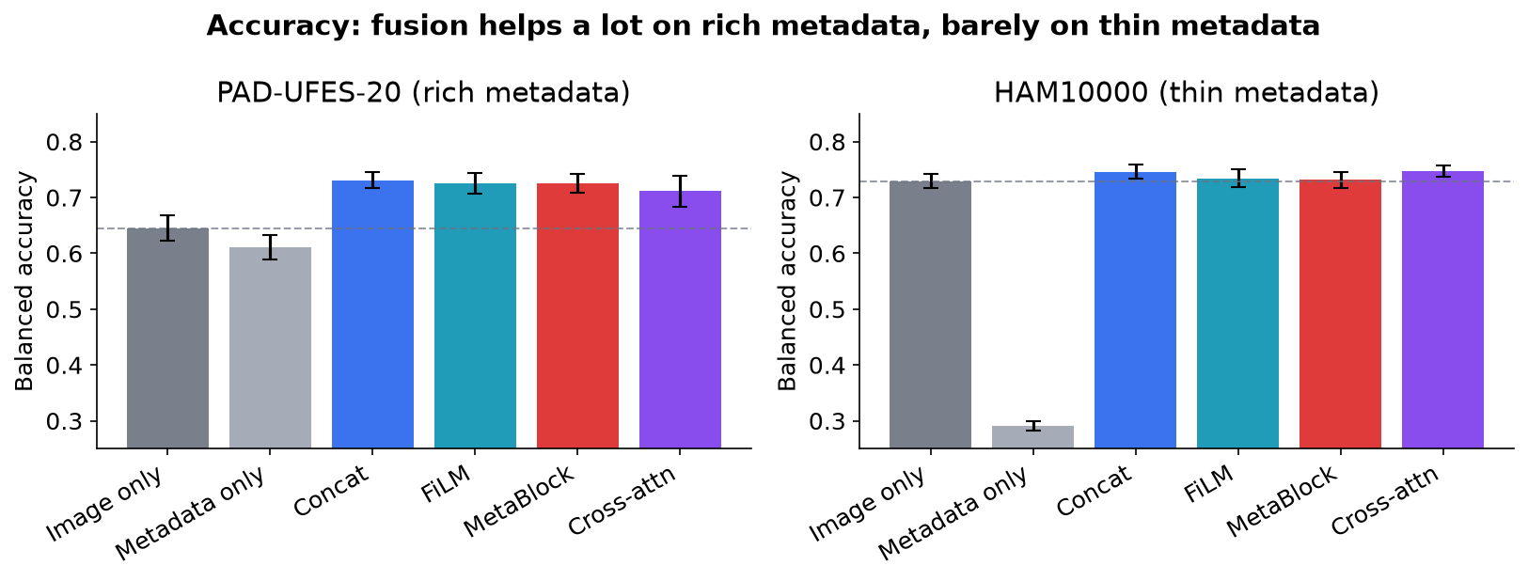
RESULT 1 · ACCURACY
Fusion helps a lot - or barely - depending on the data
PAD-UFES-20 (21 rich fields): fusion adds about 8 points. Patient details alone (0.61) nearly match the image alone (0.64).
HAM10000 (only age/sex/site): fusion adds at most ~1.8 points; details alone score just 0.29.
Two regimes in one study - one where metadata is powerful, one where it is weak. That contrast is a strength.

Slide 9
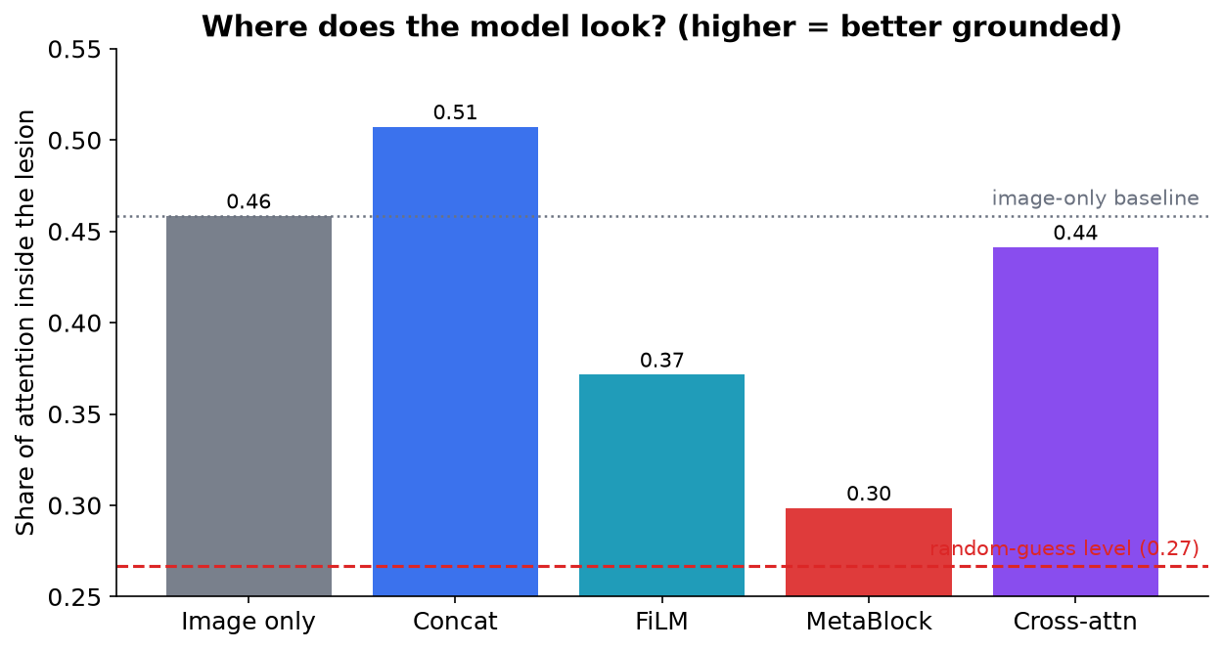
RESULT 2 · THE CENTRAL FINDING
The way you combine decides where the model looks
Same information. Opposite results.
Concatenation looks more at the lesion than image-only (0.51 vs 0.46).
MetaBlock collapses to near random guessing (0.30, chance is 0.27) - its attention has almost stopped following the lesion, yet its accuracy still looks fine.
• FiLM and cross-attention also look less than image-only.
All four differences are statistically solid; three separate measures agree.

Slide 10
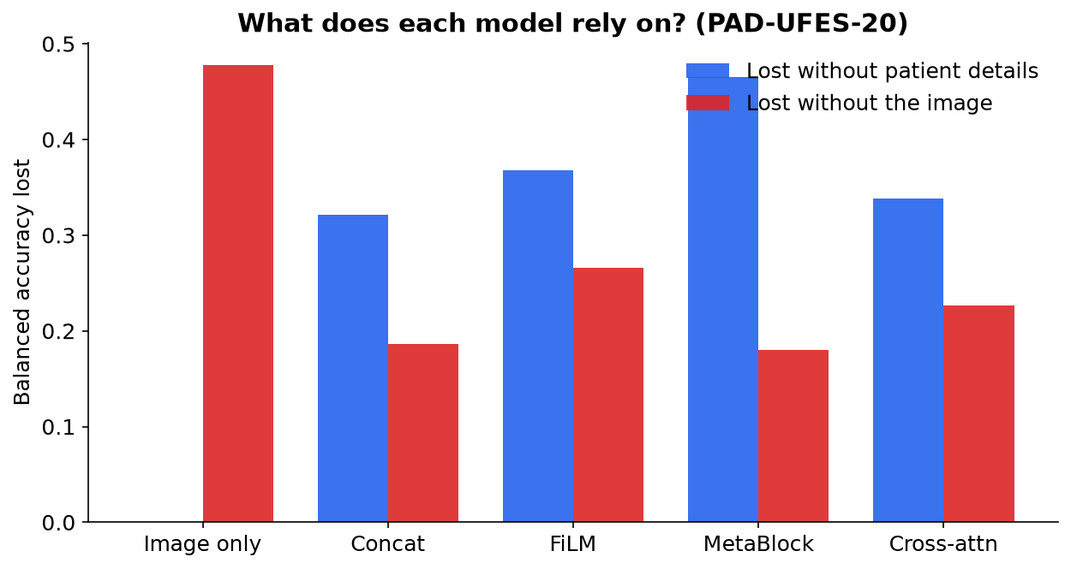
RESULT 3 · WHAT THEY LEAN ON
Every fusion model leans on details more than image
• On PAD-UFES-20, removing the patient details hurts every fusion model more than removing the image does.
Adding metadata roughly halves how much the model depends on the image (0.48 -> 0.18-0.27).
• This is offloading, measured directly - not guessed from a heat map.
The image-only model loses exactly zero when details are scrambled - the check that proves the measurement is sound.

Slide 11
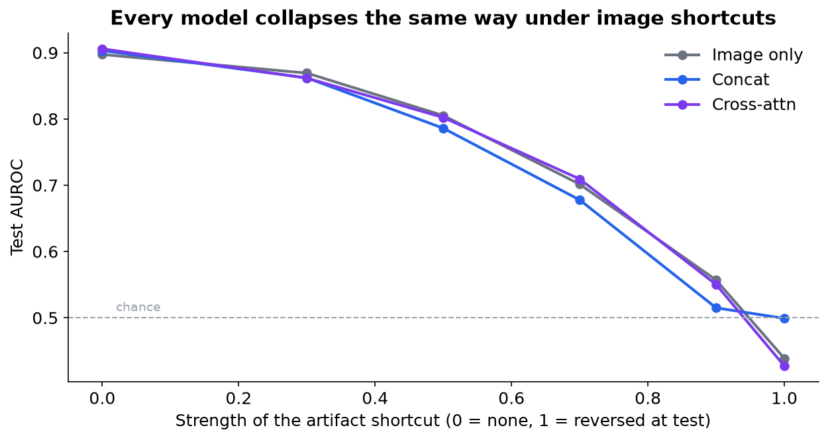
RESULTS 4 & 5 · TWO MORE CHECKS
Irrelevant details move the evidence; shortcuts fool everyone
Counterfactual (P4): changing a detail that cannot affect a lesion - 'household has piped water' - still moves the evidence. Cross-attention moves the most.
Image shortcuts (P2): no model resists them. All fall from ~0.90 to below chance when artifacts point the wrong way (left figure). Metadata neither helps nor hurts here.
Offloading under a planted detail (P3): inconclusive - too few data points, and the honest answer is to say so.

Slide 12
RIGOUR
19 tests planned in advance, corrected together
P1 Grounding: all significant
P2 Image shortcut: none significant
P3 Offloading: none significant
P4 Counterfactual: all significant
P5 Reliance: all significant
11 of 19 tests significant after correction.
P2 and P3 came back empty - but they were planned, so 'no effect' is a result, not a gap. This is what pre-registration buys.

Slide 13
What it all means
1. The mechanism matters more than the metadata. Identical information, combined differently, improves or destroys the model's visual evidence.
2. The simplest method wins twice. Plain concatenation was the most accurate on one dataset and the only one to improve grounding on the other - yet the field treats it as a throwaway baseline.
3. A model can be more accurate and less trustworthy at once. MetaBlock is competitive on accuracy while barely looking at the lesion. Accuracy hides this; our measures expose it.
4. Honesty about our own proposal. Cross-attention - what we first set out to promote - is middling on accuracy and worst at being swayed by irrelevant details. Reporting that is the contribution.

Slide 14
CONTRIBUTIONS, STATUS & WHAT'S NEXT
Where the project stands
Delivered: all experiments complete - 449 model trainings, ~21 GPU-hours; a new benchmark (N1), a new annotation-free test (N2), and the first grounding audit across fusion families (N3).
Finding (N4): fusion mechanism, not metadata, controls grounding; accuracy and trustworthiness are decoupled.
Limitations we state plainly: one offloading test was underpowered; one backbone tested; skin-tone fairness needs DDI, whose access is pending.
Next: finalise figures, secondary checks, and write up for MIDL 2027 (deadline ~Dec 2026). Framing shifts from 'same accuracy' to 'accuracy and evidence are separate things', which the data supports.
Thank you · Aniket Meena, Ritu Raj Swami, Nishant Kumar | Supervisor: Dr. Bharti Nagpal

