Slide 1
Loan Default Analysis
Understanding the Driving Factors Behind Loan Defaults

Slide 2
Agenda
Problem Statement
Analysis Approach
Univariate Analysis
Bivariate Analysis
Correlation Analysis
Key Insights
Conclusion

Slide 3
Problem Statement
The objective of this analysis is to identify patterns that indicate if a person is likely to default on a loan. By understanding these patterns, the lending company can take actions such as denying the loan, reducing the loan amount, or lending to risky applicants at a higher interest rate, thereby reducing credit loss.

Slide 4
Analysis Approach
Data Cleaning: Handle missing values by taking median or max values.
Univariate Analysis: Analyze the distribution of individual features.
Bivariate Analysis: Examine the relationship between features and the target variable (loan default).
Correlation Analysis: Identify significant correlations between features.
Visualization: Use plots to illustrate key findings and insights.

Slide 5
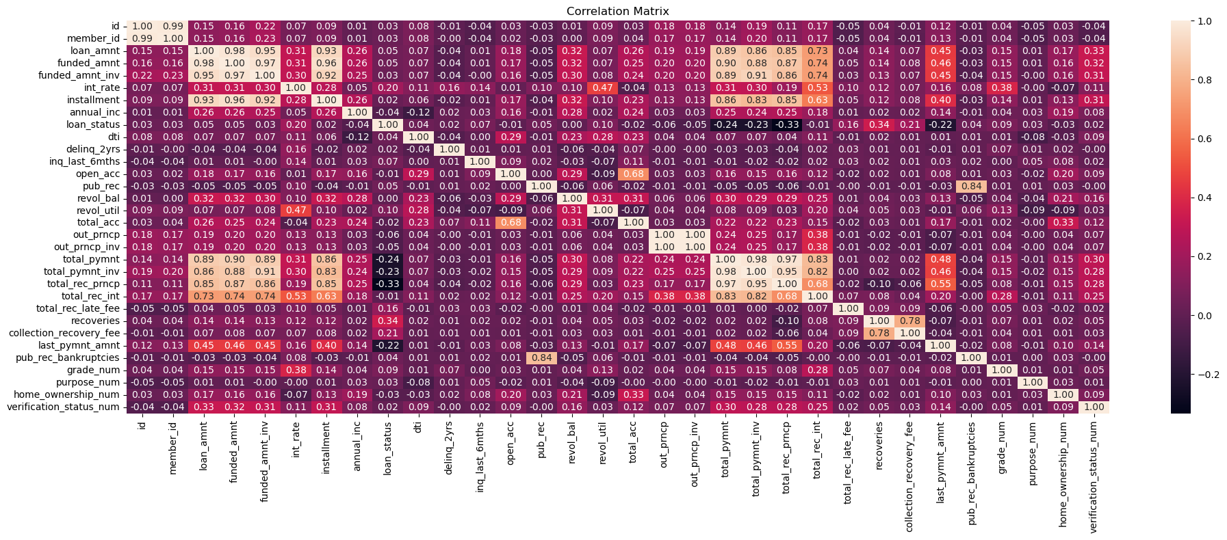
Multivariate Analysis - Correlation Matrix
This chart provide with the view of overall data to select the area for analysis.
Here columns like loan-amt, dti, installment, annual_inc, Grade, Verification status ,owners
have correlation ratio that attracted to analyse the pattern for defaulting loans.

Slide 6
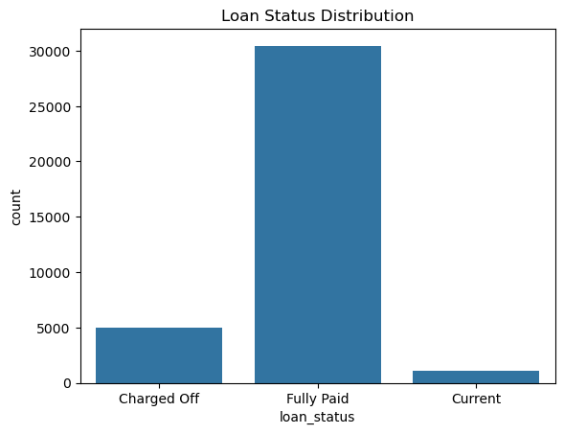
Loan Distribution Pattern
Maximum loan is fully paid
20% of loan is defaulted
3% of loan is in progress

Slide 7
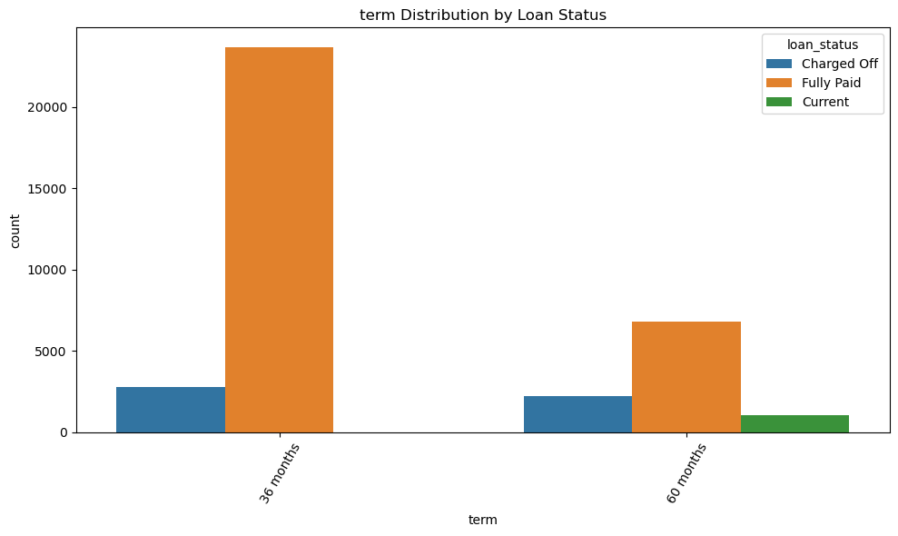
Distribution of Loan for Term
Loan provided for 60 months tenures has defaulted more
Customers credit limit should be keep check periodically for current running loans.

Slide 8
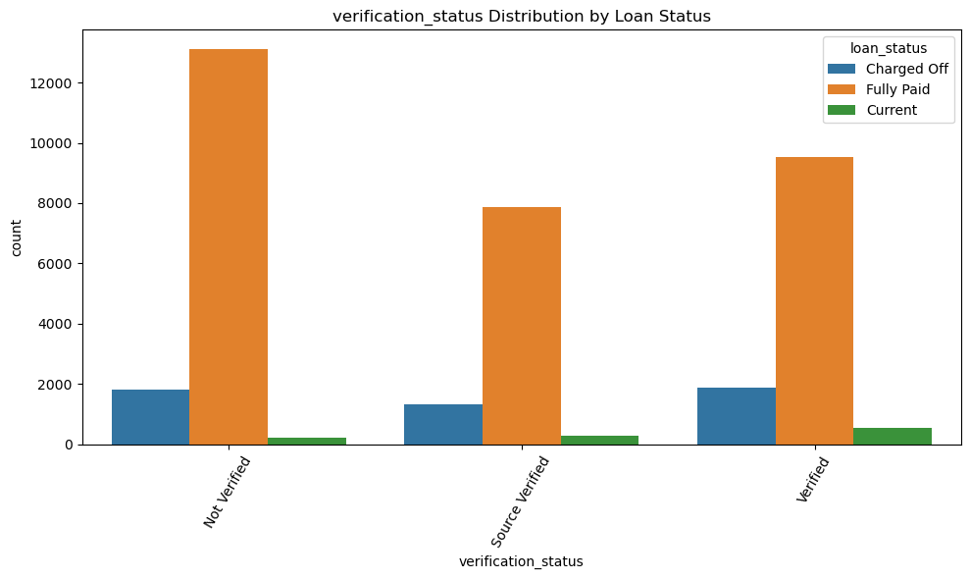
Verification status Distribution by Loan Status
People that are not verified has taken more loans.
People verified has defaulted more.
So risk can be cover by increasing processing fee/charges for lending loans.
Source verified and Verified is showing more defaulters that should be controlled
against strict validation and backlog check

Slide 9
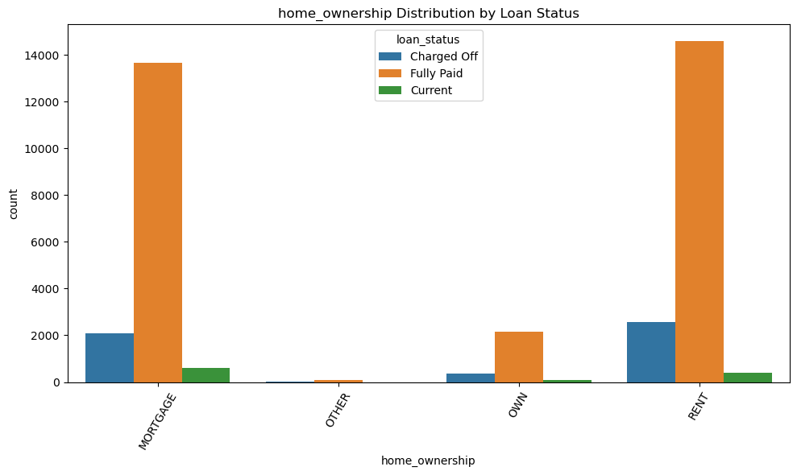
Distribution of Home Ownership
Own ,Other customers has maximum defaulted in percentage compared to Mortgage and Rent
Rented customers can be process with higher processing fee and rate of interest.

Slide 10
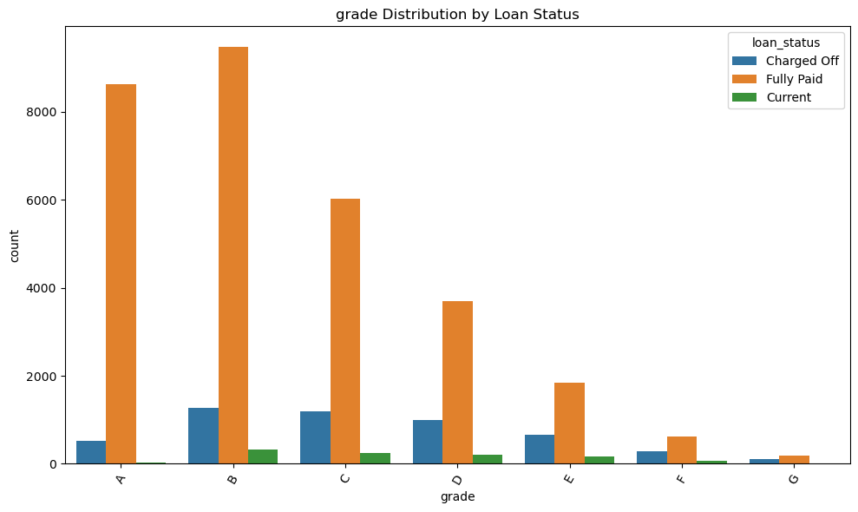
Distribution as per Grade
Maximum ratio of loan distributed among D,E,F,G Grade is defaulted

Slide 11
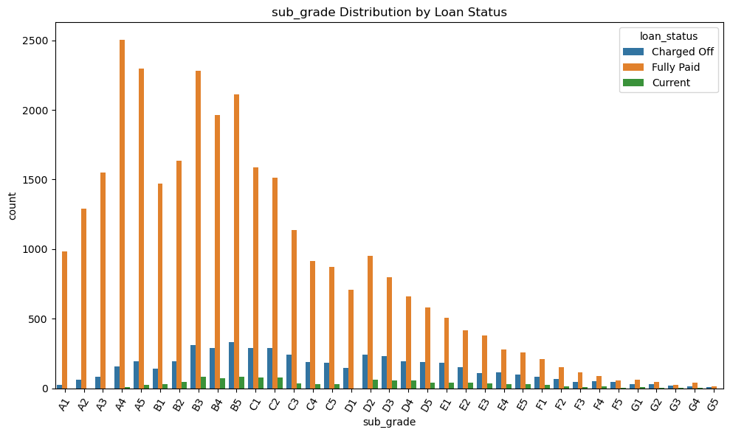
Distribution of loan among Sub Grade
Sub grade from D1 to G5 has more defaulter
While lending loan to this group can process with mortgage or higher rate of interest.

Slide 12
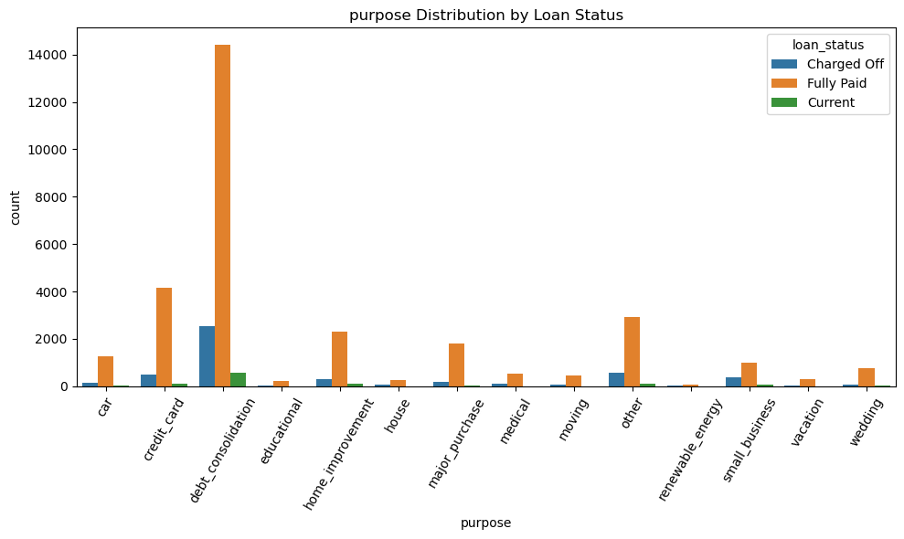
Distribution of Loan for loan purpose
Debt consolidation has given business but has noticeable defaulters as well
Rest customers are giving less business but has defaulted more in proportion
of business done.

Slide 13
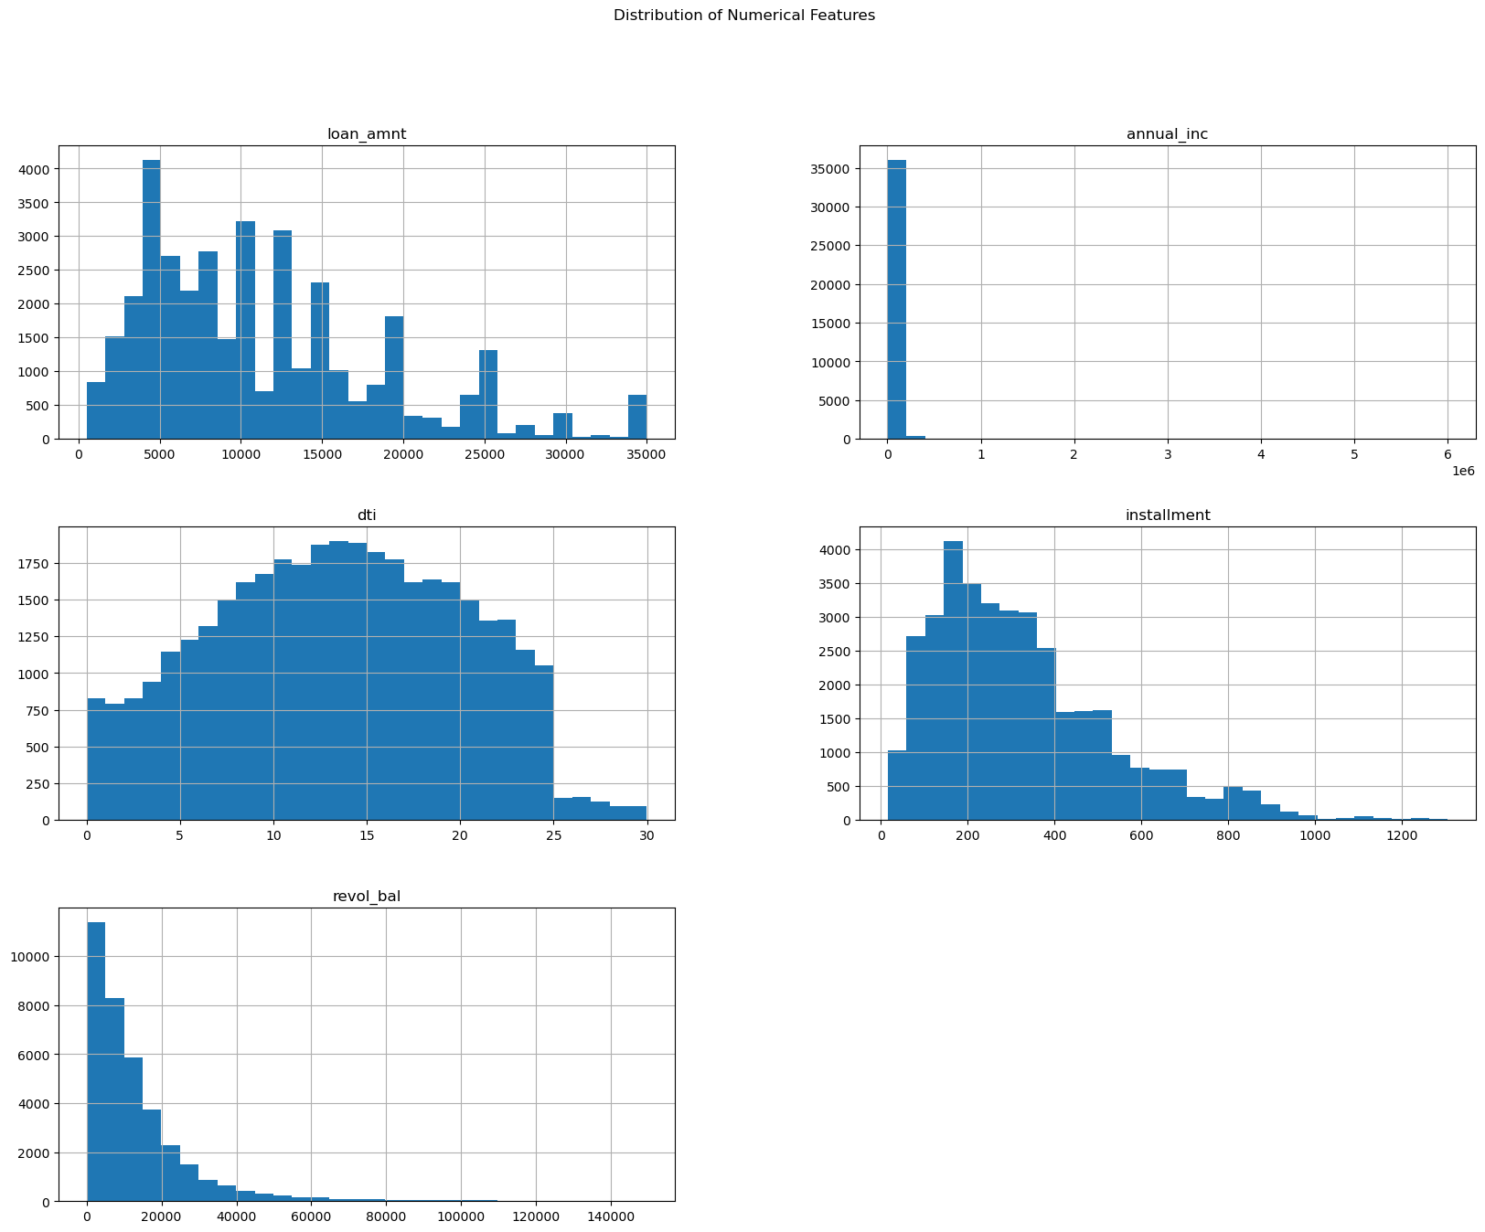
Univariate Analysis - Numerical Features
Loan amount is positively skewed
Loan is taken by maximum people having income less than 50k
Loan is taken by the people having DTI ration between 5 to 25
Instalments preferred is in between 100 to 500
Revol_bal is positively skewed

Slide 14
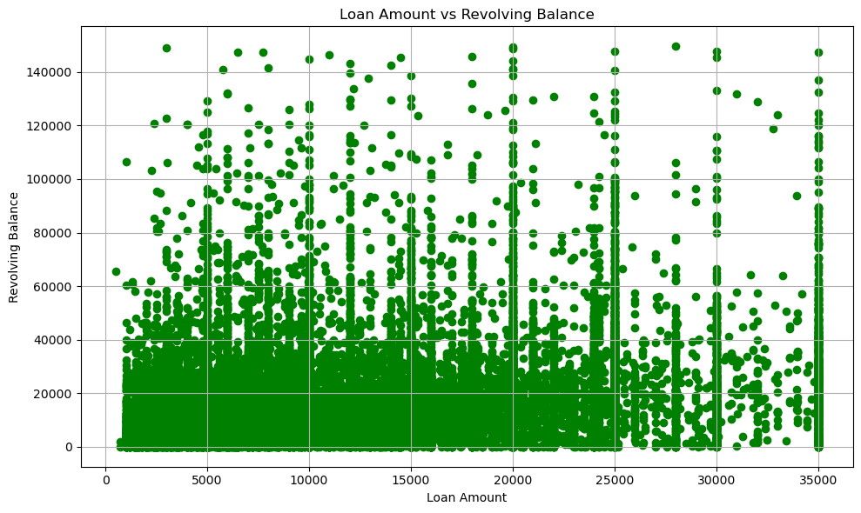
Bivariate Analysis - Loan Amount Vs Revolving Balance
Loan demanded seems in lower range of Revolving balance customer.
Max demand of loan is with Revolving balance 40K and Loan Amount in range of 25K

Slide 15
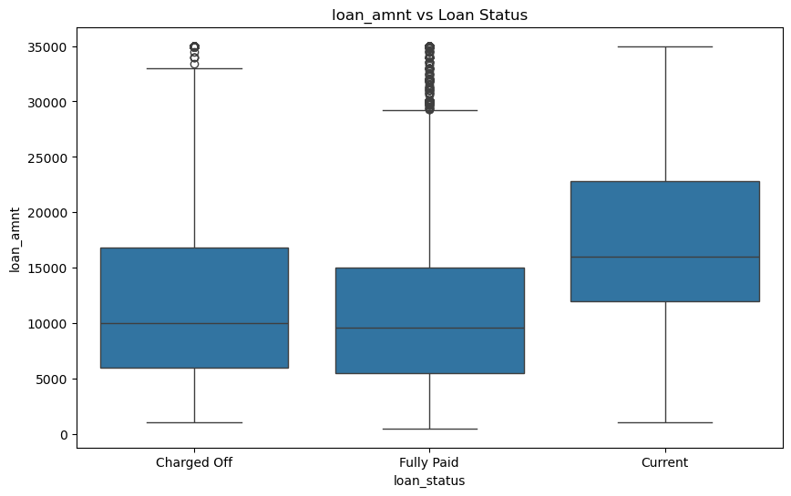
Loan Amount disbursed vs Loan status
Charged off boxplot is positive skewed hence there is possibility that more loans in the range of 5K to 18K get defaulted for current running loans

Slide 16
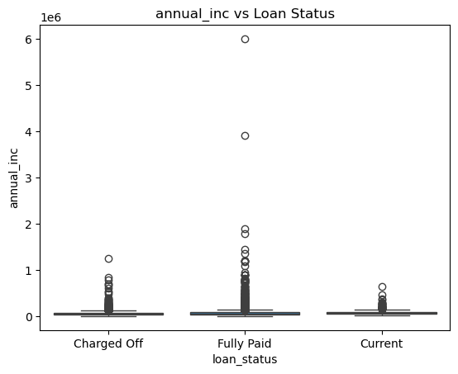
Annual Income vs Loan Status
Lower income group is more to default loans

Slide 17
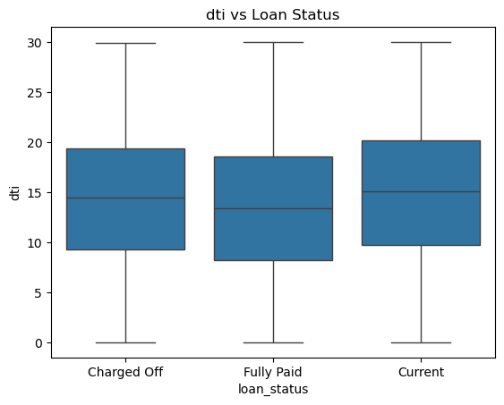
DTI Ration Vs Loan status
Current loan going customers is tending more to default in the range of DTI
range of 10-15

Slide 18
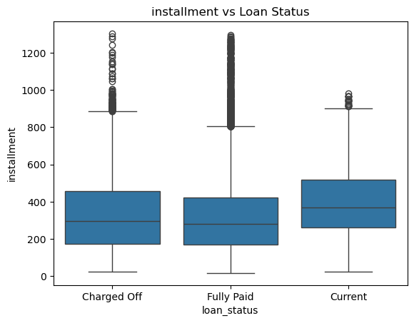
Installment vs Loan Status
Customers in the range of EMI 200 and 400 is more to tend as defaulter due to any
financial situation.

Slide 19
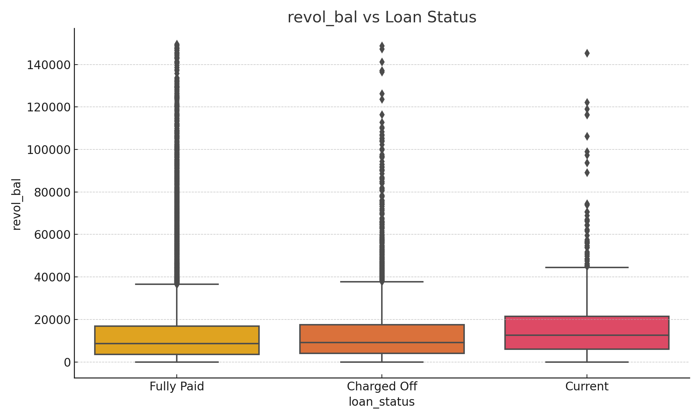
revol_bal vs Loan Status

Slide 20
Key Insights
Higher loan amounts and higher debt-to-income ratios are associated with higher default rates.
Borrowers with lower annual incomes tend to default more often.
Certain loan purposes, such as small business and debt consolidation, have higher default rates.
Higher grade and sub-grade loans tend to default less.
Home ownership status and verification status also influence default rates.
Correlation analysis shows significant relationships between certain features and loan defaults.

Slide 21
Thank You

