Slide 1

Habit Forge CS 5610 - Web Development
Project 3: Full stack application with Node + Express + Mongo + React (hooks)
Aniket Nandi (002598522)
Neil Wang (002375301)

Slide 2
Objective
Build a full-stack habit tracking app with Node.js, Express, MongoDB, and React with Hooks
Allow users to create habits, log completions, and track streaks and weekly completion percentages
Support analytics with sort, filter by date range, and personal weekly goal targets
Support user authentication with register and login so each user's habits are private

Slide 3

Design and Mockups
5 screens designed: Dashboard, Add/Edit Habit, Log View, Analytics, Navigation
Mockups focused on habit cards, log history, and analytics progress bars
React component-based layout with modal overlays and dynamic filtering

Slide 4
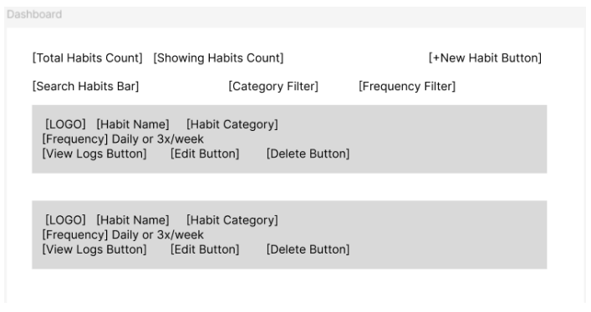
Design and Mockups

Slide 5
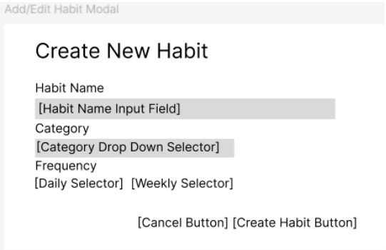
Design and Mockups

Slide 6
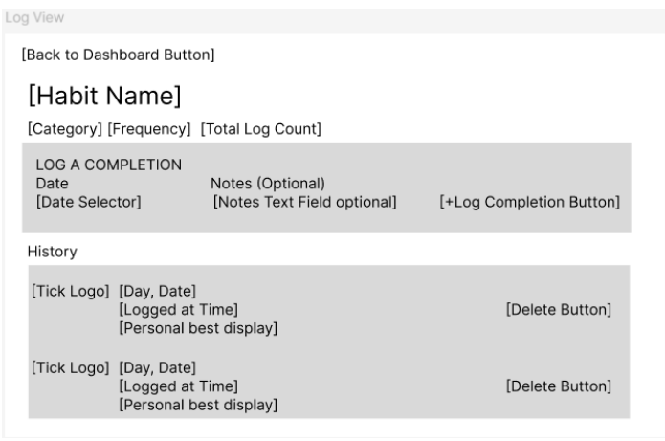
Design and Mockups

Slide 7
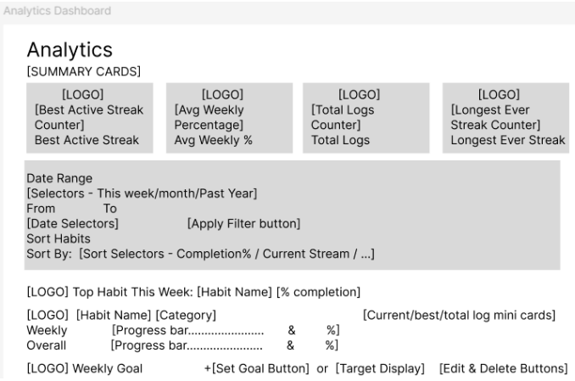
Design and Mockups

Slide 8
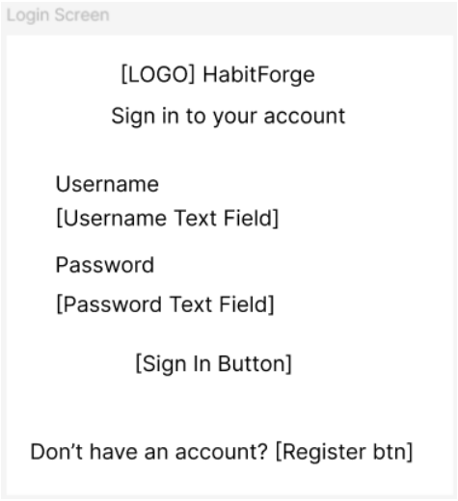
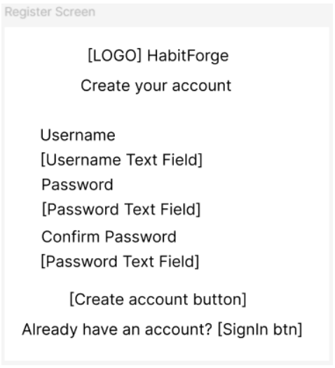
Design and Mockups

Slide 9
Technologies used
Node.js + Express (REST API backend)
MongoDB native driver (4 collections: habits, logs, goals, users)
React 18 with Hooks + React Router v6 (client-side rendering)
ESLint + Prettier + Vite (build tool) + PropTypes
Deployed on Render (backend Web Service + frontend Static Site)
Passport.js + bcrypt + express-session (authentication)

Slide 10
What Makes This Project Different?
Full analytics engine with streak calculation, weekly completion %, and date range filtering
3 MongoDB collections with full CRUD split between both team members
2046 synthetic records with realistic streak patterns, duplicate prevention and batch seeding
Per-user data isolation - each user only sees their own habits, logs, and goals via Passport session auth (except testuser which has all 1000+ seeded data)

Slide 11
What we are proud of.
Clean modular architecture: 12 React components each with own file and CSS, separate route files
Full CRUD on 3 MongoDB collections with proper indexing, validation, and cascade deletes
Deployed on Render with VITE_API_URL environment variable handling for production API calls
Realistic seed data with 2046 logs, streak patterns, duplicate prevention, and MongoDB indexes
Full Passport.js authentication with session cookies, bcrypt password hashing, and protected API routes

Slide 12
What we struggled the most with
ESLint flat config with Prettier plugin on Windows – LF vs CRLF line ending conflicts required .gitattributes fix
Vite proxy only works in development – solved with VITE_API_URL environment variable for production
Merge conflicts from coordinating commits between team members across different machines
Implementing Passport local strategy with session cookies across separate frontend and backend deployments on Render

Slide 13
Demo
Project Demo Video - https://youtu.be/vYcBYF3roz8
Project GitHub Repo - https://github.com/aniketnandi/Habit-Forge
Project Live Site - https://habit-forge-fvl4.onrender.com

Slide 14
Takeaways
Separate backend concerns early – modular routes and collections make CRUD ownership clear
React with Hooks and component-per-file structure keeps the frontend clean and maintainable
Team coordination matters – always test locally before deploying and coordinate commits carefully to avoid merge conflicts

