Slide 1
HOTEL BOOKING ANALYSIS
CAPSTONE PROJECT
by
Aniket ojha

Slide 2
Problem Statement:
In this project we will be analyzing Hotel Booking data. This data set contains booking information for a City hotel and a Resort hotel along with information on various booking criteria such as booking season, pricing data, length of stay, number of adults, children and babies, parking spaces, market segment and many more.
Primary objective is to explore and inspect the dataset; and discover important features using Exploratory Data Analysis that can govern bookings and help hotels penetrate deep into market, thereby attracting more customers.
Secondary objective is help the customers in deciding best period to visit places while availing low accommodation cost benefits.

Slide 3
Work Flow :
1. Data Collection:
Source: Describe where the data came from (e.g., Booking system database, CSV files).
Extraction: Outline the method of data extraction (e.g., SQL queries, data export).
2. Data Preparation:
Cleaning: Steps taken to clean the data (e.g., handling missing values, removing duplicates).
Transformation: Any transformations applied to the data (e.g., formatting dates, normalizing values).
Loading: Loading the cleaned data into Power BI.
3. Data Modeling:
Relationships: Define relationships between tables (e.g., Booking_Details linked with Guest_Info).
Calculated Columns & Measures: Creation of calculated columns and measures (e.g., Canceled Percentage, ADR calculations).
4. Data Visualization:
Chart Selection: Choosing appropriate visualizations (e.g., bar charts, line charts, pie charts).
Dashboard Creation: Designing dashboards to display key metrics and insights.
5. Analysis & Insights:
Exploratory Analysis: Initial exploration to understand data trends and patterns.
In-depth Analysis: Focused analysis on specific areas (e.g., booking trends, cancellation rates).
6. Interactivity:
Slicers & Filters: Adding slicers and filters for user interactivity.
Drill-Downs: Enabling drill-downs to explore data at different levels of granularity.
7. Sharing & Collaboration:
Report Publishing: Publishing reports to Power BI Service.
Collaboration: Sharing insights with stakeholders and enabling collaboration.
Understanding

Slide 4
Data Exploration and Inspection:
Libraries imported:
Data manipulation: numpy and pandas
Data visualization : matplotlib and seaborn
Initial dataset size: 119390 rows and 32 columns. Data contains following features:
hotel: Resort Hotel or City Hotel
is_canceled: Value indicating if the booking was canceled (1) or not (0)
lead_time: Number of days that elapsed between the entering date of the booking and the arrival date
arrival_date_year: Year of arrival date
arrival_date_month: Month of arrival date
arrival_date_week_number: Week number of year for arrival date
arrival_date_day_of_month: Day of arrival date
stays_in_weekend_nights: Number of weekend nights
stays_in_week_nights: Number of week nights.
adults: Number of adults
children: Number of children
babies: Number of babies
meal: Type of meal booked
country: Country of origin.

Slide 5
Data Exploration and Inspection:
market_segment: Market segment designation (TA/TO)
distribution_channel: Booking distribution channel.(T/A/TO)
is_repeated_guest: is a repeated guest (1) or not (0)
previous_cancellations: Number of previous bookings that were cancelled prior to the current booking
previous_bookings_not_canceled: Number of previous bookings not cancelled by the customer prior to the current booking
reserved_room_type: Code of room type reserved.
assigned_room_type: Code for the type of room assigned to the booking.
booking_changes: Number of changes made to the booking
deposit_type : No Deposit, Non Refund , Refundable.
agent: ID of the travel agency that made the booking
company: ID of the company/entity that made the booking .
days_in_waiting_list : Number of days the booking was in the waiting list before it was confirmed to the
customer
customer_type: type of customer. Contract, Group, Transient, Transient party.
adr: Average Daily Rate as defined by dividing the sum of all lodging transactions by the total number of
staying nights
required_car_parking_spaces: Number of car parking spaces required by the customer total_of_special_requests: Number of special requests made by the customer (e.g. twin bed or high floor)
reservation_status: Reservation last status.

Slide 6
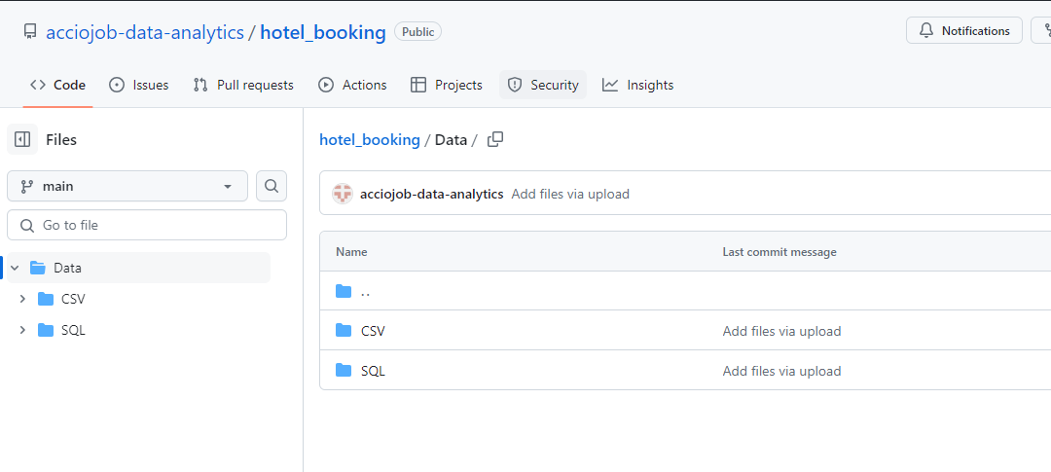
Data Collection and Preparation:
Data Collection:
Source: Accio Github
The data was sourced from the Accio github database, which includes comprehensive information on bookings, guests, and related details.

Slide 7
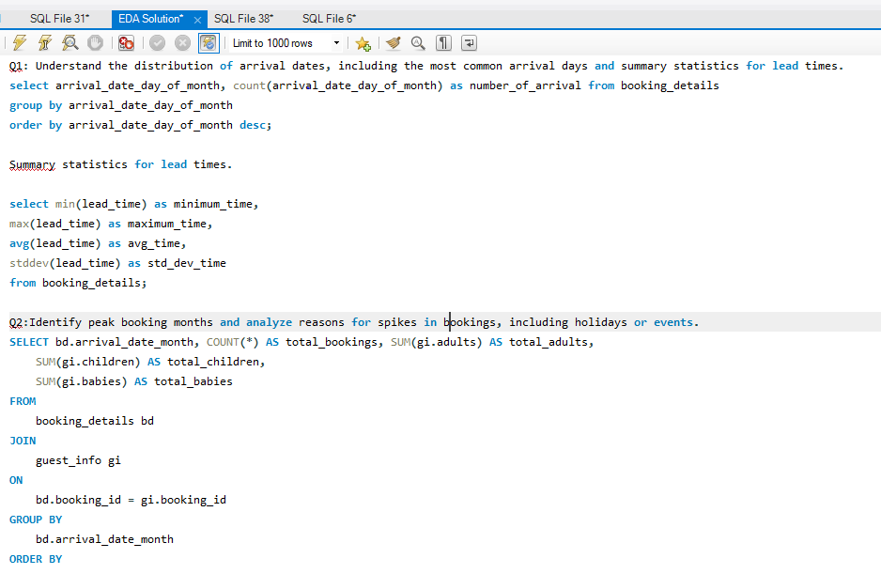
3. Extraction: SQL queries
SQL queries were used to extract the necessary data from the database. This involved writing specific queries to retrieve tables such as booking details, guest information, room details, and reservation statuses.

Slide 8
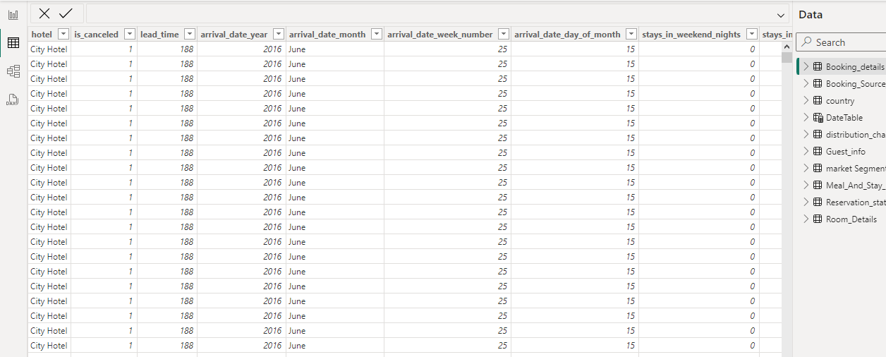
4. Data Preparation:
Cleaning: Handling missing values, removing duplicates
Handling Missing Values: Identified and filled missing values where appropriate, or removed entries that were incomplete and could not be corrected.
Removing Duplicates: Ensured that duplicate records were identified and removed to maintain data integrity.

Slide 9
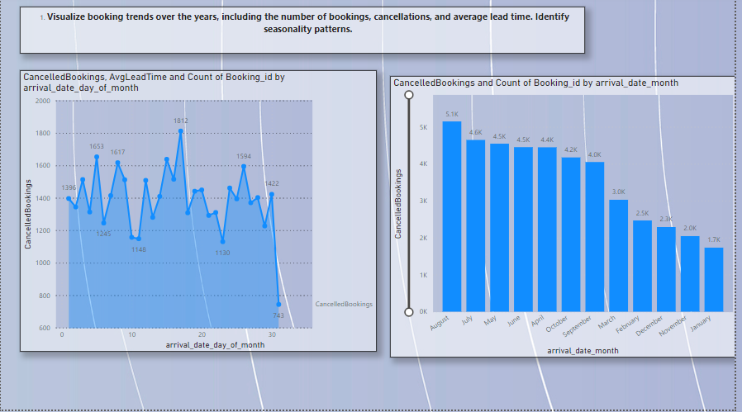
Exploratory Data Analysis (EDA):
Visualize booking trends over the years, including the number of bookings, cancellations, and average lead time. Identify seasonality patterns.

Slide 10
Insight: Visualizing booking trends over the years helps identify significant patterns and changes. By analyzing the number of bookings and cancellations alongside the average lead time, we can determine peak seasons and periods of low activity. Seasonality patterns, such as increased bookings during holidays or specific months, can be identified, allowing the hotel to optimize marketing strategies and resource allocation. Understanding these trends helps in forecasting and planning, ensuring better customer satisfaction and efficient use of resources

Slide 11
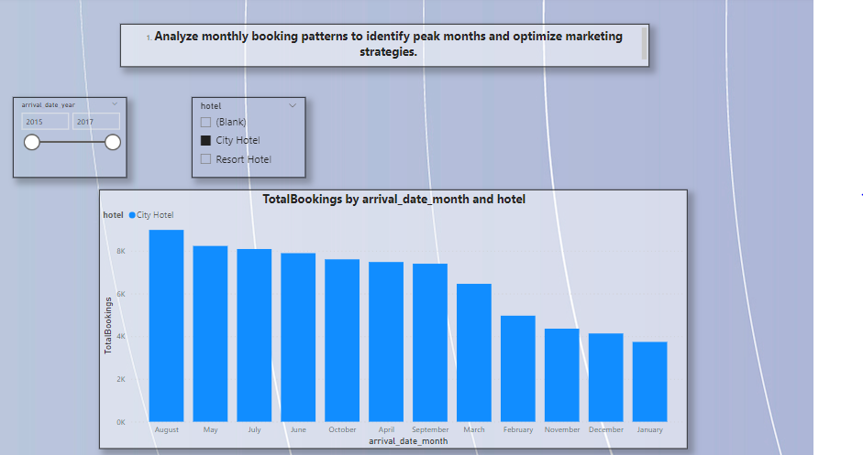
Exploratory Data Analysis (EDA):
2. Analyze monthly booking patterns to identify peak months and optimize marketing strategies.

Slide 12
Insight: Monthly booking patterns reveal the hotel's busiest and slowest months. Identifying peak months allows the hotel to allocate resources efficiently, ensuring adequate staffing and inventory. Conversely, recognizing off-peak periods enables targeted marketing campaigns to boost occupancy. By understanding these patterns, the hotel can implement promotional strategies during slower months and optimize pricing and offers during peak periods, ultimately maximizing revenue and enhancing guest experience.

Slide 13
Exploratory Data Analysis (EDA):
Compare stays in weekend nights and weekday nights to determine preferences and variations by hotel type.
`

Slide 14
Insight: Analyzing stays in weekend versus weekday nights provides valuable insights into guest preferences. Typically, weekend stays might indicate leisure travelers, while weekday stays could suggest business travelers. Comparing these patterns across different hotel types (Resort vs. City Hotel) helps tailor services and amenities to meet specific guest needs. For instance, resorts may see higher weekend occupancy, prompting offers for extended stays, while city hotels might focus on corporate packages during weekdays.

Slide 15
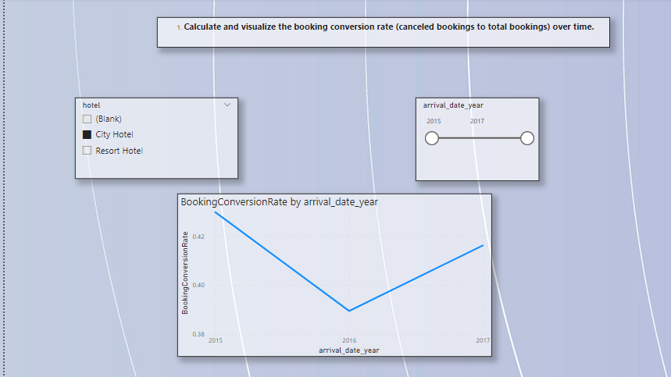
Exploratory Data Analysis (EDA):
4. Calculate and visualize the booking conversion rate (canceled bookings to total bookings) over time.

Slide 16
Insight: The booking conversion rate, representing the ratio of canceled bookings to total bookings, is crucial for understanding customer behavior and potential revenue loss. By visualizing this metric over time, the hotel can identify trends and patterns in cancellations. High cancellation rates may indicate issues with booking policies, guest dissatisfaction, or external factors. Addressing these issues through improved policies, customer engagement, or flexible booking options can reduce cancellations and enhance overall booking efficiency.

Slide 17
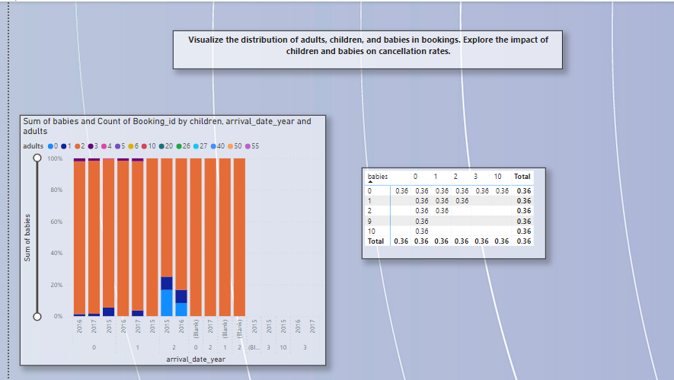
Exploratory Data Analysis (EDA):
Visualize the distribution of adults, children, and babies in bookings. Explore the impact of children and babies on cancellation rates.

Slide 18
Insight: Visualizing the distribution of adults, children, and babies in bookings provides insights into the guest demographic and helps tailor services accordingly. Understanding the impact of children and babies on cancellation rates is essential, as families with young children might have higher cancellation tendencies due to unforeseen circumstances. By identifying this trend, the hotel can develop family-friendly policies, flexible booking options, and targeted marketing campaigns to enhance guest experience and reduce cancellations.

Slide 19
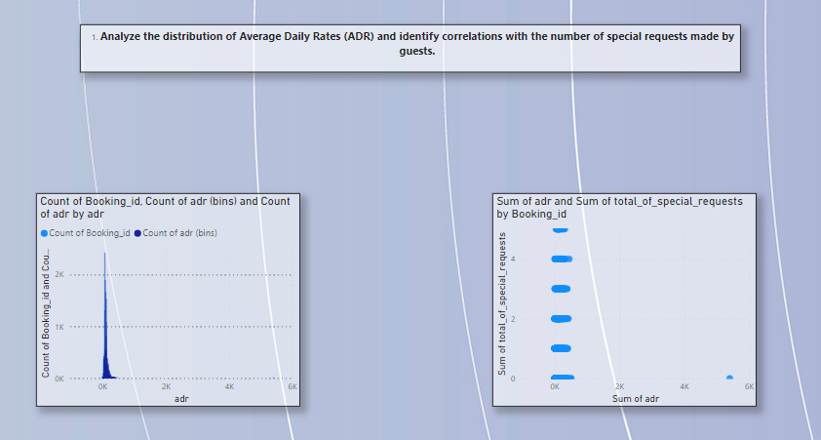
Exploratory Data Analysis (EDA):
Analyze the distribution of Average Daily Rates (ADR) and identify correlations with the number of special requests made by guests.

Slide 20
Insight: Analyzing the distribution of ADR alongside the number of special requests helps understand the relationship between pricing and guest expectations. Higher ADRs might correlate with an increase in special requests, indicating that guests paying premium rates expect additional services. Identifying these correlations enables the hotel to enhance its service offerings for higher-paying guests, ensuring that their expectations are met, which can lead to increased satisfaction and repeat bookings.

Slide 21
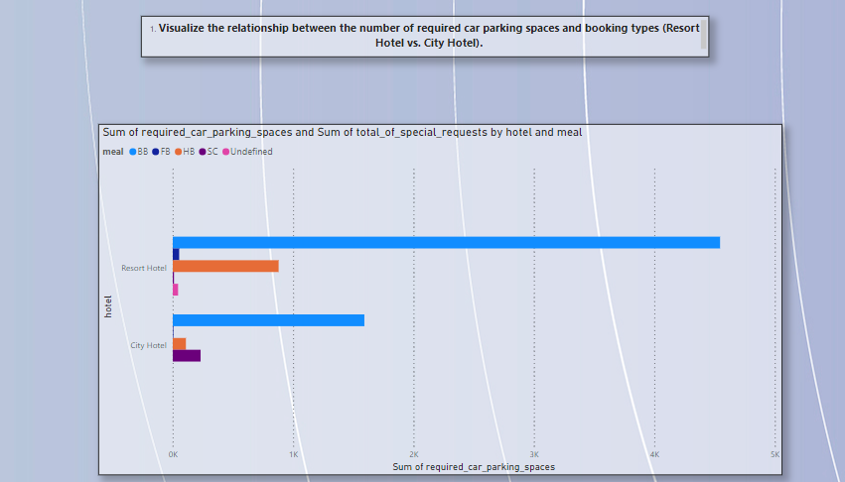
Exploratory Data Analysis (EDA):
Visualize the relationship between the number of required car parking spaces and booking types (Resort Hotel vs. City Hotel).

Slide 22
Insight: Visualizing the relationship between car parking space requirements and booking types (Resort vs. City Hotel) helps identify patterns and guest needs. Resorts might have higher parking demands due to longer stays and more leisure travelers arriving by car, while city hotels may have varied requirements depending on business travelers and short stays. Understanding these patterns aids in optimizing parking space allocation, improving guest experience, and planning future infrastructure investments.

Slide 23
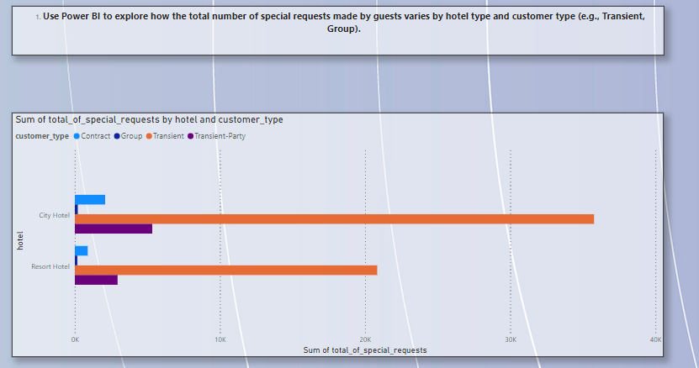
Exploratory Data Analysis (EDA):
Use Power BI to explore how the total number of special requests made by guests varies by hotel type and customer type (e.g., Transient, Group).

Slide 24
Insight: Exploring the variation in special requests by hotel type and customer type reveals critical insights into guest needs and preferences. Transient guests might have different requirements compared to groups, and these needs can vary between resort and city hotels. By identifying these patterns, the hotel can tailor its services and amenities to meet the specific demands of each customer segment, enhancing guest satisfaction and potentially increasing loyalty and repeat bookings.

Slide 25
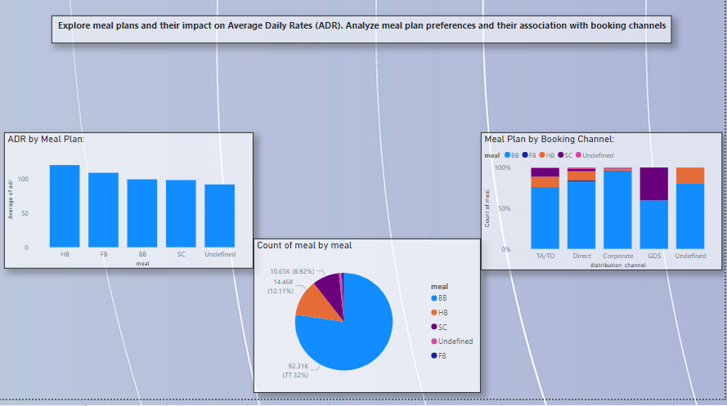
Exploratory Data Analysis (EDA):
Explore meal plans and their impact on Average Daily Rates (ADR). Analyze meal plan preferences and their association with booking channels

Slide 26
Insight: Examining meal plans and their impact on ADR provides insights into how different meal offerings influence guest spending. Analyzing preferences across various booking channels helps identify which channels attract guests opting for specific meal plans. For instance, guests booking through travel agents might prefer all-inclusive packages, while direct bookings might favor bed-and-breakfast options. Understanding these associations aids in optimizing meal plan offerings and marketing strategies to maximize revenue.

Slide 27
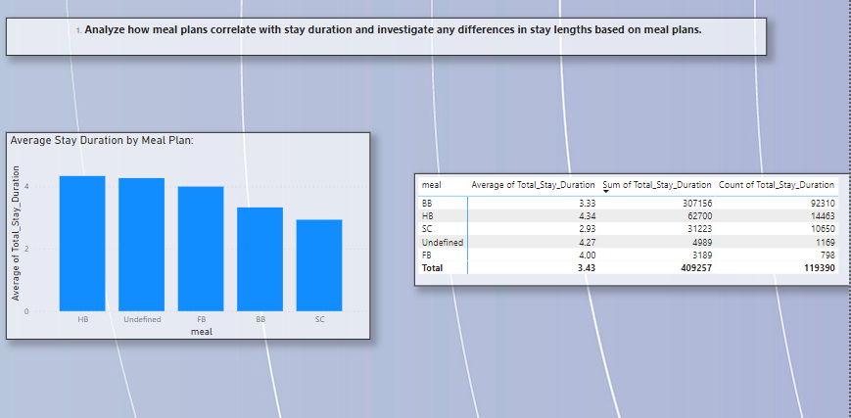
Exploratory Data Analysis (EDA):
Analyze how meal plans correlate with stay duration and investigate any differences in stay lengths based on meal plans.

Slide 28
Insight: Analyzing the correlation between meal plans and stay duration helps identify if certain meal options attract longer stays. Guests opting for full-board or all-inclusive plans may tend to stay longer, benefiting from the convenience and value of bundled meals. Understanding these differences allows the hotel to design targeted packages and promotions that cater to guests' preferences, potentially increasing average stay lengths and overall revenue.

Slide 29
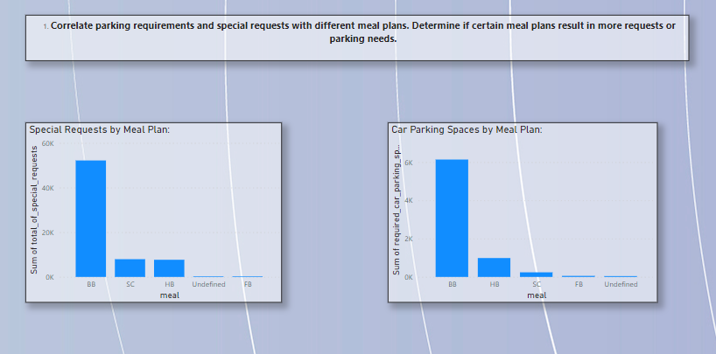
Exploratory Data Analysis (EDA):
Correlate parking requirements and special requests with different meal plans. Determine if certain meal plans result in more requests or parking needs.

Slide 30
Insight: Correlating parking requirements and special requests with meal plans helps identify patterns in guest behavior. Certain meal plans, such as full-board, may attract guests with specific needs, including parking spaces or additional services. By understanding these correlations, the hotel can anticipate guest requirements better and tailor its offerings to meet these needs, improving overall guest satisfaction and operational efficiency.

Slide 31
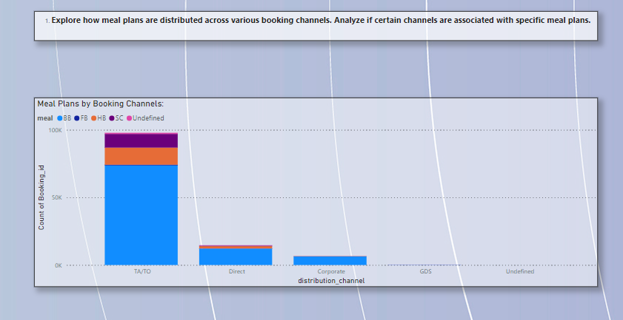
Exploratory Data Analysis (EDA):
Explore how meal plans are distributed across various booking channels. Analyze if certain channels are associated with specific meal plans.

Slide 32
Insight: Exploring the distribution of meal plans across booking channels helps identify which channels attract guests with particular preferences. For instance, online travel agents might see higher bookings for all-inclusive plans, while direct bookings may favor bed-and-breakfast options. Analyzing these trends allows the hotel to optimize its marketing strategies and partnerships with booking channels, ensuring that meal plan offerings align with guest preferences and maximize revenue.

Slide 33
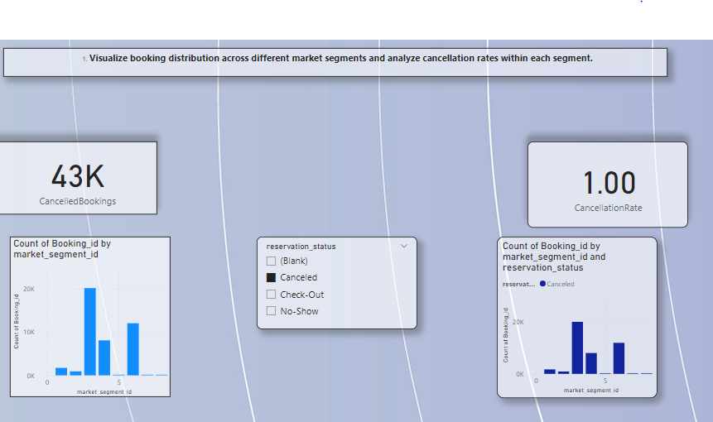
Exploratory Data Analysis (EDA):
Visualize booking distribution across different market segments and analyze cancellation rates within each segment.

Slide 34
Insight: Visualizing booking distribution across market segments and analyzing cancellation rates helps identify which segments are most valuable and which are prone to cancellations. For example, business travelers might have lower cancellation rates compared to leisure travelers. Understanding these dynamics allows the hotel to tailor its marketing and retention strategies for each segment, improving overall booking stability and customer satisfaction.

Slide 35
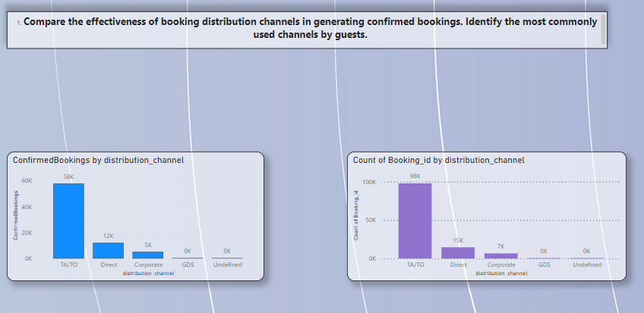
Exploratory Data Analysis (EDA):
Compare the effectiveness of booking distribution channels in generating confirmed bookings. Identify the most commonly used channels by guests.

Slide 36
Insight: Comparing the effectiveness of booking distribution channels helps identify which channels generate the most confirmed bookings. Channels such as direct bookings, online travel agents, and corporate bookings can be analyzed for their performance. Identifying the most commonly used channels allows the hotel to focus its marketing efforts and partnerships on these channels, optimizing booking conversion rates and maximizing revenue.

Slide 37
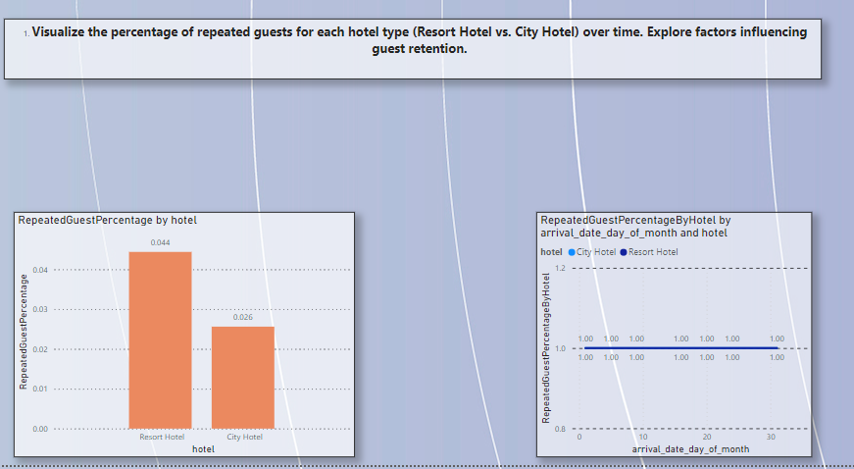
Exploratory Data Analysis (EDA):
Visualize the percentage of repeated guests for each hotel type (Resort Hotel vs. City Hotel) over time. Explore factors influencing guest retention.

Slide 38
Insight: Visualizing the percentage of repeated guests for resort and city hotels over time helps understand guest loyalty and retention patterns. Analyzing factors influencing retention, such as service quality, amenities, and guest experience, provides insights into what drives repeat bookings. This information enables the hotel to enhance its offerings and create targeted loyalty programs to increase guest retention and build a loyal customer base.

Slide 39
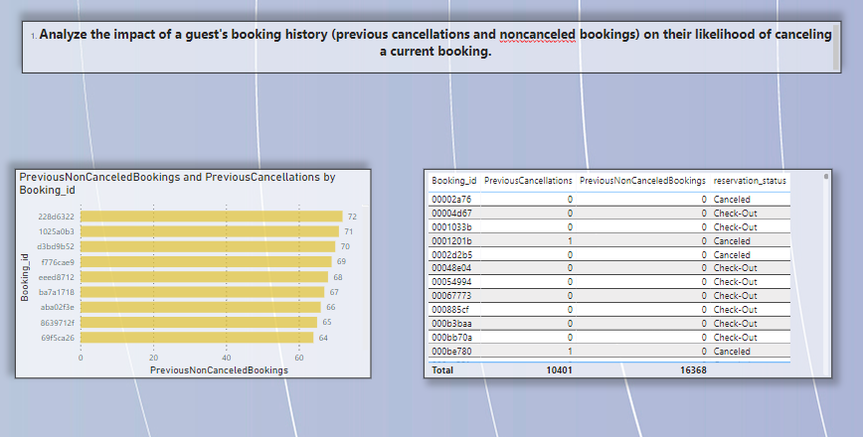
Exploratory Data Analysis (EDA):
Analyze the impact of a guest's booking history (previous cancellations and non canceled bookings) on their likelihood of canceling a current booking.

Slide 40
Insight: Analyzing a guest's booking history provides insights into their likelihood of canceling current bookings. Guests with a history of cancellations might have a higher probability of future cancellations, while those with consistent non-canceled bookings may be more reliable. Understanding these patterns allows the hotel to implement targeted retention strategies, such as flexible booking policies or personalized offers, to reduce cancellations and improve booking stability.

Slide 41
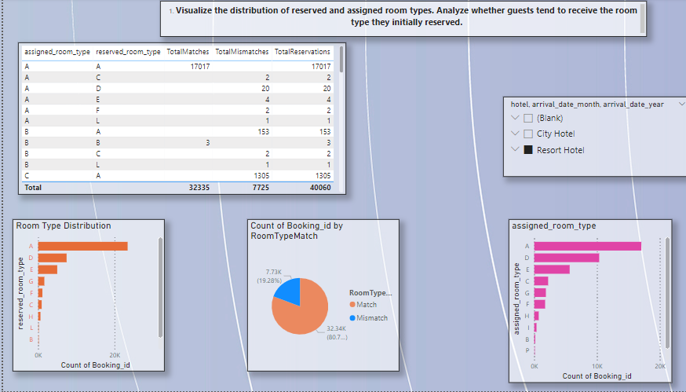
Exploratory Data Analysis (EDA):
Visualize the distribution of reserved and assigned room types. Analyze whether guests tend to receive the room type they initially reserved.

Slide 42
Insight: Visualizing the distribution of reserved and assigned room types helps understand if guests are receiving the rooms they initially reserved. Analyzing discrepancies between reserved and assigned room types can identify potential issues in the booking process or inventory management. Ensuring guests receive their preferred room type enhances satisfaction and trust, reducing the likelihood of complaints and cancellations.

Slide 43
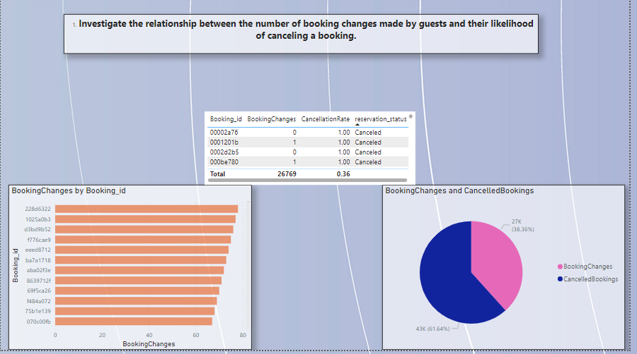
Exploratory Data Analysis (EDA):
Investigate the relationship between the number of booking changes made by guests and their likelihood of canceling a booking.

Slide 44
Insight: Investigating the relationship between booking changes and cancellations helps identify if frequent changes indicate a higher likelihood of cancellations. Guests making multiple changes may have uncertain plans, increasing the risk of cancellation. Understanding this relationship allows the hotel to offer flexible booking options and targeted communication to such guests, reducing cancellation rates and improving booking stability.

Slide 45
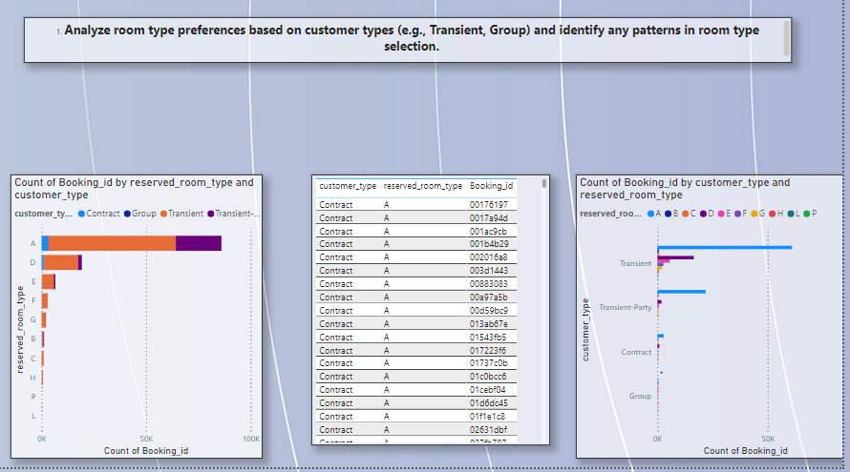
Exploratory Data Analysis (EDA):
Analyze room type preferences based on customer types (e.g., Transient, Group) and identify any patterns in room type selection.

Slide 46
Insight: Analyzing room type preferences based on customer types provides insights into what different segments prefer. Transient guests might favor standard rooms, while groups may prefer suites or connecting rooms. Identifying these patterns allows the hotel to tailor its room offerings and marketing strategies to meet the specific needs of each customer type, enhancing guest satisfaction and optimizing room occupancy.

Slide 47
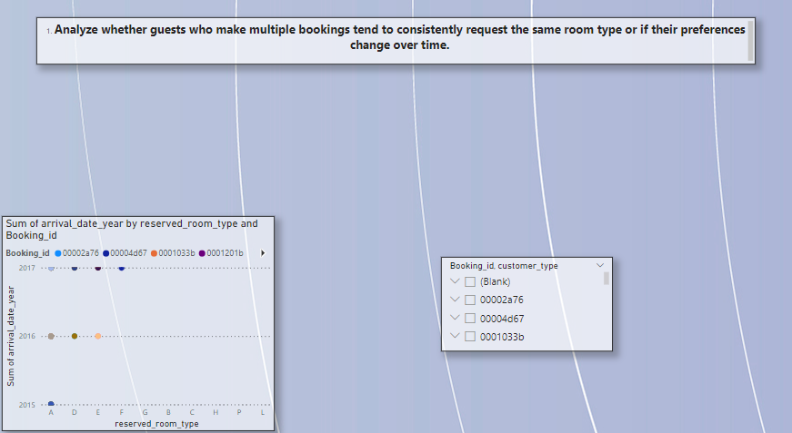
Exploratory Data Analysis (EDA):
Analyze whether guests who make multiple bookings tend to consistently request the same room type or if their preferences change over time.

Slide 48
Insight: Analyzing guests' room type preferences over multiple bookings helps identify if they consistently request the same type or change preferences over time. Consistent preferences may indicate strong loyalty to specific room features, while changing preferences might suggest evolving needs or tastes. Understanding these trends allows the hotel to personalize guest experiences and anticipate their needs, fostering loyalty and repeat bookings.

Slide 49
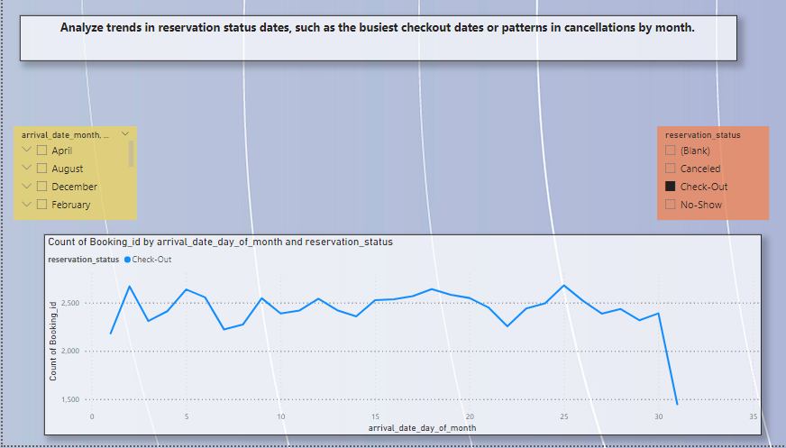
Exploratory Data Analysis (EDA):
Analyze trends in reservation status dates, such as the busiest checkout dates or patterns in cancellations by month.

Slide 50
Insight: Analyzing trends in reservation status dates helps identify the busiest checkout dates and patterns in cancellations by month. This information is crucial for operational planning, resource allocation, and marketing strategies. Understanding these trends allows the hotel to optimize staffing, enhance guest services during peak periods, and address factors leading to cancellations, ensuring a smoother operation and better guest experience.

Slide 51
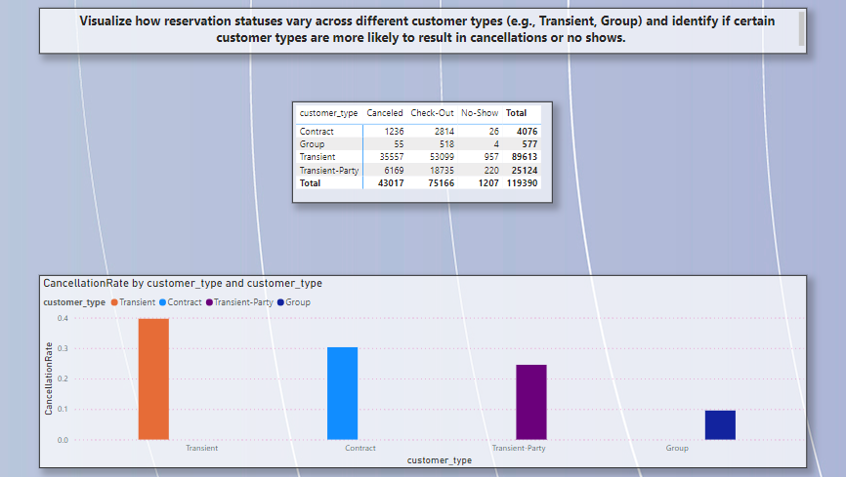
Exploratory Data Analysis (EDA):
Visualize how reservation statuses vary across different customer types (e.g., Transient, Group) and identify if certain customer types are more likely to result in cancellations or no shows.

Slide 52
Insight: Visualizing reservation statuses across different customer types reveals which segments are more prone to cancellations or no-shows. For instance, transient guests might have higher cancellation rates due to unpredictable travel plans. Identifying these patterns helps the hotel tailor its booking policies and customer communication, reducing the risk of cancellations and no-shows, and ensuring a more stable booking environment.

Slide 53
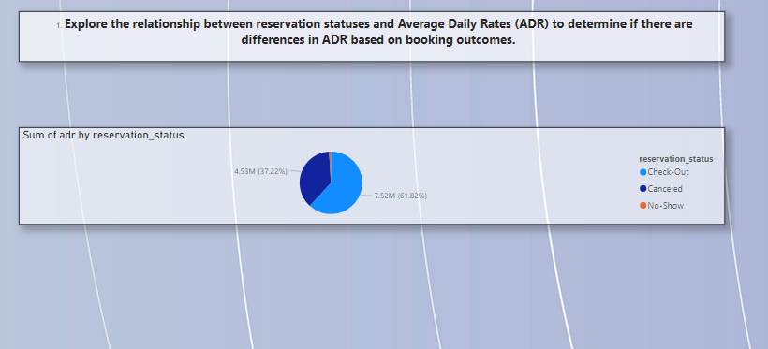
Exploratory Data Analysis (EDA):
Explore the relationship between reservation statuses and Average Daily Rates (ADR) to determine if there are differences in ADR based on booking outcomes.

Slide 54
Insight: Exploring the relationship between reservation statuses and ADR helps determine if booking outcomes affect revenue. Higher ADRs for checked-out bookings compared to canceled or no-show bookings indicate that confirmed stays contribute significantly to revenue. Understanding these differences allows the hotel to focus on strategies that maximize ADR and reduce cancellations, such as targeted promotions and flexible booking options, enhancing overall financial performance.

Slide 55
Conclusion:
Through comprehensive data analysis using Power BI, I have gained valuable insights into booking patterns, guest preferences, and operational dynamics. By understanding trends in booking behaviors, cancellations, and ADR, I can optimize marketing strategies, improve guest satisfaction, and enhance overall efficiency. Identifying key factors influencing guest decisions allows for targeted interventions, ensuring better resource allocation and revenue maximization. Our data-driven approach empowers us to anticipate market demands, tailor our services, and stay ahead in the competitive hospitality industry.

Slide 56
Conclusion:
Booking Trends: Seasonal patterns and peak booking months identified, helping to optimize marketing strategies and allocate resources effectively during high-demand periods.
Guest Preferences: Detailed analysis of room types and meal plan preferences across different customer segments, enabling tailored service offerings to enhance guest satisfaction.
Cancellation Rates: Identification of factors influencing cancellations, aiding in developing targeted retention strategies and reducing future cancellation rates.
ADR Insights: Examination of ADR correlations with booking behaviors, assisting in refining pricing strategies and maximizing revenue.

Slide 57
Customer Type Behavior: Exploration of reservation statuses and ADR variations by customer type provides insights for customized service strategies and pricing models.
Historical Impact: Evaluation of how guests’ booking history affects current booking behaviors, aiding in developing loyalty programs and enhancing guest retention efforts.

Slide 58



Signing off…

