Slide 1
MINI PROJECT ON COMMERCIAL MAILING SERVICE
SUBJECT – COMPUTER NETWORKS
SECTION – T1
TEAM MEMBERS :-
Aniket bada panda (RA2011033010053)
Garv jaiswal (RA2011033010035)
Vaibhav kumar jha (RA2011033010058)
nilay (Ra2011033010056)

Slide 2
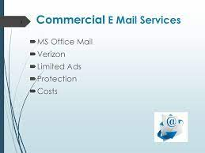
COMMERCIAL MAILING SERVICE
The term "commercial mail" refers to larger quantities of mail prepared for mailing at reduced postage. in business mail 101, the term "commercial mail" means commercial first-class mail and advertising mail (called "usps marketing mail" by the postal service).
The are many companies that uses commercial mailing services like Google, Microsoft outlook, yahoo, etc.
The protocol that is used by this companies is simple mail transfer protocol(SMTP).

Slide 3
Introduction….
SMTP stands for Simple Mail Transfer Protocol.
SMTP is a set of communication guidelines that allow software to transmit an electronic mail over the internet is called Simple Mail Transfer Protocol.
It is a program used for sending messages to other computer users based on e-mail addresses.
It provides a mail exchange between users on the same or different computers, and it also supports:
a) It can send a single message to one or more recipients.
b) Sending message can include text, voice, video or graphics.
c) It can also send the messages on networks outside the internet.

Slide 4
Working of SMTP…
Composition of Mail: A user sends an e-mail by composing an electronic mail message using a Mail User Agent (MUA). Mail User Agent is a program which is used to send and receive mail. The message contains two parts: body and header. The body is the main part of the message while the header includes information such as the sender and recipient address. The header also includes descriptive information such as the subject of the message.
Submission of Mail: After composing an email, the mail client then submits the completed e-mail to the SMTP server by using SMTP on TCP port 25.
Delivery of Mail: E-mail addresses contain two parts: username of the recipient and domain name. For example, vivek@gmail.com, where "vivek" is the username of the recipient and "gmail.com" is the domain name.
Receipt and Processing of Mail: Once the incoming message is received, the exchange server delivers it to the incoming server (Mail Delivery Agent) which stores the e-mail where it waits for the user to retrieve it.
Access and Retrieval of Mail: The stored email in MDA can be retrieved by using MUA (Mail User Agent). MUA can be accessed by using login and password.

Slide 5
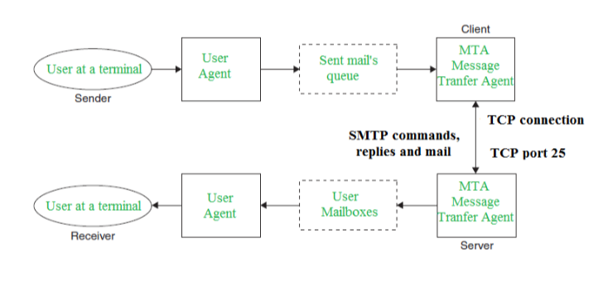
HOW SMTP WORKS :-

Slide 6
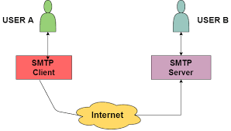
Architecture of SMTP
All the users make use of User Agent (UA). The Mail Transfer Agent (MTA) mainly helps to exchange all the messages in between both sender and receiver using the TCP/IP. The system administrator has the authority to configure the set up of local MTA, thus the users who are sending the email do not need to deal with the MTA.
The MTA keeps the queue in the pool of messages, if the receiver is not available at that moment then MTA can schedule the repeat delivery of all the messages.

Slide 7
Architecture of SMTP
MTA (Mail User Agent) forwards the emails into mailboxes of the user's local system, and then the user agent (UA) can download those messages at any time.
The SMTP Client as well as the SMTP server both has two main components and these are:
1) UA(User-Agent)
2) MTA(Mail Transfer Agent)
Let us now take a look at communication between the sender and the receiver:
The user agent at the sender side prepares the message and then sent it to the MTA. The task of the MTA is to transfer the Email across the network to the Receiver MTA. Also in order to send the Email, a system must have the client MTA and in order to receive the email, a system must have a server MTA.

Slide 8

Communication between sender and the receiver :
SENDING EMAIL:
Mail is sent by a series of request and response messages between the client and the server. The message which is sent across consists of a header and a body. A null line is used to terminate the mail header and everything after the null line is considered as the body of the message, which is a sequence of ASCII characters. The message body contains the actual information read by the receipt.

Slide 9

Communication between sender and the receiver
RECEIVING EMAIL:
The user agent at the server-side checks the mailboxes at a particular time of intervals. If any information is received, it informs the user about the mail. When the user tries to read the mail it displays a list of emails with a short description of each mail in the mailbox. By selecting any of the mail users can view its contents on the terminal.

Slide 10
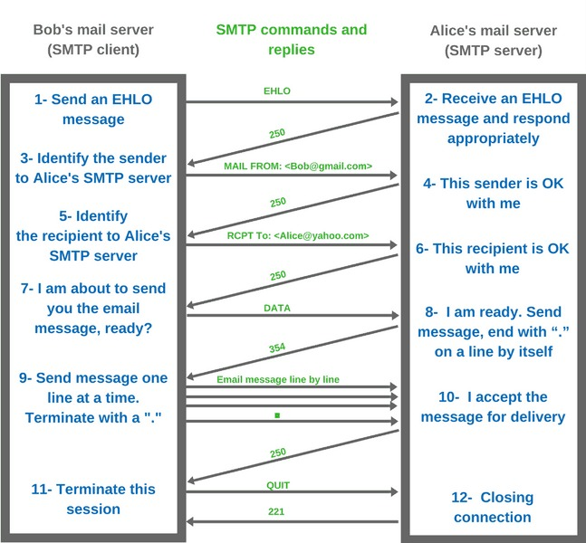
a

Slide 11
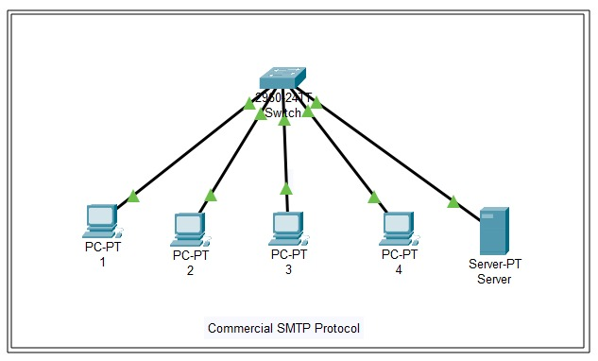
PROJECT WORK

Slide 12
THANK YOU

