Slide 1
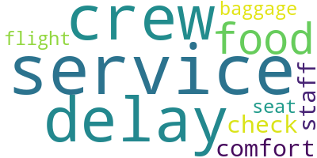
British Airways Customer Review Analysis
Total Reviews Analyzed: 1000
🔍 Key Insights:
• 55% of reviews are Positive - customers praised onboard service and crew.
• 30% of reviews are Negative - top issues include delays and baggage handling.
• Word cloud reveals key terms: service, delay, crew, food, check-in.
• Sentiment analysis was performed using Python’s TextBlob library.

