Slide 1
PROJECT TITLE: CALCULATOR
-ANIKET PATIL
DIGICROME ACADEMY

Slide 2
PROJECT OVERVIEW
Purpose and Goal:
Learn to create the calculator by GUI toolkit for python based program. By importing Tkinter library. Creating the Graphical User Interface (GUI) for enhanced presentation.

Slide 3
PROBLEM STATEMENT
To create GUI based simple calculator using the Python Tkinter library, which can be perform basic arithmetic operations like addition, subtraction, multiplication, division.

Slide 4
SOLUTION
As per our problem statement I have to create the GUI based simple calculator that perform simple arithmetic operation. So, I have to first importing the Tkinter library, then make layout for calculator’s geometry, result displaying screen, press buttons and assigning the method to them.

Slide 5
METHOLOGY
Steps involved in implementing the calculator:
Importing the Tkinter
Make a window
Create a result label
Creating press buttons for all keys with their functions with their positions.
Defining the methods for clear , show and result buttons.

Slide 6
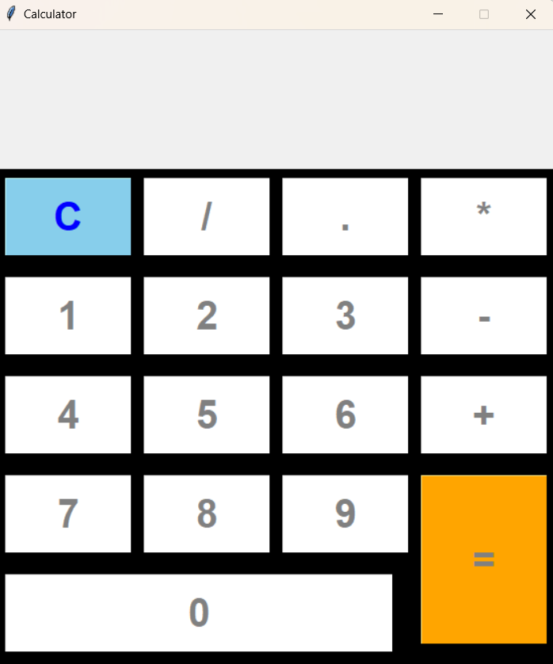
KEY FEATURES
GUI Interface for simple Calculator

Slide 7
RESULTS AND ACHIEVEMENTS
Performing the arithmetic operation like Addition, Subtraction, Multiplication and Division. When all buttons are clicked their functions will be executed in order

Slide 8
CHALLENGES FACED
While creating the GUI based simple calculator first need to learned about Tkinter libraries, i.e. how to create container, labels, buttons, and their positions.

Slide 9
CONCLUSION
Learning outcome from this project are:
1. Core Python
2. tkinter Library
3 Visual Studio Code[IDE]
4. GitHub
5. Application development using Python programming language
Uses Python codes in Realtime applications.
How to create GUI based application using Python programmes.
Functionality for creating graphical user interface

Slide 10
THANK YOU

