Slide 1


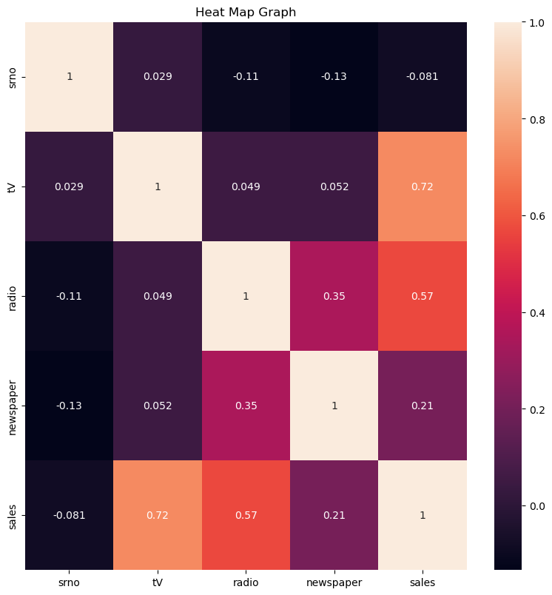
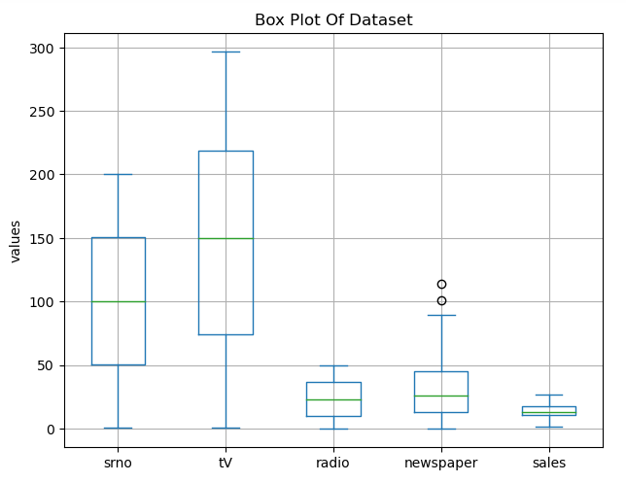
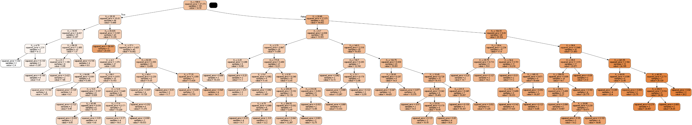
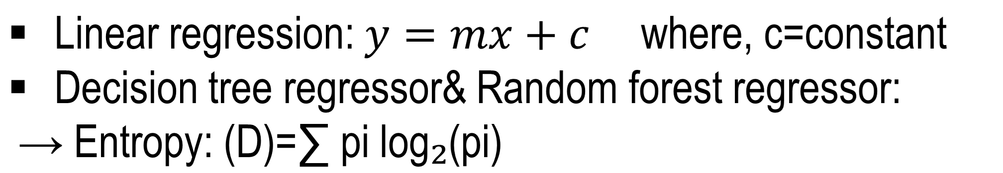

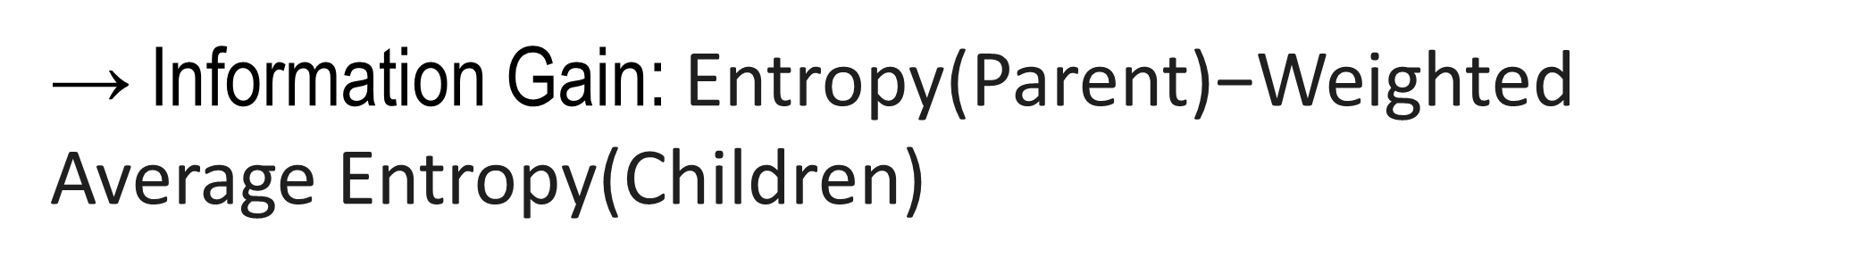
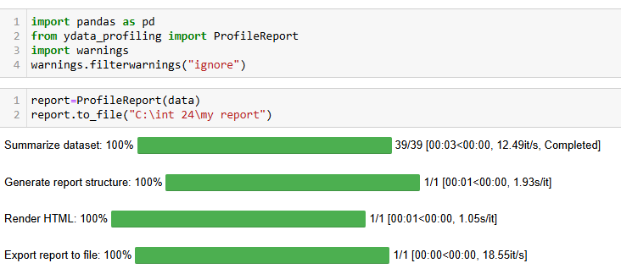
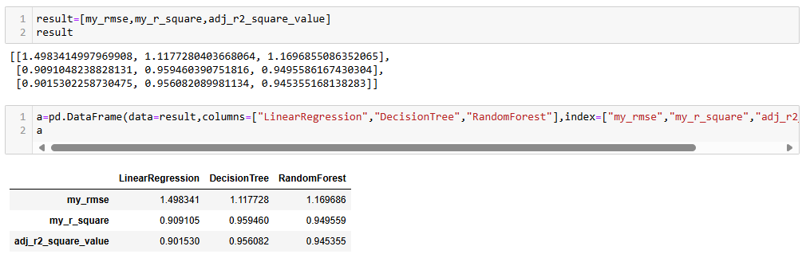
Predict Total Spends On Advertising
Aniket Rana
Department of Information Technology,
Government Polytechnic Daman
Problem Statement
Data Visualization
How do investments in television, radio, and newspaper advertising influence sales outcomes? Our objective is to create a model that predicts future sales figures based on the spending patterns across these different advertising channels
Heatmap
Box plot
Data Validation
Column Name | Dtypes | Missing value | Outliers | Typing errors
Sr. No | Float64 | 0 | No | No
Tv | Float64 | 0 | No | No
Radio | Float64 | 0 | No | No
Newspaper | Float64 | 0 | No | No
Sales | Float64 | 0 | No | No
Decision Tree
Model Development Equation
No Missing values ,outliers and Typing errors are found.
→Gini index:
Data Analysis
Hyperlink report
Comparison And Conclusion
Report Result
The Decision Tree model has the lowest RMSE(1.117728), highest R² value (0.959460) and highest Adjusted R² value (0.956082)
Libraries Used
The Decision Tree model appears to be the best-performing model among the three, based on all three evaluation metrics (RMSE, R², and Adj. R²).
Pandas
Numpy
Sklearn
Matplotlib
Seaborn
Deployment url
Github url: https://github.com/aniketrana98/linear-Regression
Streamlit url: https://aniketrana98.streamlit.app/

